Slide 1
Biostatistik
Hanno Ulmer
hanno.ulmer@i-med.ac.at
Josef Fritz
josef.fritz@i-med.ac.at
Department für Medizinische Statistik, Informatik und Gesundheitsökonomie, Medizinische Universität Innsbruck

Slide 2
Ablauf der Lehrveranstaltung
Block 1: Einführung, Allgemeines, Projektarbeit
Block 2: Deskriptive Statistik, Excel, SPSS
Block 3: Korrelation und Regression
Block 4: Konfidenzintervalle und Signifikanztests
Block 5: Mittelwerte vergleichen, t-Test
Block 6: ANOVA, Design of Experiments, MODDE
Block 7: Block 7: Präsentationen der Projektarbeiten

Slide 3
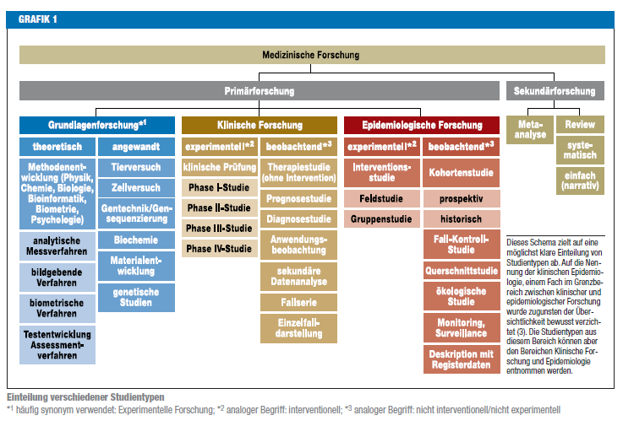
Medizinische Forschung

Slide 4

Statistik in medizinischen
Top Journals

Slide 5
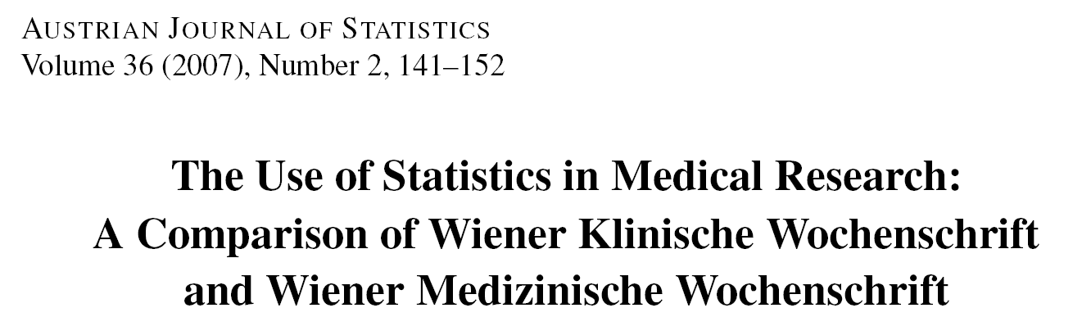

Methodik der Fallstudie
Alle Originalarbeiten publiziert im ersten Halbjahr 2004:
  Vol. 350 No. 1–26 of NEJM
  Vol. 10 No. 1–6 of NatMed
wurde für die bibliometrische Analyse ausgewählt
Editorials, Letters, Case Reports wurden nicht analysiert
Zusätzlich wurden die Wiener klinische und die Wiener medizinische Wochenschrift untersucht:

Slide 6
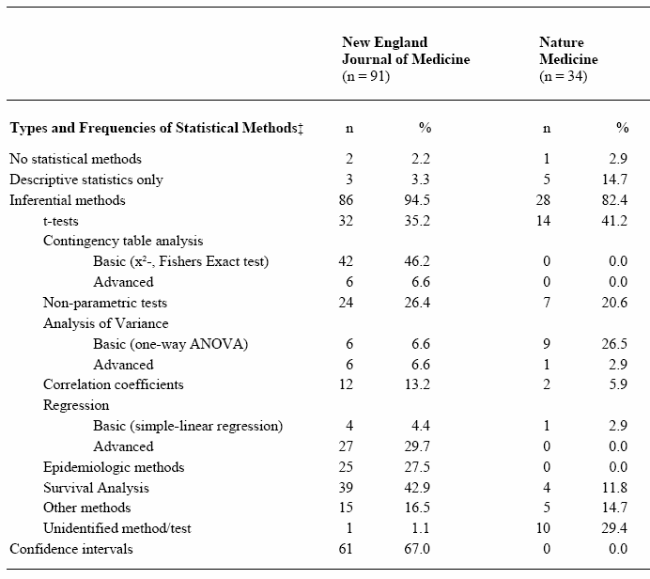
Statistische Verfahren
Kategorien nach
Emerson/Colditz 1985

Slide 7
Häufig verwendete statistische Methoden
Studienplanung
Fragestellung
Hypothesen
Studiendesign
Fallzahlschätzung
Datenerhebung
Statistische Auswertung
Deskriptive Statistik
Inferenzstatistik I: Schätzen von Parametern mittels Konfidenzintervallen
Inferenzstatistik II: Unterschiede, Hypothesenprüfung mittels Signifikanztests
Inferenzstatistik III: Zusammenhänge, Korrelations- und Regressionsanalysen

Slide 8

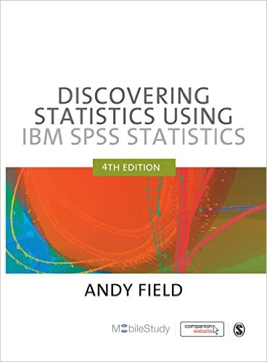



Literaturhinweise
Grundlagenwissenschaft
Klinische Forschung
Versuchsplanung

Slide 9
Quellen, Internet, Software
British Medical Journal Statistics at Square One
Deutsches Ärzteblatt Bewertung wissenschaftlicher Publikationen
Deutsche Medizinische Wochenschrift Statistik-Serie
Jumbo Münster
Graphpad Quickcalcs
R, Stata, SPSS, SAS, Statistica, GraphPad, MedCalc
nQuery Advisor, East, PASS, StudySize

Slide 10
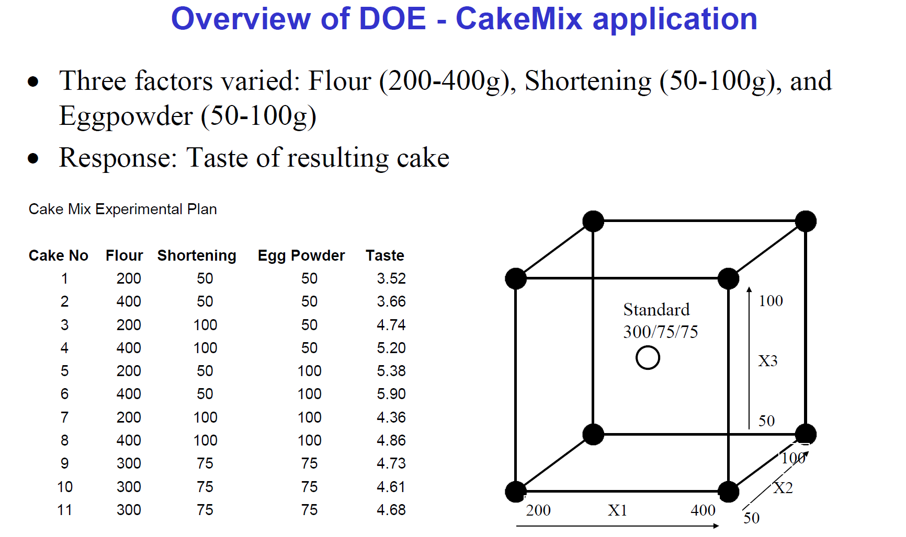
CakeMix Beispiel mit MODDE

Slide 11
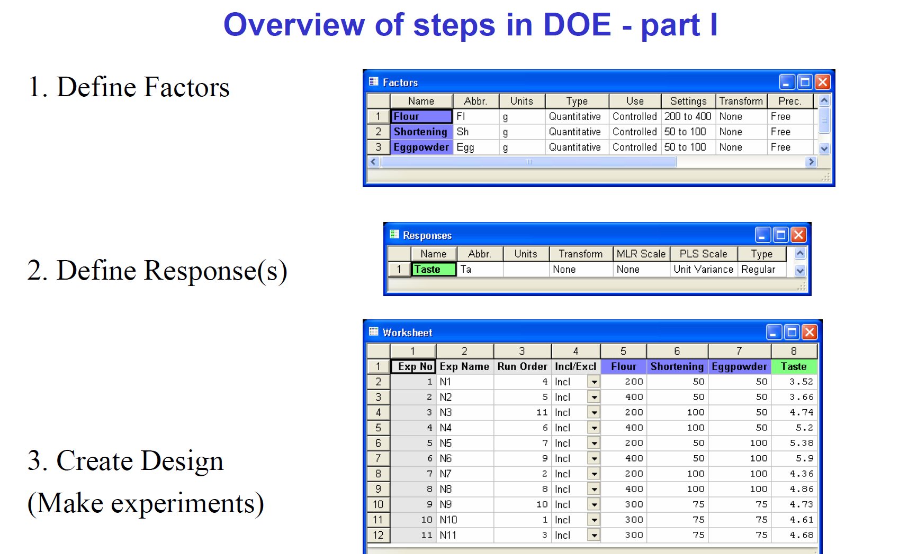
CakeMix Beispiel mit MODDE

Slide 12
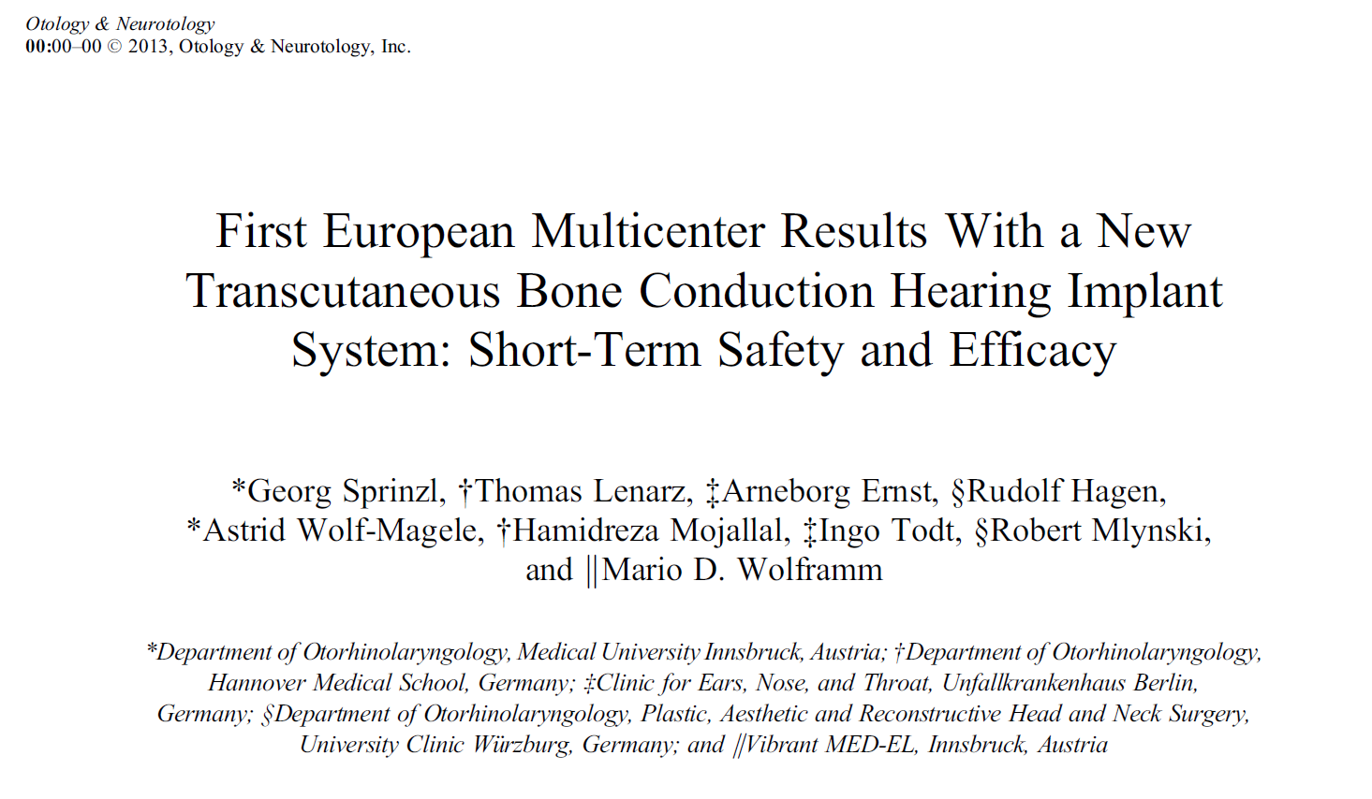
Medizinproduktestudie

Slide 13
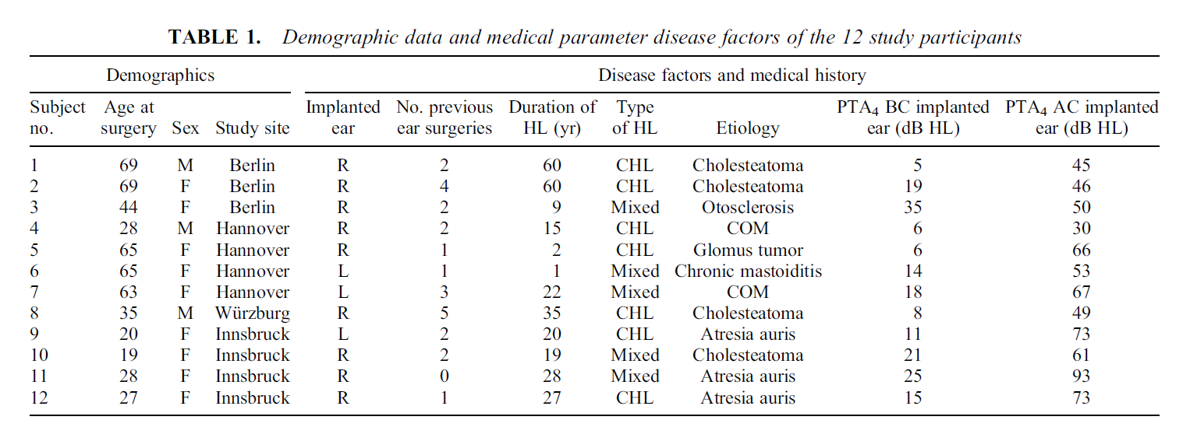
Medizinproduktestudie

Slide 14
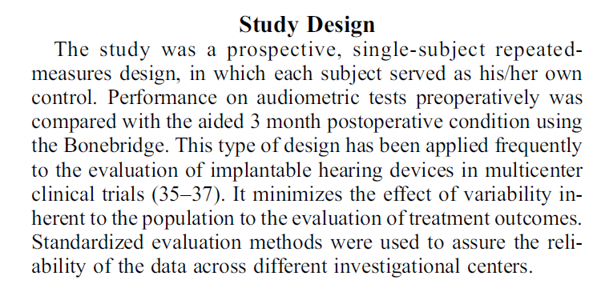
Medizinproduktestudie

Slide 15
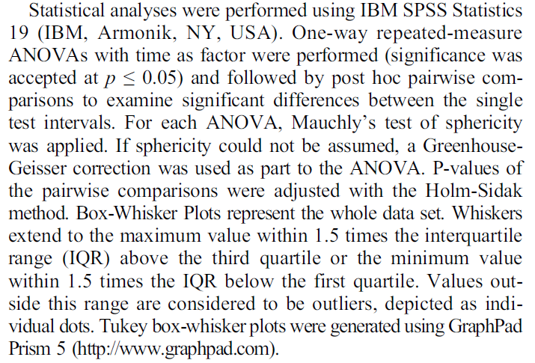
Medizinproduktestudie

Slide 16
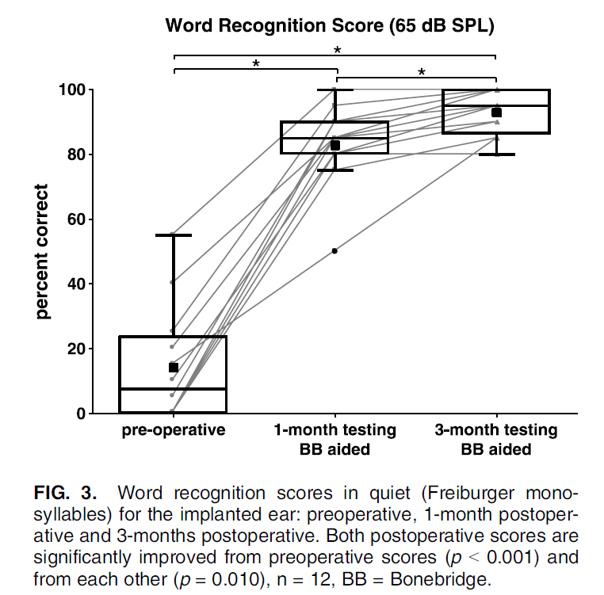
Medizinproduktestudie

Slide 17
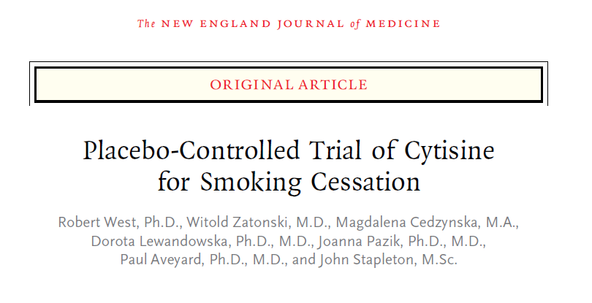
Arzneimittelstudie

Slide 18
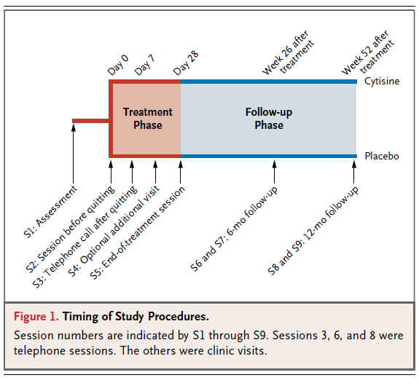
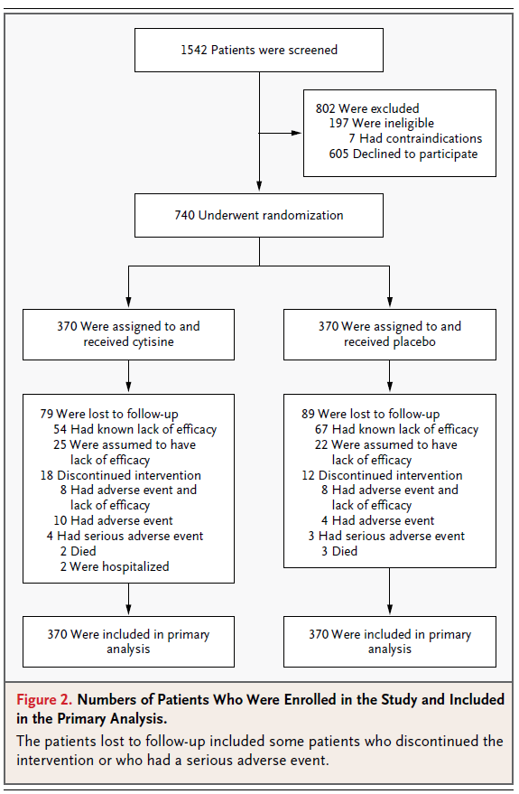
Arzneimittelstudie

Slide 19
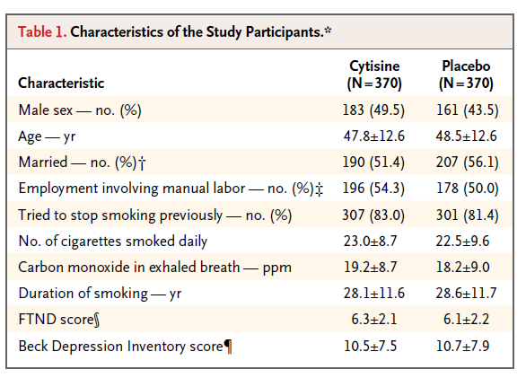
Arzneimittelstudie

Slide 20
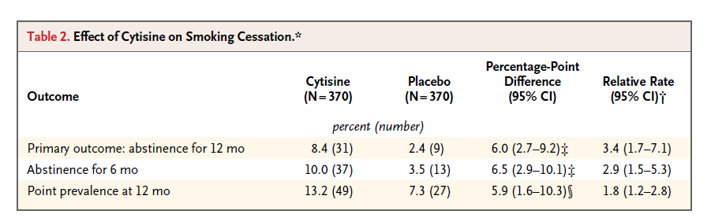
Arzneimittelstudie

Slide 21
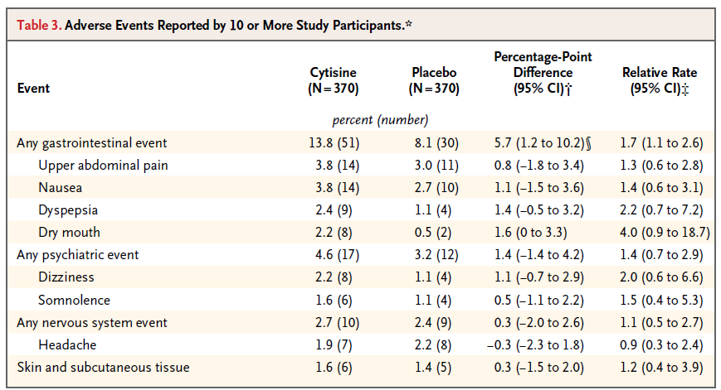
Arzneimittelstudie

Slide 22
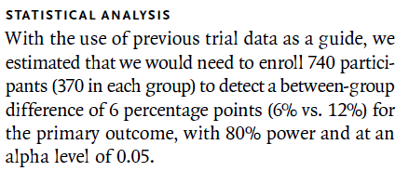
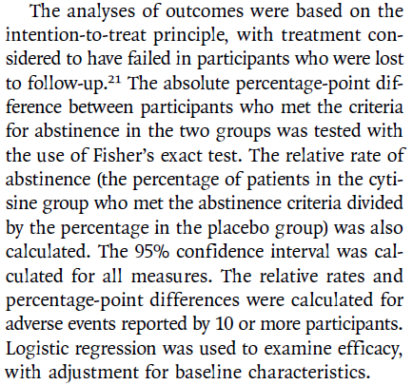
Arzneimittelstudie

Slide 23
Deskriptive Statistik
Qualitative Merkmale |  | Quantitative Merkmale normalverteilt | beliebig verteilt
n,% |  | Arithmetischer Mittelwert | Median
 |  | Standardabweichung | Perzentile
Kreis-, Balkendiagramm |  | Histogramm | Boxplot
Beispiele:
Geschlecht, Ansprechen auf Therapie, etc. |  | Blutdruck | CRP, GGT Schweregrade

Slide 24
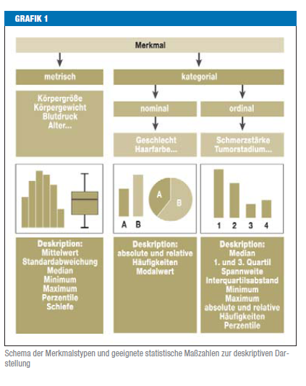
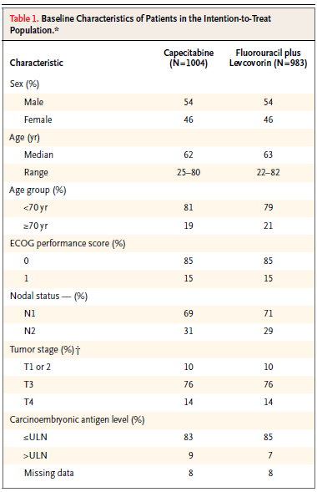
Merkmalstypen und statistische Maßzahlen, Grafiken

Slide 25
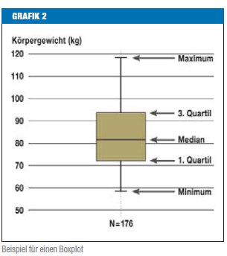
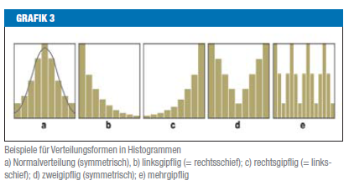
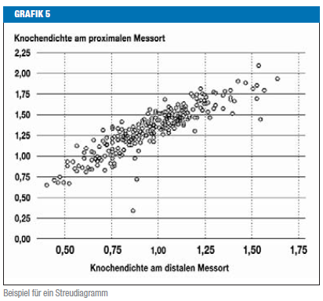
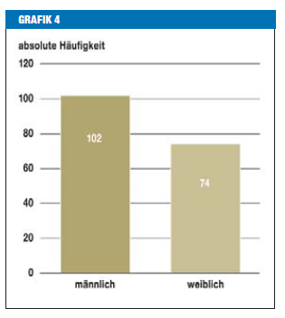
Statistische Grafiken

Slide 26
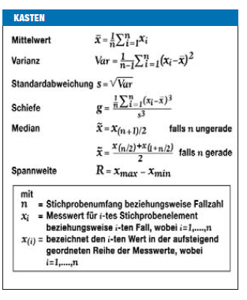

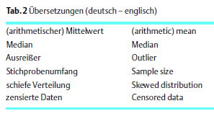

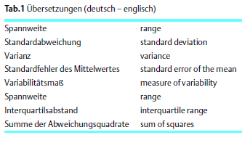
Deskriptive Statistik

Slide 27
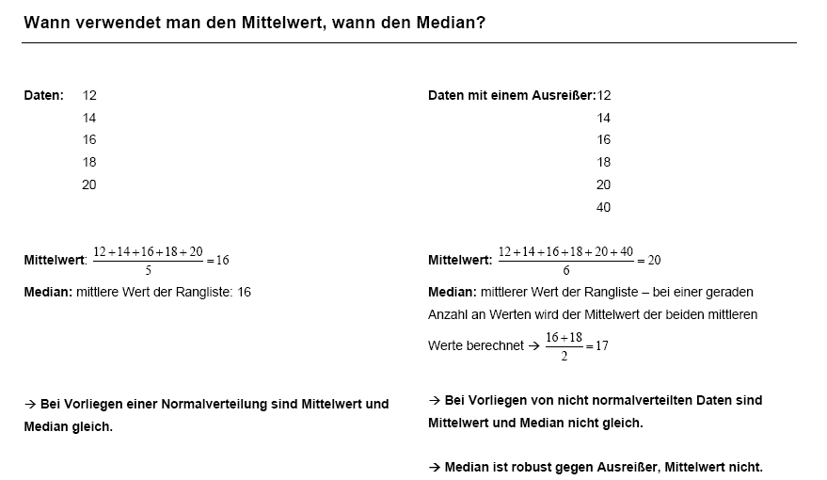
Mittelwert vs. Median - Beispiel

Slide 28
Standardabweichung oder Standardfehler?
Standardfehler beschreibt nicht die Daten, sondern gibt die Genauigkeit des Mittelwerts als Schätzwerts an.

Slide 29
Übung: Statistische Maßzahlen
Berechnen Sie bitte den arithmetischen:
  Mittelwert
  Median
  Varianz
  Standardabweichung
  Spannweite
  Interquartilsabstand
  und den Variationskoeffizient
  Erstellen Sie Histogramme und Boxplots für:

Slide 30
Punktezahlen von 20 Studenten
  6,3,7,5,6,4,4,6,7,3,5,9,6,4,2,7,5,5,8,6
Anzahl der Angestellten in 20 Apotheken
  2,3,3,3,4,4,4,4,5,5,5,5,5,5,6,6,6,8,10,15
Krankheitstage von 20 Personen
  0,0,0,0,0,0,0,0,1,1,1,1,1,2,2,2,3,3,15,76

Slide 31
Correlation
Measuring Relationships
  Scatterplots
  Covariance
  Pearson’s Correlation Coefficient
Nonparametric measures
  Spearman’s Rho
  Kendall’s Tau
Interpreting Correlations
  Causality

Slide 32
What is a Correlation?
In statistics, dependence or association is any statistical relationship, whether causal or not, between two random variables or bivariate data.
  This means that the marginal distribution of a random variable A is different from the distribution of A knowing B
Correlation is a way of measuring the relationship between two metric or ordinal variables
Correlation is a measure of association
In common usage, it most often refers to the extent to which two variables have a linear relationship with each other
(Linear) correlation => Dependence
But: Dependence ≠> (Linear) correlation

Slide 33
Very small relationship

Slide 34
Positive relationship

Slide 35
Negative relationship

Slide 36
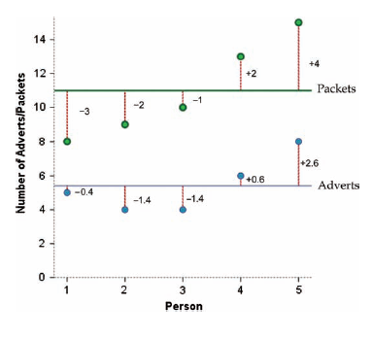
Measuring (linear) relationships
We need to see whether as one variable increases, the other increases, decreases or stays the same.
This can be done by calculating the covariance.
  We look at how much each score deviates from the mean.
  If both variables deviate from the mean by the same amount, they are likely to be related.
  Example:

Slide 37
Covariance
The variance tells us by how much scores deviate from the mean for a single variable.
It is closely linked to the sum of squares.
Covariance is similar – it tells us by how much scores on two variables differ from their respective means.

Slide 38
Example

Slide 39
Pearson correlation coefficient (1)
It depends upon the units of measurement.
  E.g. The Covariance of two variables measured in Miles might be 4.25, but if the same scores are converted to Km, the Covariance is 11.
One solution: standardise it!
  Divide by the standard deviations of both variables.
The standardised version of Covariance is known as the Pearson correlation coefficient.
  In the example:

Slide 40
Pearson Correlation Coefficient (2)
Measure of linear dependence
It varies between -1 (perfect negative) and +1 (perfect positive)
  0 = no relationship
It is an effect size
  ±.1 = small effect
  ±.3 = medium effect
  ±.5 = large effect
Coefficient of determination, r²
  By squaring the value of r you get the proportion of variance in one variable shared by the other.
In our example: 0.87², i.e. 75.7% of the variability in “Packets bought” can be explained by “Adverts watched”

Slide 41
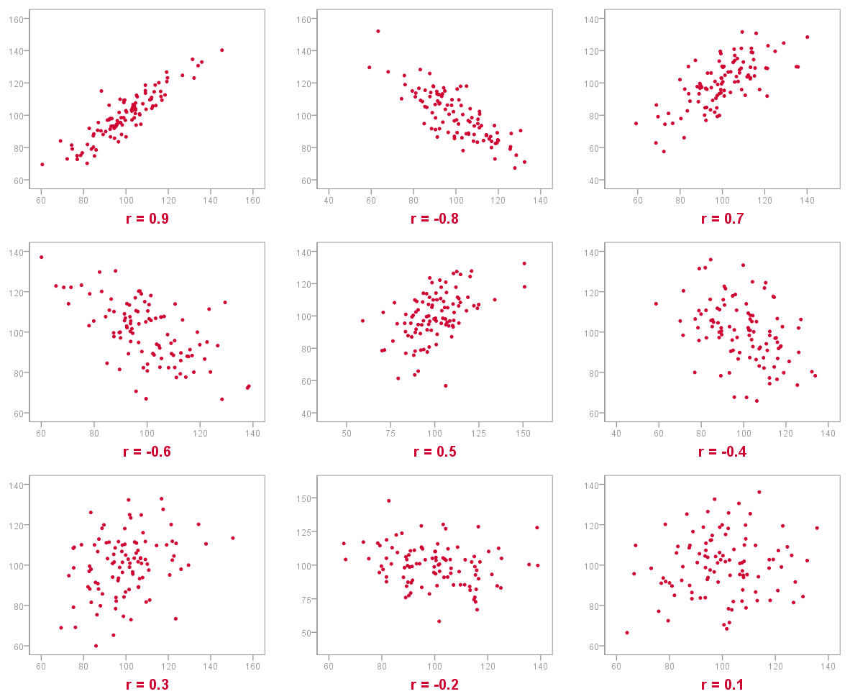
Examples

Slide 42
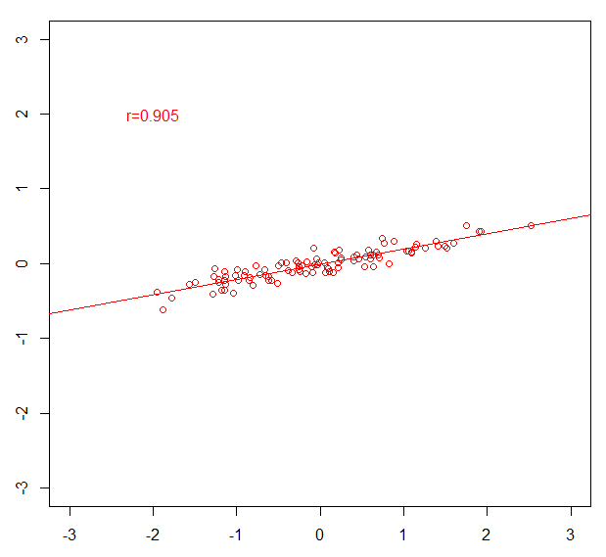
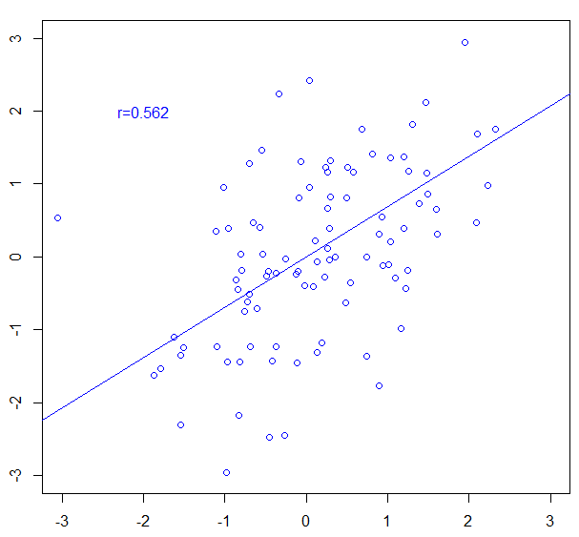
Steepness of slope ≠ Strength of correlation!

Slide 43
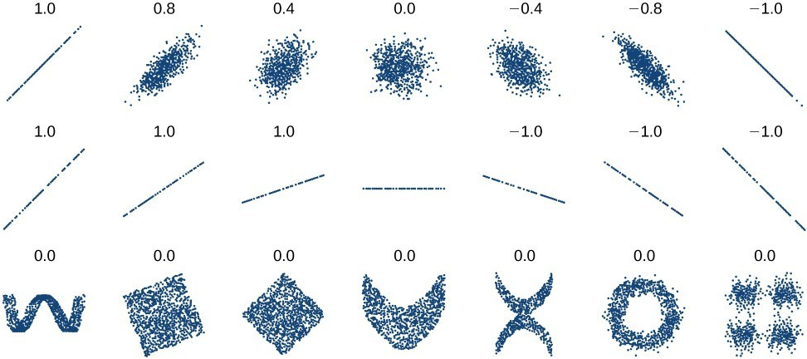
Non-linear dependencies
Pearson correlation coefficient not meaningful for non-linear dependencies!

Slide 44
Correlation/Association and causality (1)
Direction of causality:
  Correlation coefficients say nothing about which variable causes the other to change
The third-variable problem:
  in any correlation, causality between two variables cannot be automatically assumed because there may be other measured or unmeasured variables (“confounders”) affecting the results.
C
A
B

Slide 45
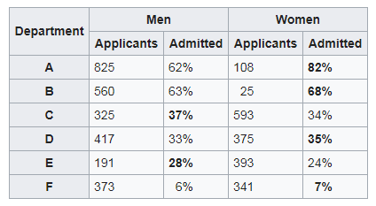
Correlation/Association and causality (2)
Due to confounders, the estimated of the effect can be distorted so severely that even the estimate shows even in the opposite direction than the true effect
Simpson‘s paradox
Appleton et al. (The American Statistician 1996;50(4))
UC Berkeley gender bias
 | Applicants | Admitted
Men | 2691 | 44%
Women | 1835 | 30%
Department
Gender
Admission

Slide 46
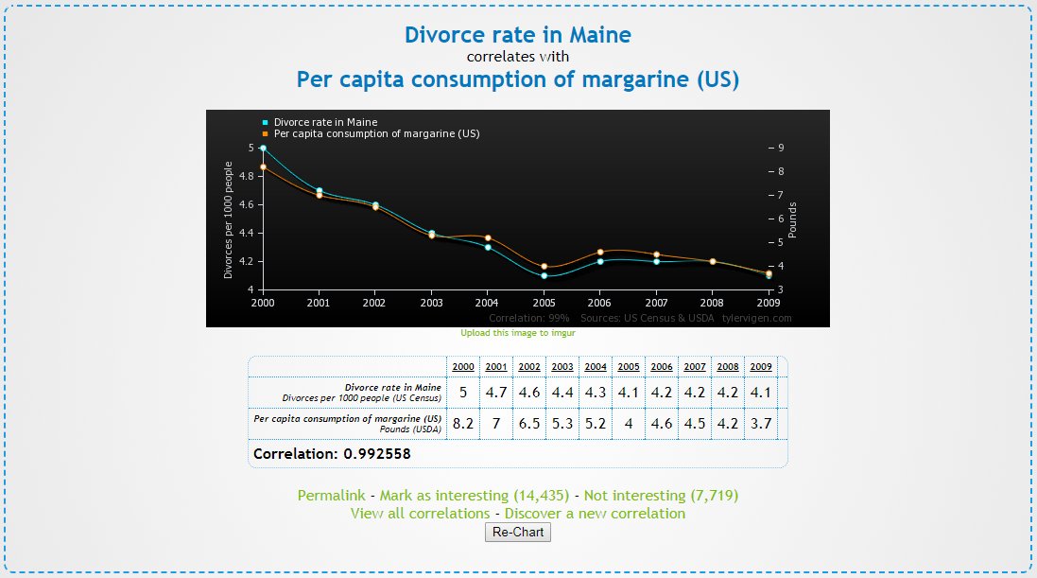
Correlation/Association and causality (3)
In many experiments/studies, the main focus is on establishing causal relationships rather than mere associations
Prerequisite:
  Appropriate study design
    Minimizing selection bias
    Minimizing measurement errors
    Minimize confounding, e.g. through randomization
    Appropriate statistical methods
    Multivariate statistics adjusting for potential third variables
    Matching
http://tylervigen.com/view_correlation?id=1703

Slide 47
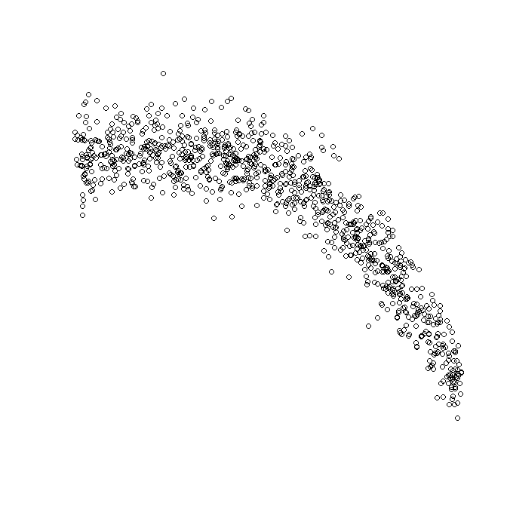
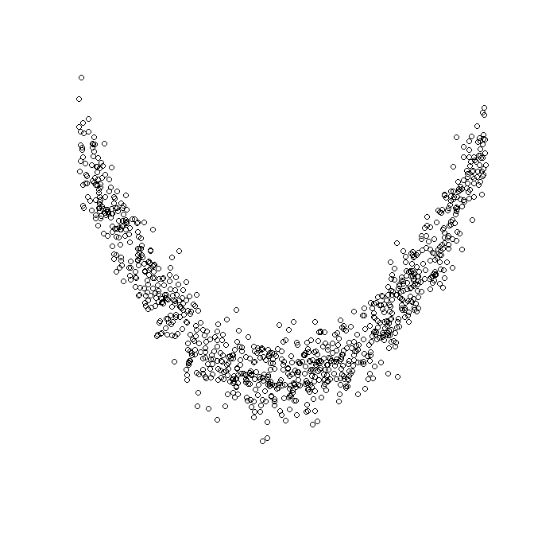
Nonparametric Correlation
Spearman’s Rho
  Pearson’s correlation on the ranked data
Kendall’s Tau
  Better than Spearman’s for small samples
Rho and Tau also appropriate for ordinal data if the assumed dependence is monotonic
R = 0.871
Monotonic
Non-monotonic
Rho = 0.667

Slide 48
Conducting Correlation Analysis

Slide 49
Reporting the results of a correlation analysis

Slide 50
Exercise
Analyse the data in Data_correlation.csv!

Slide 51
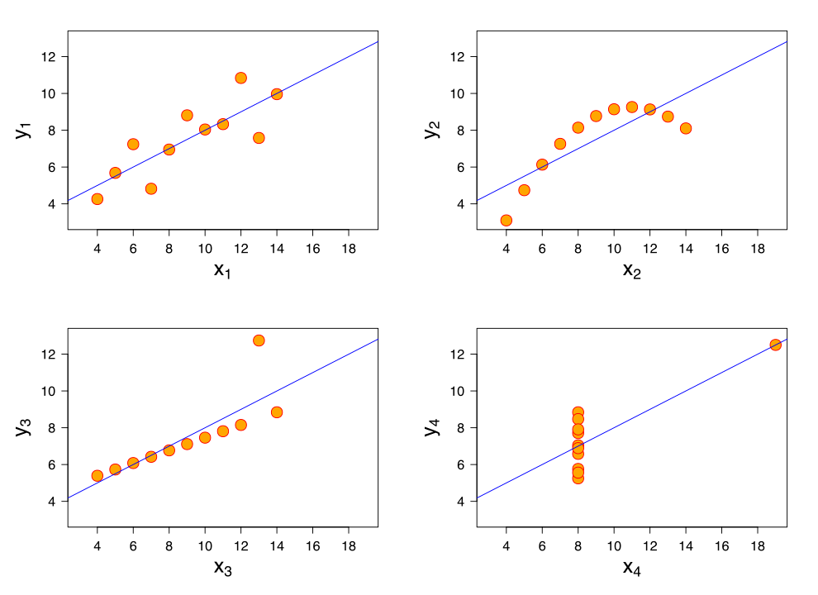
Importance of looking at a set of data graphically
Anscombe‘s quartet
All four sets (x₁ and y₁, x₂ and y₂, x₃ and y₃, x₄ and y₄) are identical when examined using only summary statsticis
Mean of x: 9, Variance of x: 11
Mean of y: 7.5, Variance of y: 4.125
Correlation between x and y: 0.816
Coefficient of determination: 0.67
Linear regression line: y=3+0.5*x
However, they vary considerably
when graphed

Slide 52
(Simple) linear regression (1)
A procedure to predict the value of one variable Y from another variable X
  X – independent variable, predictor
  Y – dependent variable, outcome
  Because there is only one predictor -> simple linear regression
  More than one predictor -> multiple linear regression
It is a hypothetical model of the relationship between two variables.
The model used is a linear one

Slide 53
(Simple) linear regression (2)
  Therefore, we describe the relationship using the equation of a straight line
b₁
  Regression coefficient for the predictor
  Gradient (slope) of the regression line
  Direction/Strength of Relationship
b₀
  Intercept (value of Y when X = 0)
  Point at which the regression line
  crosses the Y-axis (ordinate)

Slide 54
The Method of Least Squares (1)
  From all possible lines choose the one which minimizes the sum of the squared residuals (differences between the prediction from the line and the true y-value)

Slide 55

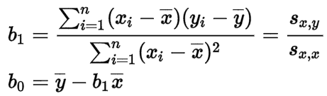
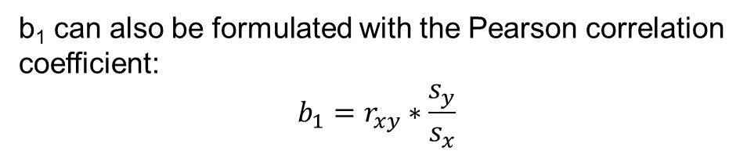
The Method of Least Squares (2)
Coefficients b₀ and b₁ of this minimation task are given by:
b₁ can also be formulated with the Pearson correlation coefficient:
$$b_{1}=r_{xy}∗\frac{s_{y}}{s_{x}}$$

Slide 56
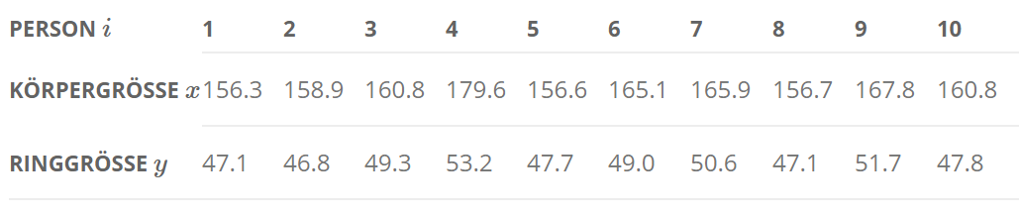
Example
Calculate variances of x and y, covariance and the Pearson correlation coefficient!
Calculate the regression line according to the least squares approach!
Calculate the variance of the residuals (ŷ-y)!

Slide 57
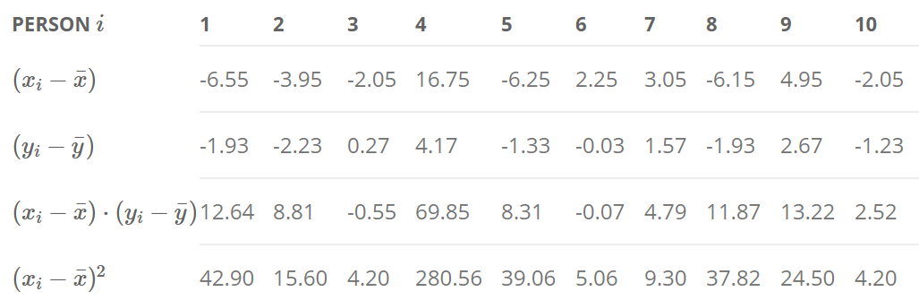
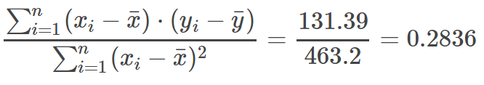

Example
$$\overline{x}=162.85$$
$$\overline{y}=49.03$$
b₁:
b₀:

Slide 58
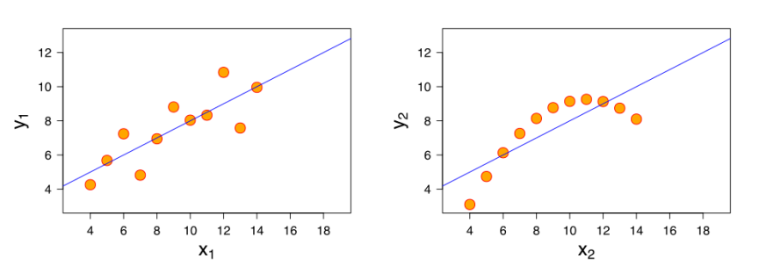

How Good is the model?
The regression line is only a model based on the data.
This model might not reflect reality.
  We need some way of testing how well the model fits the observed data.
  Graphically: Deviation from linearity?
  Diagnostics of residuals
  Coefficient of determination via decomposition of variance

Slide 59
Decomposition of variance (1)
SS_{tot}
  Total variability (variability between scores and the mean)
SS_{res}
  Residual/Error variability (variability between the regression model and the actual data)
SS_{reg}
  Model variability (difference in variability between the model and the mean)

Slide 60

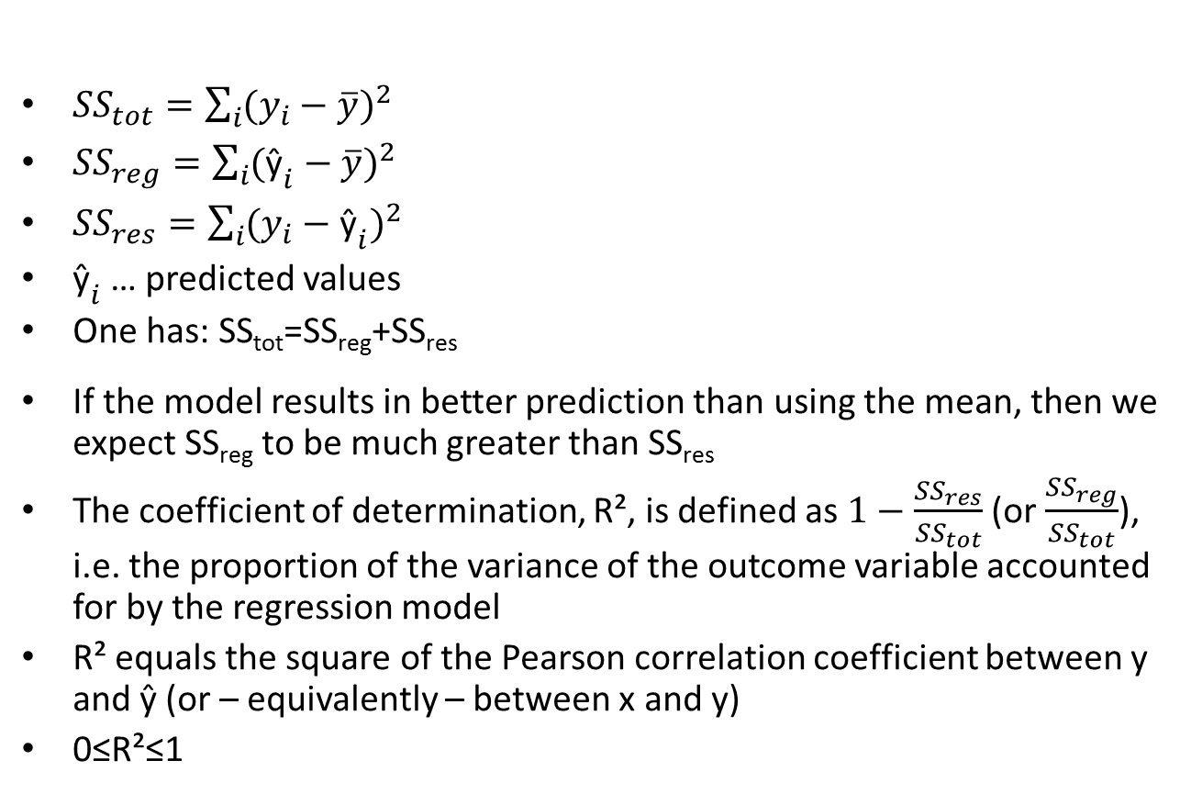
Decomposition of variance (2)
${SS}_{tot}=\sum_{i}{{(y_{i}−\overline{y})}^{2}}$
${SS}_{reg}=\sum_{i}{{({\text{ŷ}}_{i}−\overline{y})}^{2}}$
${SS}_{res}=\sum_{i}{{(y_{i}−{\text{ŷ}}_{i})}^{2}}$
${\text{ŷ}}_{i}$ … predicted values
One has: SS_{tot}=SS_{reg}+SS_{res}
If the model results in better prediction than using the mean, then we expect SS_{reg} to be much greater than SS_{res}
The coefficient of determination, R², is defined as $1−\frac{{SS}_{res}}{{SS}_{tot}}$ (or $\frac{{SS}_{reg}}{{SS}_{tot}}$), i.e. the proportion of the variance of the outcome variable accounted for by the regression model
R² equals the square of the Pearson correlation coefficient between y and ŷ (or – equivalently – between x and y)
0≤R²≤1
SS_{tot}
SS_{reg}
SS_{res}
$$R^{2}=\frac{{SS}_{reg}}{{SS}_{tot}}$$

Slide 61
Exercise: Album_Sales.sav
A record company boss was interested in predicting album sales from advertising.
Data
  200 different album releases
Outcome variable:
  Sales (CDs and Downloads) in the week after release
Predictor variable:
  The amount (in £s) spent promoting the album before release.
Analyse the data and perform a regression analysis (in SPSS)!

Slide 62
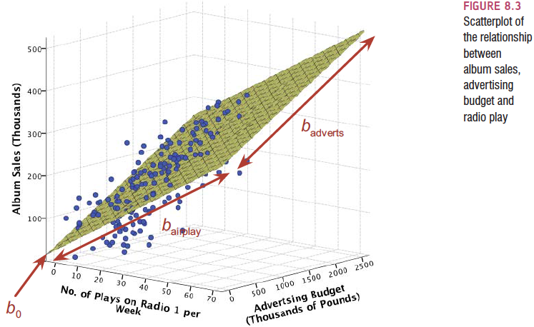
What is Multiple Regression?
(Simple) Linear Regression is a model to predict the value of one variable from another
Multiple Regression is a natural extension of this model:
  We use it to predict values of an outcome from several predictors
  It is a hypothetical model of the relationship between several variables
Simple regression - line
Multiple regression with 2 predictors - plane

Slide 63
Multiple regression: an example
A record company boss was interested in predicting album sales from advertising.
Data
  200 different album releases
Outcome variable:
  Sales (CDs and Downloads) in the week after release
Predictor variables
  The amount (in £s) spent promoting the album before release (see last lecture)
  Number of plays on the radio (new variable)

Slide 64
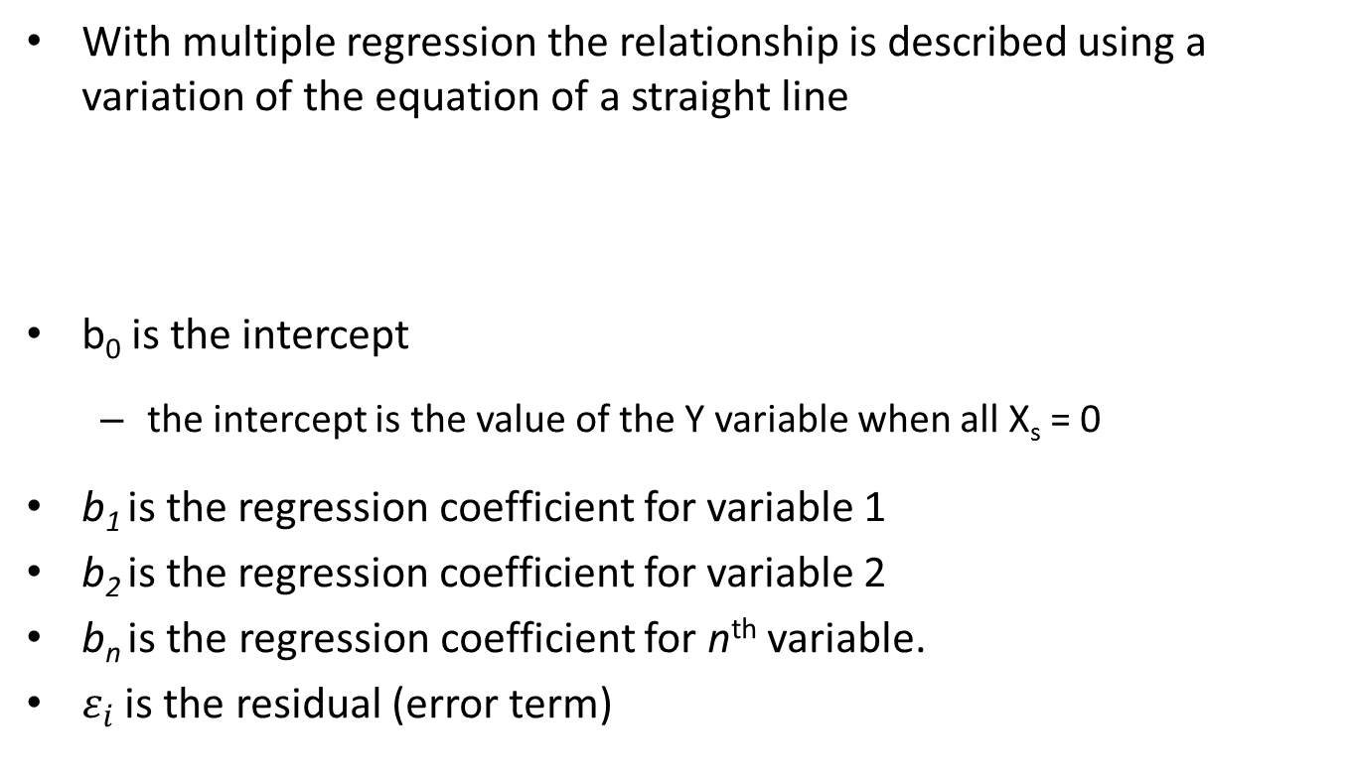
Multiple Regression as an Equation
With multiple regression the relationship is described using a variation of the equation of a straight line
b₀ is the intercept
  the intercept is the value of the Y variable when all X_{s} = 0
b₁ is the regression coefficient for variable 1
b₂ is the regression coefficient for variable 2
b_{n} is the regression coefficient for n^{th} variable.
$ε_{i}$ is the residual (error term)

Slide 65

Model fit (1)
  As in the simple linear regression model
  SS_{tot} = SS_{reg} + SS_{res}
  Coefficient of determination, R²
    The proportion of variance accounted for by the model.
R² equals the square of the Pearson correlation coefficient between y and ŷ
0≤R²≤1
Diagnostics of residuals:
  Standardized residuals
Influential cases:
    Cook’s distance
$$R^{2}=\frac{{SS}_{reg}}{{SS}_{tot}}$$

Slide 66
Model fit (2)
Diagnostics of residuals:
  Standardized residuals
  In an average sample, 95% of standardized residuals should lie between ± 2.
  99% of standardized residuals should lie between ± 2.5.
  Outliers: any case for which the absolute value of the standardized residual is 3 or more, is likely to be an outlier.
Influential cases:
  Cook’s distance
  Measures the influence of a single case on the model as a whole.
  Weisberg (1982): absolute values greater than 1 may be cause for concern

Slide 67

Which variables to include?
    First step: scatterplot

Slide 68
Method 1: Forced entry
All variables are entered into the model simultaneously
The results obtained depend on the variables entered into the model
  It is important, therefore, to have good theoretical reasons for including a particular variable

Slide 69
Method 2: Stepwise entry
Variables are entered into the model based on mathematical criteria
Computer selects variables in steps.
Step 1: Choose the predictor that can explain the most variance in the outcome variable.
Step 2: Having selected the 1st predictor, a second one is chosen from the remaining predictors.
The semi-partial correlation is used as a criterion for selection.
  The semi-partial correlation measures the relationship between two variables controlling for the effect that a third variable has on only one of the others
  It measures the unique contribution of a predictor to explaining the variance of the outcome
Drawbacks of stepwise entry:
  Rely on a mathematical criterion.
    Variable selection may depend upon only slight differences in the semi-partial correlation
    These slight numerical differences can lead to major theoretical differences
  Should be used only for exploration

Slide 70




Doing Multiple Regression in SPSS (1)

Slide 71


Doing Multiple Regression in SPSS (2)

Slide 72
How to interpret beta values?
Beta values:
  the change in the outcome associated with a unit change in the predictor
  b1= 0.085: as advertising increases by £1, album sales increase by 0.085 units.
  b2= 3367: each time (per week) a song is played on the radio its sales increase by 3367 units.
Standardised beta values:
  tell us the same but expressed as standard deviations
  β1= 0.511: As advertising increases by 1 standard deviation, album sales increase by 0.511 of a standard deviation.
  β2= 0.512: When the number of plays on the radio increases by 1 SD its sales increase by 0.512 standard deviations.

Slide 73

Reporting the model

Slide 74
Generalization (1)
When we run regression, we hope to be able to generalize the sample model to the entire population
To do this, several assumptions must be met
Violating these assumptions stops us generalizing conclusions to our target population
Variable Type:
  Outcome must be continuous
  Predictors can be continuous or dichotomous
Non-Zero Variance:
  Predictors must not have zero variance
Linearity:
  The relationship we model is, in reality, linear
Independence:
  All values of the outcome should come from a different person

Slide 75
Generalization (2)
No Multicollinearity:
  Predictors must not be highly correlated.
  Collinearity diagnostics
Homoscedasticity:
  For each value of the predictors the variance of the error term should be constant.
  plot ZRESID against ZPRED
Independent Errors:
  For any pair of observations, the error terms should be uncorrelated
Normally-distributed Errors
  Normal probability plot

Slide 76




Regression plots
Homoscedasticity: ZRESID vs. ZPRED
Normality of Errors: Histograms and P-P plots

Slide 77

Collinearity diagnostics
Tolerance should be more than 0.2 (Menard, 1995)
VIF should be less than 10 (Myers, 1990)

Slide 78
Statistische Auswertung
Deskriptive Statistik
Inferenzstatistik I: Schätzen von Parametern mittels Konfidenzintervallen
Inferenzstatistik II: Unterschiede, Hypothesenprüfung mittels Signifikanztests
Inferenzstatistik III: Zusammenhänge, Korrelations- und Regressionsanalysen

Slide 79
Ziel der schließenden Statistik
Aufgrund der Stichprobe Aussagen über die Grundgesamtheit machen
Von der Stichprobe auf die Grundgesamtheit schließen
Grundgesamtheit
  ist eine entsprechend dem jeweiligen Untersuchungsziel abgegrenzte Menge von Personen oder Objekten, über die man eine Aussage machen will.
Stichprobe
  ist eine (kleinere) Menge von Einheiten, die aus der Grundgesamtheit ausgewählt werden und die man misst oder beobachtet, um aus ihnen Schlüsse mit Gültigkeit auch für den nicht ausgewählten Teil der Grundgesamtheit zu ziehen.
Repräsentativ
  hinsichtlich der für die Untersuchung relevanten Merkmale die Struktur der Grundgesamtheit widerspiegeln

Slide 80

Grundlagen der schließenden Statistik: Verteilungsannahmen
Gleichverteilung
  Bsp.: Würfel, Münze
Binomialverteilung
  Bsp.: Ziehen mit Zurücklegen
Poissonverteilung
  Bsp.: Seltene Ereignisse mit grossen Stichprobenumfängen und konstanter Wahrscheinlichkeit
Exponentialverteilung
  Bsp.: Überlebenszeiten
Gauß- oder Normalverteilung
  Wichtigste Verteilung: siehe die folgenden Folien
Testverteilungen
  Chi-Quadrat-Verteilung
  T-Verteilung
  F-Verteilung
  Anwendung bei Signifikanztests und Konfidenzintervallen
B(n,p)
Wahrscheinlichkeitsfunktion der Binomialverteilung für n=20; p=0,1 (blau), p=0,5 (grün) und p=0,8 (rot)

Slide 81

Gauss- oder Normalverteilung
-∞ < X < + ∞
Parameter Erwartungswert μ und Varianz σ²
tabelliert ist die Standardnormalverteilung N(0,1)
  N(0,1)...Mittelwert 0, Streuung 1
    Da eine Transformation möglich ist
N(μ,σ²)

Slide 82


Quantile der Standardnormalverteilung

Slide 83

Für alle Normalverteilungen gilt
• ≈ 68% aller Beobachtungen liegen innerhalb einer
Standardabweichung um den Mittelwert
(zwischen μ − σ und μ + σ )
• ≈ 95% aller Beobachtungen liegen innerhalb zweier Standardabweichung (zwischen μ − 2σ und μ + 2σ) (Genau: zwischen μ − 1,96σ und μ + 1,96σ )
• 99.7% aller Beobachtungen liegen innerhalb dreier
Standardabweichung (zwischen μ − 3σ und μ + 3σ
Die 68-95-99.7% Regel:

Slide 84
Rolle der Normalverteilung
Viele Messwerte sind annähernd normalverteilt
  Z.B.: Gewicht einer bestimmten Gruppe
Manche Messwerte können durch Transformation an eine Normalverteilung angenähert werden
  Auch diskrete Verteilungen, wie z.B. die Binomialverteilung können durch die Normalverteilung approximiert werden
Wichtige (und günstige) statistisch-theoretische Eigenschaften
Die Normalverteilung ist Grundlage wichtiger Testverteilungen

Slide 85
Exercise 1
Entry to a certain University is determined by a national test. The scores on this test are normally distributed with a mean of 500 and a standard deviation of 100. Tom wants to be admitted to this university and he knows that he must score better than at least 70% of the students who took the test. Tom takes the test and scores 585. Will he be admitted to this university?
Z=(585 - 500) / 100 = 0.85
P = [area to the left of z = 0.85] = 0.8023 = 80.23%
Tom scored better than 80.23% of the students who took the test and he will be admitted to this University.

Slide 86
Exercise 2
The length of life of an instrument produced by a machine has a normal distribution with a mean of 12 months and standard deviation of 2 months. Find the probability that an instrument produced by this machine will last a) less than 7 months. b) between 7 and 12 months.
P(x < 7) = P(z < -2.5) = 0.0062
P(7 < x < 12) = P(-2.5 < z < 0) = 0.4938

Slide 87

t-Verteilung
Einparametrige Familie von Warscheinlichkeitsverteilungen, die 1908 von William Sealy Gosset entwickelt und nach seinem Pseudonym Student benannt wurde
Die t-Verteilung erlaubt die Berechnung der Verteilung der Differenz vom Mittelwert der Stichprobe zum wahren Mittelwert der Grundgesamtheit.
Bezeichnung: t(n),
n … Anzahl der Freiheitsgrade
Für n→∞ geht t(n) in eine
Normalverteilung über
Faustregel: ab 30 Freiheitsgraden
kann man die t-Verteilung durch
die Normalverteilung approximieren
Bsp.: für t(19) liegen 95% aller
Beobachtungen zwischen -2.093 und +2.093

Slide 88

Inferenzstatistik I: Schätzen von Parametern (Konfidenzintervalle)
“A confidence interval is used when estimating an unknown parameter from sample data. The interval gives a range for the parameter – and a confidence level that the range covers the true value.”
Freedman et al. (1991), p. 385.

Slide 89


(1-α)-Konfidenzintervall
Punktschätzer aus einer Stichprobe liefert nur einen einzigen Wert
  Verschiedene Stichproben aus ein und derselben Grundgesamtheit liefern unterschiedliche numerische Werte für den zu schätzenden Parameter
Berücksichtigung der Standardabweichung der Schätzstatistik
Konfidenzintervall – ein Bereich, in welchem der zu schätzende, unbekannte Parameter der Grundgesamtheit mit Wahrscheinlichkeit (1- α) liegt

Slide 90
Bsp.: Rule of three
Beispiel: Rule of three (adverse events)
Keine AE in n=10 Patienten
95% KI (0-30%)
Keine AE in n=100 Patienten
95% KI (0-3%)
Keine AE in n=1000 Patienten
95% KI (0-0,3%)

Slide 91

Zwei- und Einseitige Konfidenzintervalle

Slide 92
(1-α)-Konfidenzintervall
Einseitig
  Bestimmung einer Ober- bzw. Untergrenze
Zweiseitig
  symmetrisch
Üblich Werte für α
  α=0.05, α=0.01, α=0.001
Grundsätzlich kann für alle statistisch geschätzten Parameter ein Konfidenzintervall berechnet werden
  Mittelwert, Standardabweichung, Häufigkeit, Korrelationskoeffizient, ...

Slide 93
Konfidenzintervall für den Mittelwert μ (1)
Gegeben: X₁,...,X_{N} unabhängige normalverteilte Zufallsvariable N(μ,σ²)
Bei bekannter Varianz σ² folgt der Stichprobenmittelwert X_{quer}
einer N(μ,σ²/n)-Verteilung und das 95% KI berechnet sich folglich zu
Z_{1-α/2} … 1-α/2 Quantil der Normalverteilung
Bei unbekannter Varianz σ², geschätzt durch s² folgt der standardisiert Stichprobenmittelwert einer t(N-1)-Verteilung und das 95% KI berechnet sich folglich zu
t_{(N-1),1-α/2}... 1-α/2 Quantil der t-Verteilung
mit N-1 Freiheitsgraden
Allgemein gilt: t_{(N-1),1-α} >z_{1- α}

Slide 94
Beispiel
  Normalverteilte Daten: 6,3,7,5,6,4,4,6,7,3,5,9,6,4,2,7,5,5,8,6
  Fall 1: Es sei bekannt, dass die Varianz σ² = 4 ist
    X_{quer} = 5,4
    Z_{0.975} = 1.96
    95% KI für den Mittelwert: 5,4+-1,96*2/sqrt(20)
    95% KI für den Mittelwert: 4.52 – 6.28
  Fall 2: Varianz σ² unbekannt
    Stichprobenvarianz s² = 3,1
    95% KI für den Mittelwert: 5,4+-2,093*1,759/sqrt(20)
    95% KI für den Mittelwert: 4,58 - 6,22

Slide 95

Konfidenzintervall für den Mittelwert μ (2)
Fall X₁,...,X_{N} von einer Normalverteilung abweichen (unbekannte Verteilung), kann – falls n genügend groß ist – aufgrund des zentralen Grenzwertsatzes das Konfidenzintervall trotzdem über die Quantile der Normalverteilung bestimmt werden:
  http://jumbo.uni-muenster.de/fileadmin/jumbo/applets/konf1.html /sqrt(20)

Slide 96
Konfidenzintervall für einen Anteil π
Wahrscheinlichkeit π wird durch p aus einer Stichprobe vom Umfang N geschätzt
  Das Konfidenzintervall ist asymmetrisch, insbesondere falls p nahe 0 oder 1
Approximation durch Normalverteilung
  Wenn p*N>=50 und N-p*n>=50
Approximation nach Wald
Exakte Methode nach Pearson-Clopper
http://jumbo.uni-muenster.de/fileadmin/jumbo/applets/konf1.html

Slide 97
Beispiel: Schätzen von Parametern (Konfidenzintervalle)

Slide 98
Inferenzstatistik II: Signifikanztests
Eine vorgegebene Annahme (Nullhypothese H0 ) wird anhand von Daten überprüft. Wenn die Daten "stark" von dem abweichen, was man unter der Nullhypothese erwartet, lässt man die Nullhypothese fallen.
Im statistischen Test wird dieses Vorgehen formalisiert.
Nachdem die Nullhypothese H0 und die Alternativhypothese H1 so formuliert sind, dass sie sich gegenseitig ausschließen und keine dritte Möglichkeit zulassen, ergibt sich ein einfaches Entscheidungsschema mit 4 Möglichkeiten
Der Fehler 1. Art ist der Fehler, die Nullhypothese zu verwerfen, obwohl sie richtig ist.
Der Fehler 2. Art ist der Fehler, die Nullhypothese zu behalten, obwohl sie falsch ist.

Slide 99
Inferenzstatistik II: Signifikanztests
Ergebnis eines Signifikanztests ist die Teststatistik.
Der Wertebereich der Teststatistik wird in zwei Teilmengen zerlegt, den Verwerfungsbereich und den Annahmebereich. Wenn die Prüfgröße (=Realisation der Teststatistik) in den Verwerfungsbereich fällt, wird die Nullhypothese verworfen, ansonsten wird sie behalten.
Man wählt den Verwerfungsbereich so, dass unter H0 seine Wahrscheinlichkeit unter einen vorgegebenen Wert α fällt. α, das sogenannte Signifikanzniveau des Tests, ist damit die Obergrenze für die Wahrscheinlichkeit, den Fehler 1. Art zu begehen. α wird vom Versuchsleiter vorgegeben. Übliche Werte für α sind 0.05, 0.01 und 0.001.
Welches α man wählt, hängt von den Konsequenzen ab, die der Fehler 1. Art hat. Der naheliegende Wunsch, α = 0 zu wählen, scheitert daran, dass dann ß, die Wahrscheinlichkeit für den Fehler 2. Art, groß wird.
APSTATSGUY.COM: What is a p-value?
https://www.youtube.com/watch?v=-MKT3yLDkqk

Slide 100
Inferenzstatistik II: Signifikanztests
Aus der Prüfgröße kann in weiterer Folge auch der p-Wert abgeleitet werden
Dazu wird berechnet, mit welcher Wahrscheinlichkeit man die Prüfgröße oder einen extremeren Wert erhält, wenn H0 wahr ist. Diese Wahrscheinlichkeit wird als „der p-Wert“ bezeichnet.
Liegt diese Wahrscheinlichkeit unter dem Signifikanzniveau (α, oft 0.05) des Tests, wird H0 abgelehnt; andernfalls „kann H0 nicht verworfen werden“
Die Berechnung dieser Wahrscheinlichkeit ist möglich, da die Teststatistik so gewählt wird, dass ihre Verteilungsfunktion unter der Nullhypothese bekannt ist
P-Wert
APSTATSGUY.COM: What is a p-value?
https://www.youtube.com/watch?v=-MKT3yLDkqk
≥0.05
<0.05
H0
H1

Slide 101
Fehler erster und zweiter Art
Entscheidung
aufgrund des statistischen Tests
H0
H1
Tatsächlicher
unbekannter
Zustand
H0 trifft zu
1-α
α
H1 trifft zu
β
1-β
= Fehler erster Art ( Wahrscheinlichkeit, die Nullhypothese abzulehnen obwohl sie wahr ist )
wird gewöhnlich mit 5% angegeben
= Fehler zweiter Art ( Wahrscheinlichkeit, die Nullhypothese anzunehmen, obwohl sie falsch ist)
wird gewöhnlich mit 20% angegeben

Slide 102
Parallelgruppenstudie
z.B. Untersuchung der Wirksamkeit eines neuen blutdrucksenkenden Medikaments im Vergleich zu einer Standardtherapie oder Placebo (=Kontrolle)
    Nullhypothese H0: die beiden Therapien sind im Mittel gleich wirksam
      z.B. die Änderung des systolischen Blutdrucks ist im Mittel in beiden Gruppen gleich
      Die Ungültigkeit der Nullhypothese ist zu beweisen
Alternativhypothese H1: die beiden Therapien sind im Mittel unterschiedlich stark wirksam
Voraussetzung: Die beiden Gruppen stimmen in den wesentlichen Merkmalen überein – siehe Randomisierung
  Nur die Therapien sind unterschiedlich
  Strukturgleichheit der Gruppen
Notes:
102

Slide 103
Die statistischen Hypothesen
Alternativhypothese H_{A}
Forschungshypothese
  ungerichtet gerichtet
Nullhypothese H₀
geht davon aus, dass das, was mit der Alternativhypothese behauptet wird, nicht zutrifft.
  Es gibt keinen Behandlungseffekt

Slide 104
Vorgehen bei der Hypothesenüberprüfung
Formulierung der Hypothese, Auswahl des Tests
Datenerhebung
Analyse der Daten mit Methoden der beschreibenden Statistik (Häufigkeiten, Mittelwert, ….)
Überprüfung der Daten auf Ihre Verteilung
  Grafische Darstellung mittels Boxplot und Histogramm
  Statistische Überprüfung mit dem Kolmogorov-Smirnov Test
Adaptierung der Testauswahl
Durchführung des Tests
Interpretation des Ergebnisses

Slide 105

2008: 100 Jahre Student`s t-Test:
William Sealy Gosset

Slide 106
t-Test quantitatives Merkmal
 | Therapie | Syst. Blutdruck
1 | Therapie A | 169
2 | Therapie A | 139
3 | Therapie A | 137
4 | Therapie A | 152
5 | Therapie A | 142
6 | Therapie A | 163
7 | Therapie A | 183
8 | Therapie A | 143
 | 8 | 153,5
1 | Therapie B | 155
2 | Therapie B | 154
3 | Therapie B | 176
4 | Therapie B | 158
5 | Therapie B | 156
6 | Therapie B | 170
7 | Therapie B | 168
8 | Therapie B | 179
9 | Therapie B | 167
10 | Therapie B | 142
11 | Therapie B | 163
12 | Therapie B | 144
 | 12 | 161
H₀: Es besteht kein Therapieunterschied bzgl. mittleren Blutdrucks ( )
H₁: Es besteht ein Unterschied ( )
Teststatistik:
Syst. Blutdruck bei Therapie A größer bzw. kleiner als bei Therapie B => 2-seitiger t-Test
Testentscheidung:
=> Nullhypothese kann nicht abgelehnt werden

Slide 107


Student`s t-Test für unabhängige Stichproben (1)
Parametrischer Test zum Vergleich von Mittelwerten
Teststatistik:
Falls die Nullhypothese gilt, ist die Teststatistik t(N_{x}+N_{y}-2)-verteilt
Entscheidung:
  H0 wird mit Irrtumswahrscheinlichkeit α verworfen, wenn:
critical values
Rejection region: „H₀ wird abgelehnt, da Daten zu stark von dem abweichen, was man sich unter H0 erwarten würde“
Acceptance
region
Rejection
region
Rejection
region
α/2
Area = 1-α
α/2
- t_{n-1,1-α/2}
t_{n-1,1-α/2}

Slide 108

Student`s t-Test für unabhängige Stichproben (2)
Wie gelangt man von der Teststatistik zum genauen p-Wert?
Z.B.
P-value (two-sided) = 0.005 + 0.005 = 0.01 (= Area under the curve)
~0.005
~0.005
-2.6
critical value
critical value
2.6

Slide 109
Zusammenfassung Beispiel t-Test (1)
Wissenschaftliche Fragestellung: Wie gut wirkt ein neues blutdrucksenkendes Medikament?
  Dazu wurden Daten des systolischen Blutdrucks nach regelmäßiger Einnahme des neuen Medikaments (Gruppe A) bzw. nach Einnahme einer etablierten Standardmedikation (Gruppe B) erhoben.
  Gruppe A: N_{A}=8, MW_{A}=153,5, SD_{A}=16,6.
  Gruppe B: N_{B}=12, MW_{B}=161, SD_{B}=11,6.
  Wahl des geeigneten statistischen Tests: t-test.
  Da man davon ausgehen kann, dass (i) die Blutdruckwerte einer Normalverteilung folgen und (2) die Streuung innerhalb der beiden Gruppen gleich ist, sind die Voraussetzungen für den t-Test erfüllt.
  Statistische Hypothesen des t-Tests.
  H0: MW (Gruppe A) = MW (Gruppe B).
  H1: MW (Gruppe A) ≠ MW (Gruppe B).
  Wahl des Signifikanzniveaus: α=0.05.
    Obergrenze für die Wahrscheinlichkeit eines Fehlers 1. Art (=die Wahrscheinlichkeit, H0 zu verwerfen, obwohl in Wirklichkeit H0 gilt).

Slide 110


Zusammenfassung Beispiel t-Test (2)
Die Teststatistik beim t-Test ist – falls H0 gilt – t-verteilt mit 18 (N_{A}+N_{B}-2) Freiheitsgraden
  Die kritischen Werte liegen bei -2.10 und +2.10 (diese Grenzen werden so gewählt, dass die Wahrscheinlichkeit für einen Wert extremer als diese kritischen Werte nur 0.05 beträgt; der Fehler 1. Art also mit 0.05 beschränkt wird). Außerhalb dieser Grenzen wird H0 abgelehnt, ansonsten beibehalten.
  Bei unseren Daten erhalten wir einen Wert der Teststatistik von 1,193.
  Wir können also die Nullhypothese nicht ablehnen.
  Falls H0 gilt, wie wahrscheinlich ist es, einen Unterschied zwischen den Gruppen wie beobachtet oder noch größer zu erhalten (diese Wahrscheinlichkeit wird als p-Wert bezeichnet)?
  Auch diese Wahrscheinlichkeit kann mit der t(18)-Verteilung berechnet werden.
  P(|t|>1.193 | H0) = 2*0,124 = 0,248.
  p=0,248.
  Da p>0.05, kann die Nullhypothese zum Signifikanzniveau 0,05 nicht abgelehnt werden.

Slide 111

Fehler 1. und 2. Art - Zusammenhang

Slide 112
Was ist der p-Wert
Wahrscheinlichkeit, daher 0<p-Wert<=1
Er deutet an, wie wahrscheinlich es ist, ein Stichprobenergebnis wie beobachtet oder extremer zu erhalten, wenn die Nullhypothese wahr ist.
Mit dem p-Wert wird also angedeutet, wie extrem das Ergebnis ist: je kleiner der p-Wert, desto mehr spricht das Ergebnis gegen die Nullhypothese
p-Wert = P(Daten so extrem wie beobachtet|H₀)
Häufige Fehlinterpretation: p-Wert gibt an, wie wahrscheinlich die Nullhypothese bei Erhalt eines Stichprobenergebnisses wie beobachtet ist, d.h. P(H₀|Daten so extrem wie beobachtet|H₀)
Die Nullhypothese wird verworfen, wenn der p-Wert kleiner als das vom Anwender festgelegte Signifikanzniveau α ist (oft 0.01, 0.001, oder 0.05)
Wenn die Nullhypothese zugunsten der Alternativhypothese verworfen wird, wird das Resultat als statistisch signifikant bezeichnet.
Die Größe des p-Werts gibt keine Aussage über die Größe des wahren Effekts

Slide 113
Student`s t-Test für unabhängige Stichproben (3)
Ein zwei-Stichproben t-Test zum Vergleich der Mittelwerte in zwei Gruppen liefert einen Wert der Teststatistik von 2,6, was einen p-Wert von 0.01 liefert.
Richtige Interpretation:
  Falls das Experiment 100 Mal wiederholt wird, d.h. 100 Mal zufällig eine Stichprobe gezogen wird, dann Teststatistik berechnet wird etc., und falls es in Wirklichkeit keinen Unterschied zwischen den beiden Gruppen gibt (Mittelwerte sind gleich), dann kann man erwarten, dass nur eine dieser 100 Teststatistiken einen Wert ≥ |2.6| aufweist
  Falsche Interpretation:
  Die Nullhypothese ist zu 99% falsch
https://www.graphpad.com/quickcalcs/ttest1.cfm

Slide 114

Student`s t-Test für unabhängige Stichproben (4)
Damit die Teststatistik unter H₀ auch tatsächlich t-verteilt ist und der Test valide ist, müssen folgende Voraussetzungen erfüllt sein:
  Jede der beiden Grundgesamtheiten sollten normalverteilt sein, Abweichungen bei größeren Stichprobenumfängen (N>=30) zulässig (zentraler Grenzwertsatz)
  -> Graphische Überprüfung mittels Histogramm
    -> Kolmogoroff-Smirnov-Test
      H₀: Daten sind normalverteilt vs. H₁: Daten sind nicht normalverteilt
  Gleiche Varianzen in den beiden Gruppen
    -> Levene-Test

Slide 115
Gepaarter Zwei-Stichproben t-Test
Vorher-Nachher-Messungen
Gruppe 1 (vorher) nicht unabhängig von Gruppe 2 (nachher)
Modifikation der t-Tests notwendig
->Abhängiger/Gepaarter t-Test
Berechnung der Differenz D für jedes Paar

Slide 116





Beispiel
Um eine neue Therapie zur Senkung des Cholesterinspiegels zu testen, werden bei zehn Probanden vor und nach der Behandlung die Cholesterinwerte bestimmt. Es ergeben sich die folgenden Messergebnisse:
https://www.graphpad.com/quickcalcs/ttest1.cfm
Teststatistik
Kritischer Wert
Die Nullhypothese, dass die Erwartungswerte der Cholesterinwerte vor und nach der Behandlung gleich sind, kann nicht abgelehnt werden. Wenn die Behandlung überhaupt einen Effekt hat, so ist dieser nicht groß genug, um ihn mit einem so kleinen Stichprobenumfang zu entdecken.

Slide 117



Gruppenvergleich kategorialer Outcomes
Pearson`s Chi-Quadrat Test
1900
Fisher`s Exakter Test
Karl Pearson (1857-1936)
(auch Korrelation und Regression)
Sir Ronald Aylmer Fisher (1890-1962)
(auch Varianzanalyse)

Slide 118

Chi-Quadrat-Test qualitatives Merkmal
Blutdruck | Therapie A | Therapie B | Gesamt
Hypertonie | n_{1.1}=300 | n_{1.2}=150 | n_{1.}=450
Normotonie | n_{2.1}=300 | n_{2.2}=250 | n_{2.}=550
Gesamt | n_{.1}=600 | n_{.2}=400 | n=1000
H0: Es besteht kein Zusammenhang zwischen Therapie und Blutdruck ( )
H1: Es besteht ein Zusammenhang ( )
Teststatistik:
Testentscheidung: => Ablehnen der Nullhypothese

Slide 119
Chi-Quadrat-Test qualitatives Merkmal
Beobachtet:
Erwartet (unter H₀):
Blutdruck | Therapie A | Therapie B | Gesamt
Hypertonie | O₁₁=300 | O₁₂=150 | 450
Normotonie | O₂₁=300 | O₂₂=250 | 550
Gesamt | 600 | 400 | 1000
Blutdruck | Therapie A | Therapie B | Gesamt
Hypertonie | E₁₁=270 | E₁₂=180 | 450
Normotonie | E₂₁=330 | E₂₂=220 | 550
Gesamt | 600 | 400 | 1000
H0: Es besteht kein Zusammenhang zwischen Therapie und Blutdruck ( )
H1: Es besteht ein Zusammenhang ( )
Teststatistik:
p=P(X²>15,15)<0.001 => Ablehnen der Nullhypothese

Slide 120

Beispiel
Teststatistik: 121.9218 ~ χ² ((2-1)*(3-1)) = χ² (2)
Kritischer Wert von χ² (2) = 5.99
Nullhypothese (Rauchverhalten unterscheidet sich nicht zwischen Männern und Frauen) kann abgelehnt werden(p = 3.3e-27)

Slide 121
Übung: Führen Sie einen Chi-Quadrat Test durch

Slide 122


Regression – significance testing (1)
SS_{tot}=SS_{reg}+SS_{res}
$R^{2}=\frac{{SS}_{reg}}{{SS}_{tot}}$ … Coefficient of determination
Using the regression model, can we significantly better predict values of the outcome than using the mean?
H0: R²=0 (alternativ: β₁= β₂=…= β_{n}=0)
H1: R²≠0
Test statistic:
MS … Mean Squares (averages of total values)
F ~ F(n,N-(n+1))-distributed
ANOVA test – ANalysis Of VAriance
F-distribution:

Slide 123
Regression – significance testing (2)
Critical values for the F-distribution:
http://www.socr.ucla.edu/applets.dir/f_table.html
Critical value for F(1,198) for α=0.05: ~3.9

Slide 124


Regression – significance testing (3)
To test the significance of individual regression coefficients
  t-test
  Test statistic: ~ t(N-2)-distributed

Slide 125
Regression – significance testing (4)
Prerequisites that F-test (ANOVA) and t-test for regression are valid
  Homoscedasticity:
    For each value of the predictors the variance of the error term should be constant.
  Independent Errors:
    For any pair of observations, the error terms should be uncorrelated
  Normally-distributed Errors
    Normal probability plot

Slide 126




Nicht-parametrische Tests
Mann-Whitney U Test (1)
20 Patienten einer Klinik werden untersucht. 12 davon sind in kardiologischer Behandlung, während 8 dies nicht sind. Sie alle beantworten einen Fragebogen zum allgemeinen Wohlbefinden (Werte von 0 bis 35, 0 steht für ein sehr hohes, 35 für ein sehr geringes Wohlbefinden). Es soll geprüft werden, ob es Unterschiede hinsichtlich der zentralen Tendenz des Wohlbefindens zwischen den Herzpatienten und den übrigen Patienten gibt.
Mann-Whitney.sav
T-Test: Nur zulässig, falls Daten normalverteilt
Falls Voraussetzungen für T-Test nicht erfüllt, dann:
Mann-Whitney U Test: zulässig für alle Verteilungen,
solange gilt (Verteilung in den
beiden Gruppen bis auf Verschiebung gleich)

Slide 127




Nicht-parametrische Tests
Mann-Whitney U Test (2)
MWU-Test rechnet mit den Rängen, nicht mit den Messwerten selbst
Berechnung der Rangsummen in beiden Gruppen
Teststatistik U:
n1=Stichprobengrösse der Gruppe mit der größeren Rangsumme
n2=Stichprobengrösse der Gruppe mit der kleineren Rangsumme
R1=größere der beiden Rangsummen
Im Bsp.:
Stichprobe hinreichend groß (n₁+n₂>30): U annähernd normalverteilt N(n₁n₂/2;n₁n₂(n₁+n₂+1)/12)
Im Bsp.:
p < 0.05, da -2.34 < -1.96
Genauer: p=2*0.0107=0.021

Slide 128

Overview of statistical tests (1)

Slide 129

Overview of statistical tests (2)

Slide 130

Overview of statistical tests (3)

Slide 131
Overview of statistical tests (4)
Zielvariable(Outcome)
Qualitativ
Quantitativ
Normalverteilung
Beliebige Verteilung
Vergleich zweier Gruppen
Unverbunden
Chi-Quadrat Test, Fisher Test
t-Test für unverbundene Stichproben
Mann-Whitney U Test
Verbunden
McNemar Test
t-Test für verbundene Stichproben
Wilcoxon Test
Vergleich von mehr als zwei Gruppen
Unverbunden
Chi-Quadrat Test
Einfache Varianzanalyse
Kruskal-Wallis Test
Verbunden
Q-Test von Cochran
Varianzanalyse für Meßwiederholungen
Friedman Test
=>

Slide 132
Comparing several means: ANOVA
ANOVA – Analysis of variance
When we want to compare means we can use a t-test. This test has limitations:
  You can compare only 2 means: often we would like to compare means from 3 or more groups.
  It can be used only with one predictor/independent variable.
ANOVA
  Compares several means.
  Can be used when you have manipulated more than one independent variables.
  It is an extension of regression

Slide 133
Why Not Use Lots of t-Tests?
If we want to compare several means why don’t we compare pairs of means with t-tests?
  Can’t look at several independent variables.
  Inflates the Type I error rate.
1
1
2
Vs
1
3
Vs
2
3
2
Vs
3

Slide 134
Multiples Testen
„The multiple comparison problem involves the repeated testing of a series of hypotheses and the resultant increasing probability of a type I error.” Van Belle (2002), p. 149.
P (Fehler 1. Art)
z.B. Bonferroni-Korrektur:
Damit:

Slide 135
ANOVA
Null Hyothesis:
  Like a t-test, ANOVA tests the null hypothesis that the means are the same.
Experimental Hypothesis:
  The means differ.
ANOVA is an Omnibus test
  It test for an overall difference between groups.
  It tells us that the group means are different.
  It doesn’t tell us exactly which means differ.
H0: μ₁ = μ₂ = … = μ_{k}
H1: es gibt i und j mit μ_{i} ≠ μ_{j}

Slide 136
Theory of ANOVA (1)
Same concept as shown for the F-test for regression
Decomposition of the total variability (SS_{T}) into (i) variability between groups (SS_{M}) and (ii) variability within groups (SS_{R})
k … number of groups, ni … size of group i, N … n1+ … + nk
SS … Sum of squares
MS … Mean squares
SS_{T}=SS_{M}+SS_{R}

Slide 137
Theory of ANOVA (2)
        follows a F(k-1,N-k) distribution
Decision about H0 (μ₁ = μ₂ = … = μ_{k}) by comparing F with the critical value of the F(k-1,N-k) distribution
Assumptions which have to be fulfilled for the ANOVA (the same as for the t-test)
- data normally distributed
- homogeneity of variances

Slide 138
ANOVA by hand (1)
Testing the effects of viagra on libido using three groups:
  Placebo (Sugar Pill)
  Low Dose Viagra
  High Dose Viagra
The outcome/dependent variable (DV) was an objective measure of libido.

Slide 139
ANOVA by hand (2)

Slide 140
ANOVA by hand (3)
Step 1:
Step 2:
Step 3:
Step 4: Double check

Slide 141

ANOVA by hand (4)
Step 5: Calculate mean squared errors
Step 6:
Summary table:
Step 7: Critical value of F(2,12): 3.89
5.12 > 3.89 – therefore H₀ can be rejected

Slide 142
Follow-up tests
The F-ratio does not tell us specifically which group means differ from which
We need additional tests to find out where the group differences lie
-> Post Hoc tests
Compare each mean against all others.
Multiple tests
To control the family-wise error rate, stricter criteria to accept an effect as significant must be used
Simplest example is the Bonferroni method

Slide 143

Post-hoc tests
SPSS has 18 types of Post Hoc tests!
  Bonferroni (conservative option)
  Bonferroni-Holm
  Holm-Sidak
  Tukey HSD
  Scheffe
  LSD
  Dunnett

Slide 144


ANOVA in SPSS

Slide 145
ANOVA - Variants
Till now: only one factor (group variable)
  Simple ANOVA / One-way ANOVA
Extension: several factors each with >=2 levels
  Two-way/Three-way etc. ANOVA
  Several Independent Variables is known as a factorial design
ANCOVA: Analysis of Covariance, also continuous/metric independent variables are allowed
Multivariate ANOVA: several dependent variable
ANOVA for repeated measurements: subsequent observations are dependent

Slide 146



Two-way (independent) ANOVA
Two Independent Variables
Several independent variables is known as a factorial design
Benefit of factorial designs
  We can look at how variables interact
Interactions
  Show how the effects of one IV might depend on the effects of another
  Are often more interesting than main effects.
Examples:

Slide 147
Variance decomposition

Slide 148
Two-way ANOVA – example (1)
Field (2013): Testing the effects of Alcohol and Gender on ‘the beer-goggles effect’:
  IV 1 (Alcohol): None, 2 pints, 4 pints
  IV 2 (Gender): Male, Female
Dependent Variable (DV) was an objective measure of the attractiveness of the partner selected at the end of the evening.
Grand mean: 58.33

Slide 149
Two-way ANOVA – example (2)
Step 1: Calculate SS_{T}
Step 2: Calculate SS_{M}
Grand mean: 58.33

Slide 150
Two-way ANOVA – example (3)
Step 2a: Calculate SS_{A}
A₁: Female |  |  |  | A₂: Male
65 | 70 | 55 |  | 50 | 45 | 30
70 | 65 | 65 |  | 55 | 60 | 30
60 | 60 | 70 |  | 80 | 85 | 30
60 | 70 | 55 |  | 65 | 65 | 55
60 | 65 | 55 |  | 70 | 70 | 35
55 | 60 | 60 |  | 75 | 70 | 20
60 | 60 | 50 |  | 75 | 80 | 45
55 | 50 | 50 |  | 65 | 60 | 40
Mean Female = 60.21 |  |  |  | Mean Male = 56.46

Slide 151
Two-way ANOVA – example (4)
Step 2b: Calculate SS_{B}
Step 2c: Calculate SS_{AxB}
B₁: None |  |  | B₂: 2 Pints |  |  | B₃: 4 Pints
65 | 50 |  | 70 | 45 |  | 55 | 30
70 | 55 |  | 65 | 60 |  | 65 | 30
60 | 80 |  | 60 | 85 |  | 70 | 30
60 | 65 |  | 70 | 65 |  | 55 | 55
60 | 70 |  | 65 | 70 |  | 55 | 35
55 | 75 |  | 60 | 70 |  | 60 | 20
60 | 75 |  | 60 | 80 |  | 50 | 45
55 | 65 |  | 50 | 60 |  | 50 | 40
Mean None = 63.75 |  |  | Mean 2 Pints = 64.6875 |  |  | Mean 4 Pints = 46.5625

Slide 152
Two-way ANOVA – example (5)
Step 3: Calculate SS_{R}

Slide 153

Two-way ANOVA – example (6)
F-statistic for each factor (gender, alcohol, gender*alcohol):
F-distributed

Slide 154

Interpretation: Main Effect Alcohol
There was a significant main effect of the amount of alcohol consumed at the night-club, on the attractiveness of the mate that was selected, F(2, 42) = 20.07, p < .001.

Slide 155

Interpretation: Main Effect Gender
There was a no significant main effect of gender on the attractiveness of selected mates, F(1, 42) = 2.03, p = .161.

Slide 156
Interpretation: Interaction
There was a significant interaction between the amount of alcohol consumed and the gender of the person selecting a mate, on the attractiveness of the partner selected, F(2, 42) = 11.91, p < .001.

Slide 157


Is there likely to be a significant interaction effect?
Yes
No

Slide 158
Das Problem der Multiplizität
ICH E9:
„Multiplicity may arise, for example, from multiple primary variables, …
multiple comparisons of treatments, repeated evaluations over time
and/or interim analyses.“
Mehrere Zielkriterien
Mehr als 2 Behandlungsgruppen
Zielkriterium an mehreren Zeitpunkten gemessen
Zwischenauswertungen

Slide 159
Beispiel für Adjustierung des Fehlers 1. Art in Zwischenauswertungen

Slide 160

Subgruppenanalysen

Slide 161
Lösungen für das Multiplizitätsproblem
die Studie als explorativ zu definieren – data mining, fishing for significance erlaubt
1 primärer Zielparameter wird konfirmatorisch ausgewertet, alle übrigen explorativ
Alfa-Adjustierung: Aufteilung des Signifikanzniveaus (erhöht Fallzahl)
Extrembeispiel: Biomarkersuche in Proteomics und Genomics
A priori Ordnung der Hypothesen (bis zur ersten Nichtsignifikanz mit alfa=0,05 testen)

Slide 162
Design of Experiments - Grundlagen
DOE = Design of Experiments
Idee:
  Simultane Bewertung von mehreren Einflussfaktoren
  Auswahl der Zielvariable
  Planung des Experiments, Anzahl der Durchläufe
  Verwendung von ANOVA/Regressionsanalyse
Anwendungen: Naturwissenschaftliche Experimente, Marktforschung, Simulationsexperimente
Software (MODDE, SAS JMP,…) erlaubt
  Auswahl des experimentellen Designs
  Analyse der Ergebnisse des Experiments

Slide 163


DOE Grundlagen
Input: Beeinflussbare Faktoren x1, x2, x3
Output Y: Response, wird gemessen
Noise: bekannte oder unbekannte Störungen
Bestimmung der Koeffizienten c1, c2, c3 mittels Varianzanalyse (ANOVA)

Slide 164
Geschichte von DOE
The agricultural origins, 1918 – 1940s
  R. A. Fisher & his co-workers
  Profound impact on agricultural science
  Factorial designs, ANOVA
The first industrial era, 1951 – late 1970s
  Box & Wilson, response surfaces
  Applications in the chemical & process industries
The second industrial era, late 1970s – 1990
  Quality improvement initiatives in many companies
  Taguchi and robust parameter design, process robustness
The modern era, beginning circa 1990
  Wide use of computer technology in DOE
  Expanded use of DOE in Six-Sigma and in business
  Use of DOE in computer experiments

Slide 165
CakeMix Beispiel mit MODDE

Slide 166
CakeMix Beispiel mit MODDE

Slide 167

CakeMix Beispiel mit MODDE

Slide 168
Designs
Full Factorial Design:
Alle Level Kombinationen werden getestet
Latin Square Design:
nur ein zufällige Teilmenge aller Level-Kombinationen werden getestet
Plackett-Burman Designs:
sehr effizient, große Anzahl von Hauptfaktoren wird mit so wenig Durchgängen wie möglich untersucht
Box-Behnken, Central Composite, Orthogonal Arrays, Center Point Designs, etc.

Slide 169

DOE Beispiel Crash Test

