Slide 1
Ethics Committee in the Clinical Context
ao. Univ.-Prof. Mag. Dr. Hanno Ulmer
Institute of Clinical Epidemiology, Public Health, Health Economics, Medical Statistics and Informatics

Slide 2
Department portfolio
EpiCenter

Slide 3
Objectives of the lecture
What are clinical ethics committees?
Types of studies submitted to ethic committees
Ethics committees in Austria
Clinical trial regulation (CRT)
The role of a statistican in the ethics committee
Types of research studies
Randomized controlled trial (RCT)

Slide 4
Why research needs ethics?
YouTube channel of Science in Motion:
https://www.youtube.com/watch?v=kA1dL6NqVyw

Slide 5
What are clinical ethics committees?
Independent review boards that evaluate research involving human participants
Protect the rights, safety, and well-being of study participants
Review research proposals before studies can begin
Ensure studies follow ethical principles and legal requirements
Also called: Ethics Review Boards, IRBs (Institutional Review Boards), Research Ethics Committees

Slide 6
Main responsibilities?
Review research protocols: Assess risks and benefits to participants
Informed consent: Ensure participants understand what they're agreeing to
Vulnerable populations: Extra protection for children, pregnant women, mentally ill
Data protection: Check that personal information is kept confidential
Ongoing monitoring: Review safety reports during the study
Approve or reject: Can request changes or stop unethical studies

Slide 7
Key ethical principles
Respect for persons: Voluntary participation, informed consent
Beneficence: Maximize benefits, minimize harms
Justice: Fair selection of participants, equitable distribution of risks/benefits
Based on: Declaration of Helsinki, Nuremberg Code
Goal: Balance scientific progress with human rights protection

Slide 8
Types of studies reviewed by ethics committees
Clinical Trials: Drug trials (Phase I-IV), Medical device studies, Vaccine trials
Non-Interventional Studies: Observational cohort studies, Case-control studies, Registry studies
Other Research: Surgical procedure trials, Diagnostic test studies, Behavioral interventions, Quality of life assessments, Biobank and genetic studies
Note: Any research involving human participants, their data, or biological samples requires ethics committee approval

Slide 9
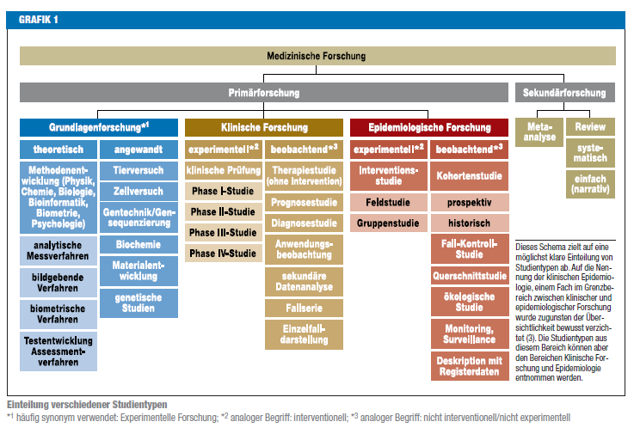
Medical research

Slide 10
What are clinical trials?
YouTube channel of Oregon Health & Science University (OHSU):
https://www.youtube.com/watch?v=mbKoXy3CRZU

Slide 11
Ethics Committees in Austria
Multiple ethics committees throughout Austria
Main types:
Medical University ethics committees (Vienna, Graz, Innsbruck), Provincial ethics committees (one per federal state), Hospital-based ethics committees
Regulated by: Austrian Medicines Act (AMG) and Medical Devices Act (MPG)
Must comply with EU Clinical Trial Regulation since 2022 Austria

Slide 12
Key Features of Austrian System
Lead ethics committee: One committee takes the lead for multi-center studies
Composition: Physicians, pharmacists, statisticians, lawyers, patient representatives, laypeople
Review timeline: Usually 60 days for decision (can be extended)
Registration: All trials registered in EU Clinical Trials Information System (CTIS)
Language: Applications can be submitted in German or English

Slide 13
Application process in Austria
Before submission: Complete study protocol, informed consent forms, insurance
Submit to: Appropriate ethics committee based on study location
Documents required: Protocol, investigator brochure, consent forms, patient information
Review process: Committee meetings typically monthly
Decision types: Approval, conditional approval (with modifications), or rejection
Fees: Application fees vary by committee and study type
After approval: Annual safety reports, amendments require new approval

Slide 14
What is the European Clinical Trial Regulation?
A new EU law (since 2014, fully active from 2022) that governs how medical research studies are conducted
Applies to all clinical trials testing new medicines or treatments on people in EU countries
Replaced the old Clinical Trials Directive from 2001
Goal: Make clinical trials safer, more transparent, and easier to conduct across multiple countries
https://www.youtube.com/watch?v=0nQ2ABHa9L0
https://euclinicaltrials.eu/

Slide 15
Why Was It Needed?
Old system problems: Each EU country had different rules and approval processes
Very complicated and slow to start multi-country studies
Limited public access to trial information
New regulation benefits: One application for all EU countries (instead of 27+ separate applications)
Faster approval process
All trial results must be made public
Better protection for study participants

Slide 16
Key Features
Single portal: CTIS (Clinical Trials Information System) - one website for all applications
Transparency: All trial results published, even negative ones
Simplified process: One assessment for all participating countries
Patient safety: Stricter rules for protecting people in trials
Faster innovation: Quicker approval means new treatments reach patients sooner

Slide 17
The role of a statistician in a clinical ethics committee
Scientific validity: Ensure studies are properly designed to answer research questions
Sample size: Verify that enough participants are enrolled to detect meaningful effects
Participant protection: Prevent exposing people to risks in poorly designed studies
Resource efficiency: Avoid wasting time and money on studies that can't provide reliable answers
Ethical principle: A study that cannot produce valid results is inherently unethical
Quote: "Bad statistics = bad ethics"

Slide 18
Key Statistical Responsibilities
Review study design: Randomization, blinding, control groups
Assess sample size calculations: Power, effect size, dropout rates
Evaluate analysis plans: Appropriate statistical methods for the research question
Check endpoints: Are primary and secondary outcomes clearly defined and measurable?
Identify bias: Selection bias, confounding, missing data strategies
Interim analyses: Review stopping rules and safety monitoring plans
Data integrity: Assess data management and quality control procedures

Slide 19
Types of research studies
Dr. Hanno Ulmer
hanno.ulmer@i-med.ac.at
Institute of Clinical Epidemiology, Public Health, Health Economics, Medical Statistics and Informatics

Slide 20
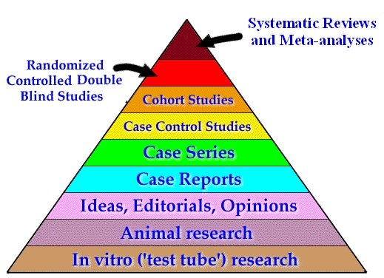
Strength of evidence

Slide 21
Interventional versus observational
a factor that is to be investigated
(efficacy of a therapy such as a new medication, a risk factor such as smoking, a protective factor such as physical activity)
interventional
observational
clinical trial,
interventional cohort study
cohort study, case-control study, (cross-sectional study)

Slide 22
Longitudinal (incidence) versus cross-sectional (prevalence) studies

Slide 23
Clinical trial

Slide 24
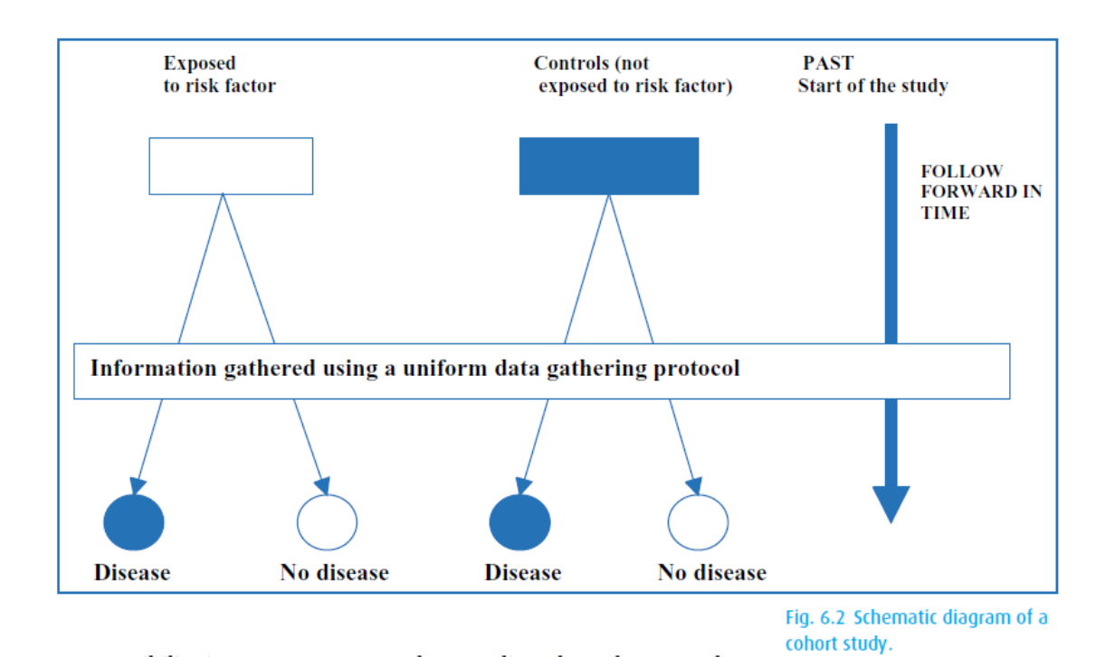
Cohort studies

Slide 25
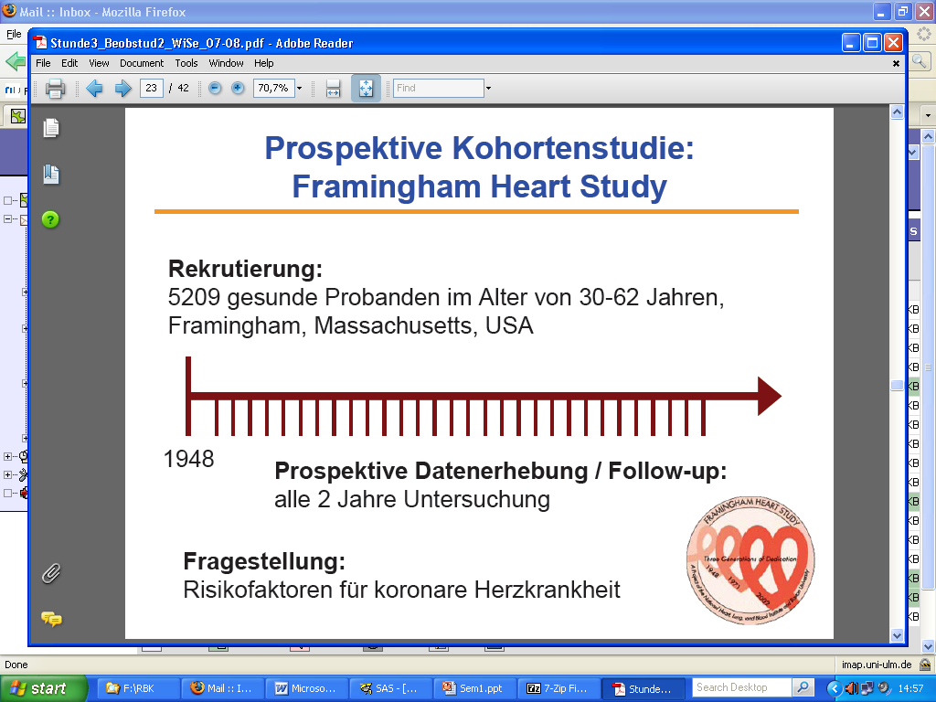
Framingham Heart Study
1948 Recruiting of 5209 healthy individuals (age 30-62 years)
1960
smoking ↑ CHD
1970
hypertension
↑ stroke
1978
Psychosocial
factors ↑ CHD
1961
cholesterol, hypertension ↑ CHD
1988
HDL ↓ CHD
1976
menopause ↑ CHD
1967
physical activity ↓ CHD
obesity ↑ CHD

Slide 26
Case control study

Slide 27
UCP breast cancer case-control study

Slide 28
Randomized controlled (clinical) trial (RCT)
  Studies for the approval of drugs or products
    Experiment, trial
    Influencing factors are controlled
  Avoidance of bias due to randomization
    Random assignment to a group, avoidance of selection
      e.g.: New therapy - standard therapy (= control group).
  Comparison with at least one second group (control)
  Achieving structural equality
      e.g.: same mean age, same gender distribution, ...

Slide 29
Randomization
Random assignment of a subject to one of the groups of the influencing factor.
  With the help of a random generator
Aim:
  Avoidance of selection bias
    Each subject has the same chance to be randomly assigned to a group
  Structural equality
    Regarding measured characteristics and unmeasured characteristics
    Additional stratification
When randomisation is not appropriate: Pairing
  Twins, Matching
  e.g.: matched case control study

Slide 30
Blinding
Elimination of bias due to prior information
  Selection bias
  Observer Bias
Characteristics of the influencing factor are unknown for the observer
  Double-blind study
    Patient and doctor do not know which form of therapy is used

Slide 31
Validity
Representativeness of the sample
Random selection
  Selection of subjects
  Center selection
    Monocentric / multicentric
    National, international
Inclusion criteria
  Stage of disease, age, ...
Exclusion criteria
  Additional diseases, additional medication, ...
Voluntariness

Slide 32
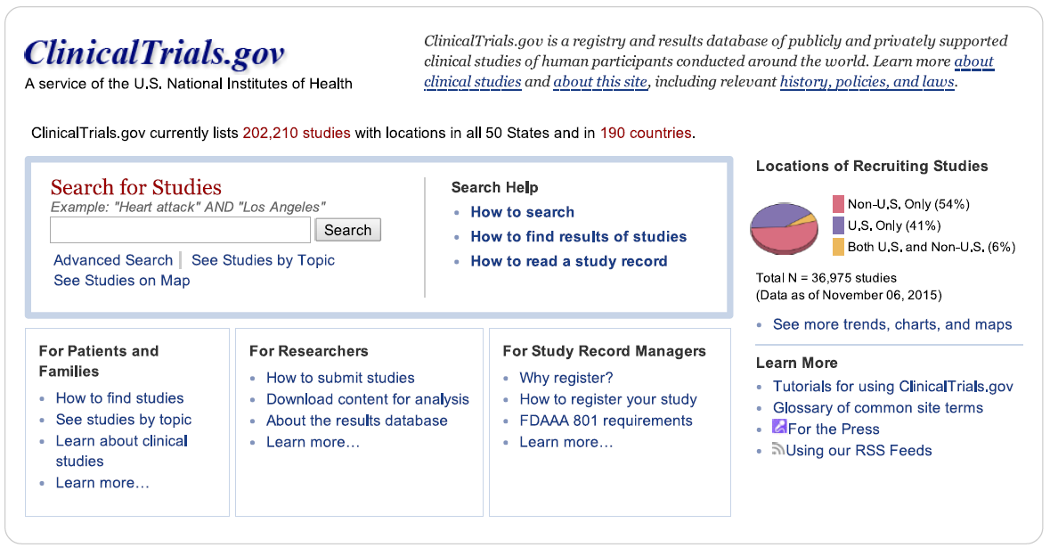
Clinicial Trials.gov
As of 10.2022: 430,108 research studies in all 50 states and 221 countries

