Slide 1
Biostatistics
ao. Univ.-Prof. Mag. Dr. Hanno Ulmer
Institute of Clinical Epidemiology, Public Health, Health Economics, Medical Statistics and Informatics

Slide 2
Organizational
Lectures (Hanno Ulmer, Claudia Lamina, Kristina Weber)
Exercises (Barbara Kollerits, Josef Fritz, Claudia Lamina)
Examination: written exam
Statistik Software: the R project

Slide 3
Department portfolio
EpiCenter

Slide 4
Statistical consulting for research projects
Institution/Clinic | Quantity
Internal medicine | 20
Anesthesia | 15
Gynecology | 13
Cardiology | 9
Radiology | 8
Urology | 7
Neurology | 6
Ophthalmology | 6
ENT | 6
Pediatrics | 6
Hygiene | 3
Institution/Clinic | Quantity
Trauma Surgery | 2
Neurosurgery | 2
Dentistry | 2
Blood Bank | 2
Thoracic Surgery | 1
Orthodontics | 1
Nuclear Medicine | 1
Psychiatry | 1
Plastic surgery | 1
BKH Hall | 1
Total | 113
Exemplary for one year

Slide 5




















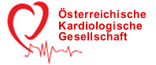









Cooperation partners / Network
(excerpt)

Slide 6







Literature
Medical statistics
Statistical software
Medical informatics
Documentation
Clinical research
Public Health
Epidemiological research
Evidence Based Medicine

Slide 7
Internet, software
British Medical Journal: Statistics at Square One
A Series on Evaluation of Scientific Publications, Deutsches Ärzteblatt
Further Statistics in Dentistry, British Dental Journal
Online calculators: e.g. Graphpad Quickcalcs
R, Stata, SPSS, SAS, Statistica, GraphPad, MedCalc, JASP
nQuery Advisor, East, PASS, sample size calculator Med Uni Wien (Robin Ristl)
RevMan5, Cochrane Collaboration
KI

Slide 8
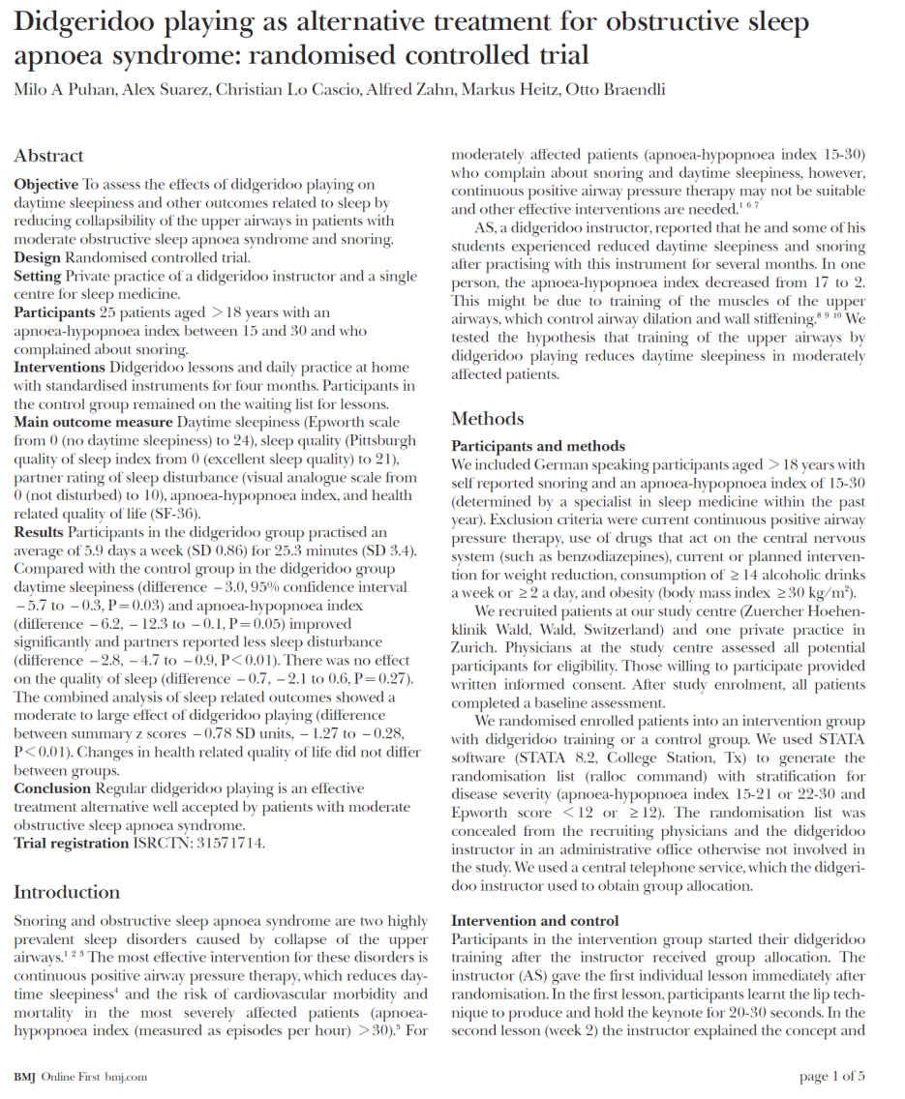
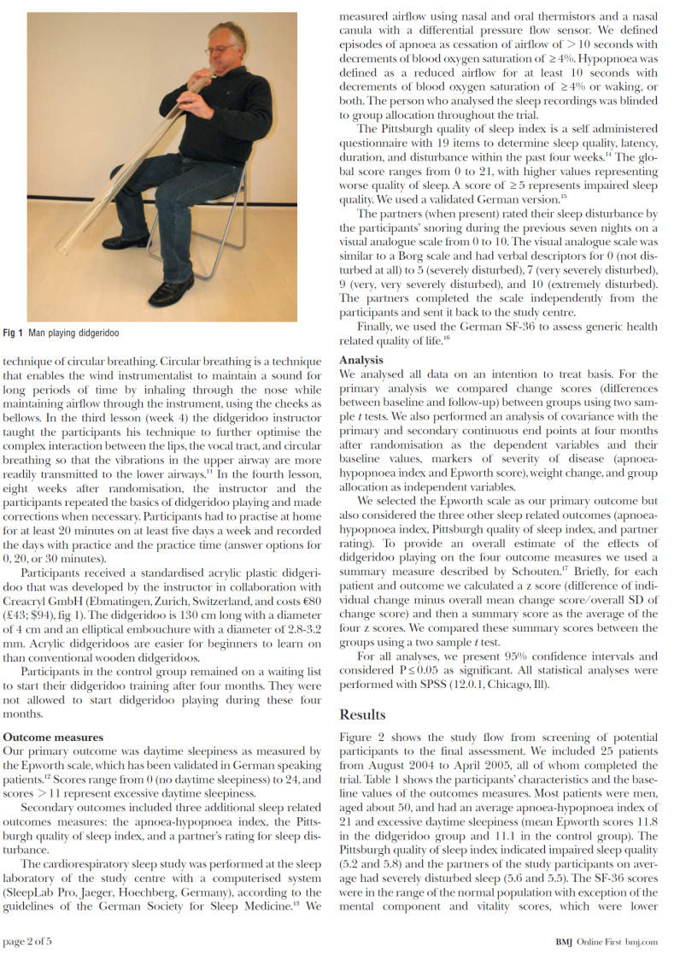
Case study: clinical trial

Slide 9
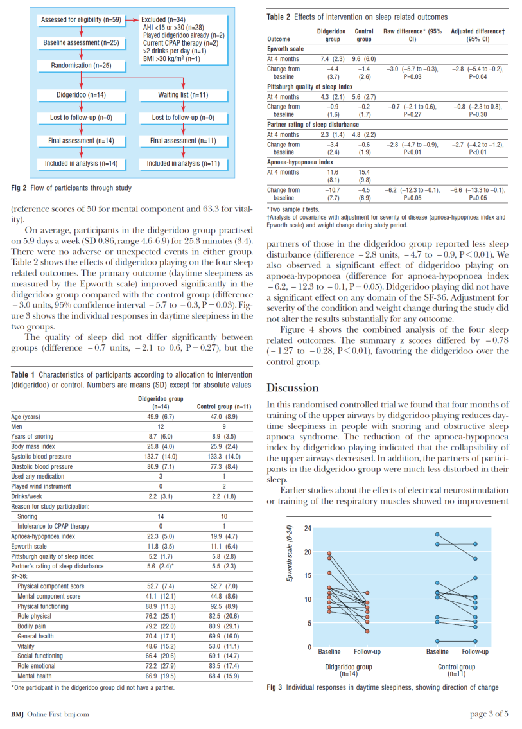
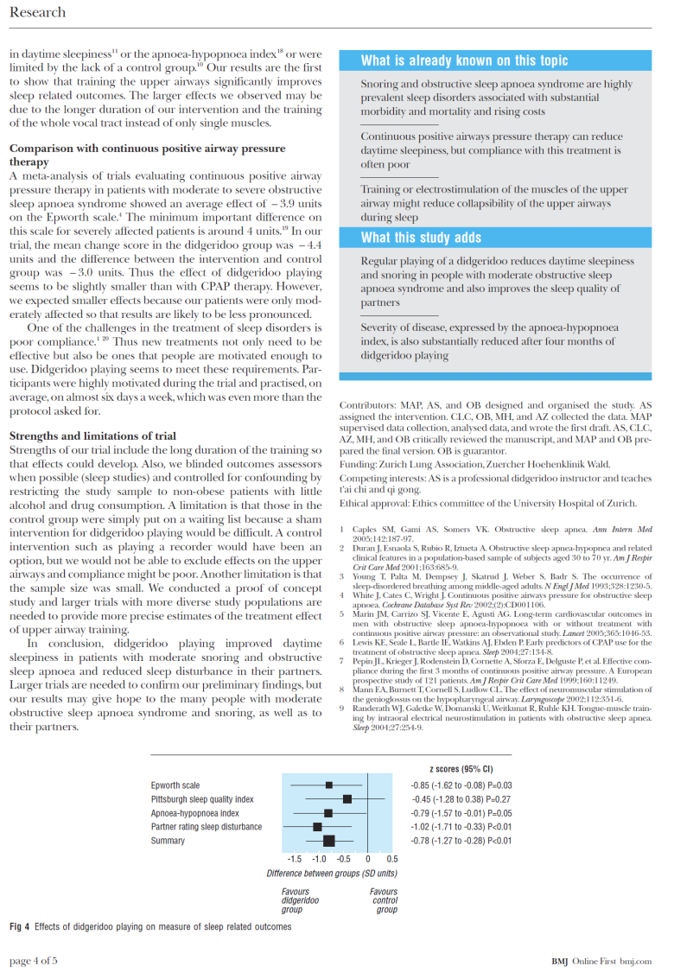
Case study: clinical trial

Slide 10
„How to read a study in 10 minutes“
Structure of a study report:
IMRaD scheme
Guidelines for writing a study report
CONSORT statement for interventional studies (RCTs)
STROBE statement for observational studies
(epidemiologic study designs: cohort study, case-control study, cross-sectional study)
STARD statement for diagnostic studyies
PRISMA statement for meta-analyis

Slide 11
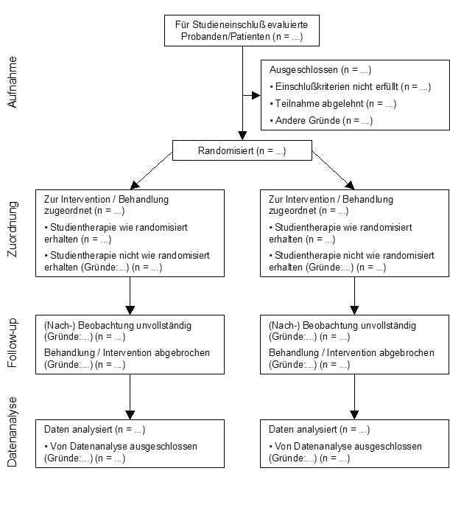
Consort statement, participant flow
Intention-to-treat
versus
Per-protocol

Slide 12
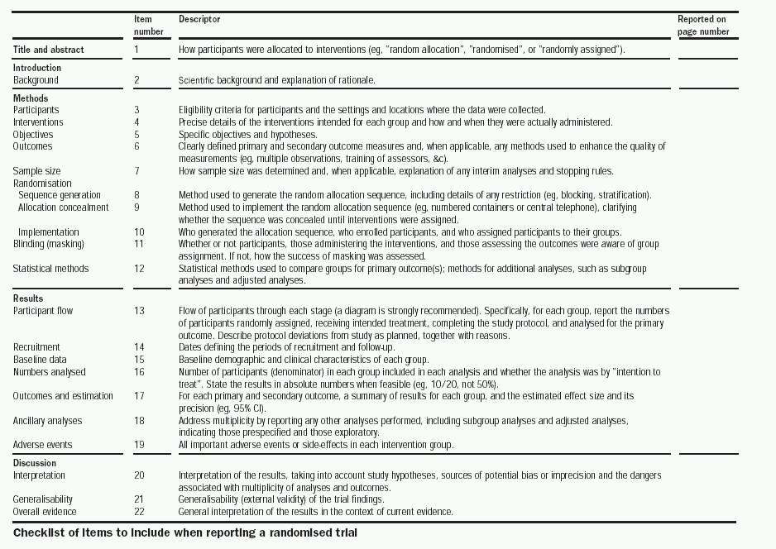

Slide 13
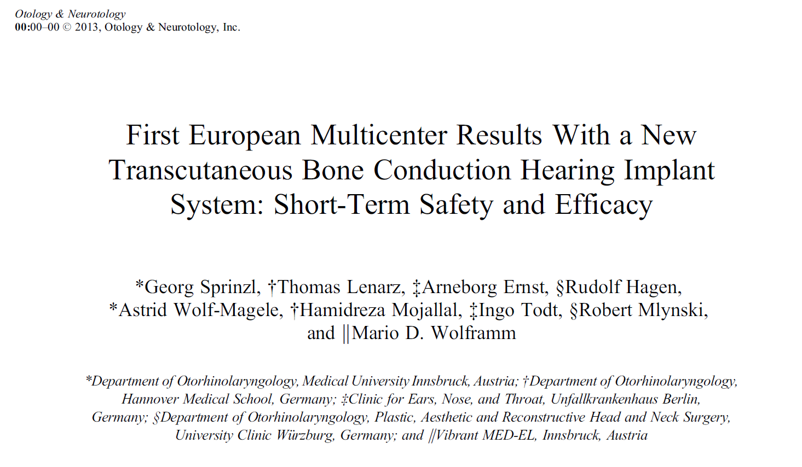
Case study: clinical trial (medical device)

Slide 14
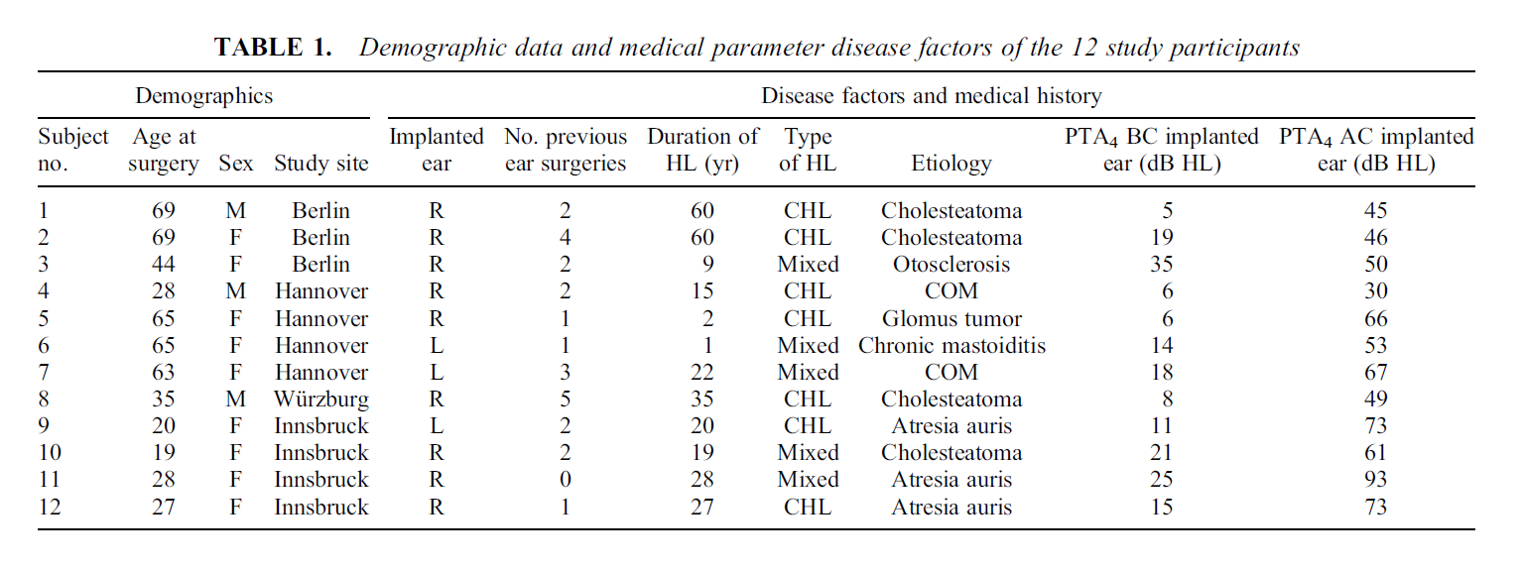
Case study: clinical trial (medical device)

Slide 15
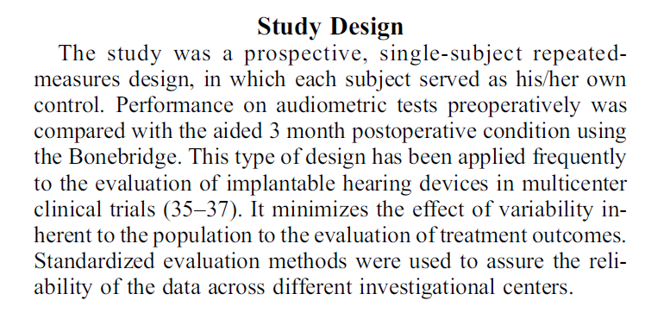
Case study: clinical trial (medical device)

Slide 16
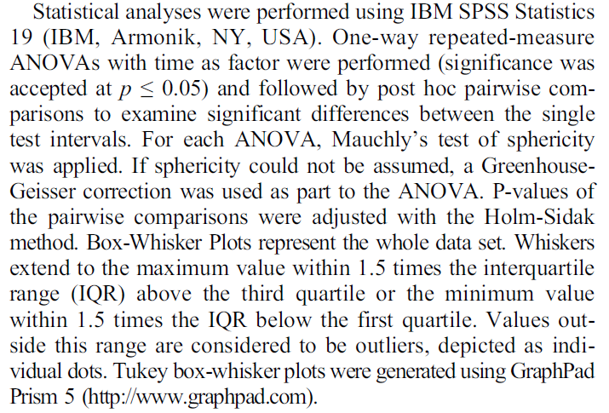
Case study: clinical trial (medical device)

Slide 17
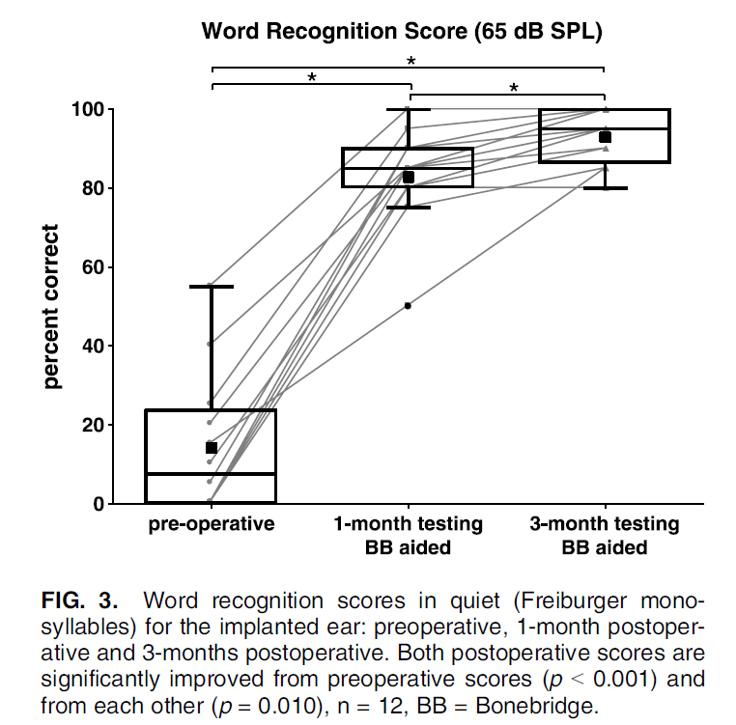
Case study: clinical trial (medical device)

Slide 18
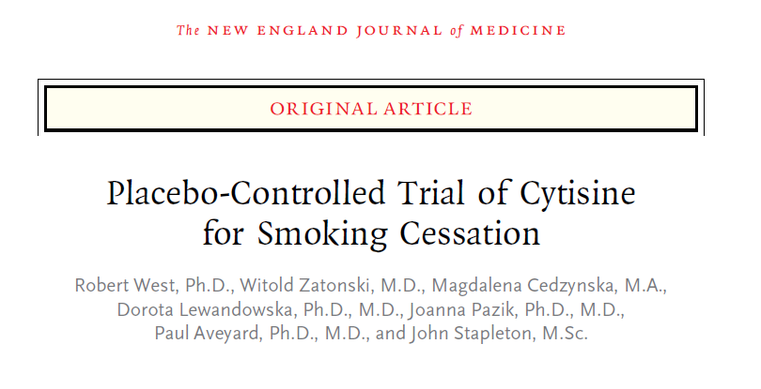
Case study: clinical trial (drug)

Slide 19
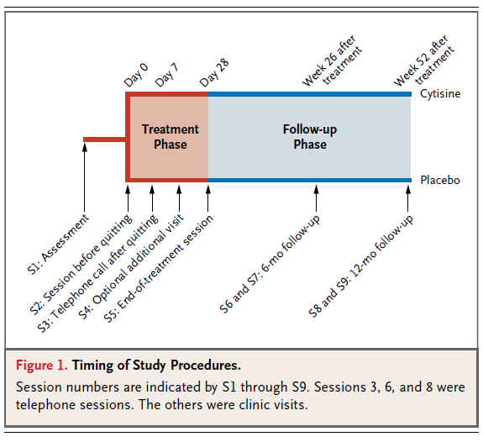
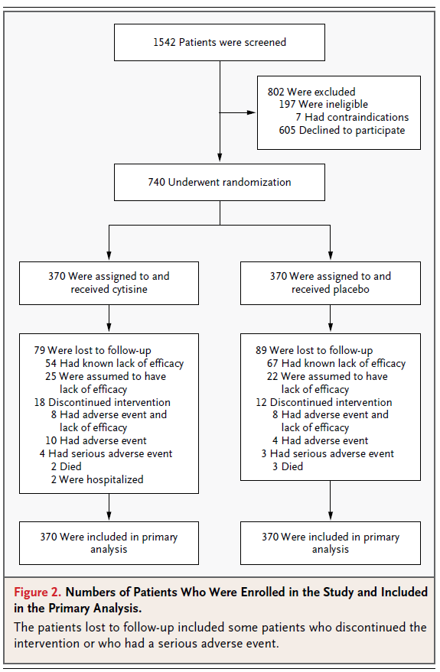
Case study: clinical trial (drug)

Slide 20
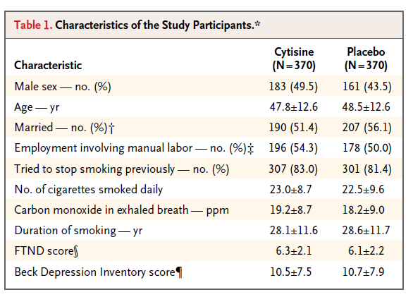
Case study: clinical trial (drug)

Slide 21
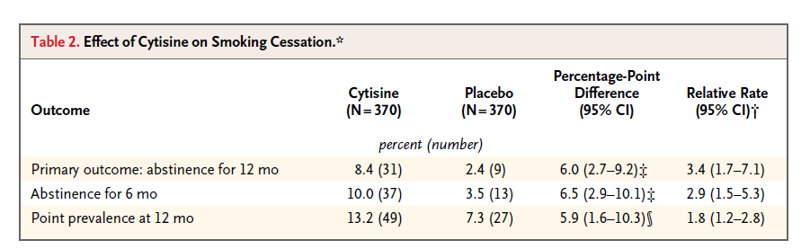
Case study: clinical trial (drug)

Slide 22
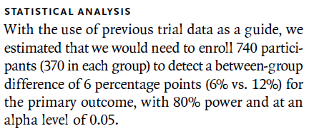
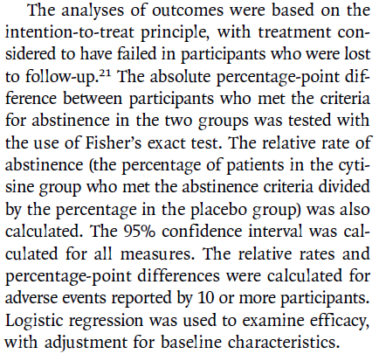
Case study: clinical trial (drug)

Slide 23
Case study: meta-analysis

Slide 24
Case study: meta-analysis

Slide 25
Case study: meta-analysis

Slide 26
Case study: meta-analysis

Slide 27
Case study: meta-analysis

Slide 28
Types of research studies
Dr. Hanno Ulmer
hanno.ulmer@i-med.ac.at
Institute of Clinical Epidemiology, Public Health, Health Economics, Medical Statistics and Informatics

Slide 29
Interventional versus observational
a factor that is to be investigated
(efficacy of a therapy such as a new medication, a risk factor such as smoking, a protective factor such as physical activity)
interventional
observational
clinical trial,
interventional cohort study
cohort study, case-control study, (cross-sectional study)

Slide 30
Longitudinal (incidence) versus cross-sectional (prevalence) studies

Slide 31
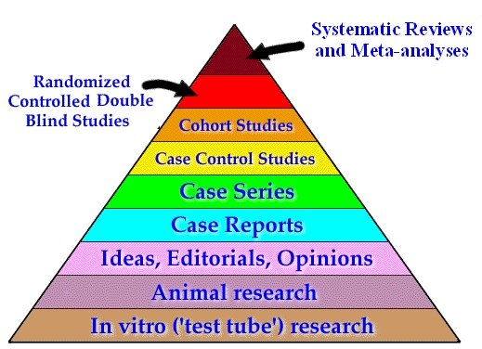
Strength of evidence

Slide 32
Clinical trial

Slide 33
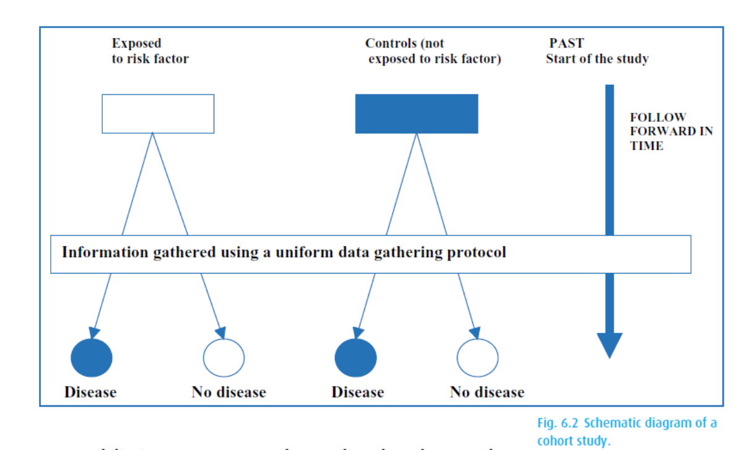
Cohort studies

Slide 34

Framingham Heart Study
1948 Recruiting of 5209 healthy individuals (age 30-62 years)
1960
smoking ↑ CHD
1970
hypertension
↑ stroke
1978
Psychosocial
factors ↑ CHD
1961
cholesterol, hypertension ↑ CHD
1988
HDL ↓ CHD
1976
menopause ↑ CHD
1967
physical activity ↓ CHD
obesity ↑ CHD

Slide 35
Case control study

Slide 36
UCP breast cancer case-control study

Slide 37
Cohort Study
Case-Control Study
prospective
retrospective
Risk Factor +
Diseased
Risk Factor +
Cases
(Diseased)
Healthy Study Population
Healthy
Risk Factor -
Diseased
Risk Factor +
Controls
(Healthy)
Risk Factor -
Healthy
Risk Factor -
Diseased
Healthy
Diseased
Healthy
Risk Factor +
A
B
A + B
Risk Factor +
A
B
A + B
Risk Factor -
C
D
C + D
Risk Factor -
C
D
C + D
Relative
Risk
A / A+B
Odds
Ratio
(A / B)
A x D
=
=
C / C+D
=
(C / D)
B x C

Slide 38
Risk assessment and 2x2 tables
Dr. Hanno Ulmer
hanno.ulmer@i-med.ac.at
Institute of Clinical Epidemiology, Public Health, Health Economics, Medical Statistics and Informatics

Slide 39
2x2 table

Slide 40
Absolute risk

Slide 41
Relative risk

Slide 42
Odds ratio

Slide 43
Attributable risk = absolute risk reduction

Slide 44
Summary of risk measures
 | Outcome positive | Outcome negative
Exposition positive | a | b | Relative Risk
Exposition negative | c | d | Odds Ratio
 | Abs. Risk Reduct. | Number needed to treat (NNT) = 1/ARR

Slide 45
Practice: Calculate RR, OR, ARR and NNT for primary outcome

Slide 46
Practice: Calculate RR, OR, ARR and NNT for primary outcome
 | abstinence (12 months) | still classified smoking
Cytisine | 31 (8.4%) | 339 | RR = 3.4
Placebo | 9 (2.4%) | 361 | OR = 3.7
 | ARR = 6% | NNT = 16.7 NNT = 1/ARR

Slide 47
Statistics in the medical and pharmaceutical sciences
Dr. Hanno Ulmer
hanno.ulmer@i-med.ac.at
Institute of Clinical Epidemiology, Public Health, Health Economics, Medical Statistics and Informatics

Slide 48
Objectives of the lecture
The role of a biostatistician in medical and pharmaceutical sciences
Randomized controlled trials
Descriptive statistics
Inferential statistics, significance testing and confidence intervals
Regression (Claudia Lamina)
Survival analysis (Claudia Lamina)

Slide 49
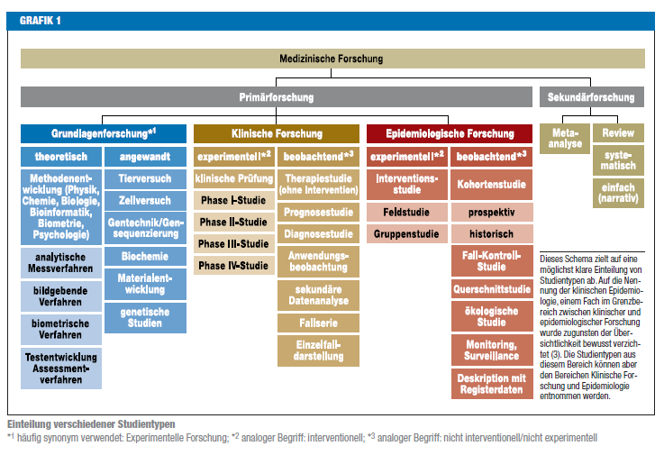
Medical research

Slide 50

Clinicial Trials.gov
As of 10.2022: 430,108 research studies in all 50 states and 221 countries

Slide 51
Randomized controlled (clinical) trial (RCT)
  Studies for the approval of drugs or products
    Experiment, trial
    Influencing factors are controlled
  Avoidance of bias due to randomization
    Random assignment to a group, avoidance of selection
      e.g.: New therapy - standard therapy (= control group).
  Comparison with at least one second group (control)
  Achieving structural equality
      e.g.: same mean age, same gender distribution, ...

Slide 52
Randomization
Random assignment of a subject to one of the groups of the influencing factor.
  With the help of a random generator
Aim:
  Avoidance of selection bias
    Each subject has the same chance to be randomly assigned to a group
  Structural equality
    Regarding measured characteristics and unmeasured characteristics
    Additional stratification
When randomisation is not appropriate: Pairing
  Twins, Matching
  e.g.: matched case control study

Slide 53
Blinding
Elimination of bias due to prior information
  Selection bias
  Observer Bias
Characteristics of the influencing factor are unknown for the observer
  Double-blind study
    Patient and doctor do not know which form of therapy is used

Slide 54
Validity
Representativeness of the sample
Random selection
  Selection of subjects
  Center selection
    Monocentric / multicentric
    National, international
Inclusion criteria
  Stage of disease, age, ...
Exclusion criteria
  Additional diseases, additional medication, ...
Voluntariness

Slide 55
Statistical Analysis:
Basic concepts and
Descriptive Statistics
Dr. Hanno Ulmer
hanno.ulmer@i-med.ac.at
Institute of Clinical Epidemiology, Public Health, Health Economics, Medical Statistics and Informatics

Slide 56
Basic statistical terms
Observation unit
  Subjects, patients, customers...,objects
Random variable, characteristic
  Gender, health status, weight, blood group
    Why "random variable"?
      Because the expression is not exactly predictable with a random selection. The result depends on chance.
Characteristic values
  Blood group: A, B, AB, 0
  Statement yes/no
  Weight in kg

Slide 57
Types of variables, scaling
Categorical
  Many expressions at last
    e.g. gender, blood group, school grades
  Counts result
Continuous
  All values of an interval possible
    e.g. weight, height, temperature, number of leukocytes
  Result of measurements (metric)
Qualitative scales (nominal, ordinal)
Quantitative scales (metric)

Slide 58
Descriptive statistics
Qualitative characteristics |  | Quantitative characteristics normally distributed | randomly distributed
n,% |  | Arithmetic mean | Median
 |  | Standard deviation | Percentile
Pie chart, bar chart |  | Histogram | Boxplot
Examples:
Gender, response to therapy, etc. |  | Blood pressure | CRP, GGT Severity

Slide 59
Frequency
Absolute frequency
  Number of observations with a given characteristic X: n(X)
    From a sample of size N
Relative frequency
  Proportion of X: h(X)=n(X)/N
    In percent
Cumulative frequency
  Only with at least ordinal data
    Sum frequency
      Sum of relative frequencies of all characteristics X

Slide 60
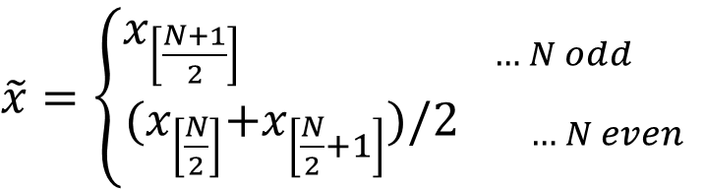
Arithmetic mean and median
Arithmetic mean:
  Given: N observations (random variable)
    x₁ ,x₂ ,...,x_{N}
Median:
  x_{[w]} ...x with rank w
$\tilde{x}=$ $\left\{\begin{aligned}x_{\left[\frac{N+1}{2}\right] … N odd } \\ {{(x}_{\left[\frac{N}{2}\right]}+x_{\left[\frac{N}{2}+1\right]})/2}_{ … N even} \end{aligned}\right.$

Slide 61
Median, mode, quartiles, extreme values
Mode (most frequent value of a distribution)
Quantiles: percentage of the data
Quartiles: Q₂₅ , Q₇₅
  Interquartile range: I₅₀ = Q_{75 –} Q ₂₅
Span: Maximum - Minimum
Percentiles: Q₁ , Q₅ , Q₁₀ , ...Q₃₃ , ..., Q₉₅ , Q₉₉
      Are often used as standard values

Slide 62
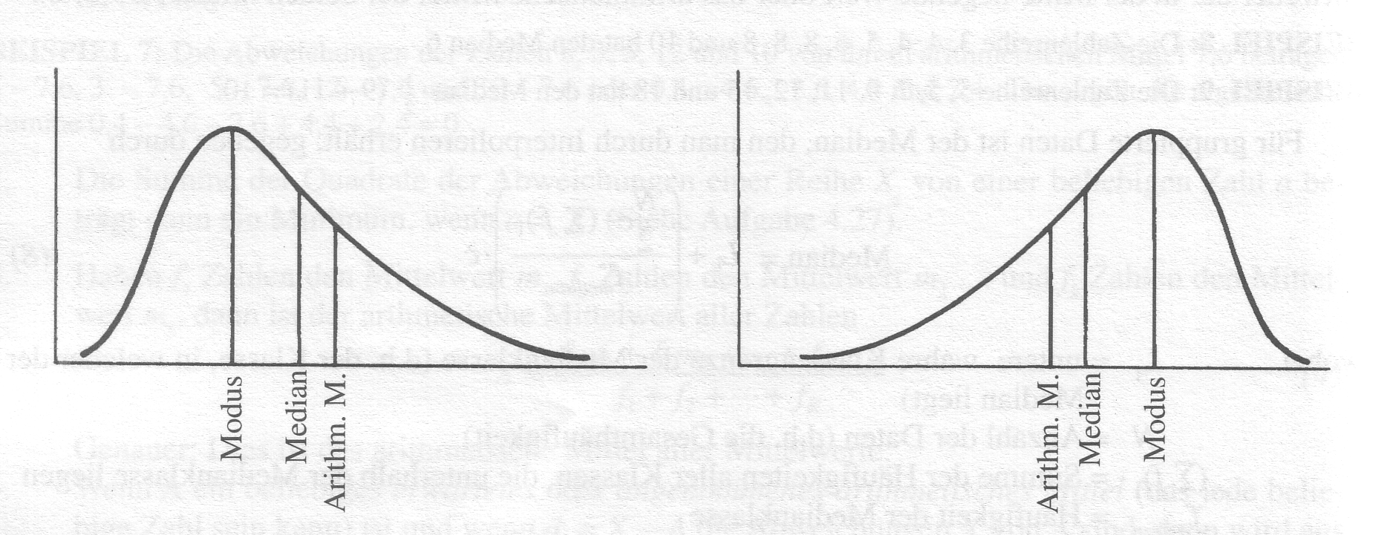
Relationship between arithmetic mean, median and mode
Symmetrical
Mean = Median = Modal value
f(-x) = f(+x)
Skewness=0
Bell-shaped

Slide 63

Measures of variation
Variance:
Standard deviation: $s= \sqrt{s^{2}}$
Coefficient of variation:
    Ratio of dispersion to mean value

Slide 64
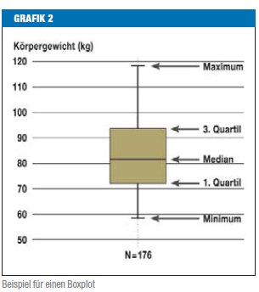
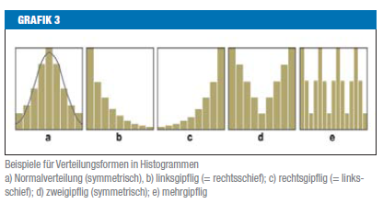
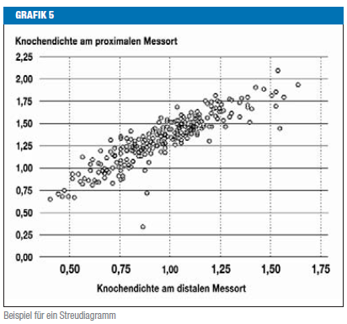
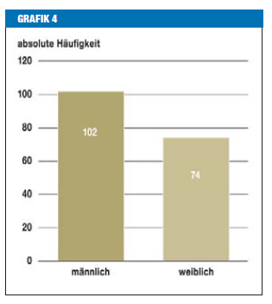
Statistical graphics

Slide 65
Histogram
X...continuous variable
Subdivision into classes of equal length and determination of the frequency per class
Classes open at the edges

Slide 66
Comparing two groups
Boxplots for therapy A and B
50% Interquartile range
Median

Slide 67
Statistical measures exercise
Please calculate:
  Mean value
  Median
  Variance
  Standard deviation
  Range
  Interquartile range
  and the coefficient of variation
  Create histograms and boxplots for:

Slide 68
Statistical measures exercise
Scores from 20 students
  6,3,7,5,6,4,4,6,7,3,5,9,6,4,2,7,5,5,8,6
Number of employees in 20 pharmacies
  2,3,3,3,4,4,4,4,5,5,5,5,5,5,6,6,6,8,10,15
Sick days of 20 people
  0,0,0,0,0,0,0,0,1,1,1,1,1,2,2,2,3,3,15,76

Slide 69
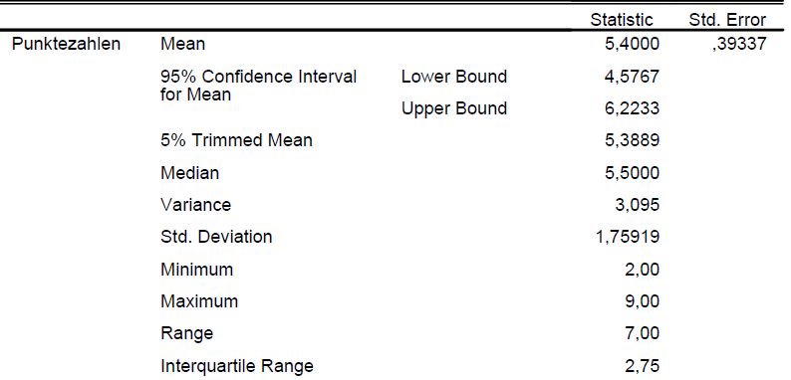
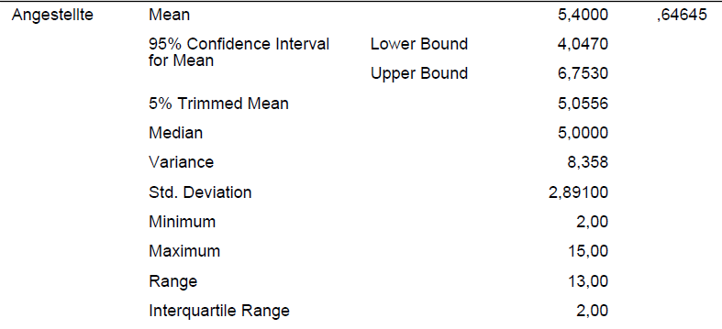
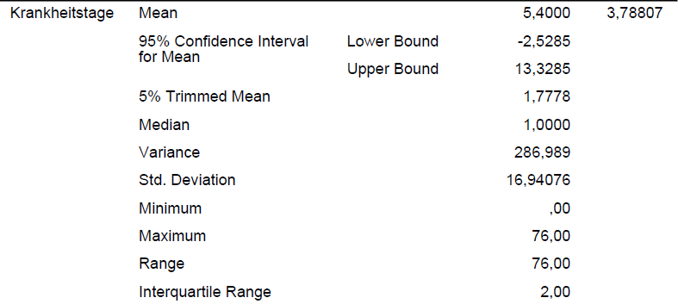
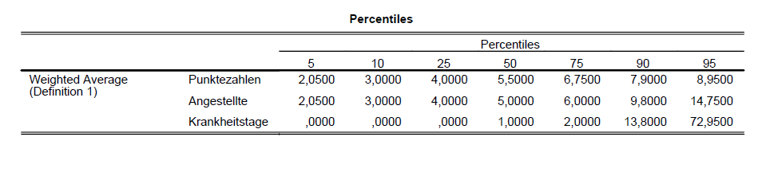

Slide 70
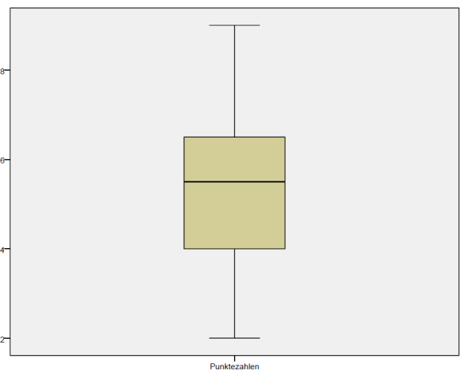
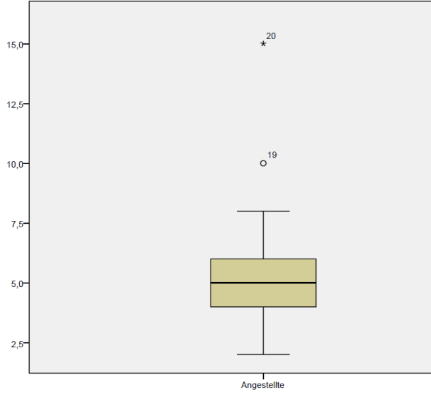
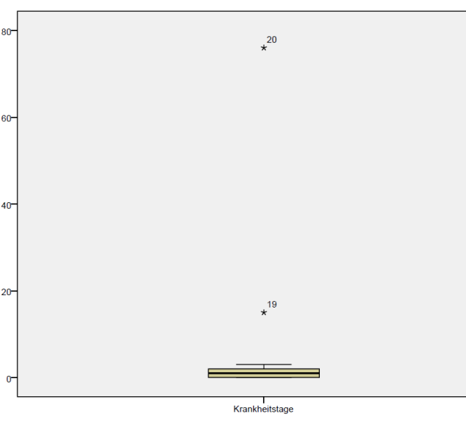
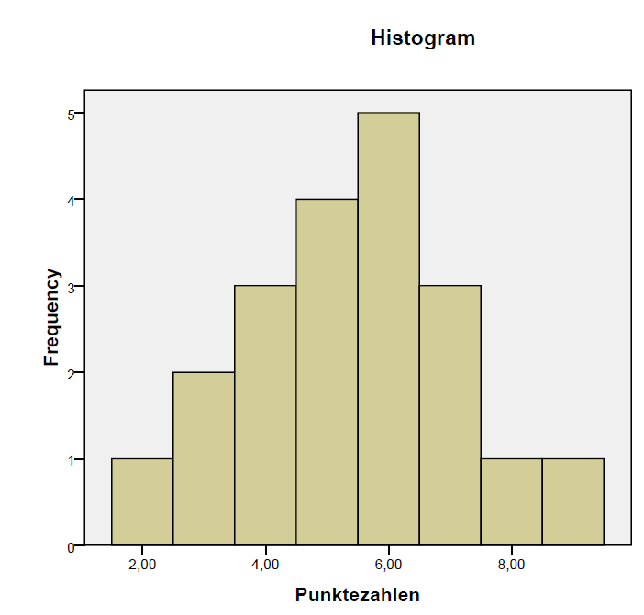
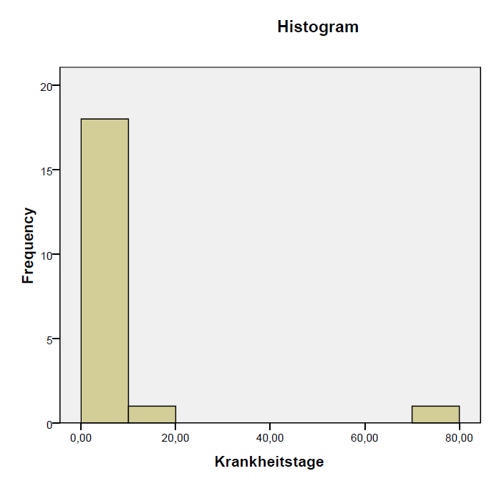
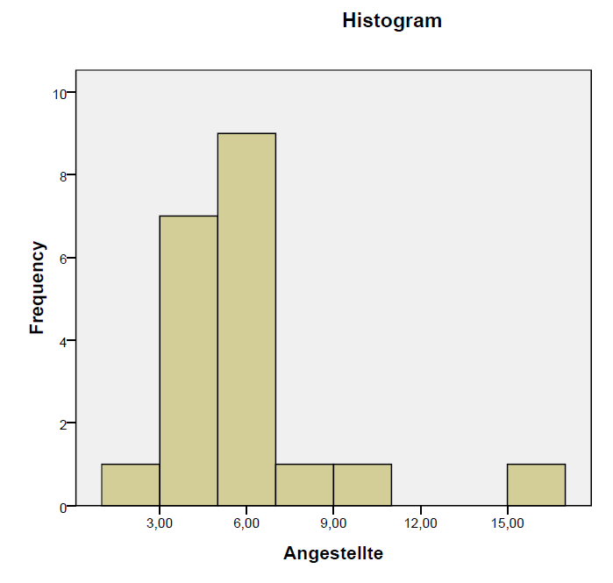
Statistical measures exercise

Slide 71
Gaussian or normal distribution
− < X < +

Slide 72
For all normal distributions:
≈ 68% of all observations lie within one standard deviation around the mean
(between μ - σ and μ + σ )
≈ 95% of all observations lie within two standard deviations (between μ - 2σ and μ + 2σ )
≈ 99% of all observations lie within three standard deviation (between μ - 3σ and μ + 3σ)
The sigma (68-95-99%) rule:

Slide 73
The 2X2 table continued:
Diagnostic study
Dr. Hanno Ulmer
hanno.ulmer@i-med.ac.at
Institute of Clinical Epidemiology, Public Health, Health Economics, Medical Statistics and Informatics

Slide 74
Diagnostic study
 | Gold standard positive | Gold standard negative
New procedure positive | a | b | Pos. pred. W.
New process negative | c | d | Neg. pred. W.
 | Sensitivity | Specificity

Slide 75
Diagnostic study
 | Gold standard positive | Gold standard negative
New test positive | 22 | 418 | PPV = 5%
New test negative | 10 | 7043 | NPV = 99.9
 | Sensitivity 68.8% | Specificity 94.4%

Slide 76
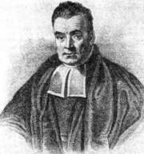
Bayes formula
Positive Predictive Value (PPV)
Thomas Bayes ~1702 - 1761
PPV = (sensitivity x prevalence) /
(sensitivity x prevalence +(1- specificity) x (1- prevalence))
Example mammography:
Prevalence: 1%, Sensitivity: 90%, Specificity: 98%.
0.90 - 0.01
ppV =
= 0.31
0.90 - 0.01 + 0.02 - 0.99

Slide 77
Statistical analyses in clinical trials
ao. Univ.-Prof. Mag. Dr. Hanno Ulmer
hanno.ulmer@i-med.ac.at
Institute of Clinical Epidemiology, Public Health, Health Economics, Medical Statistics and Informatics

Slide 78
Basic principles of statistical analyses in clinical trials
Introduction
Different types of statistical analyses
Power calculation
Multiplicity in clinical trials including
subgroup analyses,
post-hoc analyses,
interim analyses and pooled analyses

Slide 79

Use of statistics in top journals

Slide 80
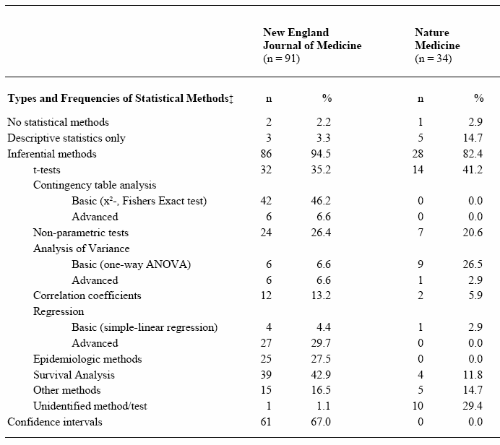
Statistical methods
Kategorien nach
Emerson/Colditz 1985

Slide 81
Design and analysis
Study planning
Resarch question, hypotheses, primary efficacy variable
Study design (interventional/observational, randomization, blinding, etc. )
Sample size estimation
Data management, etc.
Statistical analysis
Descriptive statistics
Univariable statistical testing
Parameter estimation with confidence intervals
Multivariable statistical testing using regression analyses

Slide 82

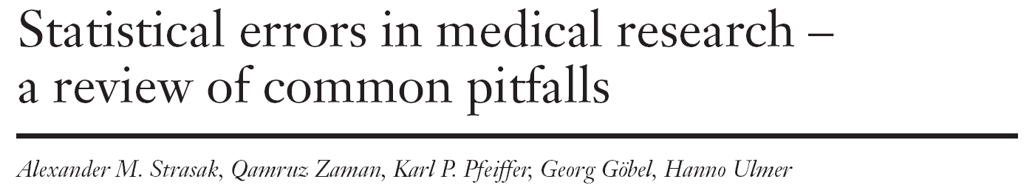
Statistical errors in medical research

Slide 83
Appendix (SMW-Artikel)

Slide 84
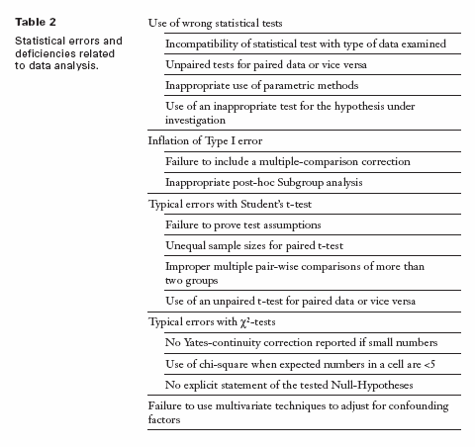

Slide 87
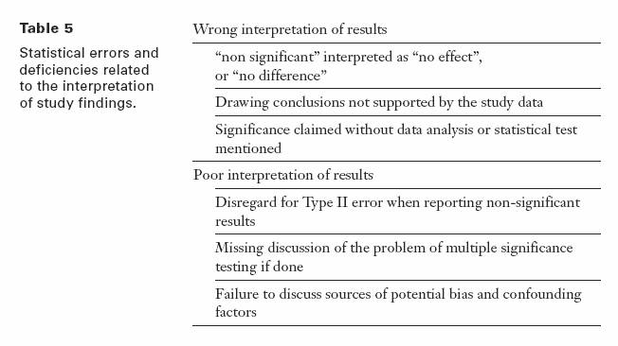

Slide 88
Day 3:
Confidence intervals and significance testing
Dr. Hanno Ulmer
hanno.ulmer@i-med.ac.at
Institute of Clinical Epidemiology, Public Health, Health Economics, Medical Statistics and Informatics

Slide 89
Confidence intervals
“A confidence interval is used when estimating an unknown parameter from sample data. The interval gives a range for the parameter – and a confidence level that the range covers the true value.”
Freedman et al. (1991), p. 385.

Slide 90
Example for 95%CI
Rule of three (adverse events in drug testing)
Phase I study:
no adverse events in n=10 patients (study sample)
--> 95%CI (0-30%) (population estimate)
Phase II study:
no adverse events in n=100 patients
--> 95%CI (0-3%)
Phase III study:
no adverse events in n=1000 patients
--> 95%CI (0-0.3%)

Slide 91
Confidence interval relates to significance testing

Slide 92
Significance testing

Slide 93
Significance testing

Slide 94
Significance testing

Slide 95
Formulating hypothesis & statistical tests
Steps in conducting a statistical test:
Quantify the scientific problem from a clinical / biological perspective
Formulate the model assumptions (distribution of the variable of interest)
Formulate the problem as a statistical testing problem:
Nullhypothesis versus alternative hypothesis
Define the „error“ you are willing to tolerate
Calculate the appropriate test statistic
Decide for the null hypothesis or against it
Formulating Hypothesis
&
Test statistics
&
p-values

Slide 96
Principles of statistical testing
Three primary measures of interest:
a point estimate,
a confidence interval, and
a p-value
Different approaches:
Test for superiority,
standard hypothesis testing
Test for non-inferiority
the difference between the new treatment and the standard is less than the smallest clinically meaningful difference, define delta, use confidence intervals
Test for equivalence
To demonstrate the difference between the new treatment and standard treatment has no clinical importance, define delta

Slide 97
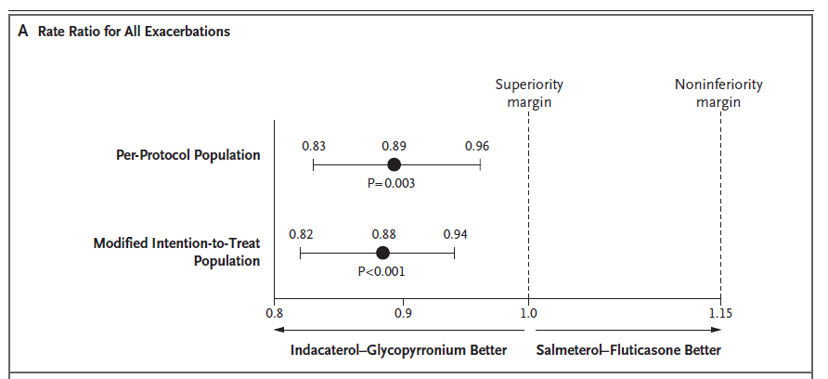
Example

Slide 98
Type I versus Type II Error
 |  | Decide for
 |  | H₀ | H₁
Reality | H₀ | Correct decision | Wrong decision: Type I error (α)
 | H₁ | Wrong decision: Type II error (β) | Correct decision: Power (1-β)

Slide 99
Common statistical tests
 | Quantitative outcome variable |  | Qualitative outcome variable
 | Normal distribution | Any other distribution | Expected frequency in each cell of the crosstable „high“ | Expected frequency in each cell of the crosstable „low“
Compare 2 groups | t-test | Wilcoxon-test / Mann-Whitney U-test | Chi-Square test | Fishers exact test
Compare >2 groups | Analysis of Variance (ANOVA) | Kruskal-Wallis-test | Chi-Square test
Testing measures of location:
Does the mean/median differ between groups
Testing frequencies in a crosstable:
Are the rows and columns independent from each other?

Slide 100
Overview of statistical significance testing

Slide 101
Overview of statistical significance testing

Slide 102
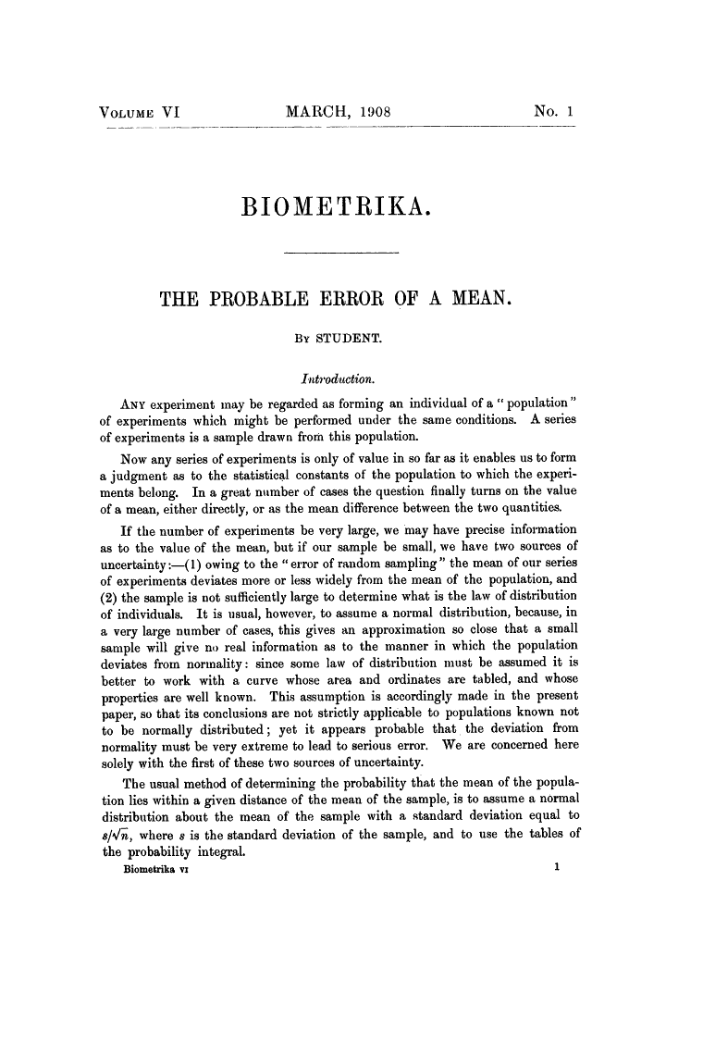
2008: 100 years Student`s t-test:
William Sealy Gosset

Slide 103
T-test
Paired t-test
  Compares two means based on related data.
  E.g., Data from the same people measured at different times.
  Data from ‘matched’ samples.
Independent t-test
  Compares two means based on independent data
  E.g., data from different groups of people
Significance testing
  Testing the significance of Pearson’s correlation coefficient
  Testing the significance of b in regression.

Slide 104

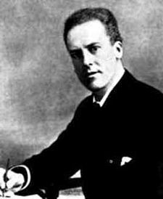

Pearson`s chi-square test 1900
Correlation and regression
Analysis of Variance
Karl Pearson (1857-1936)
Sir Ronald Aylmer Fisher (1890-1962)

Slide 105
Analysis of Variance (ANOVA)
Situation: Compare the means of k samples (k>2)
Assumption: normal distribution of the population, σ = σ₁ = σ₂ =…= σ_{k}
Hypothesis: H₀: μ₁= μ₂ =… = μ_{k} versus H₁: μ_{i} ≠ μ_{j} (i ≠ j): At least two of the means differ
Nowadays, linear mixed effects models are preferred instead of ANOVA
Group 1
Group 2
Group 3
| | | | | | | | |
all observations x_{ij}
Variability
within the group
₁
₂
₃
= means within the groups
Difference /Variability
between the groups
= is the overall mean of the variable

Slide 106
Why Not Use Lots of t-Tests?
If we want to compare several means why don’t we compare pairs of means with t-tests?
  Can’t look at several independent variables.
  Inflates the Type I error rate.
1
1
2
Vs
1
3
Vs
2
3
2
Vs
3

Slide 107
Multiple testing
„The multiple comparison problem involves the repeated testing of a series of hypotheses and the resultant increasing probability of a type I error.” Van Belle (2002), p. 149.
P (type I error)
Bonferroni-correction

Slide 108
Sample size estimation
Question: How many individuals do you have to include in your study to get a reliable result ?
We want to maximize the probability
for rejecting H₀, if H₁ is true
while keeping the Type I error α fixed
What do you have to know
to calculate the sample size
needed?
Power (typically set to 80% or 90%)
Type I error α (typically set to α = 0.05)
The difference you want to find (for t-tests: the mean difference between groups)
standard deviation / measure of variance

Slide 109
Sample size estimation
Example
Hypothesis: H₀: μ_{A}= μ_{B} versus H₁: μ_{A} ≠ μ_{B} → two-sided t-test
You consider a difference of 10 as relevant
From former studies, you know, that the standard deviation is ~ 15 mmHG
So far, you have recruited 20 patients (10 in each treatment arm)
→ What is your power?
http://campus.uni-muenster.de/fileadmin/einrichtung/imib/lehre/skripte/biomathe/bio/fallz.html

Slide 110
The multiple testing problem
The situation:
Consider a dataset with 100 independent parameters, which do not play a role in the etiology of the disease of interest (what you don‘t know, of course)
→ 100 statistical tests are performed with a significance level of α=0.05
→ The tests are constructed in that way, that maximum 5 of 100 tests reject the Nullhypothesis, although it is true (which is the case in this example)
→ You expect 5 tests to be significant just by chance

Slide 111
The multiple testing problem
The probability to get at least one Type I error increases with increasing number of tests.
Family-wise error rate (the error rate for the complete family of tests performed): α*=1-(1-α)^{k}, with α being the comparison-wise error rate
→ The significance level has to be modified for multiple testing situations
The probability
to get one or more
false discoveries
(Type I error)
k | α* (α=0.05)
1 | 0.05
5 | 0.226
10 | 0.401
100 | 0.994

Slide 112
The multiple testing problem
The Bonferroni correction method:
Control the comparison-wise error rate: Reject H₀, if p < α
Control the family-wise error rate (including k tests): Reject H₀, if p < α/k
→ Advantage: simple
Problem: Bonferroni-correction increases the probability of a type II error
→ the power of detecting a true association is reduced → Disadvantage:
too conservative
k | α/k (α=0.05)
1 | 0.05
5 | 0.01
10 | 0.005
100 | 0.0005
0.05/5=0.01

Slide 113
Controlling procedures
Family-wise error rate (FWER) is the probability of making one or more false discoveries, or type I errors when performing multiple hypotheses tests.
Alpha controlling algorithms:
Bonferroni, Bonferroni-Holm, Hochberg, Prospective Alpha Allocation Scheme, Fixed-Sequence Method, Gatekeeping Testing Strategies, Resampling-based multiple testing strategies
ANOVA Post-hoc tests: Bonferroni, LSD, Dunnett, Tukey, Scheffe, etc.

Slide 114
The multiple testing problem
How to report p-values / results of significance tests in papers:
If you are only interested in test decisions (significant or not) to a pre-specified α-level → report only the decision
If you are interested in the „certainty“ of your test decision → report all p-values
(can be interpreted as strength of evidence against the Nullhypothesis)
In the case of multiple testing: report all raw p-values + a reasonable correction
How it should be (1):
Statistical test | P-value
Test 1 | 0.005
Test 2 | 0.02
Test 3 | n.s.
Test 4 | <0.0001
Statistical test | P-value
Test 1 | 0.005*
Test 2 | 0.02
Test 3 | 0.2
Test 4 | 0.00008*
*remained significant with Bonferroni correction for multiple testing

Slide 115
The multiple testing problem
How to report p-values / results of significance tests in papers:
If you are only interested in test decisions (significant or not) to a pre-specified α-level → report only the decision
If you are interested in the „certainty“ of your test decision → report all p-values
(can be interpreted as strength of evidence against the Nullhypothesis)
In the case of multiple testing: report all raw p-values + a reasonable correction
How it should be (1): How it should be (2):
Statistical test | P-value
Test 1 | 0.005*
Test 2 | 0.02
Test 3 | 0.2
Test 4 | 0.00008*
Statistical test | P-value | P-value corrected
Test 1 | 0.005 | 0.02
Test 2 | 0.02 | 0.08
Test 3 | 0.2 | 0.8
Test 4 | 0.00008 | 0.00032
*remained significant with Bonferroni correction for multiple testing

Slide 116
Multiplicity issues in clinical trials
ICH E9, EMA Points to Consider on Multiplicity Issues in Clinical Trials,
FDA Multiple Endpoints in Clinical Trials, Guidance for Industry
Multiplicity may arise from multiple primary variables, multiple comparisons of treatments, repeated evaluations over time and/or interim analyses.
A clinical study that requires no adjustment of the type I error is one that consists of the two treatment groups, that uses a single primary variable, and has a confirmatory statistical strategy that pre-specifies just one single null hypothesis relating to the primary variable and no interim analysis… all other situations require attention to the potential effects of multiplicity.
Controlling type I error family-wise means that the accepted and pre-specified alfa has to be split, and that the various null hypotheses have to be tested at the resulting fraction of alfa. This is usually referred to as adjusting the type I error level.

Slide 117
Simple example for type I error adjusting in interim analyses

Slide 118
Commonly used alpha spending procedures in interim analyses
Pocock (1977) Biometrika 64, 191-199
Divide type 1 error evenly across number of analyses. Good opportunity for early stopping.
O’Brien-Fleming (1979) Biometrics 35, 549-556
Use up very little error at early looks and much more error at later looks.
Fleming-Harrington-O’Brien (1984) Controlled Clinical Trials 5, 348-361
Similar to OF above, but less conservative.
Jones & Lewis, “Data and Safety Monitoring” in Biostatistics in Clinical Trials
(ed. Redmond & Colton).

Slide 119
Subgroup analysis (forest plots)

Slide 120
Subgroup analysis (forest plots)

Slide 121
Multiple primary variables
Co-primary endpoints:
Demonstration of treatment effects on all endpoints is necessary
to establish clinical benefit

Slide 122
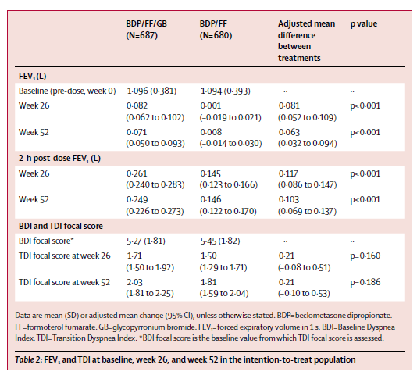
Multiple primary variables

Slide 123
Multiplicity issues in clinical trials
The ICH E9 guideline on biostatistical principles in clinical trials recommends that generally clinical trials have one primary variable.
If, however, a single variable is not sufficient to capture the range of clinically relevant treatment benefits, the use of more than one primary variable may become necessary.
Statistically significance is then needed for all primary variables. Therefore, no formal adjustment is necessary.
Two or more primary variables ranked according to clinical relevance. No formal adjustment is necessary. However, no confirmatory claims can be based on variables that have a lower rank (hierarchical testing).

Slide 124
Multiplicity issues in clinical trials
Composite variables: usually this variable is primary. All components should be analysed separetely. Treatment should beneficially affect all components. However, if claims are based on subgroups of components, this needs to be pre-specified. Composite variables are typically in the context of survival analysis.
Multiple analyses may be performed on the same variable but with varying subsets of patient data. From these sets of subjects one (usually the full set, exception when testing for equivalence) is selected for the primary analysis. No adjustment, supporting analyses.

Slide 125
Multiplicity issues in clinical trials
It is essential to consider the extent to which the analyses were planned prior to the availability of data…This is particularly important in the case of any subgroup analyses, because if such analyses are not preplanned they will ordinarily not provide an adequate basis for definitive conclusions.
Reliable conclusions from subgroup analyses generally require pre-specification and appropriate statistical analysis strategies. Usually subgroup analyses have only a supportive or exploratory role after the primary objective has been accomplished.

Slide 126
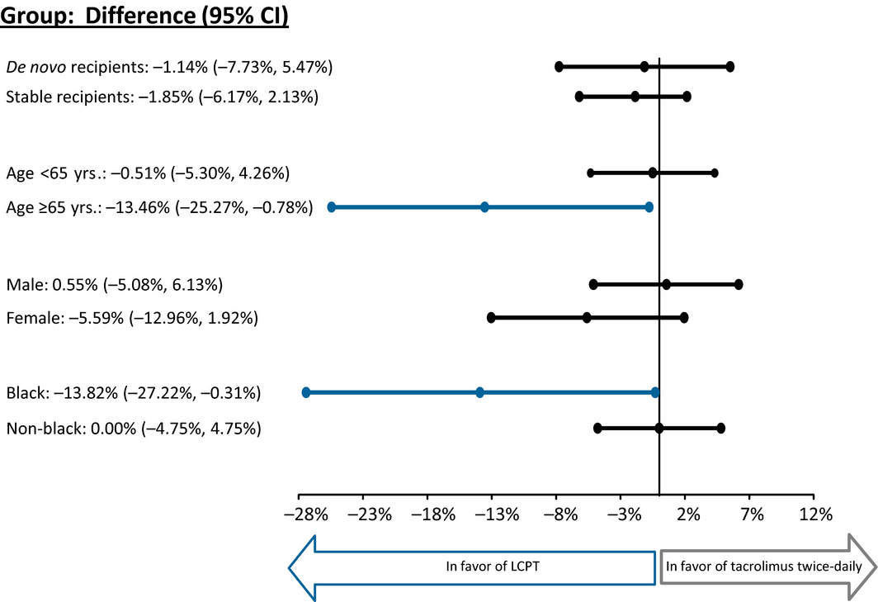
A pooled subgroup-analysis

