Slide 1
Doktorats-Studium Medizinische Wissenschaft (Dr. scient. med.)
Statistics, Beyond the Basics

Slide 2

Statistics, beyond the basics
ao. Univ.-Prof. Mag. Dr. Hanno Ulmer
Department of Medical Statistics, Informatics and Health Economics, Innsbruck Medical University

Slide 3
Design and analysis
Study planning
Resarch question, hypotheses, primary efficacy variable
Study design (interventional/observational, randomization, blinding, etc. )
Sample size estimation
Data management, etc.
Statistical analysis
Descriptive statistics
Univariable statistical testing
Parameter estimation with confidence intervals
Multivariable statistical testing using regression analyses

Slide 4
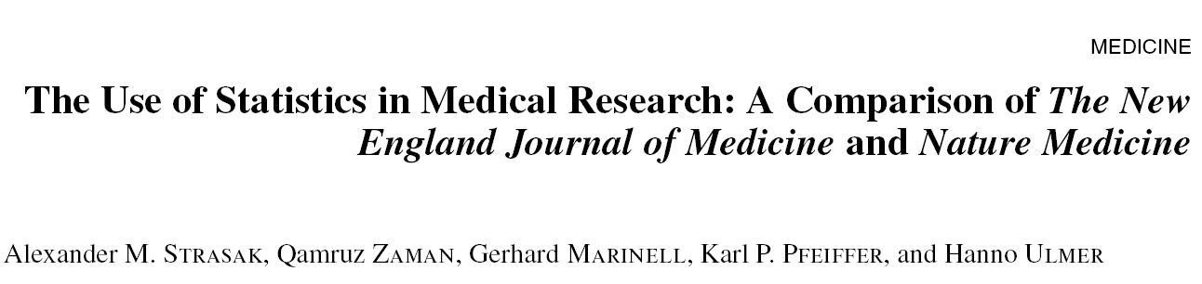
Use of statistics in top journals

Slide 5
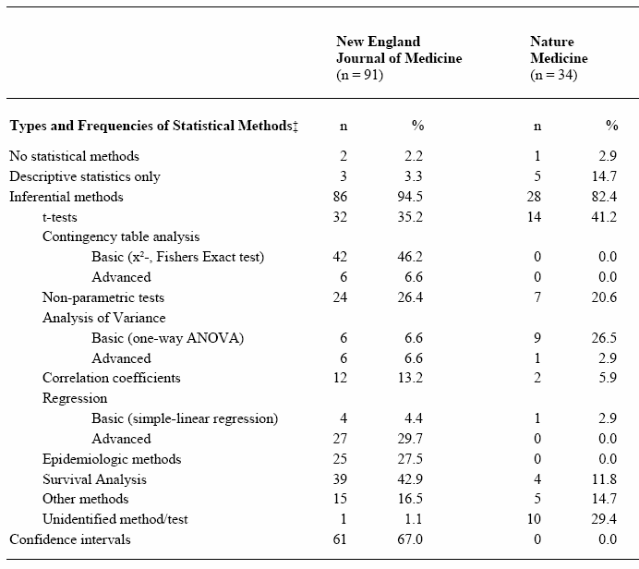
Statistical methods
Kategorien nach
Emerson/Colditz 1985

Slide 6

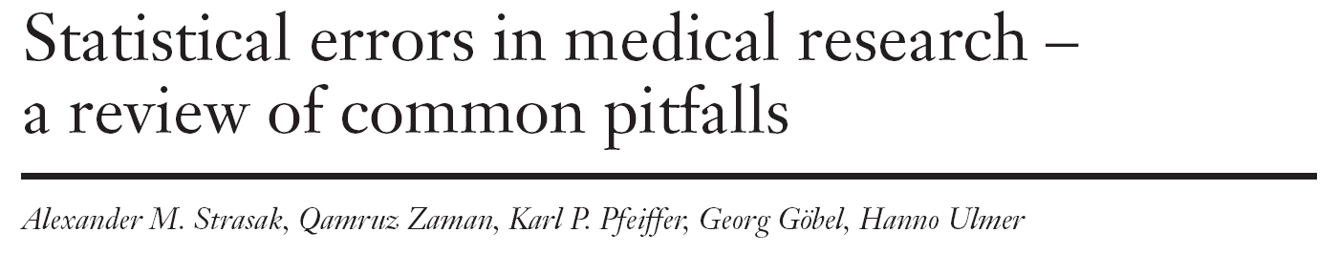
Statistical errors in medical research

Slide 7
Appendix (SMW-Artikel)

Slide 8
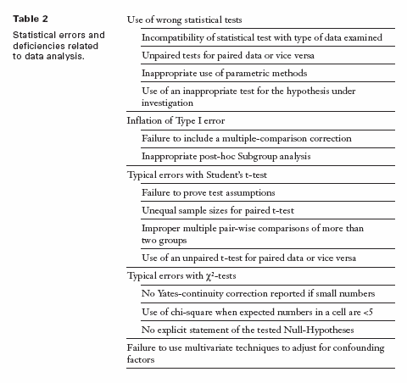

Slide 11
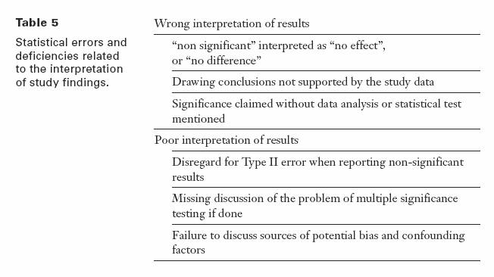

Slide 12







Literature
Medical statistics
Statistical software
Medical informatics
Documentation
Clinical research
Public Health
Epidemiological research
Evidence Based Medicine

Slide 14
Internet, software
British Medical Journal: Statistics at Square One
A Series on Evaluation of Scientific Publications, Deutsches Ärzteblatt
Further Statistics in Dentistry, British Dental Journal
Online calculators: e.g. Graphpad Quickcalcs
R, Stata, SPSS, SAS, Statistica, GraphPad, MedCalc, JASP
nQuery Advisor, East, PASS, StudySize
RevMan5, Cochrane Collaboration

Slide 15
Statistical Analysis:
Basic concepts and
Descriptive Statistics
Dr. Hanno Ulmer
hanno.ulmer@i-med.ac.at
Innsbruck, October 2011
Department of Medical Statistics, Informatics and Health Economics, Innsbruck Medical University

Slide 16
Basic statistical terms
Observation unit
  Subjects, patients, customers...,objects
Random variable, characteristic
  Gender, health status, weight, blood group
    Why "random variable"?
      Because the expression is not exactly predictable with a random selection. The result depends on chance.
Characteristic values
  Blood group: A, B, AB, 0
  Statement yes/no
  Weight in kg

Slide 17
Types of variables, scaling
Categorical
  Many expressions at last
    e.g. gender, blood group, school grades
  Counts result
Continuous
  All values of an interval possible
    e.g. weight, height, temperature, number of leukocytes
  Result of measurements (metric)
Qualitative scales (nominal, ordinal)
Quantitative scales (metric)

Slide 18
Descriptive statistics
Qualitative characteristics |  | Quantitative characteristics normally distributed | randomly distributed
n,% |  | Arithmetic mean | Median
 |  | Standard deviation | Percentile
Pie chart, bar chart |  | Histogram | Boxplot
Examples:
Gender, response to therapy, etc. |  | Blood pressure | CRP, GGT Severity

Slide 19
Frequency
Absolute frequency
  Number of observations with a given characteristic X: n(X)
    From a sample of size N
Relative frequency
  Proportion of X: h(X)=n(X)/N
    In percent
Cumulative frequency
  Only with at least ordinal data
    Sum frequency
      Sum of relative frequencies of all characteristics X

Slide 20
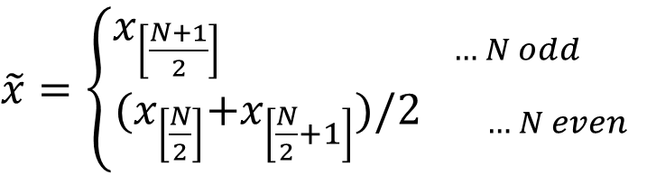
Arithmetic mean and median
Arithmetic mean:
  Given: N observations (random variable)
    x₁ ,x₂ ,...,x_{N}
Median:
  x_{[w]} ...x with rank w
$\tilde{x}=$ $\left\{\begin{aligned}x_{\left[\frac{N+1}{2}\right] … N odd } \\ {{(x}_{\left[\frac{N}{2}\right]}+x_{\left[\frac{N}{2}+1\right]})/2}_{ … N even} \end{aligned}\right.$

Slide 21
Median, mode, quartiles, extreme values
Mode (most frequent value of a distribution)
Quantiles: percentage of the data
Quartiles: Q₂₅ , Q₇₅
  25%, 75% - share
Interquartile range: I₅₀ = Q_{75 –} Q ₂₅
Span: Maximum - Minimum
Percentiles: Q₁ , Q₅ , Q₁₀ , ...Q₃₃ , ..., Q₉₅ , Q₉₉
      Are often used as standard values

Slide 22
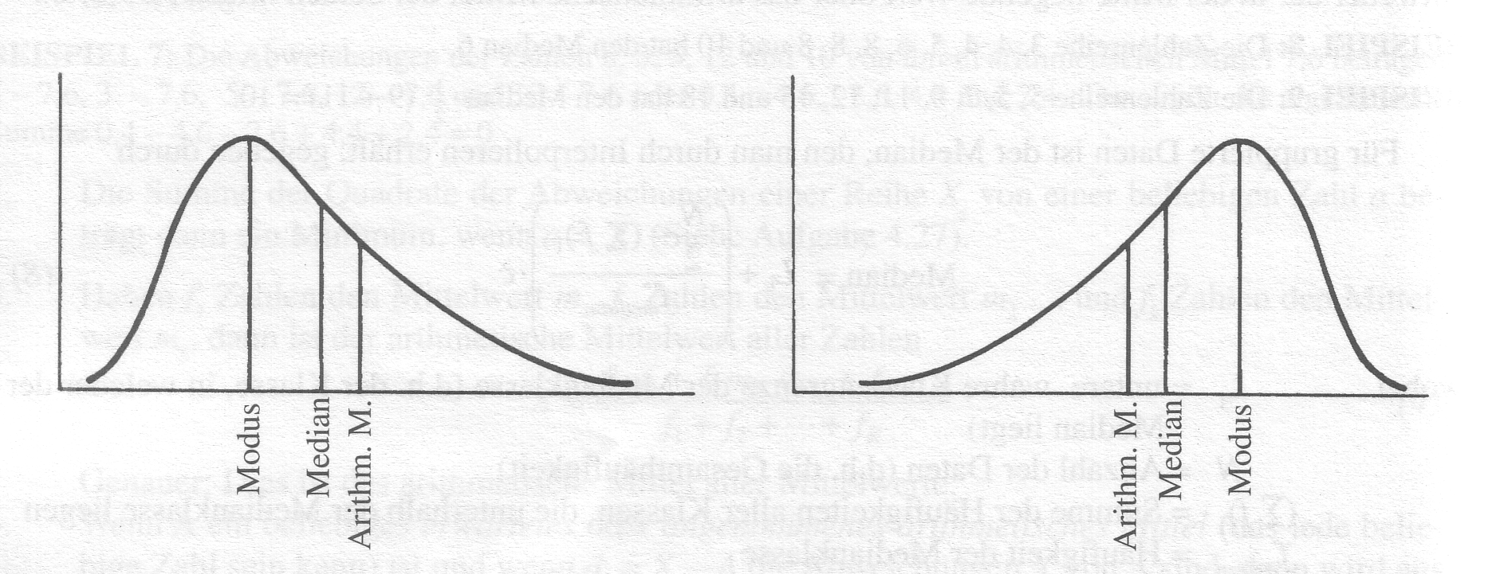
Relationship between arithmetic mean, median and mode
Symmetrical
Mean = Median = Modal value
f(-x) = f(+x)
Skewness=0
Bell-shaped

Slide 23

Measures of variation
Variance:
Standard deviation: $s= \sqrt{s^{2}}$
Coefficient of variation:
    Ratio of dispersion to mean value

Slide 24
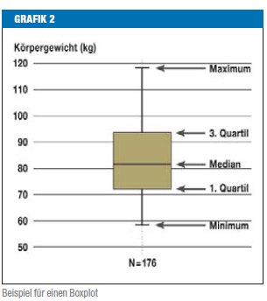
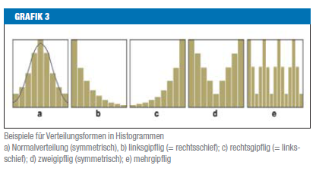
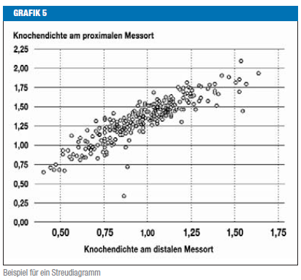
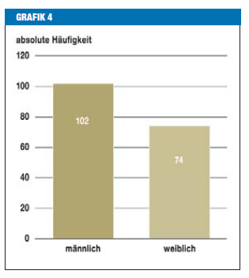
Statistical graphics

Slide 25
Histogram
X...continuous variable
Subdivision into classes of equal length and determination of the frequency per class
Classes open at the edges

Slide 26
Comparing two groups
Boxplots for therapy A and B
50% Interquartile range
Median

Slide 27
Statistical measures exercise
Please calculate:
  Mean value
  Median
  Variance
  Standard deviation
  Range
  Interquartile range
  and the coefficient of variation
  Create histograms and boxplots for:

Slide 28
Statistical measures exercise
Scores from 20 students
  6,3,7,5,6,4,4,6,7,3,5,9,6,4,2,7,5,5,8,6
Number of employees in 20 pharmacies
  2,3,3,3,4,4,4,4,5,5,5,5,5,5,6,6,6,8,10,15
Sick days of 20 people
  0,0,0,0,0,0,0,0,1,1,1,1,1,2,2,2,3,3,15,76

Slide 29
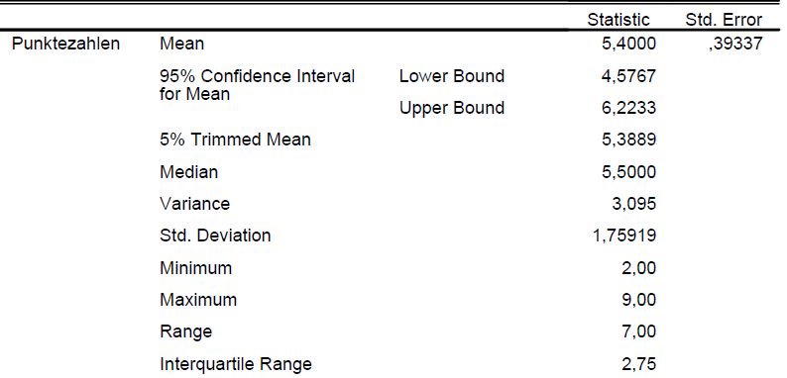
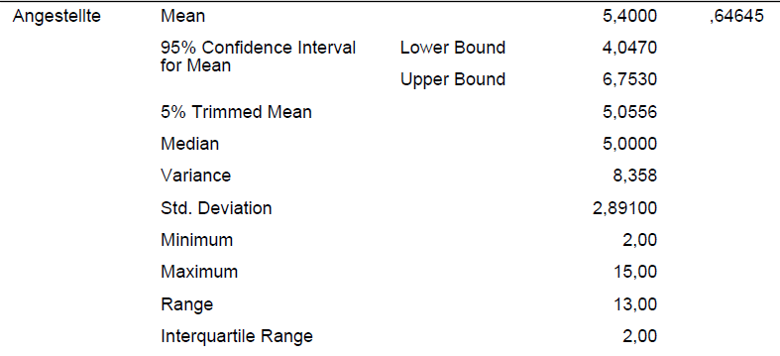
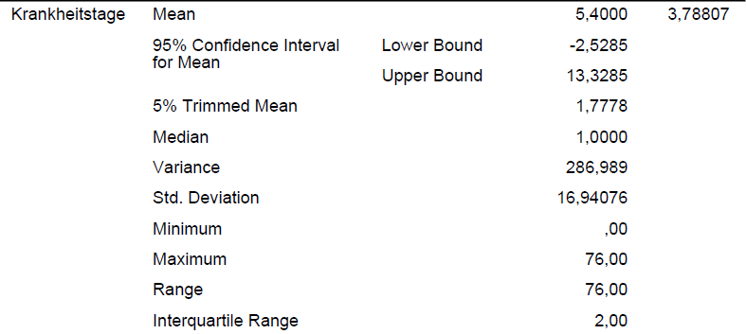
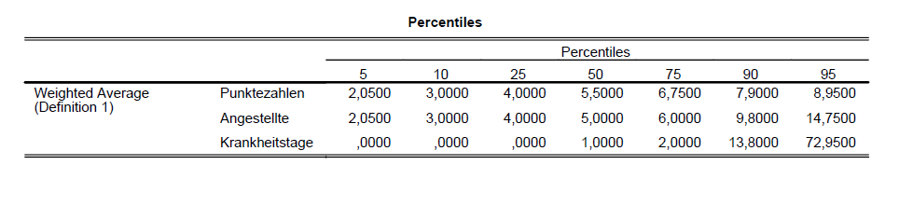

Slide 30
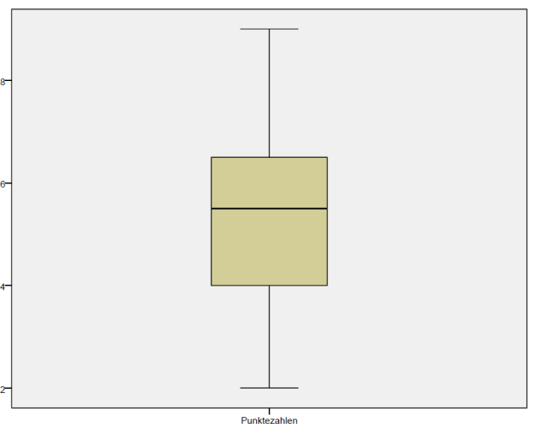
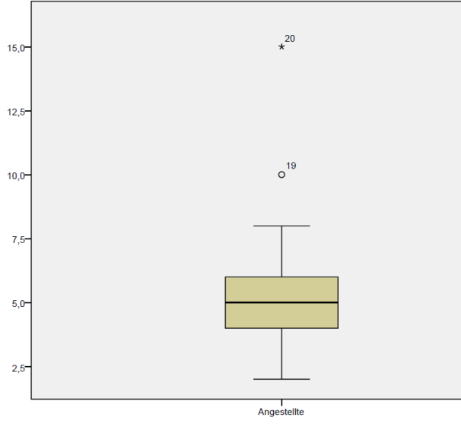
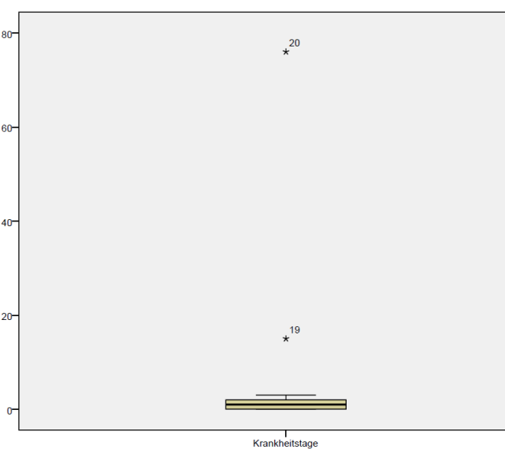
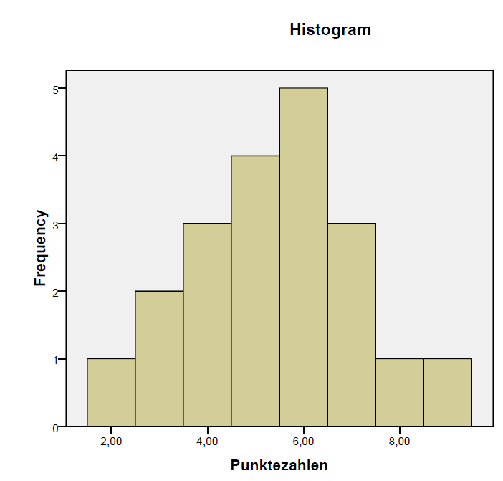
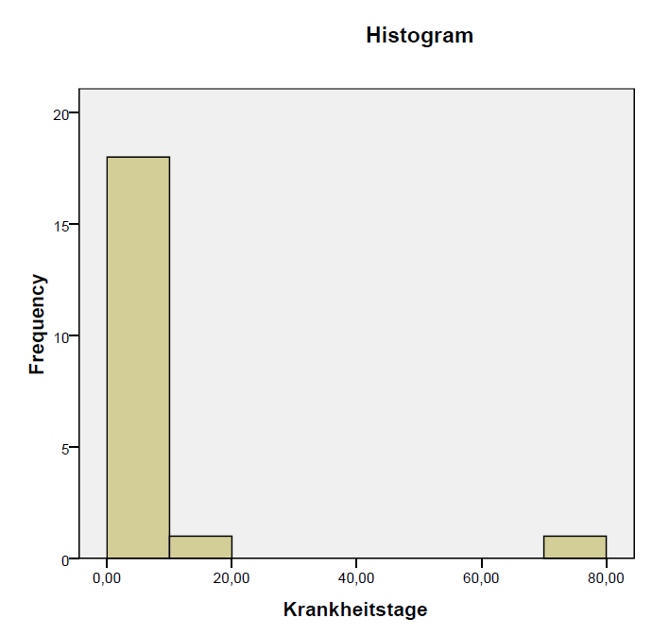
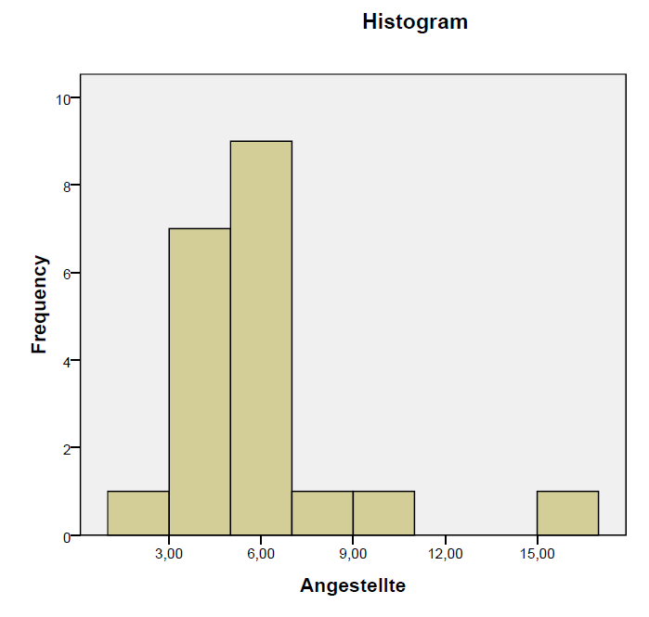
Statistical measures exercise

Slide 31
Gaussian or normal distribution
− < X < +

Slide 32
For all normal distributions:
≈ 68% of all observations lie within one standard deviation around the mean
(between μ - σ and μ + σ )
≈ 95% of all observations lie within two standard deviations (between μ - 2σ and μ + 2σ )
≈ 99% of all observations lie within three standard deviation (between μ - 3σ and μ + 3σ)
The sigma (68-95-99%) rule:

Slide 33
The 2X2 table continued:
Diagnostic study
Dr. Hanno Ulmer
hanno.ulmer@i-med.ac.at
Innsbruck, October 2011
Department of Medical Statistics, Informatics and Health Economics, Innsbruck Medical University

Slide 34
Diagnostic study
 | Gold standard positive | Gold standard negative
New procedure positive | a | b | Pos. pred. W.
New process negative | c | d | Neg. pred. W.
 | Sensitivity | Specificity

Slide 35
Diagnostic study
 | Gold standard positive | Gold standard negative
New test positive | 22 | 418 | PPV = 5%
New test negative | 10 | 7043 | NPV = 99.9
 | Sensitivity 68.8% | Specificity 94.4%

Slide 36
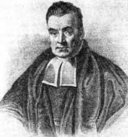
Bayes formula
Positive Predictive Value (PPV)
Thomas Bayes ~1702 - 1761
PPV = (sensitivity x prevalence) /
(sensitivity x prevalence +(1- specificity) x (1- prevalence))
Example mammography:
Prevalence: 1%, Sensitivity: 90%, Specificity: 98%.
0.90 - 0.01
ppV =
= 0.31
0.90 - 0.01 + 0.02 - 0.99

Slide 37
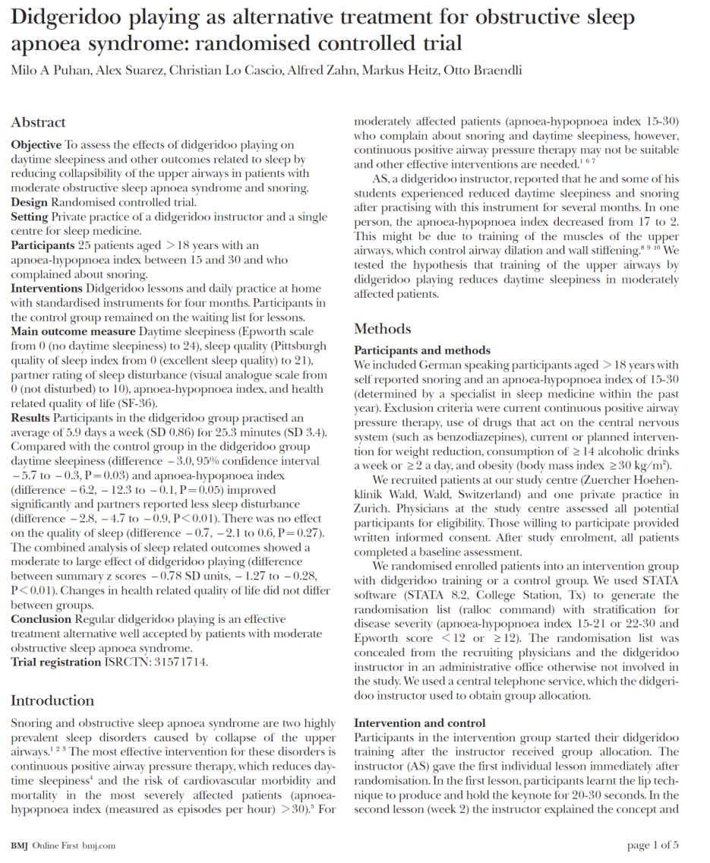
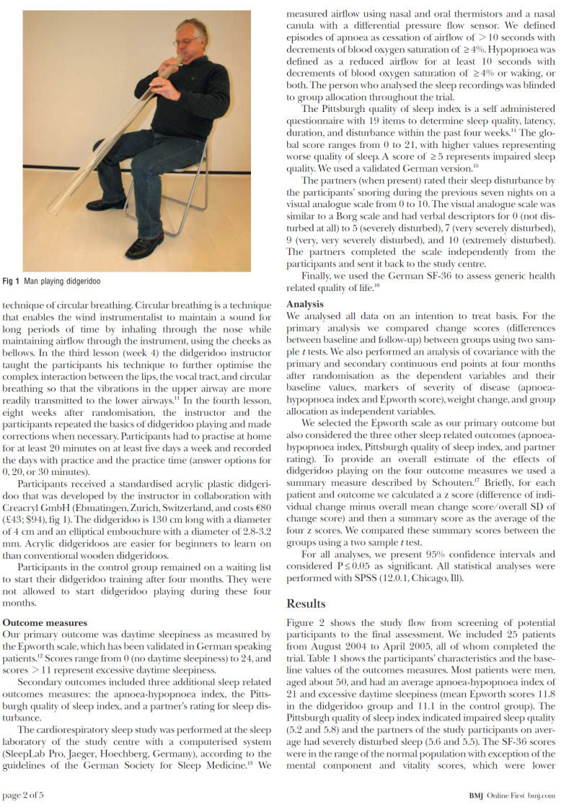
Case study: clinical trial

Slide 38
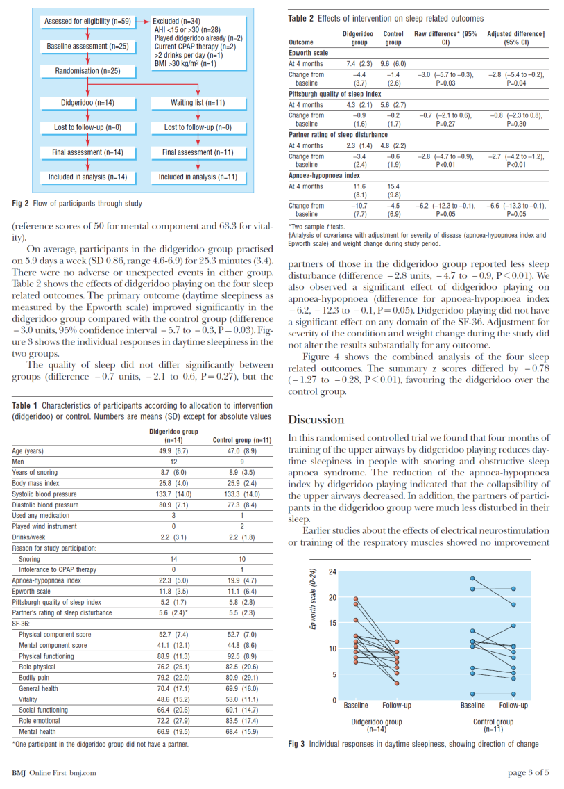
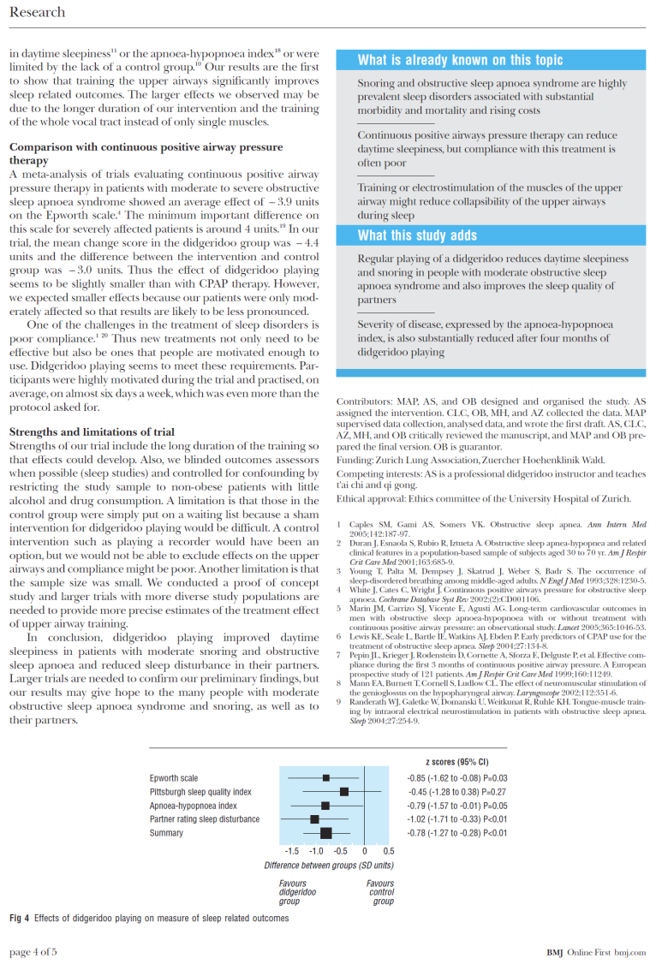
Case study: clinical trial

Slide 39
„How to read a study in 10 minutes“
Structure of a study report:
IMRaD scheme
Guidelines for writing a study report
CONSORT statement for interventional studies (RCTs)
STROBE statement for observational studies
(epidemiologic study designs: cohort study, case-control study, cross-sectional study)
STARD statement for diagnostic studyies
PRISMA statement for meta-analyis

Slide 40
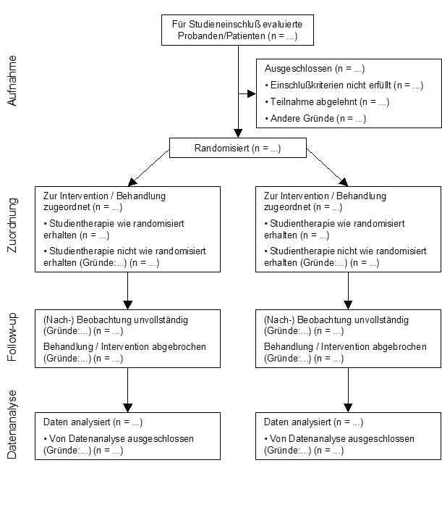
Consort statement, participant flow
Intention-to-treat
versus
Per-protocol

Slide 41
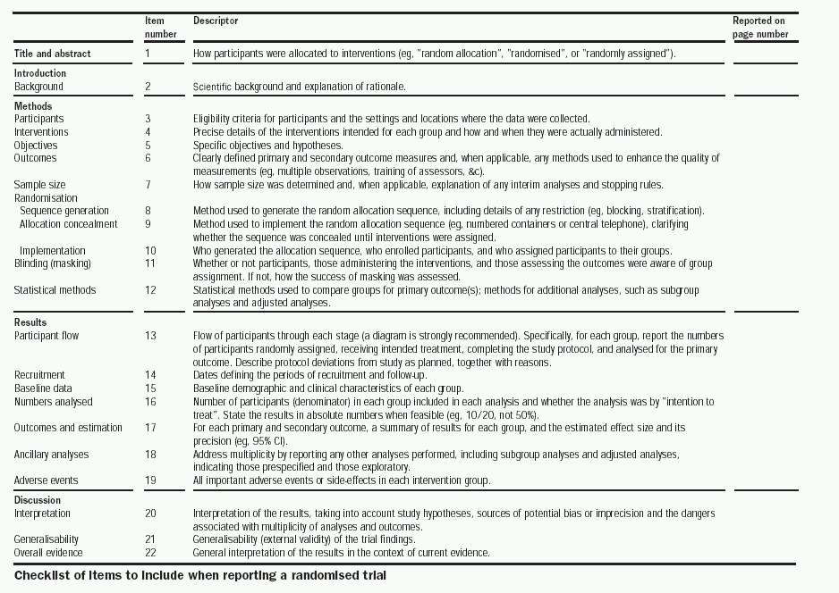

Slide 42
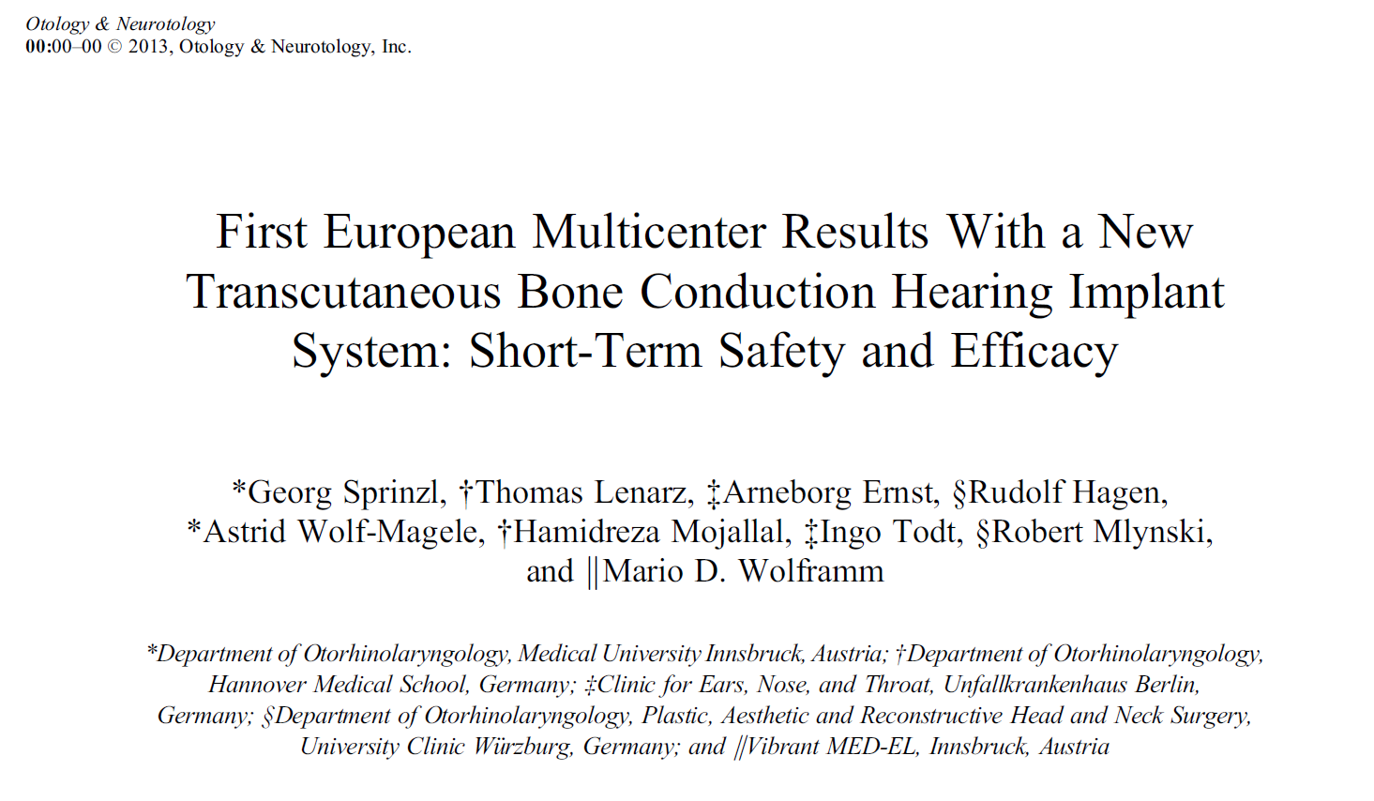
Case study: clinical trial (medical device)

Slide 43
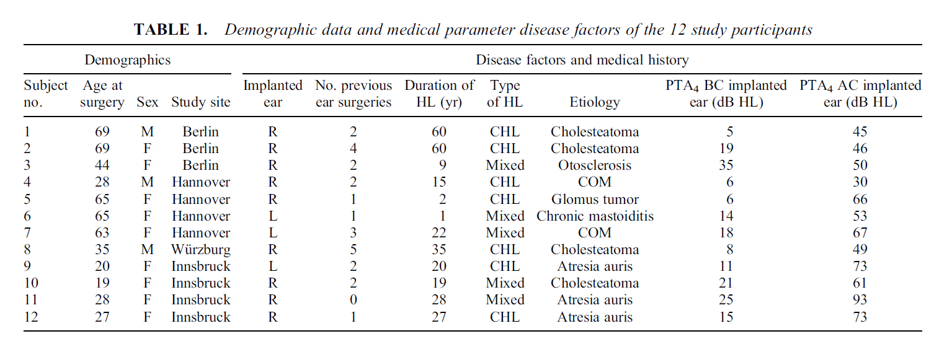
Case study: clinical trial (medical device)

Slide 44
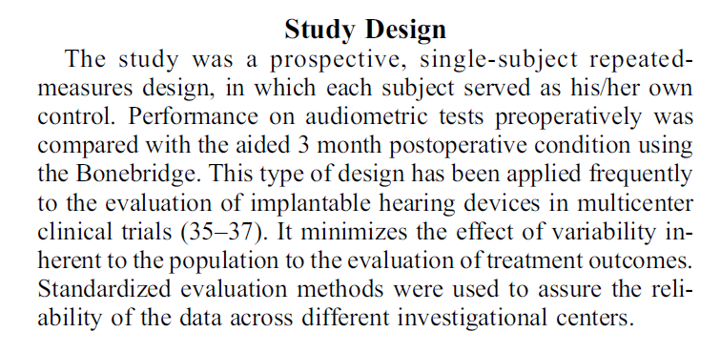
Case study: clinical trial (medical device)

Slide 45
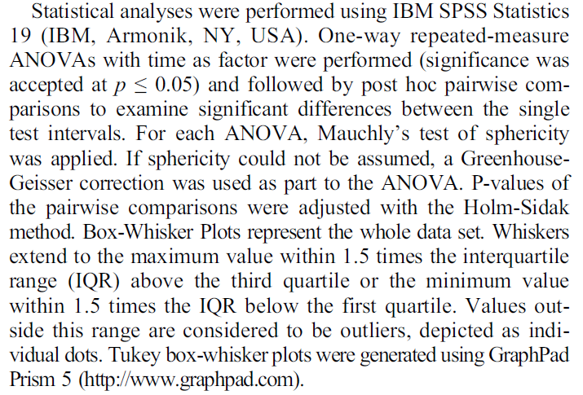
Case study: clinical trial (medical device)

Slide 46
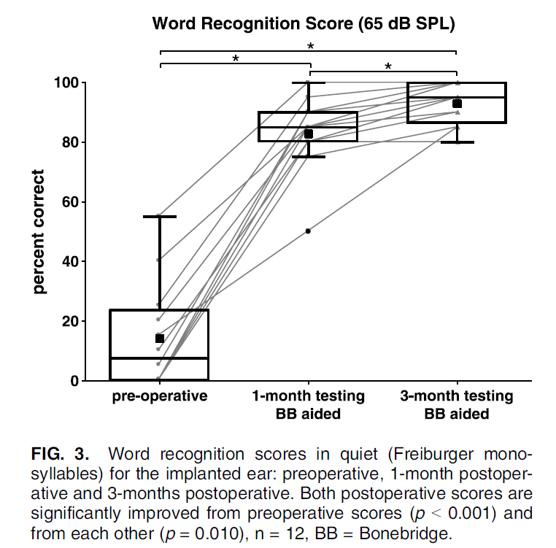
Case study: clinical trial (medical device)

Slide 47
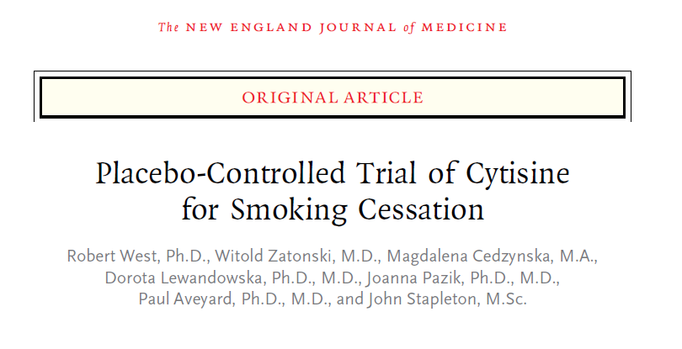
Case study: clinical trial (drug)

Slide 48
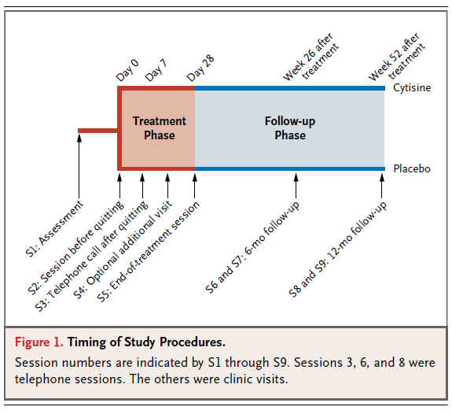
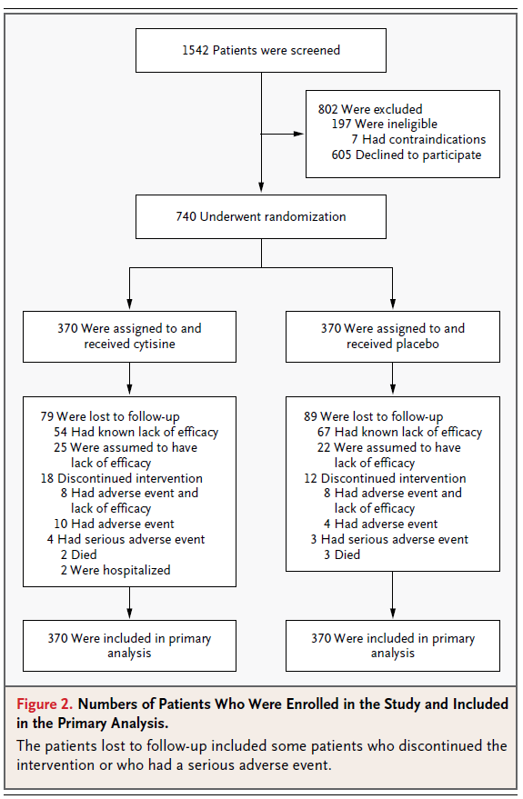
Case study: clinical trial (drug)

Slide 49
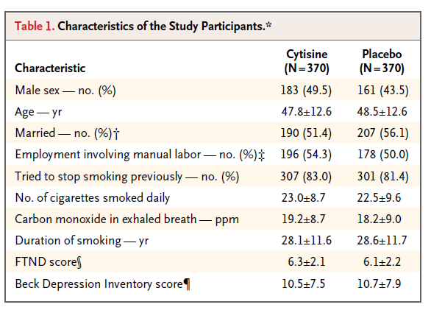
Case study: clinical trial (drug)

Slide 50
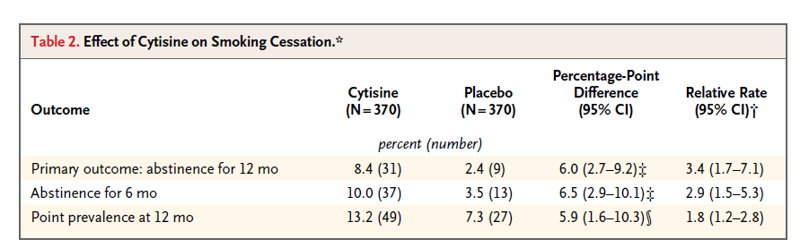
Case study: clinical trial (drug)

Slide 51
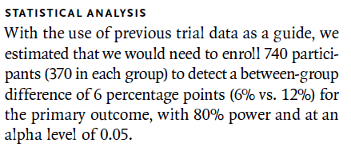
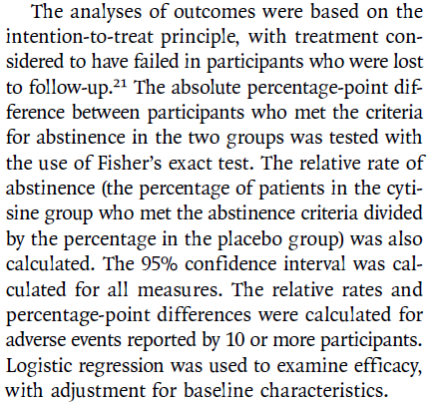
Case study: clinical trial (drug)

Slide 52
Case study: meta-analysis

Slide 53
Case study: meta-analysis

Slide 54
Case study: meta-analysis

Slide 55
Case study: meta-analysis

Slide 56
Case study: meta-analysis

Slide 57
Types of research studies
Dr. Hanno Ulmer
hanno.ulmer@i-med.ac.at
Department of Medical Statistics, Informatics and Health Economics, Innsbruck Medical University

Slide 58
Interventional versus observational
a factor that is to be investigated
(efficacy of a therapy such as a new medication, a risk factor such as smoking, a protective factor such as physical activity)
interventional
observational
clinical trial,
interventional cohort study
cohort study, case-control study, (cross-sectional study)

Slide 59
Longitudinal (incidence) versus cross-sectional (prevalence) studies

Slide 60
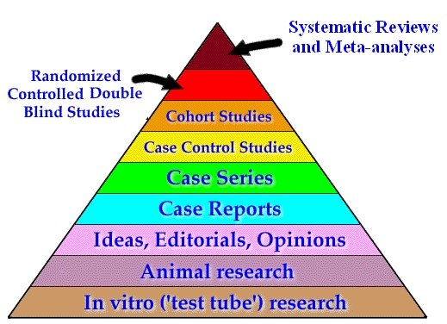
Strength of evidence

Slide 61
Clinical trial

Slide 62

Clinicial Trials.gov
As of 10.2022: 430,108 research studies in all 50 states and 221 countries

Slide 63
Randomized controlled (clinical) trial (RCT)
  Studies for the approval of drugs or products
    Experiment, trial
    Influencing factors are controlled
  Avoidance of bias due to randomization
    Random assignment to a group, avoidance of selection
      e.g.: New therapy - standard therapy (= control group).
  Comparison with at least one second group (control)
  Achieving structural equality
      e.g.: same mean age, same gender distribution, ...

Slide 64
Randomization
Random assignment of a subject to one of the groups of the influencing factor.
  With the help of a random generator
Aim:
  Avoidance of selection bias
    Each subject has the same chance to be randomly assigned to a group
  Structural equality
    Regarding measured characteristics and unmeasured characteristics
    Additional stratification
When randomisation is not appropriate: Pairing
  Twins, Matching
  e.g.: matched case control study

Slide 65
Blinding
Elimination of bias due to prior information
  Selection bias
  Observer Bias
Characteristics of the influencing factor are unknown for the observer
  Double-blind study
    Patient and doctor do not know which form of therapy is used

Slide 66
Validity
Representativeness of the sample
Random selection
  Selection of subjects
  Center selection
    Monocentric / multicentric
    National, international
Inclusion criteria
  Stage of disease, age, ...
Exclusion criteria
  Additional diseases, additional medication, ...
Voluntariness

Slide 67
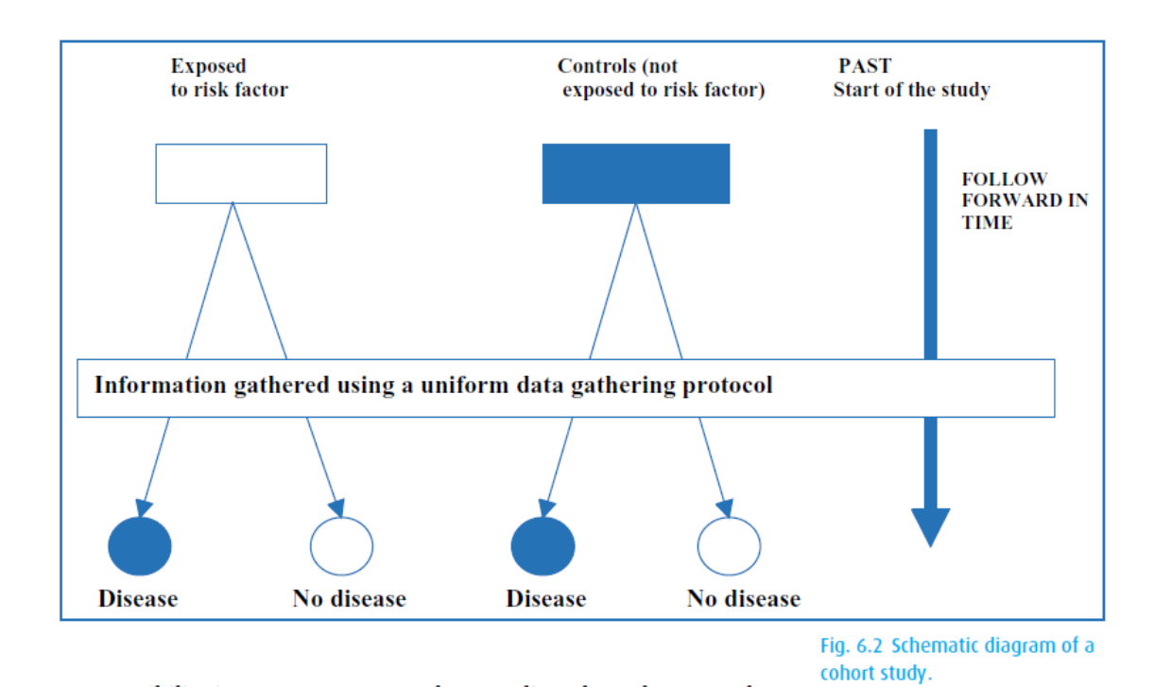
Cohort studies

Slide 68
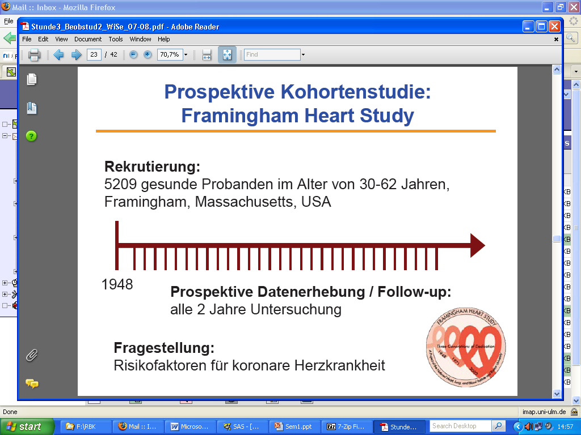
Framingham Heart Study
1948 Recruiting of 5209 healthy individuals (age 30-62 years)
1960
smoking ↑ CHD
1970
hypertension
↑ stroke
1978
Psychosocial
factors ↑ CHD
1961
cholesterol, hypertension ↑ CHD
1988
HDL ↓ CHD
1976
menopause ↑ CHD
1967
physical activity ↓ CHD
obesity ↑ CHD

Slide 69
Case control study

Slide 70
UCP breast cancer case-control study

Slide 71
Cohort Study
Case-Control Study
prospective
retrospective
Risk Factor +
Diseased
Risk Factor +
Cases
(Diseased)
Healthy Study Population
Healthy
Risk Factor -
Diseased
Risk Factor +
Controls
(Healthy)
Risk Factor -
Healthy
Risk Factor -
Diseased
Healthy
Diseased
Healthy
Risk Factor +
A
B
A + B
Risk Factor +
A
B
A + B
Risk Factor -
C
D
C + D
Risk Factor -
C
D
C + D
Relative
Risk
A / A+B
Odds
Ratio
(A / A+B) / (B / A+B)
A x D
=
=
C / C+D
=
(C / C+D) / (D / C+D)
B x C

Slide 72
Risk assessment and 2x2 tables
Dr. Hanno Ulmer
hanno.ulmer@i-med.ac.at
Department of Medical Statistics, Informatics and Health Economics, Medical University Innsbruck

Slide 73
2x2 table

Slide 74
Absolute risk

Slide 75
Relative risk

Slide 76
Odds ratio

Slide 77
Attributable risk = absolute risk reduction

Slide 78
Summary of risk measures
 | Outcome positive | Outcome negative
Exposition positive | a | b | Relative Risk
Exposition negative | c | d | Odds Ratio
 | Abs. Risk Reduct. | Number needed to treat (NNT) = 1/ARR

Slide 79
Practice: Calculate RR, OR, ARR and NNT for primary outcome

Slide 80
Practice: Calculate RR, OR, ARR and NNT for primary outcome
 | abstinence (12 months) | still classified smoking
Cytisine | 31 (8.4%) | 339 | RR = 3.4
Placebo | 9 (2.4%) | 361 | OR = 3.7
 | ARR = 6% | NNT = 16.7 NNT = 1/ARR

Slide 81
Day 3:
Confidence intervals and significance testing
Dr. Hanno Ulmer
hanno.ulmer@i-med.ac.at
Department of Medical Statistics, Informatics and Health Economics, Innsbruck Medical University

Slide 82
Confidence intervals
“A confidence interval is used when estimating an unknown parameter from sample data. The interval gives a range for the parameter – and a confidence level that the range covers the true value.”
Freedman et al. (1991), p. 385.

Slide 83
Example for 95%CI
Rule of three (adverse events in drug testing)
Phase I study:
no adverse events in n=10 patients (study sample)
--> 95%CI (0-30%) (population estimate)
Phase II study:
no adverse events in n=100 patients
--> 95%CI (0-3%)
Phase III study:
no adverse events in n=1000 patients
--> 95%CI (0-0.3%)

Slide 84
Confidence interval relates to significance testing

Slide 85
Significance testing

Slide 86
Significance testing

Slide 87
Significance testing

Slide 88
Formulating hypothesis & statistical tests
Steps in conducting a statistical test:
Quantify the scientific problem from a clinical / biological perspective
Formulate the model assumptions (distribution of the variable of interest)
Formulate the problem as a statistical testing problem:
Nullhypothesis versus alternative hypothesis
Define the „error“ you are willing to tolerate
Calculate the appropriate test statistic
Decide for the null hypothesis or against it
Formulating Hypothesis
&
Test statistics
&
p-values

Slide 89
Principles of statistical testing
Three primary measures of interest:
a point estimate,
a confidence interval, and
a p-value
Different approaches:
Test for superiority,
standard hypothesis testing
Test for non-inferiority
the difference between the new treatment and the standard is less than the smallest clinically meaningful difference, define delta, use confidence intervals
Test for equivalence
To demonstrate the difference between the new treatment and standard treatment has no clinical importance, define delta

Slide 90
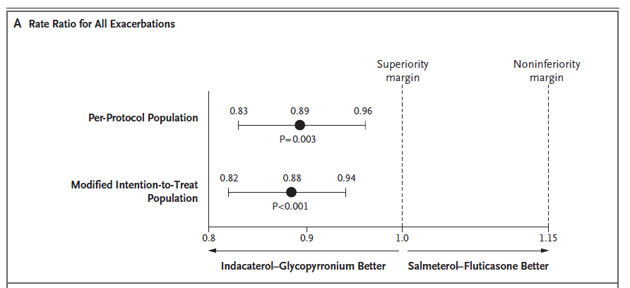
Example

Slide 91
Type I versus Type II Error
 |  | Decide for
 |  | H₀ | H₁
Reality | H₀ | Correct decision | Wrong decision: Type I error (α)
 | H₁ | Wrong decision: Type II error (β) | Correct decision: Power (1-β)

Slide 92
Common statistical tests
 | Quantitative outcome variable |  | Qualitative outcome variable
 | Normal distribution | Any other distribution | Expected frequency in each cell of the crosstable „high“ | Expected frequency in each cell of the crosstable „low“
Compare 2 groups | t-test | Wilcoxon-test / Mann-Whitney U-test | Chi-Square test | Fishers exact test
Compare >2 groups | Analysis of Variance (ANOVA) | Kruskal-Wallis-test | Chi-Square test
Testing measures of location:
Does the mean/median differ between groups
Testing frequencies in a crosstable:
Are the rows and columns independent from each other?

Slide 93
Overview of statistical significance testing

Slide 94
Overview of statistical significance testing

Slide 95
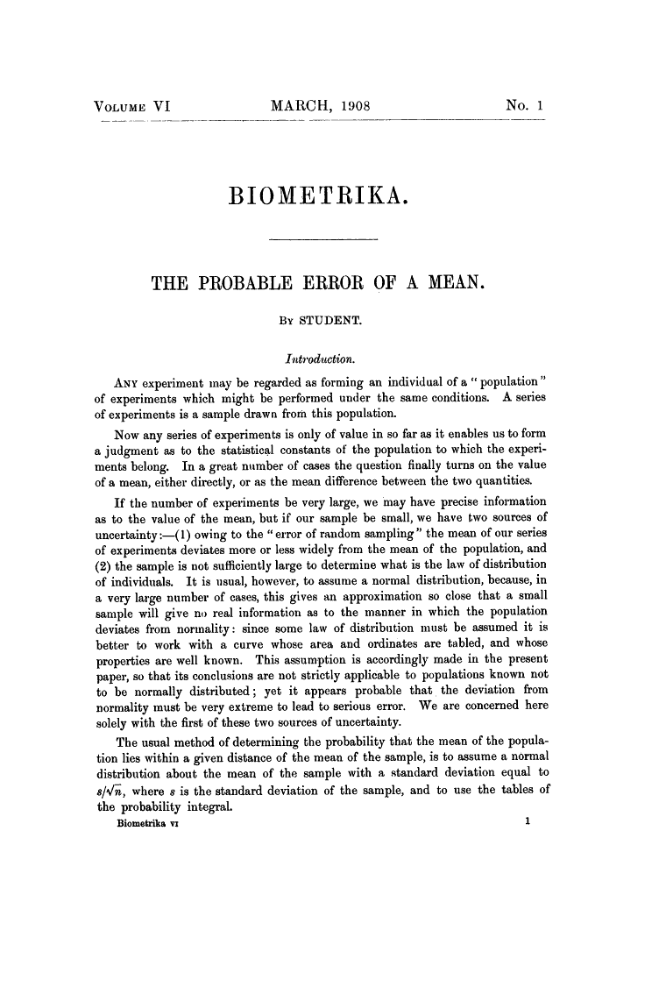
2008: 100 years Student`s t-test:
William Sealy Gosset

Slide 96
T-test
Paired t-test
  Compares two means based on related data.
  E.g., Data from the same people measured at different times.
  Data from ‘matched’ samples.
Independent t-test
  Compares two means based on independent data
  E.g., data from different groups of people
Significance testing
  Testing the significance of Pearson’s correlation coefficient
  Testing the significance of b in regression.

Slide 97

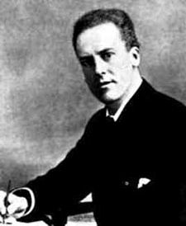

Pearson`s chi-square test 1900
Correlation and regression
Analysis of Variance
Karl Pearson (1857-1936)
Sir Ronald Aylmer Fisher (1890-1962)

Slide 98
Analysis of Variance (ANOVA)
Situation: Compare the means of k samples (k>2)
Assumption: normal distribution of the population, σ = σ₁ = σ₂ =…= σ_{k}
Hypothesis: H₀: μ₁= μ₂ =… = μ_{k} versus H₁: μ_{i} ≠ μ_{j} (i ≠ j): At least two of the means differ
Nowadays, linear mixed effects models are preferred instead of ANOVA
Group 1
Group 2
Group 3
| | | | | | | | |
all observations x_{ij}
Variability
within the group
₁
₂
₃
= means within the groups
Difference /Variability
between the groups
= is the overall mean of the variable

Slide 99
Why Not Use Lots of t-Tests?
If we want to compare several means why don’t we compare pairs of means with t-tests?
  Can’t look at several independent variables.
  Inflates the Type I error rate.
1
1
2
Vs
1
3
Vs
2
3
2
Vs
3

Slide 100
Multiple testing
„The multiple comparison problem involves the repeated testing of a series of hypotheses and the resultant increasing probability of a type I error.” Van Belle (2002), p. 149.
P (type I error)
Bonferroni-correction

Slide 101
Sample size estimation
Question: How many individuals do you have to include in your study to get a reliable result ?
We want to maximize the probability
for rejecting H₀, if H₁ is true
while keeping the Type I error α fixed
What do you have to know
to calculate the sample size
needed?
Power (typically set to 80% or 90%)
Type I error α (typically set to α = 0.05)
The difference you want to find (for t-tests: the mean difference between groups)
standard deviation / measure of variance

Slide 102
Sample size estimation
Example
Hypothesis: H₀: μ_{A}= μ_{B} versus H₁: μ_{A} ≠ μ_{B} → two-sided t-test
You consider a difference of 10 as relevant
From former studies, you know, that the standard deviation is ~ 15 mmHG
So far, you have recruited 20 patients (10 in each treatment arm)
→ What is your power?
http://campus.uni-muenster.de/fileadmin/einrichtung/imib/lehre/skripte/biomathe/bio/fallz.html

Slide 103
The multiple testing problem
The situation:
Consider a dataset with 100 independent parameters, which do not play a role in the etiology of the disease of interest (what you don‘t know, of course)
→ 100 statistical tests are performed with a significance level of α=0.05
→ The tests are constructed in that way, that maximum 5 of 100 tests reject the Nullhypothesis, although it is true (which is the case in this example)
→ You expect 5 tests to be significant just by chance

Slide 104
The multiple testing problem
The probability to get at least one Type I error increases with increasing number of tests.
Family-wise error rate (the error rate for the complete family of tests performed): α*=1-(1-α)^{k}, with α being the comparison-wise error rate
→ The significance level has to be modified for multiple testing situations
The probability
to get one or more
false discoveries
(Type I error)
k | α* (α=0.05)
1 | 0.05
5 | 0.226
10 | 0.401
100 | 0.994

Slide 105
The multiple testing problem
The Bonferroni correction method:
Control the comparison-wise error rate: Reject H₀, if p < α
Control the family-wise error rate (including k tests): Reject H₀, if p < α/k
→ Advantage: simple
Problem: Bonferroni-correction increases the probability of a type II error
→ the power of detecting a true association is reduced → Disadvantage:
too conservative
k | α/k (α=0.05)
1 | 0.05
5 | 0.01
10 | 0.005
100 | 0.0005
0.05/5=0.01

Slide 106
Controlling procedures
Family-wise error rate (FWER) is the probability of making one or more false discoveries, or type I errors when performing multiple hypotheses tests.
Alpha controlling algorithms:
Bonferroni, Bonferroni-Holm, Hochberg, Prospective Alpha Allocation Scheme, Fixed-Sequence Method, Gatekeeping Testing Strategies, Resampling-based multiple testing strategies
ANOVA Post-hoc tests: Bonferroni, LSD, Dunnett, Tukey, Scheffe, etc.

Slide 107
The multiple testing problem
How to report p-values / results of significance tests in papers:
If you are only interested in test decisions (significant or not) to a pre-specified α-level → report only the decision
If you are interested in the „certainty“ of your test decision → report all p-values
(can be interpreted as strength of evidence against the Nullhypothesis)
In the case of multiple testing: report all raw p-values + a reasonable correction
How it should be (1):
Statistical test | P-value
Test 1 | 0.005
Test 2 | 0.02
Test 3 | n.s.
Test 4 | <0.0001
Statistical test | P-value
Test 1 | 0.005*
Test 2 | 0.02
Test 3 | 0.2
Test 4 | 0.00008*
*remained significant with Bonferroni correction for multiple testing

Slide 108
The multiple testing problem
How to report p-values / results of significance tests in papers:
If you are only interested in test decisions (significant or not) to a pre-specified α-level → report only the decision
If you are interested in the „certainty“ of your test decision → report all p-values
(can be interpreted as strength of evidence against the Nullhypothesis)
In the case of multiple testing: report all raw p-values + a reasonable correction
How it should be (1): How it should be (2):
Statistical test | P-value
Test 1 | 0.005*
Test 2 | 0.02
Test 3 | 0.2
Test 4 | 0.00008*
Statistical test | P-value | P-value corrected
Test 1 | 0.005 | 0.02
Test 2 | 0.02 | 0.08
Test 3 | 0.2 | 0.8
Test 4 | 0.00008 | 0.00032
*remained significant with Bonferroni correction for multiple testing

Slide 109
Multiplicity issues in clinical trials
ICH E9, EMA Points to Consider on Multiplicity Issues in Clinical Trials,
FDA Multiple Endpoints in Clinical Trials, Guidance for Industry
Multiplicity may arise from multiple primary variables, multiple comparisons of treatments, repeated evaluations over time and/or interim analyses.
A clinical study that requires no adjustment of the type I error is one that consists of the two treatment groups, that uses a single primary variable, and has a confirmatory statistical strategy that pre-specifies just one single null hypothesis relating to the primary variable and no interim analysis… all other situations require attention to the potential effects of multiplicity.
Controlling type I error family-wise means that the accepted and pre-specified alfa has to be split, and that the various null hypotheses have to be tested at the resulting fraction of alfa. This is usually referred to as adjusting the type I error level.

Slide 110
Simple example for type I error adjusting in interim analyses

Slide 111
Commonly used alpha spending procedures in interim analyses
Pocock (1977) Biometrika 64, 191-199
Divide type 1 error evenly across number of analyses. Good opportunity for early stopping.
O’Brien-Fleming (1979) Biometrics 35, 549-556
Use up very little error at early looks and much more error at later looks.
Fleming-Harrington-O’Brien (1984) Controlled Clinical Trials 5, 348-361
Similar to of above, but less conservative.
Jones & Lewis, “Data and Safety Monitoring” in Biostatistics in Clinical Trials
(ed. Redmond & Colton).

Slide 112
Multiplicity issues in clinical trials
The ICH E9 guideline on biostatistical principles in clinical trials recommends that generally clinical trials have one primary variable.
If, however, a single variable is not sufficient to capture the range of clinically relevant treatment benefits, the use of more than one primary variable may become necessary.
Statistically significance is then needed for all primary variables. Therefore, no formal adjustment is necessary.
Two or more primary variables ranked according to clinical relevance. No formal adjustment is necessary. However, no confirmatory claims can be based on variables that have a lower rank (hierarchical testing).

Slide 113
Multiplicity issues in clinical trials
Composite variables: usually this variable is primary. All components should be analysed separetely. Treatment should beneficially affect all components. However, if claims are based on subgroups of components, this needs to be pre-specified. Composite variables are typically in the context of survival analysis.
Multiple analyses may be performed on the same variable but with varying subsets of patient data. From these sets of subjects one (usually the full set, exception when testing for equivalence) is selected for the primary analysis. No adjustment, supporting analyses.

Slide 114
Multiplicity issues in clinical trials
It is essential to consider the extent to which the analyses were planned prior to the availability of data…This is particularly important in the case of any subgroup analyses, because if such analyses are not preplanned they will ordinarily not provide an adequate basis for definitive conclusions.
Problems with subgroup analyses include increased probability of type I error when H0 true, decreased power (increased type II error) in individual subgroups when H1 true.
A treatment-covariate interaction exists when the treatment effect is not the same for all values of a covariate (e.g., gender, age, etc.)
Quantitative interactions: Treatment effects in the same direction, but of different magnitude in some subgroups (common and even expected)
Qualitative interactions: Treatment effects in opposite direction (rare)

Slide 115
Multiplicity issues in clinical trials
Reliable conclusions from subgroup analyses generally require pre-specification and appropriate statistical analysis strategies. Usually subgroup analyses have only a supportive or exploratory role after the primary objective has been accomplished.
A specific claim of beneficial effects in a subgroup requires pre-specification of the corresponding null hypothesis and an appropriate confirmatory analysis strategy. Considerations of power would be expected in the protocol, and randomisation would generally be stratified.
Enrichment strategies: the prospective use of any patient characteristics to select a study population in which detection of a drug effect is more likely.

Slide 116
Adjustment and multivariate analysis
Dr. Hanno Ulmer
hanno.ulmer@i-med.ac.at
Department of Medical Statistics, Informatics and Health Economics, Innsbruck Medical University

Slide 117
Adjusting for a single variable in multivariate analysis

Slide 118
Adjusting for two variables in multivariate analysis

Slide 119
Medical Statistics, Informatics, and Health Economics
INNSBRUCK MEDICAL UNIVERSITY
Multivariable analysis - regression
Basic idea concerning the outcome:
Dichotomous outcome: yes / no event (fixed observation period)
event = death, disease occurrence, accident
Survival analysis: time to event data (variable observation period)
event = onset of a certain tumour ≈ diagnosis
X
Y

Slide 120
Adjusting for >2 variables: regression analyses
Multiple linear regression (when the outcome variable is continuous)
Multiple logistic regression (when the outcome variable is binary event)
Cox proportional hazards regression analysis (when the outcome variable is time-to-event)

Slide 121
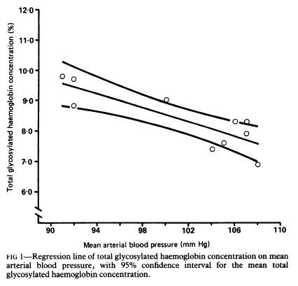
Medical Statistics, Informatics, and Health Economics
INNSBRUCK MEDICAL UNIVERSITY
Regression, introduction
n=10
Br Med J 1988;296:1238-1242

Slide 122
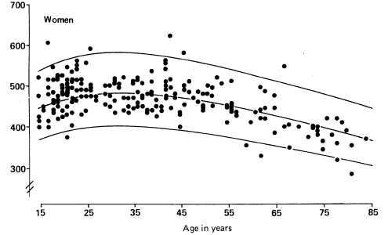
Medical Statistics, Informatics, and Health Economics
INNSBRUCK MEDICAL UNIVERSITY
Regression, introduction
Observed values of peak expiratory flow (PEF) in 228 women who had never smoked and who fulfilled other strict criteria of normality (regression curve and 90% confidence intervals)
Br Med J 1989;298:1068-1070

Slide 123
Regression analyses
Regression analysis is a statistical method to assess associations and relationships between independent and dependent variables
Predictor (risk factor, therapy) -- > Outcome (disease)
Multivariable analysis:
k independent variables (predictors) -- > 1 dependent variables (outcome)

Slide 124
Confounding,
Moderation, Mediation
With regression analyses (models) it is possible to assess the effect of a predictor variables on an outcome and to adjust this effect for a third variables.
The third variable can act as a confounder, moderator or mediator.
A causal graph (DAG – directed acylic graph) allows to visualize the relationships

Slide 125
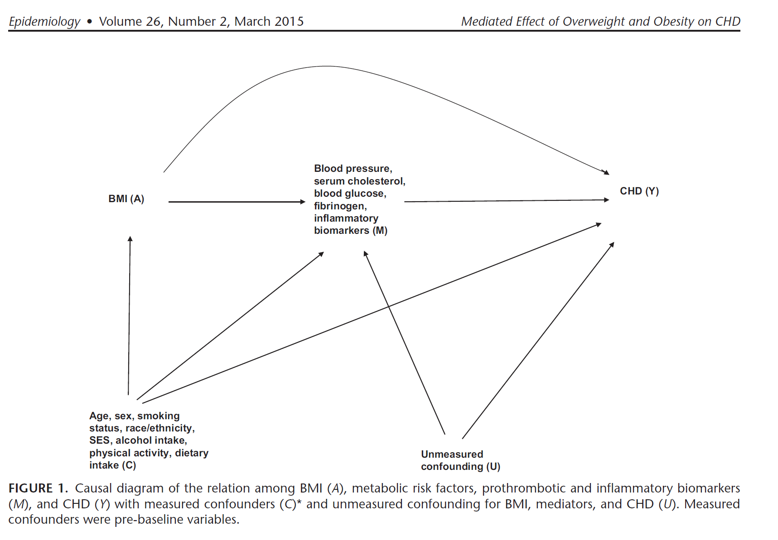

Confounding, Moderation, Mediation

Slide 126
Example
Continuous outcome: linear regression
Sex, age, BMI -> systolic blood pressure
Estimating beta coefficient (slopes)
Binary outcome: logistic regression
Sex, age, BMI -> CHD within 10 years
Estimating odds ratio
Time-to-event outcome: Cox proportional hazards regression
Sex, age, BMI -> time to CHD (survival analysis)
Estimating hazard ratio

Slide 127
Example data
Vorarlberg Health Examinations (VHM&PP)
Sex (male, female) categorical
Age in years continuous
Year of examination continuous
Body mass index in kg/m2 continuous
Systolic blood pressure in mmHG continuous
Total cholesterol in mg/dl continuous
Fasting glucose in mg/dl continuous
Smoking (current or past, never) categorical
Coronary heart disease mortality time to event
(ICD-10: I20-I25) continuous and categorical

Slide 128
Confounding
Confounding:
A “mixing of the effect” of the exposure-disease relationship with a third (or more) factors
BMI ----------------------------------------- > CHD
< ------ sex, age, smoking ----- >

Slide 129
Example
Relationship between BMI and CHD incidence:
Crude Hazard Ratio
Obesity (30+ kg/m2) versus normal weight (20-25 kg/m2)
HR = 2.54 95%CI (2.32-2.78)
Sex, age and smoking adjusting hazard ratio:
HR = 1.60 95%CI (1.46-1.75)
Adjusted = controlled for confounding
Calculated with Cox proportional hazards regression analysis

Slide 130
Confounding
Three essential characteristics:
The confounder is associated with the exposure of interest (BMI)
The confounder is associated with the disease (CHD)
The confounder is not in the causal pathway leading from the exposure of interest (BMI) to the disease of interest (CHD)

Slide 131
Methods for Preventing Confounding in Study Designs
1. Stringent inclusion criteria to narrow the variability between study participants
2. Randomization (intervention/RCT only)
In an optimal RCT, study groups only differ regarding the intervention
3. Matching (observational studies):
Simple Matching e.g. for age and sex in case-controls studies
versus
Propensity Score Matching (involves logistic regression analysis)
Very popular in clinical research:
Blackstone EH. Comparing apples and oranges. J Thoracic and Cardiovascular Surgery 2002; 1: 8-15.
An example:
Ruttmann E et al. Second internal thoracic artery versus radial artery in coronary artery bypass grafting: a long-term, propensity score-matched follow-up study. Circulation. 2011 20;124(12):1321-9.

Slide 132
Effect Modification/Moderation
Effect modification occurs when the association between the exposure (BMI) and the disease (CHD) varies by levels of a third factor.
How to assess: include interaction terms into the regression model
Interaction age*obesity p<0.001
Young: BMI ----------------------------------------- > CHD
Old: BMI ----------------------------------------- > CHD

Slide 133
Example
Relationship between BMI and CHD incidence moderated by age:
Interaction age*obesity p<0.001
Obesity (30+ kg/m2) versus normal weight (20-25 kg/m2)
Sex, age and smoking adjusting hazard ratio:
<50 years of age:
HR = 3.13 95%CI (2.27-4.31)
50+ years of age:
HR = 1.51 95%CI (1.37- 1.66)

Slide 134
Mediation
Mediation occurs if factors, like confounders, are associated with the exposure of interest (BMI) and the disease (CHD), but are in the causal pathway leading from the exposure to the disease.
These factors are called mediators:
BMI ---- > blood Pressure, cholesterol, diabetes ---- > CHD

Slide 135
Example
Mediators in the relationship between BMI and CHD incidence:
Sex, age and smoking adjusting hazard ratio:
Total effect of BMI (obesity versus normal weight) on CHD:
HR = 1.70 95%CI (1.57-1.85)
Direct effect of BMI on CHD
HR = 1.30 95%CI (1.15–1.47)
Indirect effect mediated by blood pressure, cholesterol and glucose
HR = 1.31 95%CI ( 1.16-1.48) (95%CIs estimated by Bootstrap)
HRs … multiplicative, do not add

Slide 136
Example
Mediators in the relationship between BMI and CHD incidence:
Effect of BMI on CHD mediated by blood pressure, cholesterol and glucose
PERM (Percentage of excess risk mediated) =
(1.70-1.30)/(1.70-1)*100
= 57% (approximative formula)
Global Burden of Metabolic Risk Factors for Chronic Diseases Collaboration. Metabolic mediators of the effects of body-mass index, overweight, and obesity on coronary heart disease and stroke: a pooled analysis of 97 prospective cohorts with 1·8 million participants. Lancet. 2014 Mar 15;383(9921):970-83

Slide 137
Mediation Techniques
Traditional approach:
Baron RM, Kenny DA. The moderator-mediator variable distinction in social
psychological research: conceptual, strategic, and statistical considerations. J
Pers Soc Psychol. 1986 Dec;51(6):1173-82
New approaches:
Lange T, Rasmussen M, Thygesen LC. Assessing natural direct and indirect effects through multiple pathways. Am J Epidemiol. 2014 Feb 15;179(4):513-8.
VanderWeele T. Explanation in Causal Inference: Methods for Mediation and Interaction. Oxford University Press 2015.
New approaches applied on BMI --- > CHD problem:
Lu Y, Hajifathalian K, Rimm EB, Ezzati M, Danaei G. Mediators of the effect of body mass index on coronary heart disease: decomposing direct and indirect effects. Epidemiology. 2015 Mar;26(2):153-62.

Slide 138
Survival analysis (time-to-event data)
Kaplan-Meier curves
KAPLAN, E. L. and MEIER, P. (1958). Nonparametric estimation from incomplete observations. J. Amer. Statist. Assoc. 53 457-481.
Log-rank test
Cox Proportional Hazards Model
Cox, D. R. (1972). Regression Models and Life Tables (with discussion). J. R. Statistic. Soc. 34: 187-220.

Slide 139

Example

Slide 140
Analysis of count data
Poisson regression
is a generalized linear model form of regression analysis used to model count data and contingency tables
Negative bionomial regression
is a popular generalization of Poisson regression because it loosens the highly restrictive assumption that the variance is equal to the mean made by the Poisson model.
Zero-inflated regression model
attempt to account for excess zeros

Slide 141
Medical Statistics, Informatics, and Health Economics
INNSBRUCK MEDICAL UNIVERSITY
Multivariable analysis, introduction
Mediation
X
(0 / 1)
Y
smoking
lung cancer
M
tar deposit
(where: 0 = not exposed; 1 = exposed)

Slide 142

Medical Statistics, Informatics, and Health Economics
INNSBRUCK MEDICAL UNIVERSITY
Logistic regression, basics
"... In many studies the outcome variable of interest is the
presence or absence of some condition, such as responding to
treatment or having a myocardial infarction ...."
Logistic function:
𝑥 independent variable
𝑦 dependent variable
Altman 1995
wikipedia

Slide 143

Medical Statistics, Informatics, and Health Economics
INNSBRUCK MEDICAL UNIVERSITY
Logistic regression, basics
Dot plot
select if (DM2 AND female)
n=143
OR = 1.042 (95% CI 1.005 to 1.080)

Slide 144
Medical Statistics, Informatics, and Health Economics
INNSBRUCK MEDICAL UNIVERSITY
Logistic regression, example
Introduction / research question
"The aim of this study was to identify a minimal set of relevant
patient-, disease-, and surgery-related variables to predict both
serious and minor complications in surgical patients"
Br J Surg 2002;89:94-102

Slide 145
Medical Statistics, Informatics, and Health Economics
INNSBRUCK MEDICAL UNIVERSITY
Logistic regression, example
Patients and methods
"Patients were followed throughout their hospital stay and for 30
days after discharge. From January 1996 to January 1997, 3075
consecutive patients were admitted or readmitted"
"Univariate and multivariate logistic regression analyses were
applied to evaluate the relationships between baseline
characteristics and the occurrence of complications [...],
comparing the risk of developing a minor or serious complication
with respect to patients with an uneventful course"
Br J Surg 2002;89:94-102

Slide 146
Medical Statistics, Informatics, and Health Economics
INNSBRUCK MEDICAL UNIVERSITY
Logistic regression, example
Patients and methods
Patient-related factors:
age weight loss, ASA physical status, history of pulmonary disease , gender, smoking behaviour, renal failure
Disease-related factors:
diagnosis , urgency of admission
Surgery-related factors:
extent of surgery, performed as a day-care procedure
Br J Surg 2002;89:94-102

Slide 147
Medical Statistics, Informatics, and Health Economics
INNSBRUCK MEDICAL UNIVERSITY
Logistic regression, example
Results
"Of the 3075 included patients, 2381 had an uneventful course, 319
patients developed minor (grade 1-4) and 375 one of more serious
complications (grade 5-7) [...]
Follow-up data are missing in 166 patients"
Br J Surg 2002;89:94-102

Slide 148

Medical Statistics, Informatics, and Health Economics
INNSBRUCK MEDICAL UNIVERSITY
Logistic regression, example
table incomplete !!!
Br J Surg 2002;89:94-102

Slide 149

Medical Statistics, Informatics, and Health Economics
INNSBRUCK MEDICAL UNIVERSITY
Logistic regression, example
table incomplete !!!
Br J Surg 2002;89:94-102

Slide 150
Medical Statistics, Informatics, and Health Economics
INNSBRUCK MEDICAL UNIVERSITY
Logistic regression, example
Prediction
"The risk of the reference patient developing a serious complication
is 2 per cent. The reference patient is a female, younger than 40
years of age, treated with elective, minor non-day-care surgery, for
a diagnosis not involving the central part of the body. She is a
patient without major weight loss, classified as ASA I, who does not
smoke, have pulmonary disease or renal failure"
"An otherwise healthy, non-smoking 82-year-old man with a
ruptured aneurysm of the abdominal aorta has a 58 per cent risk of
a serious complication [...] This risk increases to 84 per cent if he
smokes and has pulmonary and renal disease"
Br J Surg 2002;89:94-102

Slide 151
Medical Statistics, Informatics, and Health Economics
INNSBRUCK MEDICAL UNIVERSITY
Logistic regression, example
Conclusion
"Serious complications in patients admitted to a surgical ward can
be predicted using a model consisting of 11 variables. The risk
score can be used in the decision-making process before surgery"
Br J Surg 2002;89:94-102

Slide 152
Medical Statistics, Informatics, and Health Economics
INNSBRUCK MEDICAL UNIVERSITY
Logistic regression, basics
Variables
Dichotomous:
male / female
≥65 / <65 years of age
hypertension yes / no
Categorical:
ASA grade (physical status)
postal code
Continuous:
age (completed years)
height (cm.)
weight (kg.)
systolic blood pressure (mm.Hg)

Slide 153
Medical Statistics, Informatics, and Health Economics
INNSBRUCK MEDICAL UNIVERSITY
Logistic regression, basics
Model
death (yes/no) =
constant +
β₁ * age (years) +
β₂ * smoking (yes/no) +
β₃ * gender (male/female) +
β₄ * chronic disease (yes/no)
β = ln(OR) ⟹ OR = e^{β}

Slide 154
Survival analysis
Dr. Hanno Ulmer
hanno.ulmer@i-med.ac.at
Department of Medical Statistics, Informatics and Health Economics, Innsbruck Medical University

Slide 155
Survival Analysis
Kaplan-Meier Method
KAPLAN, E. L. and MEIER, P. (1958). Nonparametric estimation from incomplete observations. J. Amer. Statist. Assoc. 53 457-481.
Log-rank test
Cox proportional hazards regression analysis
Cox, D. R. (1972). Regression Models and Life Tables (with discussion). J. R. Statistic. Soc. 34: 187-220.

Slide 156
Survival analysis
Time-to-event analysis
Two outcome variables:
- time (hours, days, months, years)
- event: occurs
does not occur during study (censored)

Slide 157
Survival analysis

Slide 158
Survival analysis

Slide 159
Survival analysis

Slide 160

Medical Statistics, Informatics, and Health Economics
INNSBRUCK MEDICAL UNIVERSITY
Survival analysis
Kaplan-Meier method: descriptive

Slide 161

Medical Statistics, Informatics, and Health Economics
INNSBRUCK MEDICAL UNIVERSITY
Survival analysis
Kaplan-Meier method: descriptive

Slide 162

Medical Statistics, Informatics, and Health Economics
INNSBRUCK MEDICAL UNIVERSITY
Survival analysis
Kaplan-Meier method: descriptive

Slide 163

Medical Statistics, Informatics, and Health Economics
INNSBRUCK MEDICAL UNIVERSITY
Survival analysis
Kaplan-Meier method: descriptive

Slide 164

Medical Statistics, Informatics, and Health Economics
INNSBRUCK MEDICAL UNIVERSITY
Survival analysis
Kaplan-Meier method: descriptive

Slide 165

Medical Statistics, Informatics, and Health Economics
INNSBRUCK MEDICAL UNIVERSITY
Survival analysis
Kaplan-Meier method: descriptive

Slide 166
Medical Statistics, Informatics, and Health Economics
INNSBRUCK MEDICAL UNIVERSITY
Survival analysis
Kaplan-Meier method: descriptive
Each patient contributes information to the calculations for as long as they are known to be event-free
Requirements:
censoring 'non-informative' (independent of possible event)
sufficient follow-up to capture enough events
no unequal follow-up between different groups
survival probabilities remain the same during long study
consistency in study methods in a multicentre study
adequate number of events
Br J Cancer 2003;89:232-238

Slide 167

Medical Statistics, Informatics, and Health Economics
INNSBRUCK MEDICAL UNIVERSITY
Survival analysis
Kaplan-Meier method: descriptive
https://stats.oarc.ucla.edu/sas/seminars/sas-survival/

Slide 168

Medical Statistics, Informatics, and Health Economics
INNSBRUCK MEDICAL UNIVERSITY
Survival analysis
Kaplan-Meier method: descriptive
Lancet 2008;371:1085-1097

Slide 169





Medical Statistics, Informatics, and Health Economics
INNSBRUCK MEDICAL UNIVERSITY
Multivariable survival analysis - regression
Cox proportional hazards regression model
: hazard (probability of event per time unit at time t)
where:
is the (unknown) underlying hazard, i.e. the %-age of subjects
who fail at time t among those who have not failed previously
hazard ratio:
N.B. Survival reflects the cumulative non-occurrence of the event
Grobbee & Hoes 2009
Br J Cancer 2003;89:232-238
Grobbee & Hoes 2009

Slide 170


Medical Statistics, Informatics, and Health Economics
INNSBRUCK MEDICAL UNIVERSITY
Multivariable survival analysis - regression
Cox proportional hazards regression model
not only hazard ratios
Br J Cancer 2003;89:431-436

Slide 171
Medical Statistics, Informatics, and Health Economics
INNSBRUCK MEDICAL UNIVERSITY
Multivariable survival analysis - regression
Cox proportional hazards regression model
Aim of study:
a single factor is under investigation for its association with survival, but several other factors exist (one factor of primary interest and 'nuisance' factors)
a collection of factors of known relevance are under investigation for their ability to predict survival
a collection of factors are under investigation for their potential association with survival, possibly with additional known factors ('exploratory' study)
The aim of a study influences the choice of the covariates
Br J Cancer 2003;89:605-611

Slide 172
Medical Statistics, Informatics, and Health Economics
INNSBRUCK MEDICAL UNIVERSITY
Multivariable survival analysis - regression
Cox proportional hazards regression model
Assumption: covariate effects on the outcome constant over time
Additionally,
proportional hazards (PH) assumption:
visual inspection (Kaplan-Meier graph with parallel curves)
  examination of the curves for assumption violation:
  crossing of curves
  one curve drops, another plateaus
Schoenfeld's residuals: statistical tests and graphical displays
  not in SPSS
Harrell 2001

Slide 173

Medical Statistics, Informatics, and Health Economics
INNSBRUCK MEDICAL UNIVERSITY
Multivariable survival analysis - regression
Cox proportional hazards regression model
PH assumption
violation
https://www.theanalysisfactor.com/assumptions-cox-regression/

Slide 174

Medical Statistics, Informatics, and Health Economics
INNSBRUCK MEDICAL UNIVERSITY
Multivariable survival analysis - regression
Cox proportional hazards regression model
PH assumption
violation
https://www.theanalysisfactor.com/assumptions-cox-regression/

Slide 175
Medical Statistics, Informatics, and Health Economics
INNSBRUCK MEDICAL UNIVERSITY
Multivariable survival analysis - regression
Cox proportional hazards regression model
Solutions when PH assumption is violated:
include time-dependent effect
stratify the analysis on the violating variable
use some other model (there are various ones, e.g. Weibull)
https://www.actuaries.org.uk/system/files/field/document/Plenary%201_Dr%20Ilyas%20Bakbergenuly.pdf

Slide 176
Medical Statistics, Informatics, and Health Economics
INNSBRUCK MEDICAL UNIVERSITY
Multivariable survival analysis - regression
Cox proportional hazards regression model
Solutions when PH assumption is violated:
include time-dependent effect
Ann Oncol 2009;20:1113-1120

Slide 177

Medical Statistics, Informatics, and Health Economics
INNSBRUCK MEDICAL UNIVERSITY
Multivariable survival analysis - regression
Cox proportional hazards regression model
Solutions when PH assumption is violated:
include time-dependent effect
Ann Oncol 2009;20:1113-1120

Slide 178
Medical Statistics, Informatics, and Health Economics
INNSBRUCK MEDICAL UNIVERSITY
Multivariable survival analysis
Some issues
Categorisation of continuous variables:
  causes information loss
  introduces measurement error
  leads to biased estimates
  reduces the ability to detect real relationships
  relevant for non-linear relationship
  use established cut-points with clinical meaning
  divide into more than two categories
  adequate number of individuals and events in each group
  gives more robust estimates
Br J Cancer 2003;89:781-786

Slide 179
Medical Statistics, Informatics, and Health Economics
INNSBRUCK MEDICAL UNIVERSITY
Multivariable survival analysis
Some issues
Categorisation of continuous variables
Multiple measurements for the same covariate
When the censoring is informative
Missing data
Several covariates from which only a handful are to be chosen
Predictive ability of a developed model and its validation
Unmeasured factors that may affect survival time
Analysis of several types of events or repeated events
Left-censored data
Neural network and regression tree methods
Br J Cancer 2003;89:781-786

Slide 180
Medical Statistics, Informatics, and Health Economics
INNSBRUCK MEDICAL UNIVERSITY
Survival analysis
Incorrect analyses
Summarising survival
Survival curves
Comparing responders and non-responders
Multiple comparisons
Altman 1995

Slide 181
Medical Statistics, Informatics, and Health Economics
INNSBRUCK MEDICAL UNIVERSITY
Survival analysis
Incorrect analyses
Error: summarising survival by the proportion of subjects still alive
at for example a year after the start of the study
arbitrary choice of one year
loss of information about exact survival time
biased for the subjects followed up less than a year
Even worse because of censoring: mean survival time
Solution: calculate median survival time from Kaplan-Meier curve
Altman 1995

Slide 182
Medical Statistics, Informatics, and Health Economics
INNSBRUCK MEDICAL UNIVERSITY
Survival analysis
Incorrect analyses
Survival curve is a 'step function' (no smoothing of probabilities)
Do not over-interpret tail of the curve
(unstable due to small numbers at risk)
Remedies:
always show the numbers at risk at regular time intervals
curtail the survival curve when only five subjects still at risk
Altman 1995

Slide 183
Medical Statistics, Informatics, and Health Economics
INNSBRUCK MEDICAL UNIVERSITY
Survival analysis
Incorrect analyses
Comparing responders and non-responders not valid since groups
are defined by a factor not known at the start of the treatment:
responders survived for a period in order to achieve a response
responders may be more likely to survive longer even if not treated
Solution (sometimes): comparison survival of non-responders
from treatment start with that of responders from time of response
Altman 1995

Slide 184
Medical Statistics, Informatics, and Health Economics
INNSBRUCK MEDICAL UNIVERSITY
Survival analysis
Incorrect analyses
The logrank test: non-parametric comparison independent groups
of survival times - a hypothesis test, where the null hypothesis
states the groups are samples from the same population
When exploring the relation of numerous variables to survival:
variables are likely to be associated with each other
one variable in 20 will be significant by chance
Solution: multivariable analysis
Altman 1995

