Slide 1
Institute meeting 11 March 2025
Hörsaal Histologie

Slide 2
Events
Institute meetings
8 April
6 May
3 June
EPI Forum
April: Stefan Kuhle, Guest: Kristina Weber (Roche)
Institute opening 25 March 16:00
Rektorat and FM
Semmelweis scientific opening, Vienna 23 April
OeGEPi Meeting 23 May

Slide 3
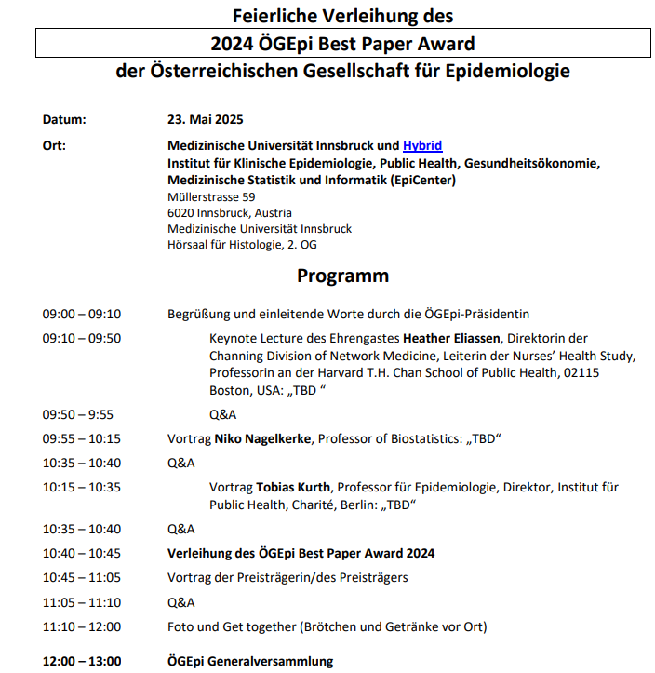
DRAFT

Slide 4
Research Report Q2 2023 – Q1 2025
General facts: Maja
Working Groups, topics
Epidemiology and public health of infectious disease (e.g. Long-term effectiveness of an ultra-rapid rollout vaccination campaign with BNT162b2 on the incidence of SARS-CoV-2 infection)
Peter Willeit, Lena Tschiderer, Lisa Seekircher, Lisa Waltle, Pallavi Saxena, Hanno Ulmer
Epidemiology and public health of cardiovascular disease (e.g. Sex differences in risk factor relationships with subarachnoid haemorrhage and intracranial aneurysms: A Mendelian Randomisation study)
Peter Willeit, Lena Tschiderer, Lisa Seekircher, Lisa Waltle, Clara Meijs, Isabel Geiger
Cancer Epidemiology (e.g. Body mass index, triglyceride-glucose index, and prostate cancer death: a mediation analysis in eight European cohorts)
Josef Fritz, Hanno Ulmer, Sarah Maier

Slide 5
Research Report Q2 2023 – Q1 2025
AI and machine learning (e.g. The Impact of Multi-Institution Datasets on the Generalizability of Machine Learning Prediction Models in the ICU)
Partrick Rockenschaub, Matthias Perkonigg
Statistical methods and causal inference (e.g. Target trial emulation to evaluate the effect of immune-related adverse events on outcomes in metastatic urothelial cancer)
Josef Fritz, Hanno Ulmer, Sarah Maier, Stefan Kuhle, Paul Klingler
Clinical trials, registries and cohort studies
Hanno Ulmer, Sarah Maier, Lalit Kaltenbach, Peter Willeit, Lisa Waltle, Lena Tschiderer…?
Health data research hub
Georg Göbel, Joachim Masser, Natalie Baur, Piotr Tymoszuk

Slide 6
Organizational
Kitchen cleaning plan
Closed doors policy
???

