Slide 1
Cardiovascular, Cancer, and Infectious Disease Research: Three Decades of Epidemiological Evidence from the VHM&PP Study
Speaker: Hanno Ulmer
Institute of Clinical Epidemiology, Public Health, Health Economics, Medical Statistics and Informatics (EpiCenter) Innsbruck, Medical University of Innsbruck
Abstract
Introduction: This presentation will first introduce the EpiCenter Innsbruck at the Medical University of Innsbruck, that conducts population health research in cardiovascular disease, cancer, and infectious disease. Our methodological portfolio includes epidemiological and statistical approaches, causal inference techniques with emphasis on mediation analyses, and more recent expansion to AI-based prediction methods.
Data Sources: Our analyses utilize several clinical trials and epidemiological studies, primarily the Bruneck Study and the Vorarlberg Health Monitoring and Promotion Programme (VHM&PP).
Research Overview: This presentation covers selected studies conducted with the VHM&PP dataset. These studies include examinations of long-term tracking patterns of cardiovascular risk factors and documentation of secular and temporal trends in these factors over time. Our investigations of gamma-glutamyltransferase and uric acid have contributed to understanding CVD mortality risk, alongside analyses of sex-specific patterns in CVD risk factors and outcomes. Through mediation analyses, we have estimated direct and indirect effects of CVD risk factors on mortality. Similar analytical approaches were applied to cancer incidence and mortality outcomes. As part of the international Me-Can consortium, we contributed to research on metabolic syndrome and cancer. Recent work has addressed obesity-related cancer, comparing metabolically healthy and unhealthy obese individuals, providing insights into the heterogeneity of obesity phenotypes. Additional studies examined the TYG index in chronic kidney disease and, during thepandemic, we investigated the relationship between long-term body mass index and COVID-19-related intensive care requirements.
Conclusion: This body of work demonstrates the value of long-term population-based cohorts in characterizing disease patterns and advancing our understanding of modifiable risk factors.

Slide 2
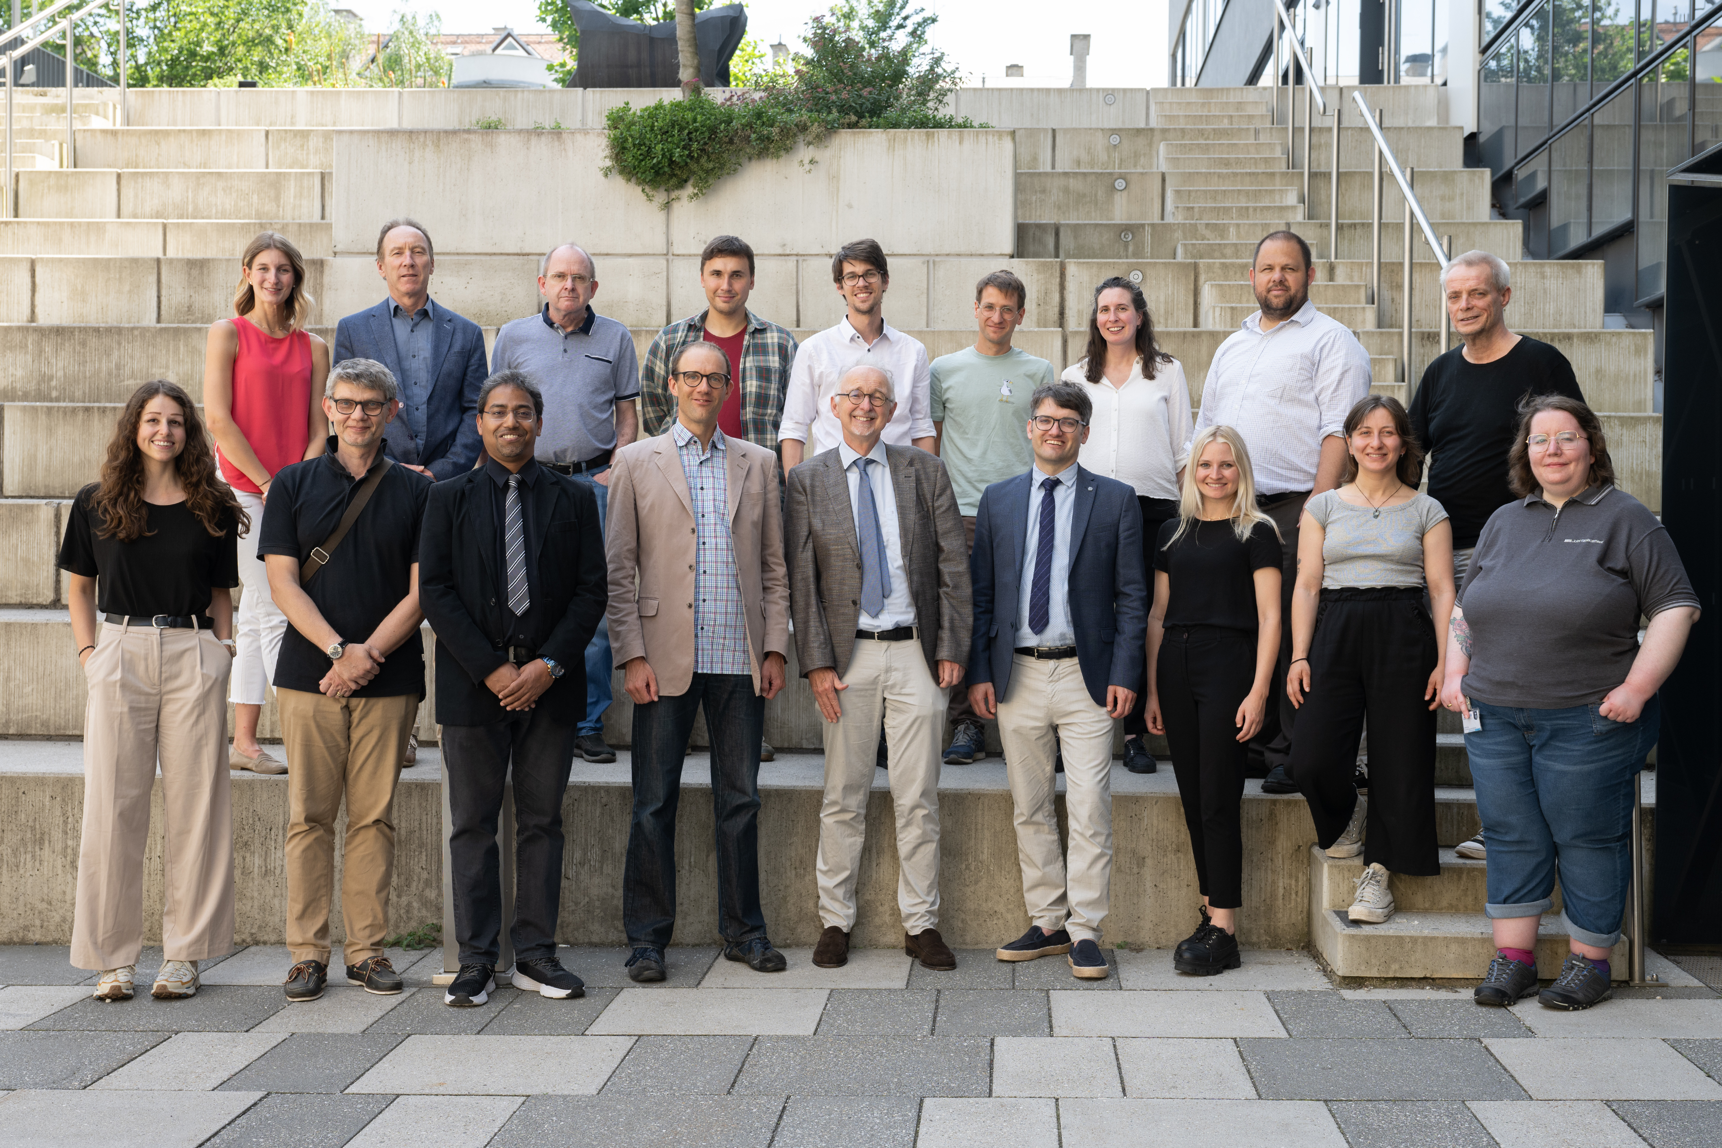


Slide 3






Our Research Focus Areas
Cardiovascular Disease
Cancer
Infectious Disease
Advancing prevention and treatment strategies for heart conditions
Investigating novel approaches to cancer detection and therapy
Combating emerging and endemic infectious threats
Methodology
Artificial Intelligence
Biobanking
Developing robust research frameworks and statistical approaches
Leveraging AI to transform healthcare delivery and research
Building comprehensive biological sample repositories for future research

Slide 4
COVID-19 Research Leadership
Gurgelstudie
REDUCE
Shieldvacc-2
RT-qPCR-detected SARS-CoV-2 infection across 250 schools in Austria, informing national education policy during the pandemic.
Ultra-rapid rollout vaccination campaign against COVID-19 conducted in the Schwaz District, demonstrating effective mass immunization strategies.
Phase-4 study evaluating correlates of protection following two-dose vaccination against COVID-19.

Slide 5
Interventional Trials
01
02
ADHP Trial
STROKE-CARD
RCT on screening for atrial fibrillation using smartphones to prevent stroke in the general population.
RCT of post-stroke disease management program to reduce cardiovascular risk and improve quality of life.
03
04
LEODOR
HARVITA
RCT on efficacy and safety of levosimendan infusions for recently hospitalized patients with advanced heart failure.
RCT comparing skeletonized versus pedicled harvesting technique of the left internal thoracic artery.

Slide 6




Strategic Research Consortia
Proof-ATHERO
LPASC
Collaborative consortium advancing atherosclerosis research through integrated multi-center studies.
Lipoprotein(a) Studies Collaboration investigating genetic and environmental factors in cardiovascular disease.
Me-Can
ODDS
Metabolic Syndrome and Cancer Project examining links between metabolic health and cancer risk.
The Obesity and Disease Development Sweden (ODDS) study, a pooled cohort

Slide 7



Global Research Partnerships
NCD-RisC
ERFC
Non-Communicable Disease Risk Factor Collaboration analyzing worldwide trends in health risk factors across populations.
Emerging Risk Factors Collaboration investigating novel biomarkers and risk prediction models for cardiovascular disease.

Slide 8


Landmark Observational Studies
Bruneck Study
VHM&PP
Population-based prospective cohort study with 33 years of follow-up, providing invaluable insights into cardiovascular disease progression and prevention.
Large prospective cohort study in Vorarlberg linked to preventative medical examinations, tracking long-term health outcomes across the region.

Slide 9
The Bruneck Study
Expanding Three Decades of Insights into Aging, Lifestyle, and Health

Slide 10

The advent of the Bruneck study
Initiated by Johann Willeit, Friedrich Oberhollenzer, and Georg Egger in 1990
Representative random sample
93.4% participation rate
< 0.1% population mobility per year
Notes:
Initiated by Johann Willeit, Friedrich Oberhollenzer, and Georg Egger
93.4% of eligible subjects joined the study making the highest participation rates of all population- and community-based studies worldwide
suitable for epidemiologic research in the light of low population mobility (< 0.1% per year) enabling long-term follow-up

Slide 11
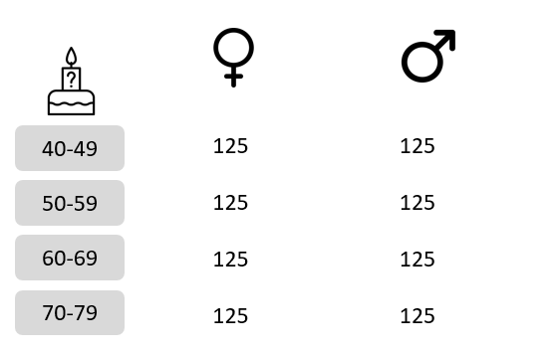
Bruneck 1
Sex- and age-stratified random sample
Based on population registry
Follow-up examinations every 5 years
The extension: Bruneck 2
Extension of the Bruneck cohort to all inhabitants over 65 years of age
Baseline examination in 2017-2019
n = 1,062

Slide 12
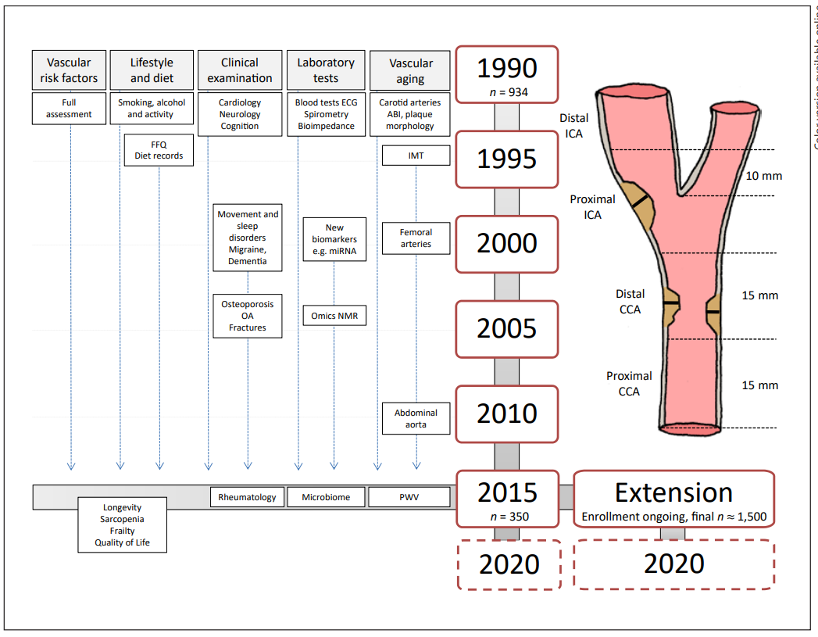
Data collection
2023
2023
Adapted from Kiechl & Willeit (2019)
Notes:
ECG, electrocardiogram; OA, osteoarthritis; IMT, intima-media thickness; ICA, internal carotid artery; CCA, common carotid artery; NMR, nuclear magnetic resonance; ABI, ankle-brachial index; FFQ, food frequency questionnaire; PWV, pulse wave velocity.
Relatively high consistency in examining personnell

Slide 13


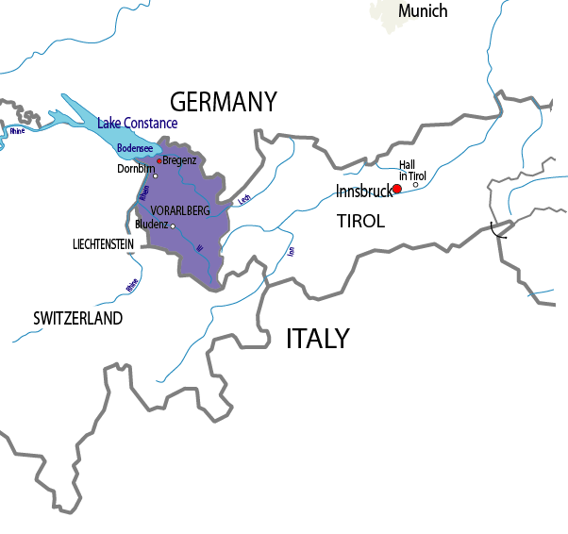
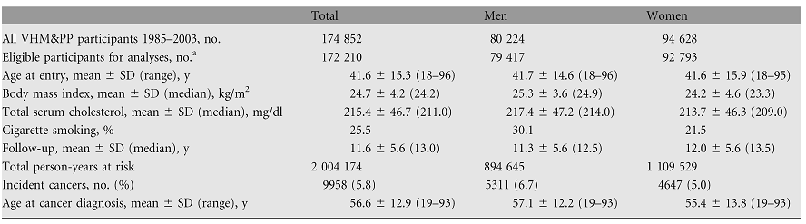
Health examinations in Vorarlberg (Austria)
https://epicenter.i-med.ac.at/research/studies/the-vorarlberg-health-monitoring-promotion-programme-vhmpp/vhmpp-publications/

Slide 14
Challenges
Computational problems (in the beginning)
Data privacy, informed consent and ethical approval
Data management and record linkage (death causes – Statistik Austria, cancer registry Vorarlberg, Austrian dialysis and transplant registry, Covid-19 intensive care)
Statistical issues:
Repeated measurements
Measurement error
Non-linear relationships
Mediation analysis

Slide 15
Repeated measurements
There are approx. 180,000 individuals in the VHM&PP database with almost 800,000 repeated measurements
The use of repeated measurements is statistically challenging:
Irregular number of repeated measurements per individual
(between 1 and 21)
Irregular time intervals
Number and time intervals are not randomly distributed and may be informative

Slide 16
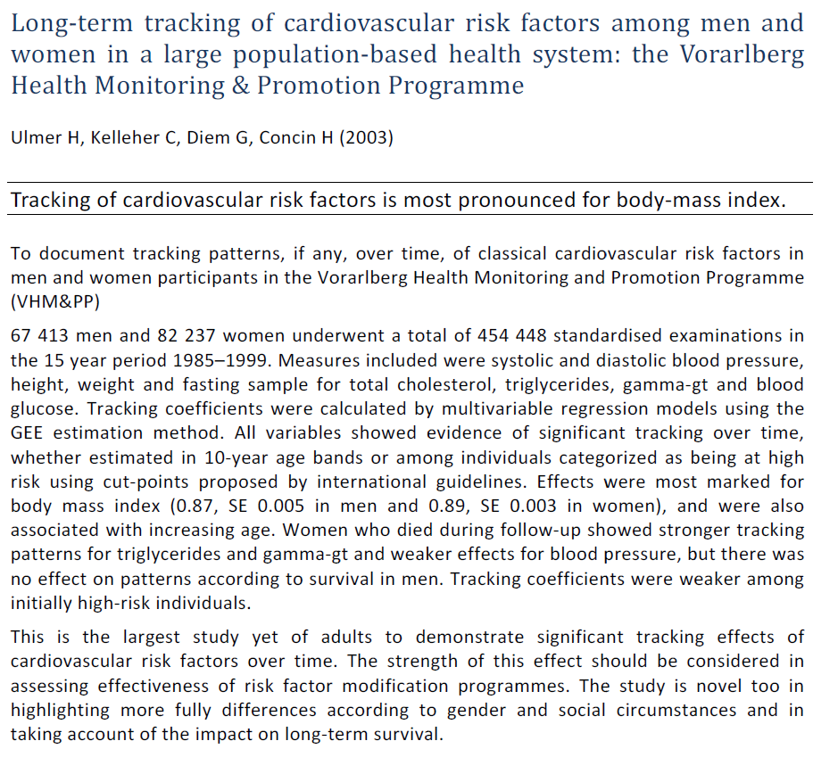

Slide 17
Measurement Error
Repeated measurements allow the correction for random error and within-person variability of the exposure measurements,
to counteract regression dilution bias of risk associations.
Regression dilution ratios were estimated with
linear mixed effect models
or GEE models (see: tracking of CVD risk factors)
p
q
y
ijr
=
a
+
a
i
+
(
b
+
b
i
+
c
1
t
ijr
)
y
ij
0
+
c
2
t
ijr
+
∑
α
k
x
ij
0
,
k
+
∑
β
l
z
ij
0
,
l
+
ε
ijr
k
=
1
l
=
1
Regression dilution ratio = (b+b_{i}+c₁|t_{ijr}|)
Regression dilution ratio = (β1

Slide 18
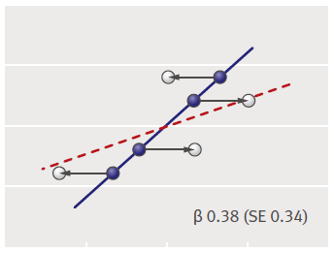
Regression dilution bias
Hutcheon JA et al. Br Med J 2010;340:1402-1406
exposure with random error:
6 observations, 10 simulations

Slide 19
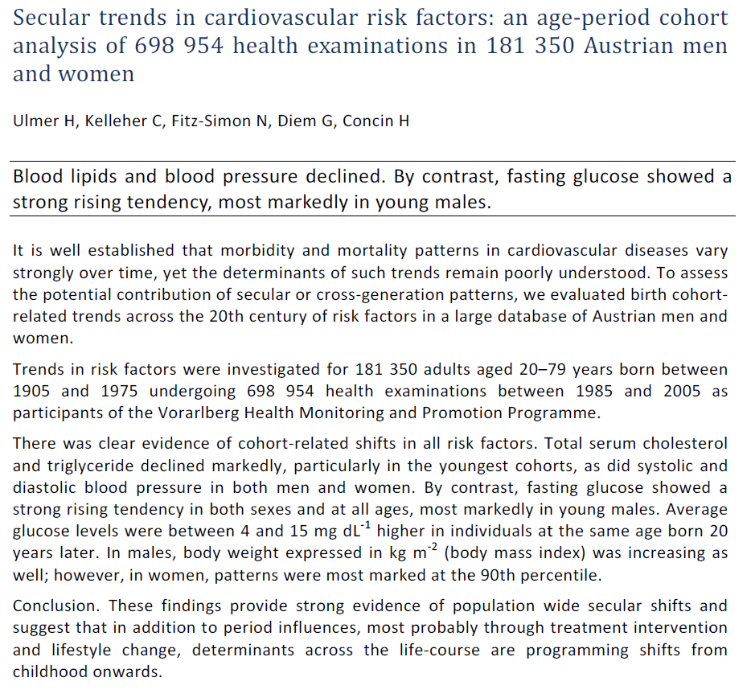

Slide 21
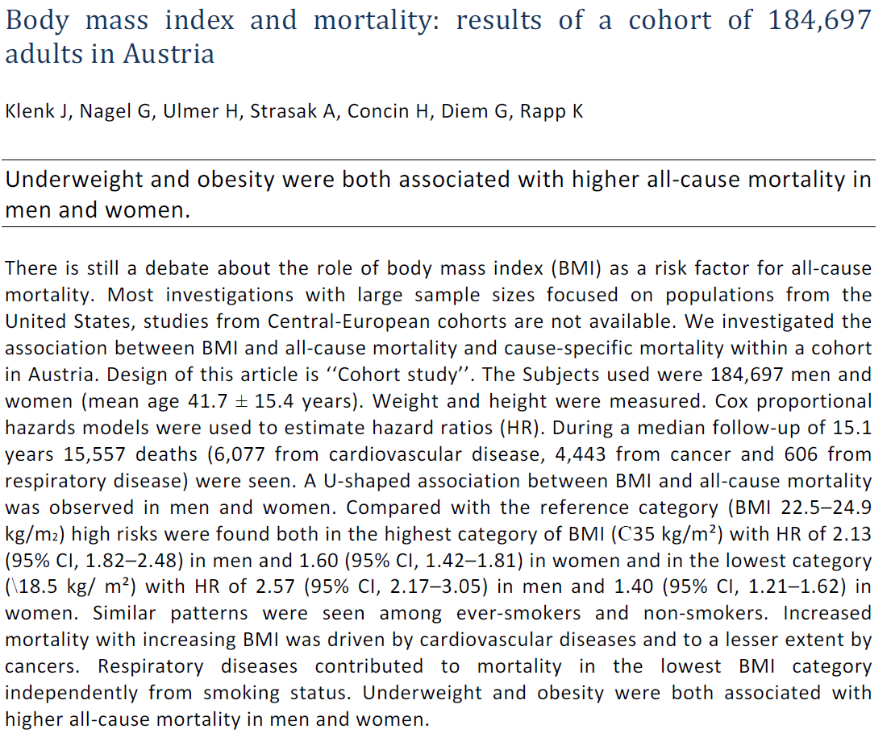

Slide 22
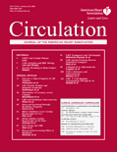
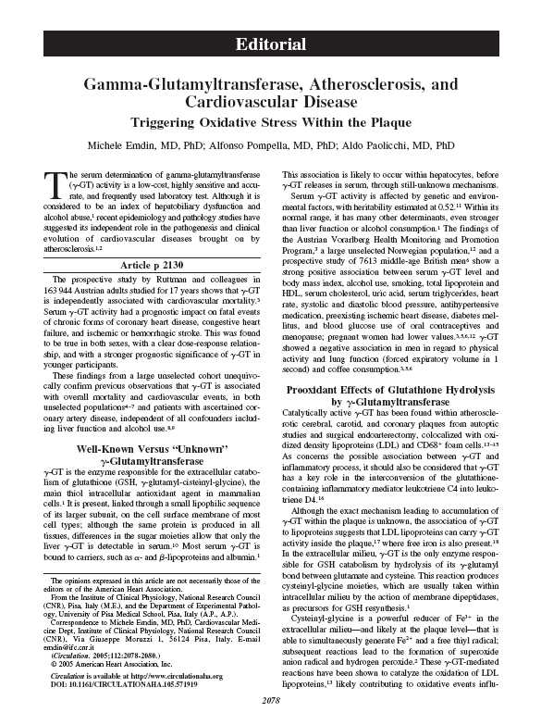
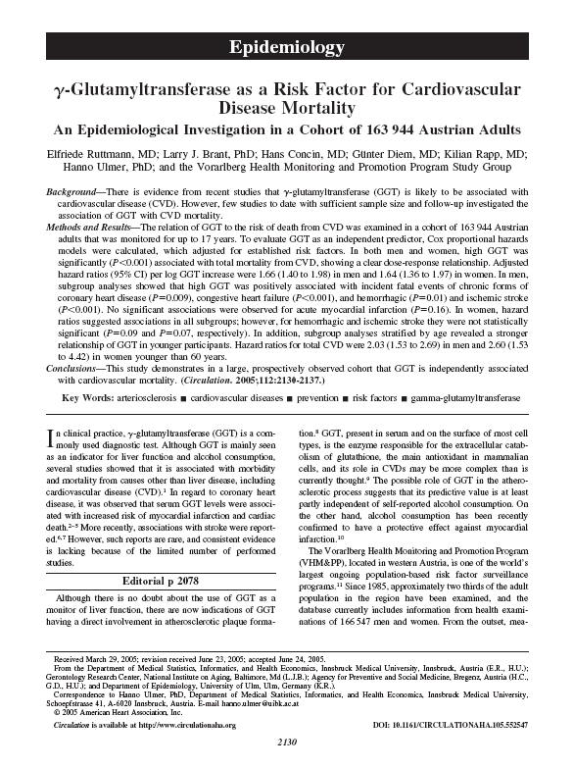

Slide 23
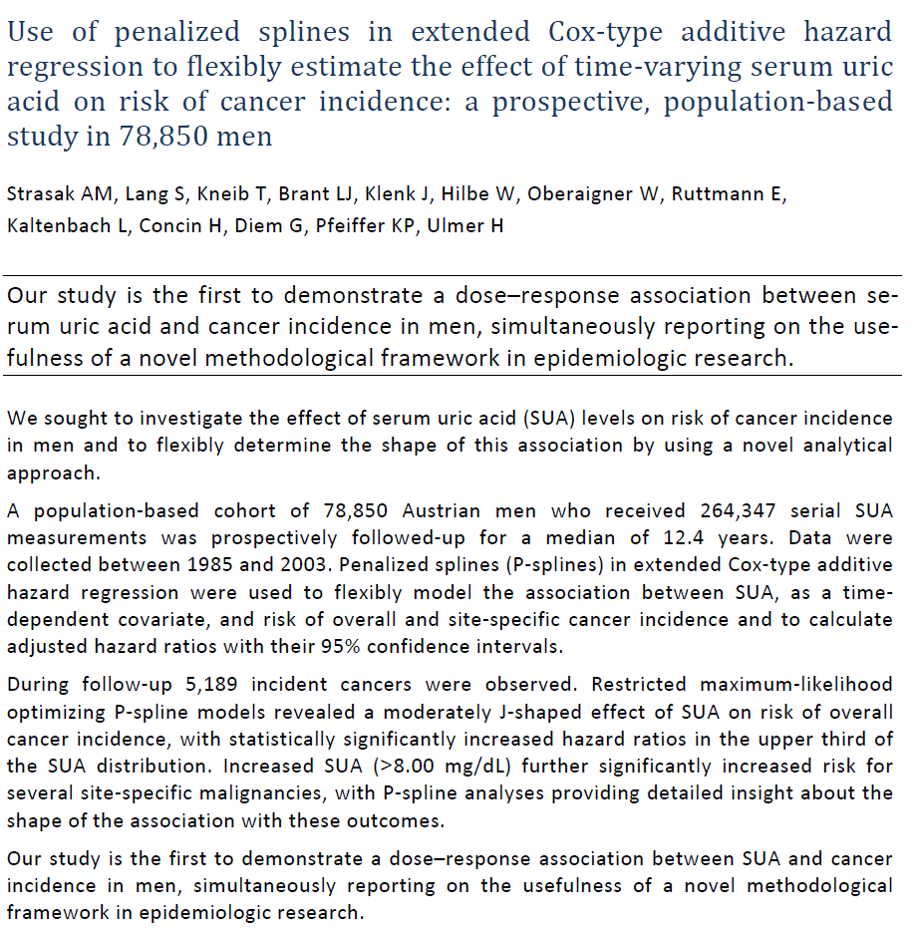

Slide 24
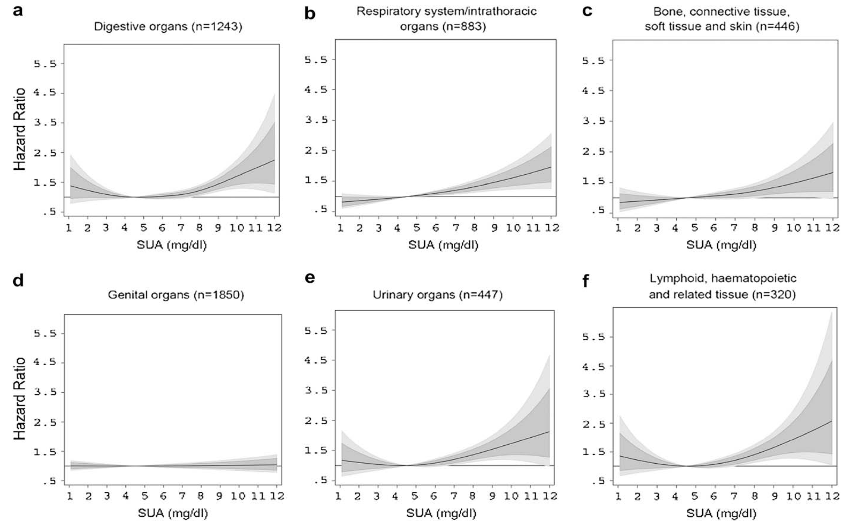

Slide 25
Mediation analysis
Cause-and-effect relationship
How does this effect come about?
What are the underlying mechanisms?
Statistical mediation analysis
  Quantifying specific causal pathways measured via specific variables which are assumed to be affected by the exposure and themselves affect the outcome
  Total effect
  Indirect (mediated) effect (red arrows)
  Direct effect (green arrow)
M
→Mediation analysis
X
Y

Slide 26

DO RISK FACTORS EXPLAIN THE
SEX/GENDER GAP IN MORTALITY
FROM CORONARY HEART DISEASE?
Josef Fritz, Michael Edlinger, Cecily Kelleher, Susanne Strohmaier, Gabriele Nagel, Hans Concin, Elfriede Ruttmann, Margarethe Hochleitner, Hanno Ulmer
Medical University of Innsbruck, Austria, University College Dublin, Ireland
University of Oslo, Norway, University of Ulm, Germany
Agency for Preventive and Social Medicine, Bregenz, Austria
hanno.ulmer@i-med.ac.at
Notes:
Folie zu DOI noch ergänzen!!!

Slide 27
PURPOSE
Age and sex are the strongest predictors of
coronary heart disease mortality
Premature CHD (I20-I25) deaths – before age 65 - in Europe:
330,000 death cases, of which 77% in males, 23% in females
(Nichols et al, Eur Heart J 2014)
Aim of study:
to estimate, how much of this large sex difference is explained
by the major risk factors (RFs):
- systolic blood pressure
- total cholesterol
- fasting glucose
- smoking

Slide 28
FIGURE 1. UNDERLYING MODEL
confounders in red mediators in blue
We assume that the 4 RFs are in the causal pathway between sex and mortality, mediating the total sex effect,
e.g. male sex causes hypertension, and hypertension causes CHD

Slide 29
MATERIAL AND METHODS
      We used prospective cohort data from the Vorarlberg Health Monitoring and Promotion Programme (VHM&PP), Austria
      A total of 172,262 individuals underwent baseline
      health examinations with fasting measurements of RFs
      There were 3,892 CHD deaths during a follow-up of 14.6 years
      For data analysis, we used a recently developed statistical mediation method (Lange et al, Am J Epidemiol 2014)
      Designed for survival data
Allowing breakdown into single components of the indirect sex effect (that is explained by the RFs)

Slide 30
FIGURE 2. WHAT RISK FACTORS EXPLAIN
hanno.ulmer@i-med.ac.at

Slide 31
RESULTS AND CONCLUSIONS
      The mortality difference between sexes decreased with age
      <50 years: HR=4.7 (95%CI 3.5-6.1)
      ≥50 years: HR=1.9 (95%CI 1.7-2.1)
      The extent to which risk factors contributed varied with age
      <50 years: the 4 RF explained 41% (95%CI 27-54%) of sex effect
      ≥50 years: the 4 RF explained 8% (95%CI 4-12%) of sex effect
      In younger individuals, the female survival advantage was explained to a substantial part through the pathways of the
      4 major risk factors
      As blood pressure and cholesterol were the strongest factors, our results correspond to the oestrogen/testosterone thesis

Slide 32

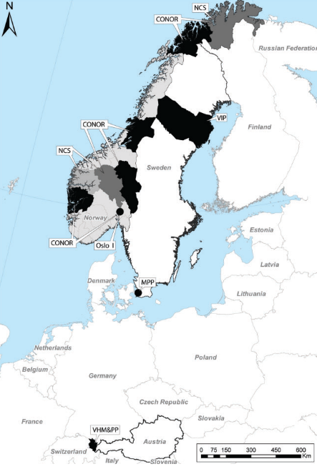
The Metabolic Syndrome and Cancer Project Me-Can project (Me-Can)
http://me-can.se/
Pooling of six population-based European cohorts
>800,000 individuals
>80,000 incident cancers over a follow-up of ~20 years
>30 original articles over the last 10 years
Cohort Profile: The Metabolic syndrome and Cancer project (Me-Can), Int J Epi, 2009

Slide 33
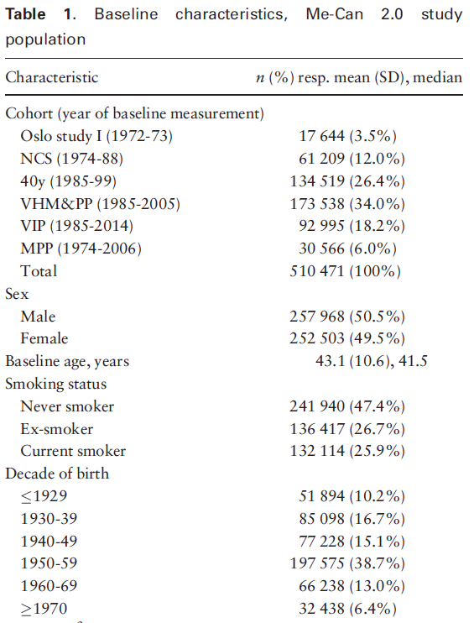
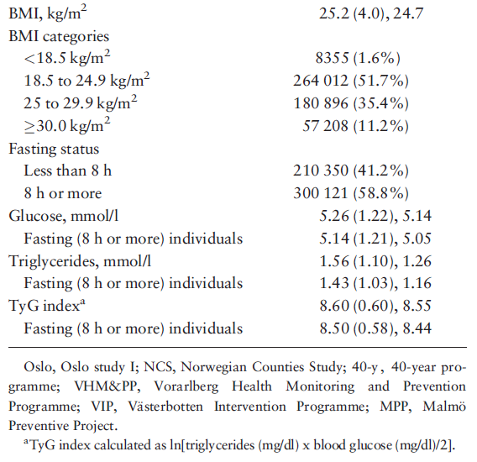

Slide 34
Me-Can project
Sex-specific risk estimates of incident cancer by site per unit MetS score (standardised sum of the five separate z-scores)
Males
Females

Slide 35
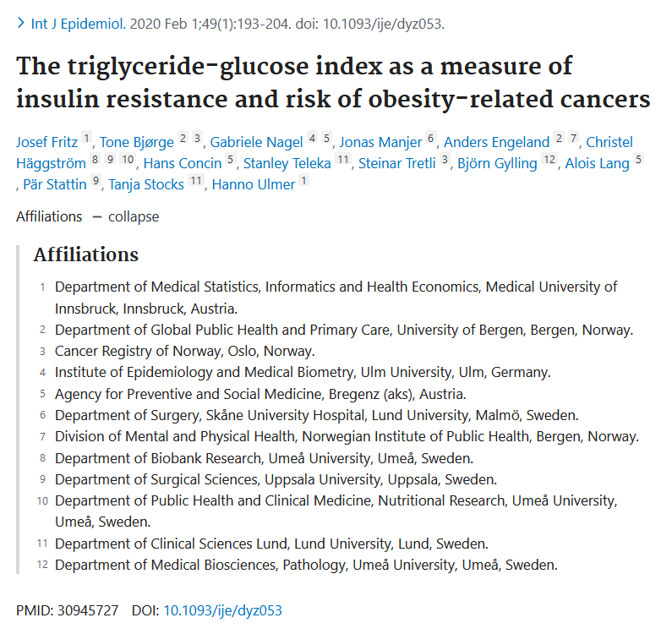

Slide 36
TyG Index: A Novel Measure for Insulin Resistance
TyG index = the logarithmized product of fasting levels of
triglycerides and glucose (“TyG index”).
Simple measure of insulin resistance.
Good correlation with the euglycemic-hyperinsulinemic clamp test (Pearson correlation of -0.68), similar magnitude as the frequently used HOMA-IR.
Both lipotoxicity and glucotoxicity play crucial roles in insulin resistance modulation and are reflected in the TyG index.
A promising surrogate measure for insulin resistance in large-scale epidemiological studies.
First proposed by: Simental-Mendía LE et al. The Product of Fasting Glucose and Triglycerides As Surrogate for Identifying Insulin Resistance in Apparently Healthy Subjects. Metab Syndr Relat Disord 2008.

Slide 37
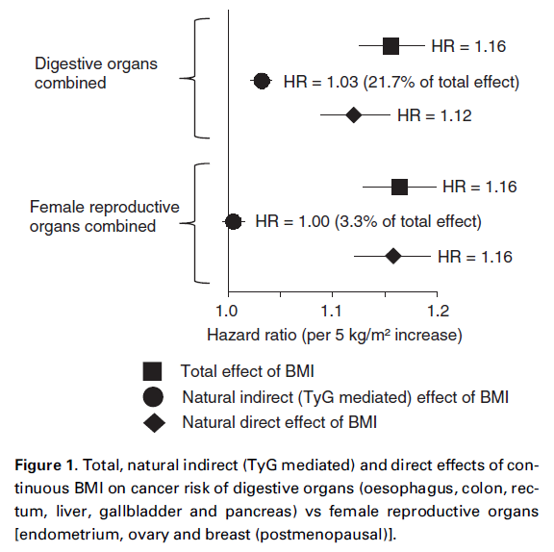
The TyG Index substantially mediated the effect of BMI for gastrointestinal cancers, but not for gynecological cancers.
Our results confirm a promoting role of insulin resistance as measured through the TyG index in the pathogenesis of gastrointestinal cancers.
Our results provide limited evidence that insulin resistance as measured through the TyG index connects excess body weight with risk of cancers of the female reproductive organs.

Slide 38

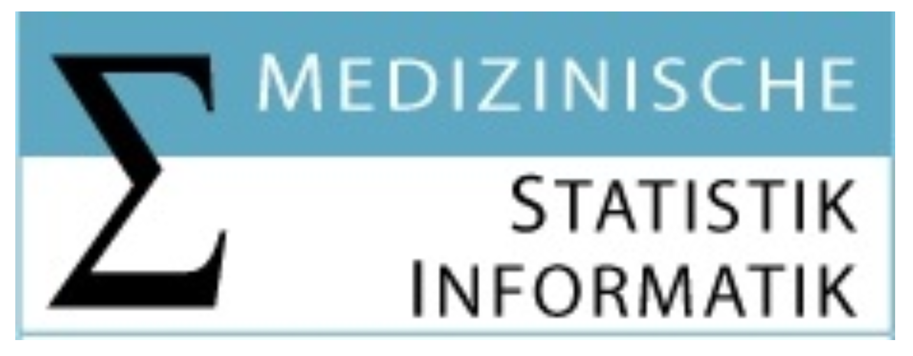
The Association of Excess Body Weight with Risk of ESKD
Is Mediated Through Insulin Resistance,
Hypertension, and Hyperuricemia
07 October 2022 – ÖGHN
Josef Fritz
josef.fritz@i-med.ac.at; josef.fritz@med.lu.se
Institute of Medical Statistics and Informatics, Medical University of Innsbruck
Department of Translational Medicine, Lund University, Sweden

Slide 39

Background and Aim
Other
Direct effect
Overweight/Obesity
End-stage kidney disease
Insulin resistance
Hypertension
Indirect effects
Hyperuricemia
Hypercholesterolemia

Slide 40
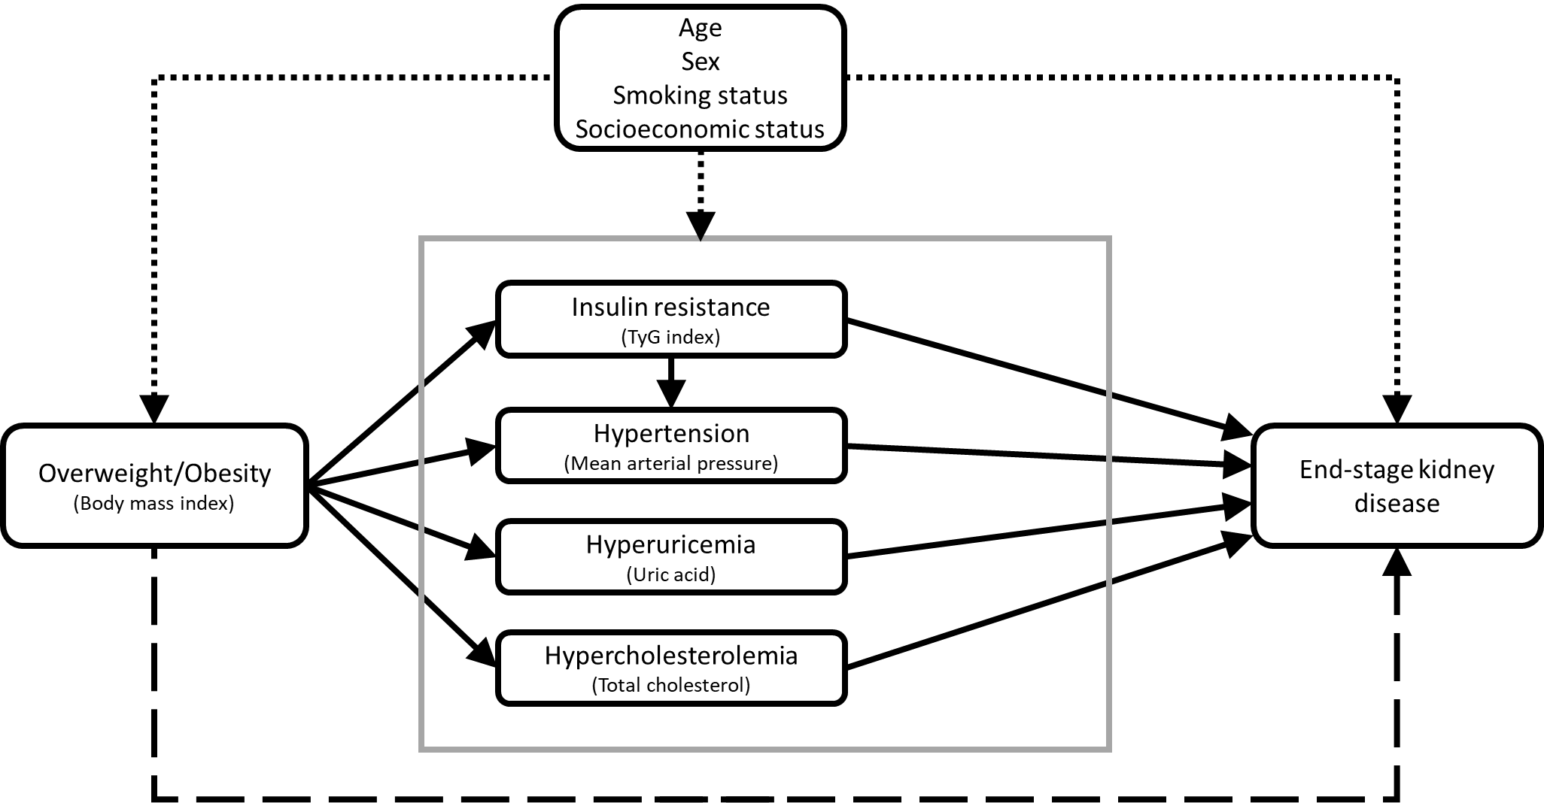
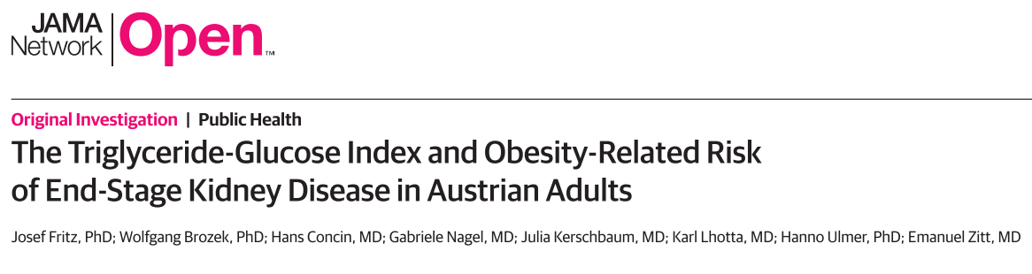
Material and Methods
100,269 participants of the Vorarlberg Health Monitoring and Promotion Program (mean age 46.4 years)
Linked to the Austrian Dialysis and Transplant Registry (OEDTR) and the National Mortality Registry
463 incident ESKD cases over a mean follow-up of 23.1 years
2-stage regression model for mediation analysis (Vansteelandt & Daniel, Epidemiology 2017)

Slide 41
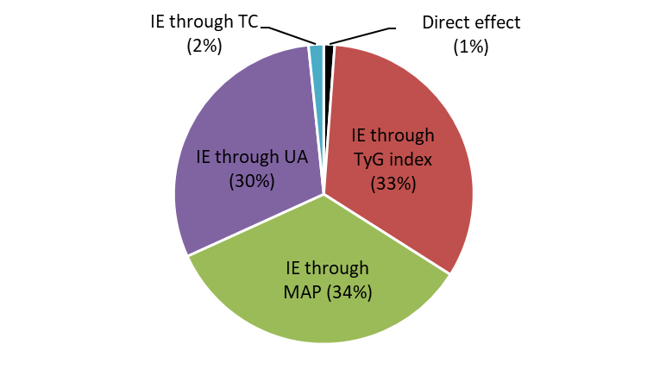
Results
BMI on ESKD | HR per 5 kg/m² BMI increase (95% CI)
Total effect | 1.57 (1.38 to 1.77)
Direct effect | 1.01 (0.88 to 1.14)
Joint indirect effect (IE) | 1.56 (1.49 to 1.64)
IE through TyG index | 1.16 (1.11 to 1.21)
IE through MAP | 1.17 (1.13 to 1.21)
IE through UA | 1.15 (1.11 to 1.18)
IE through TC | 1.01 (1.00 to 1.02)
MAP – mean arterial pressure.
UA – uric acid.
TC – total cholesterol.

Slide 42
Summary
The BMI effect on ESKD is fully mediated by insulin resistance, hypertension, and hyperuricemia
  TC not relevant
  UA important
Overweight/Obesity does not per-se increase the risk for ESKD, but only in combination with an unhealthy metabolic profile
  Metabolically healthy obesity = hardly any ESKD risk increase
  Metabolically unhealthy obesity = substantial ESKD risk increase
The control of metabolic risk factors is essential in mitigating the adverse effects of BMI on kidney function

Slide 43
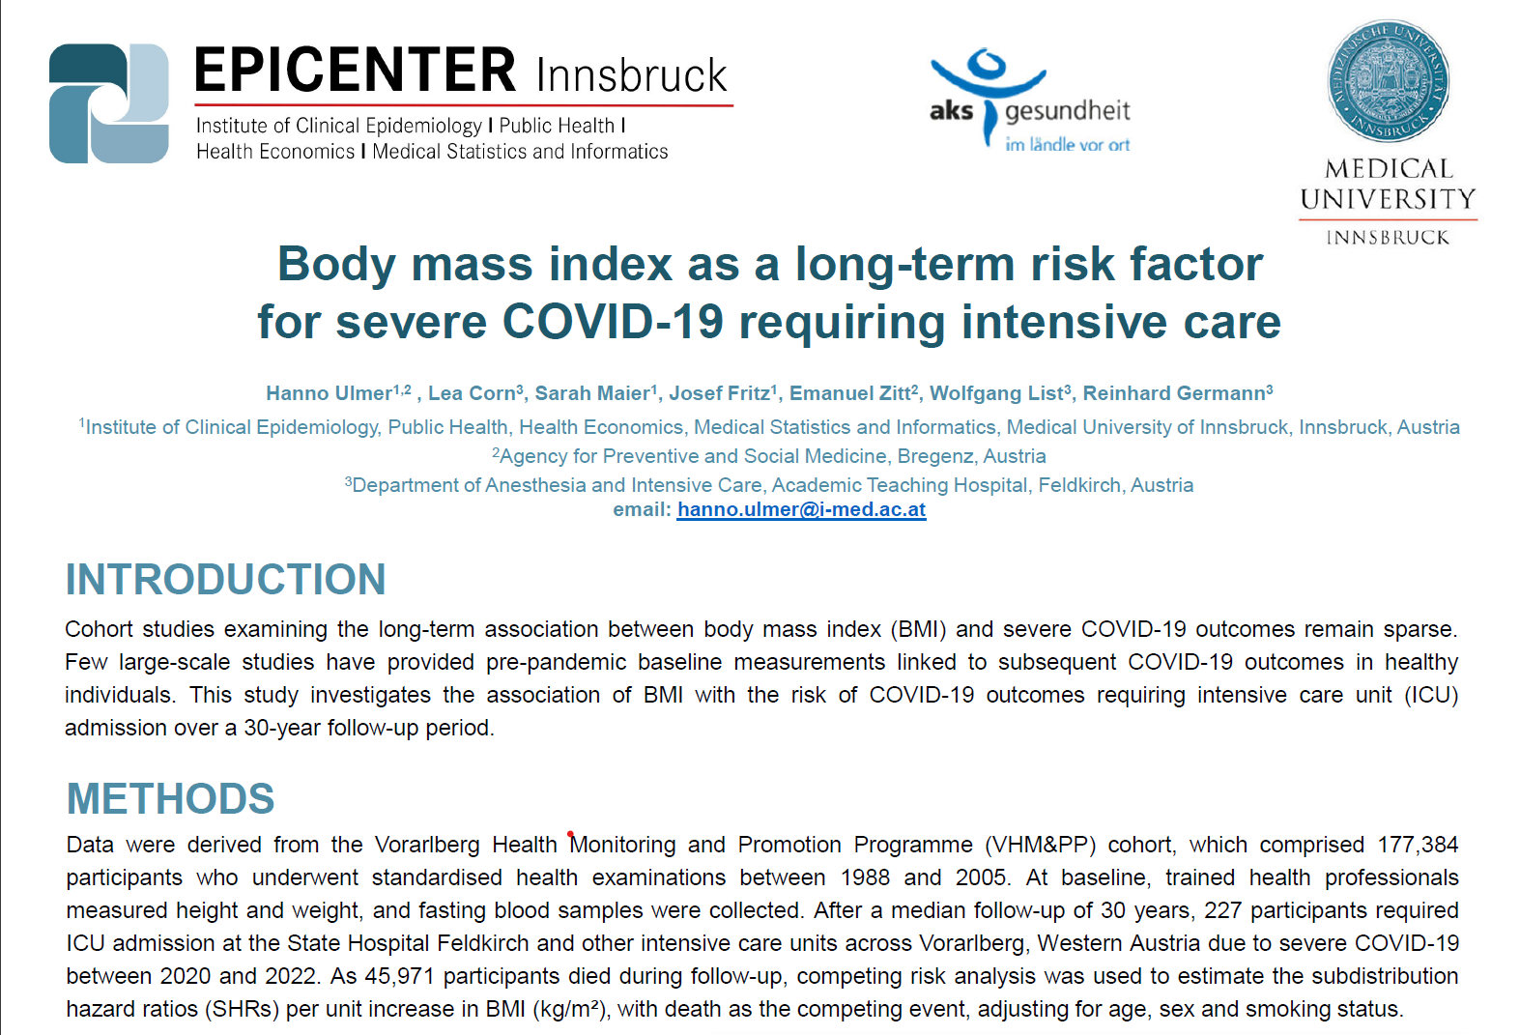

Slide 44
