Slide 1




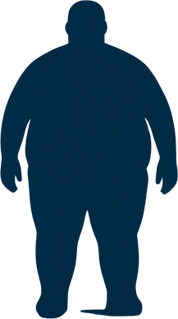

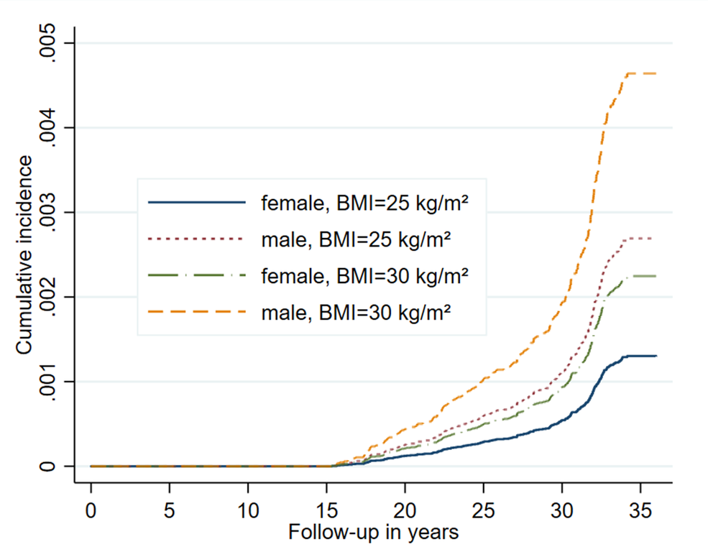




Long-Term Association of Body Mass Index Measured in Middle Adulthood with Severe COVID-19 Requiring Intensive Care Later in Life: A 30-Year Population-Based Cohort Study
30 Years
Of Follow-up
One Measure
That Matters
Hanno Ulmer^{1,2} , Lea Corn³, Sarah Maier¹, Josef Fritz¹, Emanuel Zitt², Wolfgang List³, Reinhard Germann³
1 Institute of Clinical Epidemiology, Public Health, Health Economics, Medical Statistics and Informatics, Medical University of Innsbruck, Innsbruck, Austria
2 Agency for Preventive and Social Medicine, Bregenz, Austria
3 Department of Anesthesia and Intensive Care, Academic Teaching Hospital, Feldkirch, Austria
email: hanno.ulmer@i-med.ac.at
Background
Aims
THE STUDY IN NUMBERS
Obesity is a well-established risk factor for severe COVID-19, but most evidence is based on body mass index (BMI) measured near the time of infection. Few studies have linked pre-pandemic measurements to COVID-19 outcomes.
To examine the long-term association between BMI measured in middle adulthood and subsequent ICU admission for severe COVID-19.
177,384
227
45,971
~30 years
Methods
participants
(VHM&PP cohort)
1988-2005
ICU admissions for COVID-19 from the cohort (2020-2022)
non-COVID-19
deaths treated as competing events
EXPOSURE
OUTCOME
ANALYSIS
ADJUSTED FOR
BMI measured at baseline (1988-2005) in middle adulthood
ICU admission for severe COVID-19 (2020-2022)
Competing-risk regression (sub-distribution hazard ratios) per 1 kg/m² in BMI
Age, sex, smoking, systolic blood pressure, fasting glucose, triglycerides, cholesterol
Baseline & ICU Characteristics
Key Results
CUMULATIVE INCIDENCE OF ICU ADMISSION
FOR SEVERE COVID-19
AT BASELINE (1988-2005)
AT ICU ADMISSION (2020-2022)
BMI was independently associated with higher risk of ICU admission for severe COVID-19.
Median age
42 years
Median age
70 years
1.12
54%
female
65%
male
SHR per 1 kg/m2
increase in BMI
(95% CI: 1.09-1.14)
Participants who later required ICU admission for COVID-19 had a higher mean BMI:
Statistically significant positive
association after full adjustment.
27.2 ± 4.9 kg/m²
409 total COVID-19 ICU admission in Vorarlberg
Male sex strongly increased risk:
SHR 2.07 (95% CI: 1.56-2.75)
^{vs}
STRONGER BMI*ICU ASSOCIATION IN FEMALES
24.9 ± 4.3 kg/m²
227 were from the VHM&PP cohort
Females
SHR 1.14
per kg/m²
(95%CI: 1.11-1.16)
Males
SHR 1.09
per kg/m²
(95%CI: 1.05-1.12)
Higher BMI in middle adulthood and male sex was associated with greater risk of ICU admission for COVID-19 decades later.
^{(those who did not)}
Interaction between sex and BMI:
p=0.029
Conclusion
Middle age
ICU
Higher BMI measured 30 years prior to infection was independently associated with increased risk of severe COVID-19 requiring ICU, suggesting that long standing elevated body weight contributes to this risk.
the path ahead
2020-2022+
1988-2005
Risk of severe COVID-19
requiring ICU
References
BMI measured
[1] Ulmer H, Kelleher C, Diem G, Concin H. Long-term tracking of cardiovascular risk factors among men and women in a large population-based health system: the Vorarlberg Health Monitoring & Promotion Programme. European Heart Journal. 2003 Jun;24(11):1004-13.
[2] Gao M, Piernas C, Astbury NM, Hippisley-Cox J, O'Rahilly S, Aveyard P, Jebb SA. Associations between body-mass index and COVID-19 severity in 6·9 million people in England: a prospective, community-based, cohort study. Lancet Diabetes Endocrinol. 2021 Jun;9(6):350-359.
[3] Robertson J, Adiels M, Lissner L, Mehlig K, Af Geijerstam A, Lindgren M, Gisslén M, Ekblom Bak E, Rosengren A, Åberg M. BMI in early adulthood is associated with severe COVID-19 later in life: A prospective cohort study of 1.5 million Swedish men. Obesity (Silver Spring). 2022 Mar;30(3):779-787.
[4] Großschädl F, Bauer S. The relationship between obesity and nursing care problems in intensive care patients in Austria. Nurs Crit Care. 2022;27:512–518.

