Slide 1
Statistical approaches in mediation analysis: a comparison of methods for survival data
Josef Fritz, Hanno Ulmer
Department for Medical Statistics, Informatics and Health Economics,
Innsbruck Medical University
Contact: josef.fritz@i-med.ac.at, hanno.ulmer@i-med.ac.at

Slide 2
Outline
Mediation / causal inference
Mediation analysis for survival data
    Application of methods from Baron&Kenny, VanderWeele, Lange
Lessons learned from two case studies
      Body mass index (BMI) -> coronary heart disease (CHD),
      mediated by blood pressure, cholesterol, and glucose
      Sex/gender -> CHD,
      mediated by blood pressure, cholesterol, glucose, and smoking
      With the use of own data from the Vorarlberg health examination database (VHM&PP)

Slide 3
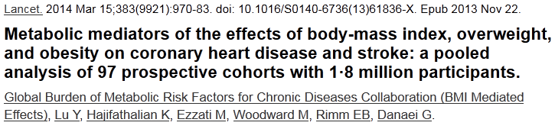
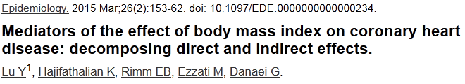
Motivation (1)
Mediation/causal inference has arrived in the medical literature.
We contributed VHM&PP data to a large meta-analysis:
Recently, the same working group published yet another paper:

Slide 4
Motivation (2)
We are currently investigating the sex – CHD mortality relationship.
With mediators blood pressure (BP), total cholesterol (TC), fasting glucose (FG), smoking status (SS).
Paper in submission:
  Mediation analysis of the relationship between sex/gender, cardiovascular risk factors and mortality from coronary heart disease
  Josef Fritz, Michael Edlinger, Cecily Kelleher, Susanne Strohmaier, Gabriele Nagel, Hans Concin, Elfriede Ruttmann, Margarethe Hochleitner, Hanno Ulmer
Sex
BP, TC, FG, SS
CHD mortality

Slide 5
Mediation vs. confounding
Regression analysis allows to estimate the effect of an exposure variable on an outcome variable in the presence of one or more ‘third factors’.
These third factors can operate differently. They can act as confounders, moderators or mediators.
A confounder is associated with the exposure and the outcome. The confounder is not in the causal pathway leading from the exposure to the outcome.
Mediation occurs if factors, like confounders, are associated with the exposure of interest and the outcome, but are in the causal pathway leading from the exposure to the outcome.

Slide 6
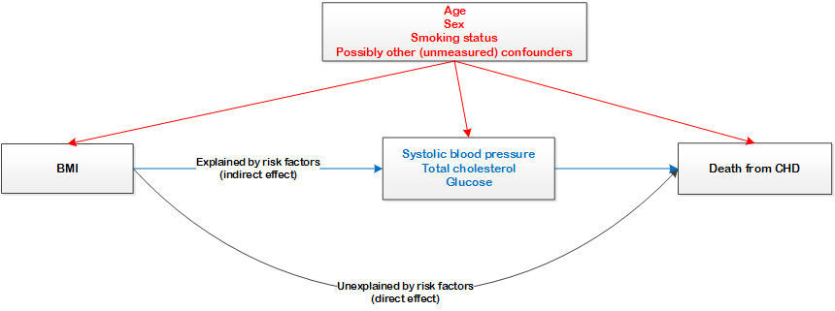
Case study 1 – BMI and CHD
Red: confounders
Blue: mediators
CHD defined as ICD-10 codes I20-I25.
Aim: estimation of direct and indirect path.

Slide 7
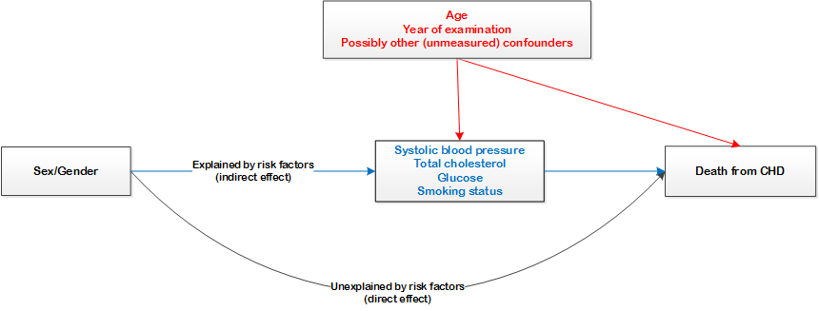
Case study 2 – Sex/Gender and CHD
Red: confounders
Blue: mediators

Slide 8
Mediation analysis
Total, direct and indirect effects
For the BMI – CHD example for Cox regression (λ - hazard)
Total effect (TE):
Controlled direct effect (CDE):
(M - some fixed mediator level)
Natural direct effect (NDE):
Natural indirect effect (NIE):
It can be shown: TE = NDE x NIE
For CDE no such decomposition exists!

Slide 9
Mediation analysis
„Classical“ methods
Aim of mediation analysis: decomposition of total effect into (natural) direct and indirect effect
Classical methods: Baron&Kenny 1986
  2-stage regression models
  Product method: first model for mediators, second model for outcome including exposure and mediators
  Difference method: two models for exposure, one with and one without mediators
  Advantage: easy to implement
  Drawback: only mathematically consistent in “easy” settings

Slide 10
Mediation analysis
„New“ methods
2-stage regression models
  Refinement of product method with interactions
  T. VanderWeele: Explanation in Causal Inference: Methods for Mediation and Interaction. Oxford University Press 2015.
Weighting based approaches
  T. Lange (2014): Assessing natural direct and indirect effects through multiple pathways. Am J Epidemiol. 2014.
Inverse probability based approaches
Applicable for more general settings, but not so easy to implement any more.

Slide 11
Case study 1 – BMI and CHD
Comparison of methods:
  Classical product method (Baron&Kenny, 1986)
  Classical difference method (Baron&Kenny, 1986)
  Regression based approach developed by T. VanderWeele (refinement of product method) (2011; 2012)
  Weighting based approach developed by T. Lange (2014)
Classification of BMI: normal vs. overweight vs. obesity.
Observation: BMI*Age is highly significant in a survival model on CHD.
Therefore, stratification by age group is highly indicated!

Slide 12
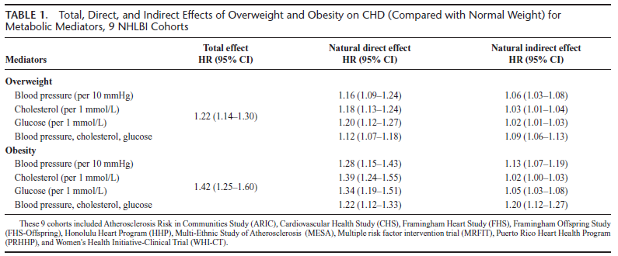
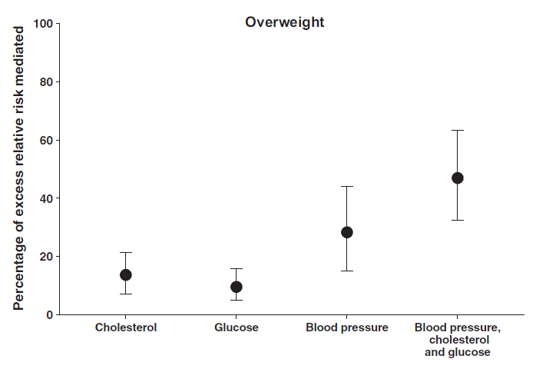
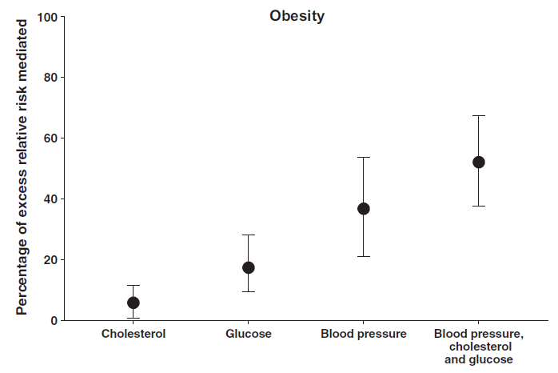
Lu et al. (2015): Results
48%
47%
37%
28%
17%
14%
10%
6%

Slide 13
Case study 1
Results overweight vs. normal weight

Slide 14
Case study 1
Results obesity vs. normal weight

Slide 15
Remarks concerning methodology (1)
Methods deliver considerably different results. Interestingly, the new methods of VanderWeele and Lange often differ quite widely, while the classical methods deliver results in between.
This may be due to:
  Strict assumptions (unmeasured confounding) which may be violated.
  Classical methods do only deliver approximate results.
  The method by VanderWeele only delivers exact results for “rare” outcomes.
  Lange’s method requires non-intertwined pathways.

Slide 16
Case study 2 – Sex/Gender and CHD (1)
In general, men have a higher CHD mortality risk than women, especially at younger ages.
Can the difference in CHD mortality risk between sexes be explained by different risk factor profiles and if yes, how much can be explained?
New mediation approach according to Lange et al. (Am J Epidemiol, 2014).
Allows breakdown of indirect effect into single components for non-intertwined pathways.
Since moderating effect of age, stratification for age groups <50,
50-64, 65-74, and ≥75 years.

Slide 17
Case study 2 – Sex/Gender and CHD (2)
  Effect decomposition, Lange et al.

Slide 18
Remarks concerning methodology (2)
Baron&Kenny: Easy, old, but reliable, product method preferable in survival setting
VanderWeele: correction for exposure-mediator interaction possible, only for “rare” outcomes.
Lange: computationally intensive, stringent assumptions (non-intertwined pathways), decomposition in single components possible
There is no universally “best” method for all settings. Sensitivity analysis with different methods are recommended.

