Slide 1
From simple correlation to causal inference
Hanno Ulmer
Department for Medical Statistics, Informatics and Health Economics,
Innsbruck Medical University
Contact: hanno.ulmer@i-med.ac.at

Slide 2
Fat consumption and mortality from coronary heart disease: A highly influential correlation analysis Ancel Keys (1953) Journal of the Mount Sinai Hospital New York

Slide 3
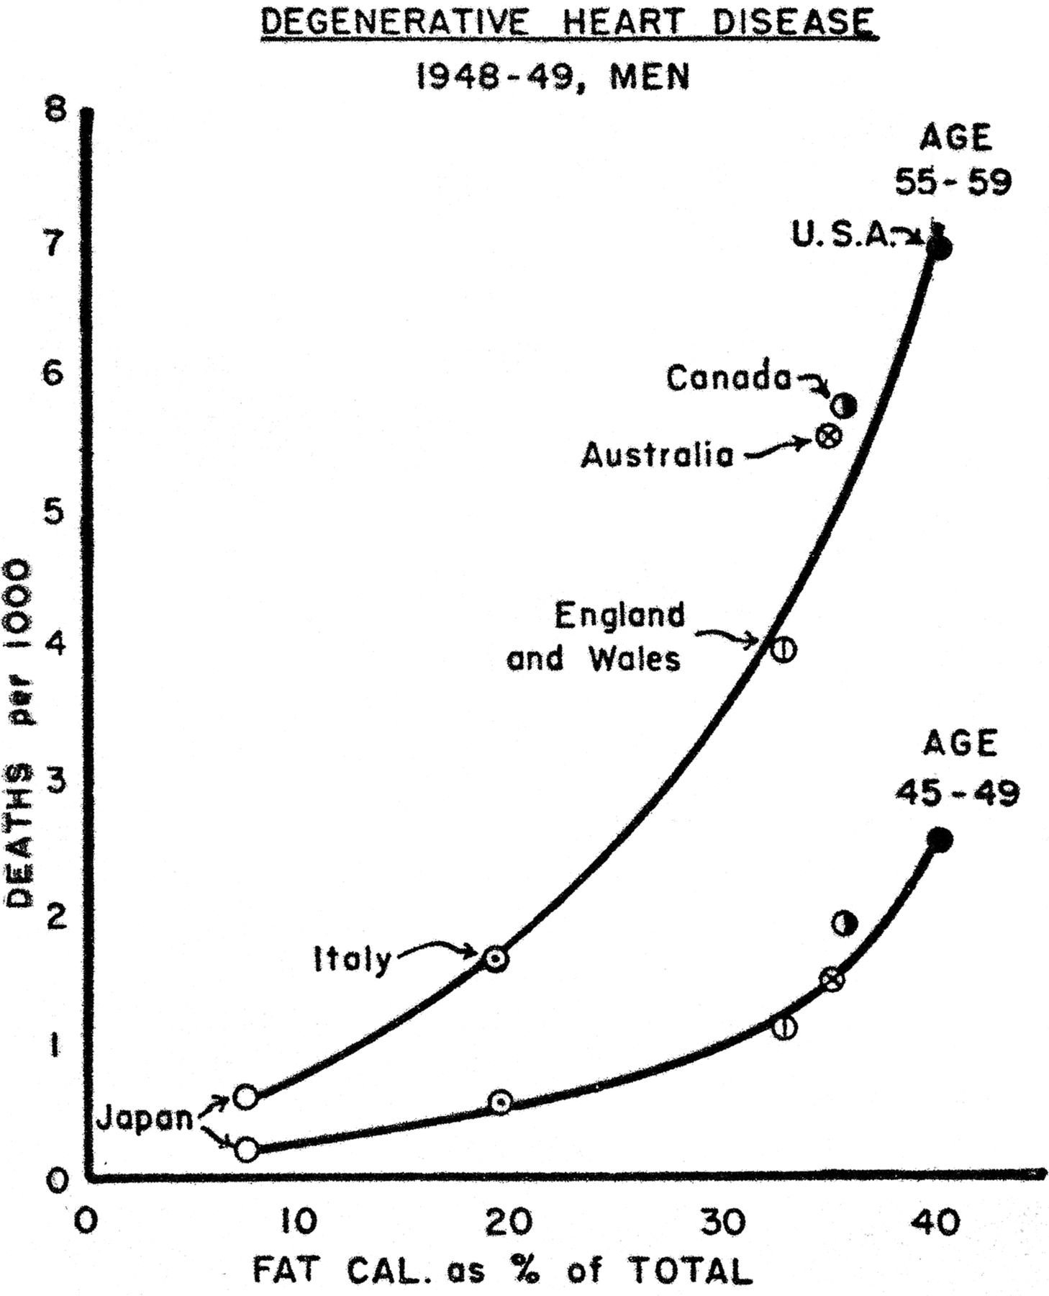
Mortality from degenerative heart disease according to dietary fat (fat calories as a percentage of total calories) among men aged 45–49 years (lower curve) and men aged 55–59 years (upper curve), 1948–1949.
Henry Blackburn, and Darwin Labarthe Am. J. Epidemiol. 2012;aje.kws374
© The Author 2012. Published by Oxford University Press on behalf of the Johns Hopkins Bloomberg School of Public Health. All rights reserved. For permissions, please e-mail: journals.permissions@oup.com.
Notes:
Mortality from degenerative heart disease according to dietary fat (fat calories as a percentage of total calories) among men aged 45–49 years (lower curve) and men aged 55–59 years (upper curve), 1948–1949. Results were calculated from national food balance data for 1949 supplied by the Nutrition Division of the Food and Agriculture Organization of the United Nations. (Reproduced with permission from the Journal of Mount Sinai Hospital (8).)‏

Slide 4
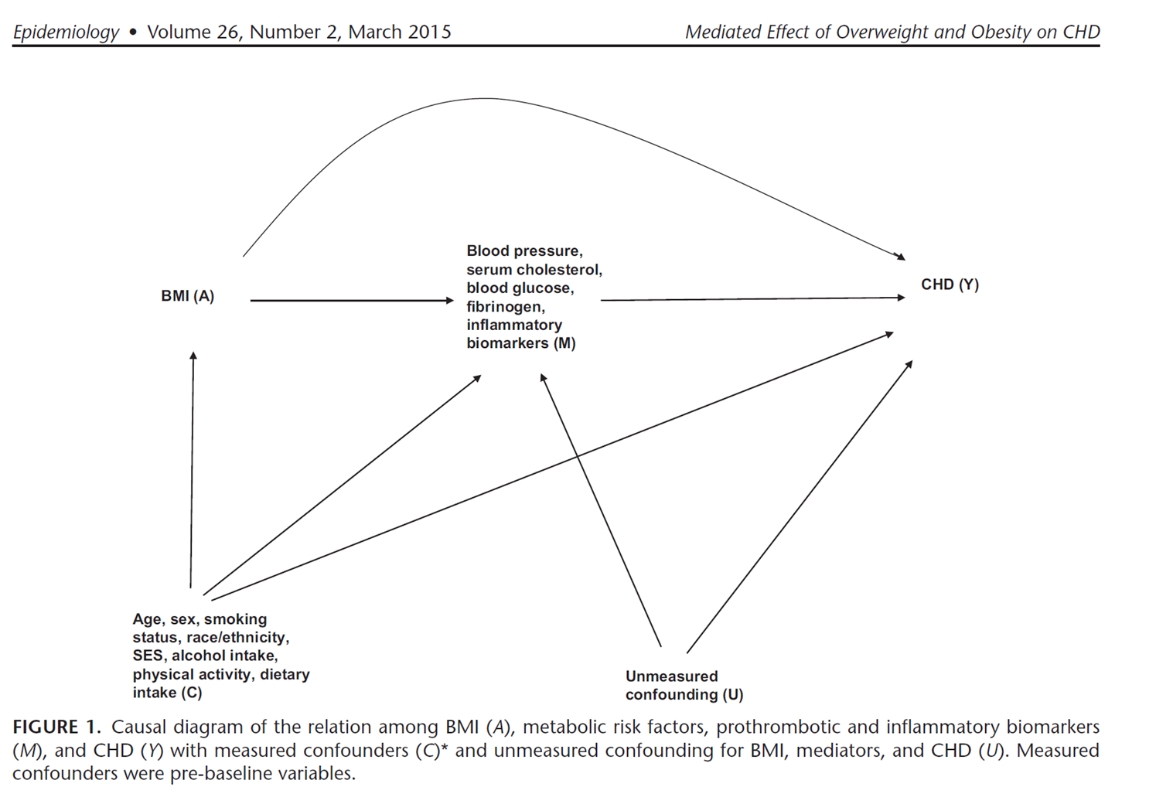
Epidemiology 2015: Causal Inference with modern mediation techniques

Slide 5
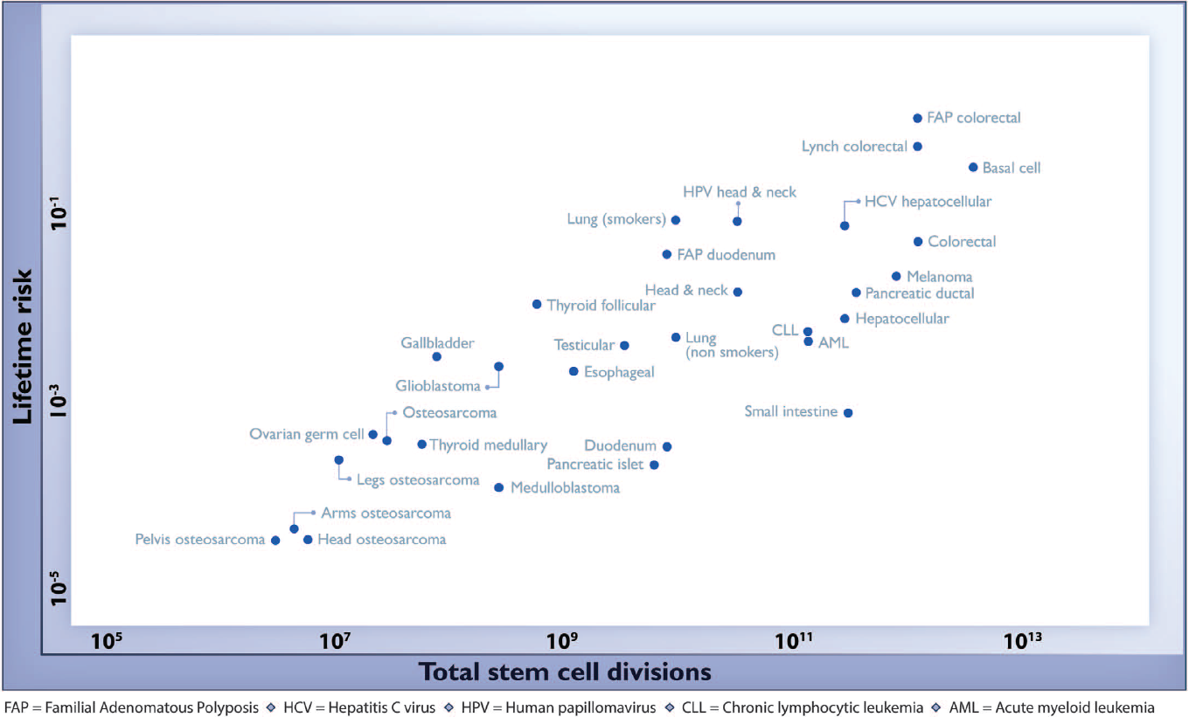
Science 2015: Cancer due to „bad luck“ (Spearman’s rho = 0.81; P < 3.5 × 10⁻⁸)

