Slide 1

The Powerful Contribution of Primary Care Databases to Epidemiology: A Reflection on the VHM&PP
Professor Cecily Kelleher DMed MD MPH FRCPI FFPH FFPHMI
Principal, College of Health and Agricultural Sciences
University College Dublin

Slide 2
In this talk
Some general background on Population databases
A focus on Vorarlberg Health Monitoring & Promotion Programme (VHM&PP)

Slide 3
Intrododuction
Global patterns of adult chronic disease present an ongoing challenge
These patterns are determined across the lifecourse and vary within and between countries
Large-scale datasets with the power to address long-term outcomes are of continuing major importance
Linkage data, especially in primary care and related to mortality outcomes are a particularly rich resource

Slide 4
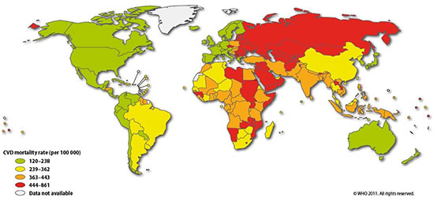
Global Burden of Cardiovascular Diseases

Slide 5
International Context of Downward Trends (* ICD Codes 410-414, 8th/9th Division and 120-125, 10th Revision WHO 2002 )

Slide 6
Potential uses of Large-scale Data
Descriptive research of natural history and epidemiology
Surveillance purposes
Monitoring of routine management protocols
Assessment of impact of health promotion policy Interventions

Slide 7
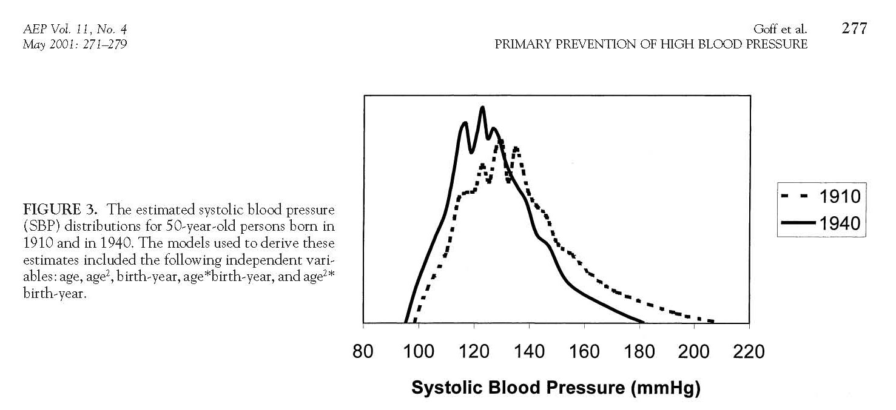
Birth cohort evidence of population influences on blood pressure in the United States, 1887-1994 Goff DC, Howard G, Russel GB, Labarthe DR. AEP Vol. 11, No. 4 May 2001: 271-279.

Slide 8
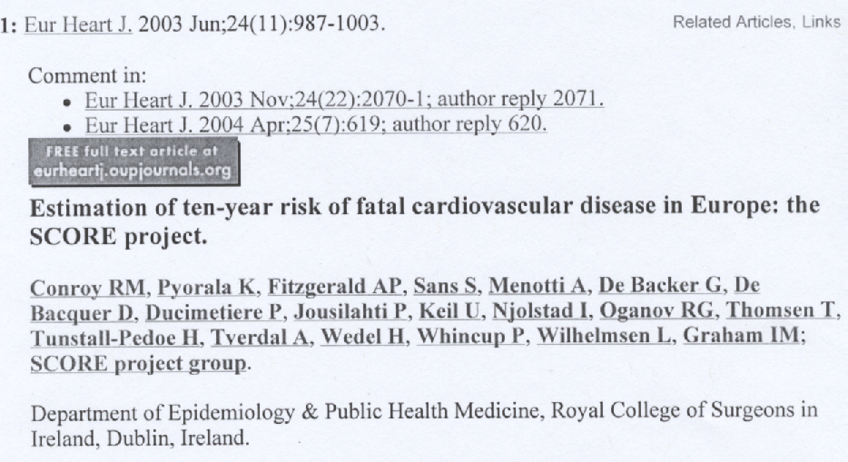
SCORE estimates of CVD risk

Slide 9
European Guidelines on CVD Prevention 2012
Countries at low risk using SCORE risk chart include Austria, Belgium, France, Ireland, Spain, United Kingdom
Parameters needed to assess SCORE are gender, age, smoking habits, blood pressure and total cholesterol (mmol/l)

Slide 10
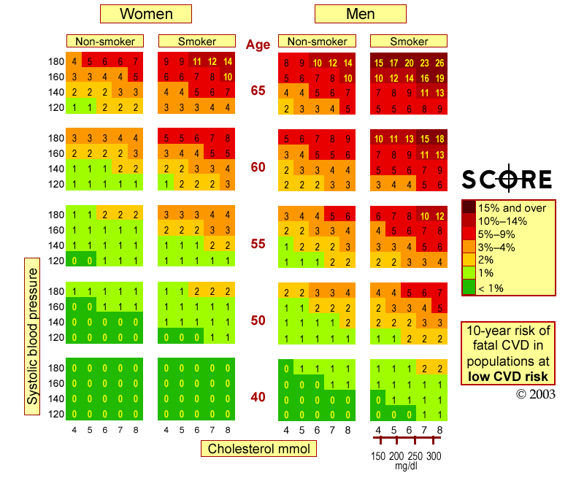
LR, TC

Slide 11

Thrombosis Prevention Trial
Lancet 1998; 351: 233-241
5499 men at high risk of IHD recruited from 108 practices in the MRC GPRF. Allocation to Warfarin, Aspirin, the combination or placebo.
WA reduced events by 39% compared to Placebo.
These results add evidence that Aspirin reduces non-fatal IHD. Warfarin reduced all IHD chiefly because of an effect on fatal events.

Slide 12

Lifeways Cross-Generation Study of a Thousand Families in the Republic of Ireland 2001-2017
Aims:
Determine health status, diet and lifestyle in families
Establish patterns and links across generations
Document primary care utilisation patterns across the social spectrum and across generations

Slide 13


Lifeways: Three Year olds follow-up in General Practice
Fitzsimon et al, IMJ 2007
“In logistic regression models, based on quartiles of intake, which adjusted for maternal lifestyle and socio-economic circumstances, relatively higher maternal fruit and vegetable intake and oily fish consumption were associated with lower risk of children developing asthma.”

Slide 14

Data access and sharing in the UK NHS
Each NHS visit experience is held in a Summary Care Record (SCR)
Since April 2015 all GPs should offer their patients online access to summary information
Only authorised healthcare professionals can access SCR
One can opt out at any time by filling an opt out form

Slide 15
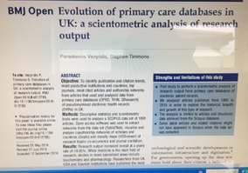
Evolution of primary care databases in UK
Vezyridis and Timmons BMJ Open 2016; 6(10):e012785
UK databases include:
CPRD (formerly known as the General Practice Research Database)
The Health Improvement Network (THIN)
Qresearch

Slide 16
Evolution of primary care databases Vezyridis and Timmons BMJ Open 2016; 6(10):e012785
Big data (analytics) refer to the aggregation and interrogation of-high volume, high velocity, high variety-data sets so as to reveal new, non obvious information and patterns
In the UK, big data have been at the forefront of research activity and policy-making, termed as one of the eight great technologies
These population based databases contain data originating from routine general practice
They include good information on morbidity and lifestyle, prescribing, preventive care and inter-practice variation.
Since they are continuously and automatically updated, they are ideal for researchers to monitor healthcare trends and effectiveness of new interventions and treatments, at minimum cost

Slide 17
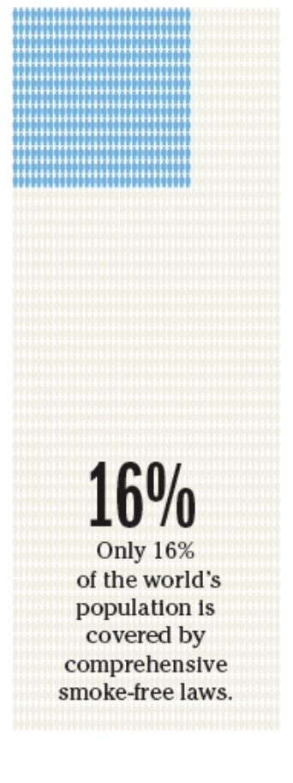
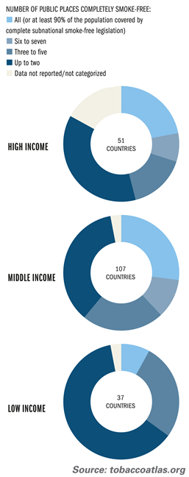
The Tobacco Atlas 2015
Smoke-free legislation by income level; High, middle, low income countries, 2012

Slide 18


Updated Review 2016

Slide 19
Legislative Smoking Bans
Frazer K, Callinan JE, McHugh J, van Baarsel S, Clarke A, Doherty K, Kelleher C.
Cochrane Database Syst Rev. 2016 Feb 4;2:CD005992
  PICO
  Population: Smokers and non- smokers
  Intervention: Comprehensive or partial smoking bans implemented by legislation
  Comparison: No bans
  Outcomes: health outcomes associated with second-hand smoke exposure. Active smoking, tobacco consumption
  Eligibility Criteria
  Settings: Country, Region or State
  Minimum standard was having indoor smoking ban explicitly stated in the study
  6 months follow up period
  Measured health outcomes
  Population smoking prevalence rates

Slide 20
Legislative Smoking Bans
Frazer K, Callinan JE, McHugh J, van Baarsel S, Clarke A, Doherty K, Kelleher C.
Cochrane Database Syst Rev. 2016 Feb 4;2:CD005992
77 studies
44 studies
Cardiovascular
ACS / AMI
Stroke
7 studies
Perinatal
LBW
Pre term birth
Maternal smoking
21 studies
Respiratory
11 studies
Mortality
24 studies
Active smoking
Asthma
COPD
Lung function
Smoking related deaths
Smoking prevalence
Tobacco consumption
Population-level
36 ITS
23 Controlled before and after
18 uncontrolled before and after
  A number of studies provided evidence for multiple outcomes

Slide 21
Key Message
Frazer K, Callinan JE, McHugh J, van Baarsel S, Clarke A, Doherty K, Kelleher C.
Cochrane Database Syst Rev. 2016 Feb 4;2:CD005992
Introduction of a legislative smoking ban leads to improved health outcomes through a reduction in second-hand smoke exposure for countries and their populations

Slide 22
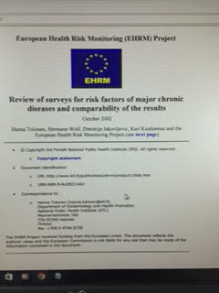
European Health Risk Monitoring Project
National Principal Investigators (NPI) and other contributors
Austria: Günter Diem (NPI), Hanno Ulmer; aks, Arbeitskreis für Vorsorge- und Sozialmedizin, Bregenz
Ireland: Cecily Kelleher (NPI); University College Galway, Sharon Friel; National University of Ireland, Galway

Slide 23
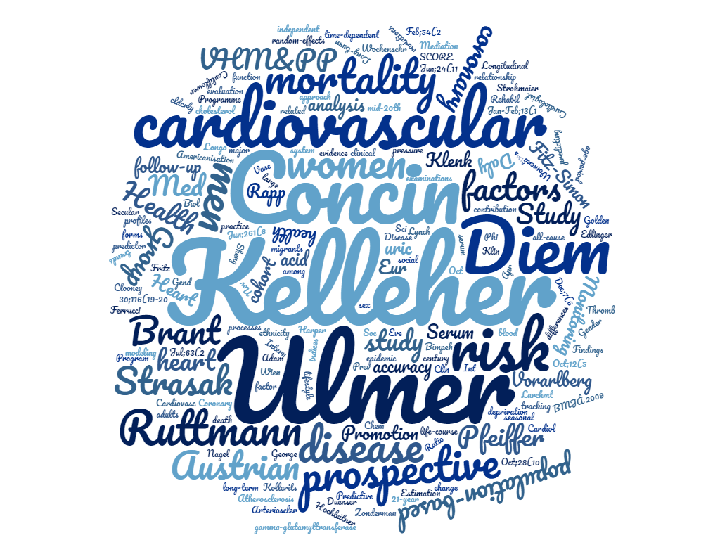

Slide 24
Examples of VHM & PP analyses
Tracking of Risk Factors for CVD over time
Secular and Cohort trends in Risk Factors over time
Gender differences in Lifecourse risk for men and women in relation to risk factor exposures
Novel application of routinely measured parameters as biomarkers for risk (e.g. Serum Uric Acrid and GGT)

Slide 25
Tracking of CVD Risk Factors in Adults
45,4448 standardised examinations between 1985-1999.
All CVD risk factors showed significant tracking over time.
Effects were most marked for Body Mass Index (0.87 in Men and 0.89 in women)
Largest study yet to demonstrate significant tracking in adults of CVD risk factors

Slide 26
The role of GGT as a predictor of incident Diabetes
These results provide clear evidence of a positive, independent association between high GGT and incident diabetes expressed by fasting hyperglycaemia, being markedly stronger in older individuals. No significant interaction of GGT with BMI
Ulmer et al, Eur Heart J 2008; 29(Suppl): 477

Slide 27
Why Eve is not Adam
Patterns of cholesterol levels showed marked differences between men and women in relation to age and cause of death.
The role of high cholesterol in predicting death from CHD could be confirmed in men of all ages and in women >50 years old.
Low cholesterol occurs even among younger respondents and is not a marker for frailty of age.

Slide 28
Mean levels of cholesterol by age for men and women, first visit, Ulmer et al, J Women’s Health 2004

Slide 29
Cardiovascular risk assessment and mortality outcome
The prognosis among re-attenders at all levels of risk is significantly better than non-returners, with both CVD and all-cause mortality over 10 years being significantly lower among re-attenders than those who never return, even when accounting for baseline risk factor profile
Ulmer et al, 2016

Slide 30
Mortality Experience in Men and Women according to follow-up Category in VHM &PP (Ulmer et al, 2016)

Slide 31
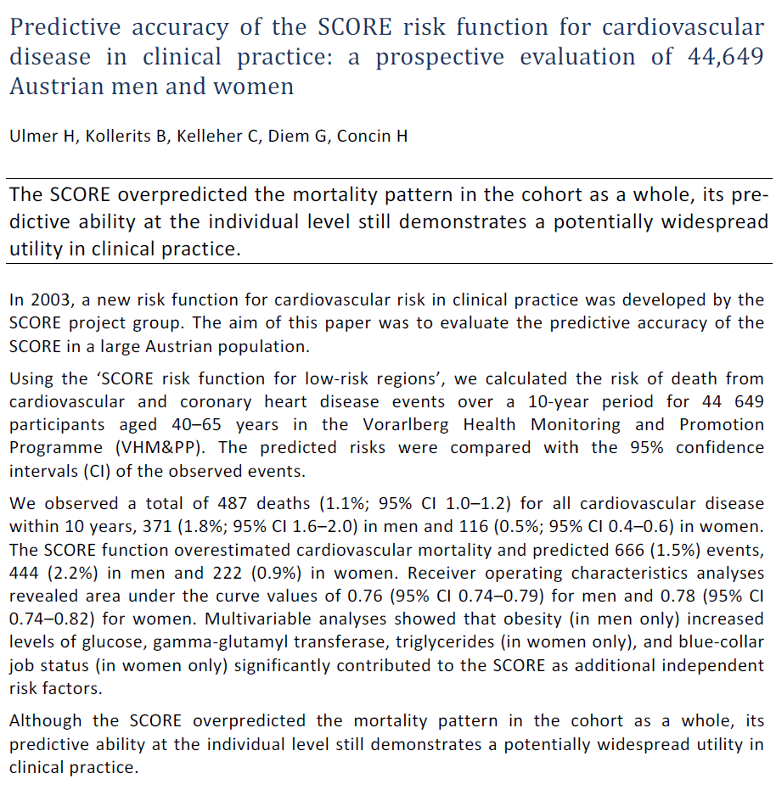

Slide 32
Secular trends in CVD risk factors
J Intern Med 2007; 261: 566-576
Trends in risk factors for 181,350 adults aged 20-79 years born between 1905 and 1975.
Clear evidence of cohort-related shifts in all risk factors.
Average Glucose levels were between 4 and 15 mg/dl higher in individuals at the same age born 20 years earlier.
Strong evidence of population wide secular shifts.

Slide 34


What do these two have in common?

Slide 35
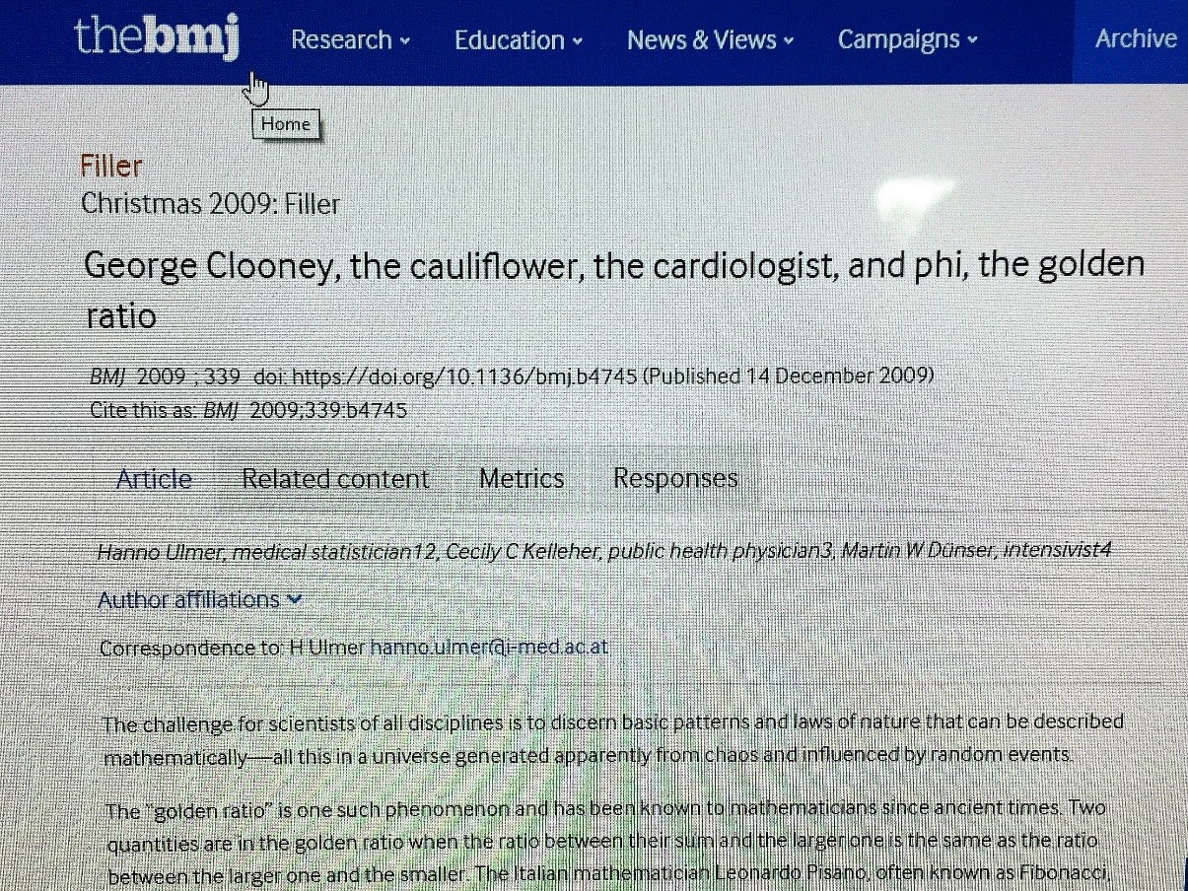
George Clooney, the cauliflower, the cardiologist and phi, the golden ratio
Ulmer et al, BMJ 2009; 339: b4745
“Although the systolic: diastolic BP ratio in whole population was 1.6235, the mean ratio in those who did not die during the 20-year observation period was 1.6180 and was 1.7459 in those who did.
BP values in well individuals exhibit the golden ratio”

Slide 36
Conclusions
The VHM&PP has made a major contribution to public health as a systematic linkage database in primary care
It is also a key contributor to a number of International consortia.
The story continues….
Danke!

Slide 37
References
1: Fritz J, Edlinger M, Kelleher C, Strohmaier S, Nagel G, Concin H, Ruttmann E, Hochleitner M, Ulmer H. Mediation analysis of the relationship between sex, cardiovascular risk factors and mortality from coronary heart disease: Findings from the population-based VHM&PP cohort. Atherosclerosis. 2015 Nov;243(1):86-92. doi: 10.1016/j.atherosclerosis.2015.08.048. PubMed PMID: 26363437.
2: Brant LJ, Ferrucci L, Sheng SL, Concin H, Zonderman AB, Kelleher CC, Longo DL, Ulmer H, Strasak AM. Gender differences in the accuracy of time-dependent blood pressure indices for predicting coronary heart disease: A random-effects modeling approach. Gend Med. 2010 Dec;7(6):616-27. doi: 10.1016/j.genm.2010.11.005. PubMed PMID: 21195361; PubMed Central PMCID: PMC3023955.
3: Strasak AM, Kelleher CC, Klenk J, Brant LJ, Ruttmann E, Rapp K, Concin H, Diem G, Pfeiffer KP, Ulmer H; Vorarlberg Health Monitoring and Promotion Program Study Group. Longitudinal change in serum gamma-glutamyltransferase and cardiovascular disease mortality: a prospective population-based study in 76,113 Austrian adults. Arterioscler Thromb Vasc Biol. 2008 Oct;28(10):1857-65. doi: 10.1161/ATVBAHA.108.170597. PubMed PMID: 18617645; PubMed Central PMCID: PMC2643843.
4: Strasak AM, Kelleher CC, Brant LJ, Rapp K, Ruttmann E, Concin H, Diem G, Pfeiffer KP, Ulmer H; VHM&PP Study Group. Serum uric acid is an independent predictor for all major forms of cardiovascular death in 28,613 elderly women: a prospective 21-year follow-up study. Int J Cardiol. 2008 Apr 10;125(2):232-9. doi: 10.1016/j.ijcard.2007.11.094. PubMed PMID: 18237790.
5: Strasak A, Ruttmann E, Brant L, Kelleher C, Klenk J, Concin H, Diem G, Pfeiffer K, Ulmer H; VHM&PP Study Group. Serum uric acid and risk of cardiovascular mortality: a prospective long-term study of 83,683 Austrian men. Clin Chem. 2008 Feb;54(2):273-84. PubMed PMID: 18039719.
6: Ulmer H, Kelleher CC, Fitz-Simon N, Diem G, Concin H. Secular trends in cardiovascular risk factors: an age-period cohort analysis of 698,954 health examinations in 181,350 Austrian men and women. J Intern Med. 2007 Jun;261(6):566-76. PubMed PMID: 17547712.
7: Kelleher CC, Lynch JW, Daly L, Harper S, Fitz-Simon N, Bimpeh Y, Daly E, Ulmer H. The "Americanisation" of migrants: evidence for the contribution of ethnicity, social deprivation, lifestyle and life-course processes to the mid-20th century Coronary Heart Disease epidemic in the US. Soc Sci Med. 2006 Jul;63(2):465-84. PubMed PMID: 16473446.
8: Ulmer H, Kollerits B, Kelleher C, Diem G, Concin H. Predictive accuracy of the SCORE risk function for cardiovascular disease in clinical practice: a prospective evaluation of 44 649 Austrian men and women. Eur J Cardiovasc Prev Rehabil. 2005 Oct;12(5):433-41. PubMed PMID: 16210929.
9: Ulmer H, Kelleher C, Diem G, Concin H, Ruttmann E. Estimation of seasonal variations in risk factor profiles and mortality from coronary heart disease. Wien Klin Wochenschr. 2004 Oct 30;116(19-20):662-8. PubMed PMID: 15941075.
10: Ulmer H, Kelleher C, Diem G, Concin H. Why Eve is not Adam: prospective follow-up in 149650 women and men of cholesterol and other risk factors related to cardiovascular and all-cause mortality. J Womens Health (Larchmt). 2004 Jan-Feb;13(1):41-53. PubMed PMID: 15006277.
11: Ulmer H, Kelleher C, Diem G, Concin H. Long-term tracking of cardiovascular risk factors among men and women in a large population-based health system: the Vorarlberg Health Monitoring & Promotion Programme. Eur Heart J. 2003 Jun;24(11):1004-13. PubMed PMID: 12788300.

