Slide 1

Warum sind internationale Eliteuniversitäten auf uns zugekommen und kooperieren mit uns?
Hanno Ulmer
Department for Medical Statistics, Informatics and Health Economics,
Innsbruck Medical University
Contact: hanno.ulmer@i-med.ac.at

Slide 2
Introduction
In 1976, the general practitioner Leopold Bischof wrote an article in Methods of Information in Medicine entitled
"Die Datenverarbeitung für die Gesundheitsvorsorge in Vorarlberg".
In this work, Bischof laid the visionary foundation of a system of population-based, data-driven health examinations in Vorarlberg, the westernmost province of Austria.

Slide 3
Introduction
The ’Arbeitskreis für Vorsorge- und Sozialmedizin’ (aks) in Bregenz began to routinely document health examinations, from 1985 onwards with an IT system that functions to this day.
In the beginning, contrarily to Bischof's intent, the data-recording was mainly used for accounting purposes.
It was only in 2003, that the data started to be re-used for epidemiological research under the name of "Vorarlberg Health Monitoring & Promotion Programme" (VHM&PP).

Slide 4

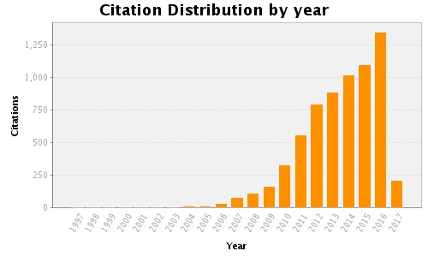
Total Articles in Publication List: 120
Articles With Citation Data: 116
Sum of the Times Cited: 6865
Average Citations per Article: 59.18
h-index: 36
Last Updated: 04/03/2017 13:25 GMT

Slide 5
Milestones on the way to the use of the database
Hans Concin took responsibility for aks Wissenschaft
Cecily Kelleher, epidemiologist and public health expert from University of Dublin. She was the first to recognize in 2001 the full potential of the database
The first peer-reviewed publication:
Ulmer H, Kelleher C, Diem G, Concin H. Tracking of Cardiovascular Risk Factors: the Vorarlberg Health Monitoring & Promotion Programme. European Heart Journal 2003.
Statistical and methodological discussions with Prof. Larry Brant, chief statistician of the Baltimore Longitudinal Study of Aging (BLSA)
The involvement of epidemiologists from nearby located University of Ulm: Prof. Stefan Weiland, Killian Rapp, Jochen Klenk and Gabriele Nagel
Highly motivated scientists: Alexander Strasak, Wegene Borena, Susanne Strohmaier, Michael Edlinger, Josef Fritz and Phd students from Ulm

Slide 6
Milestones on the way to the use of the database
Invitation to collaborate in the Metabolic Syndrome and Cancer (Me-Can) and in the ESCAPE projects
Cooperations with
the Emerging Risk Factor Collaboration (ERFC) - University of Cambridge,
the Global Burden of Metabolic Risk Factors for Chronic
Diseases Collaboration – Harvard University,
and the NCDRisC Factor Collaboration – Imperial College London

Slide 7
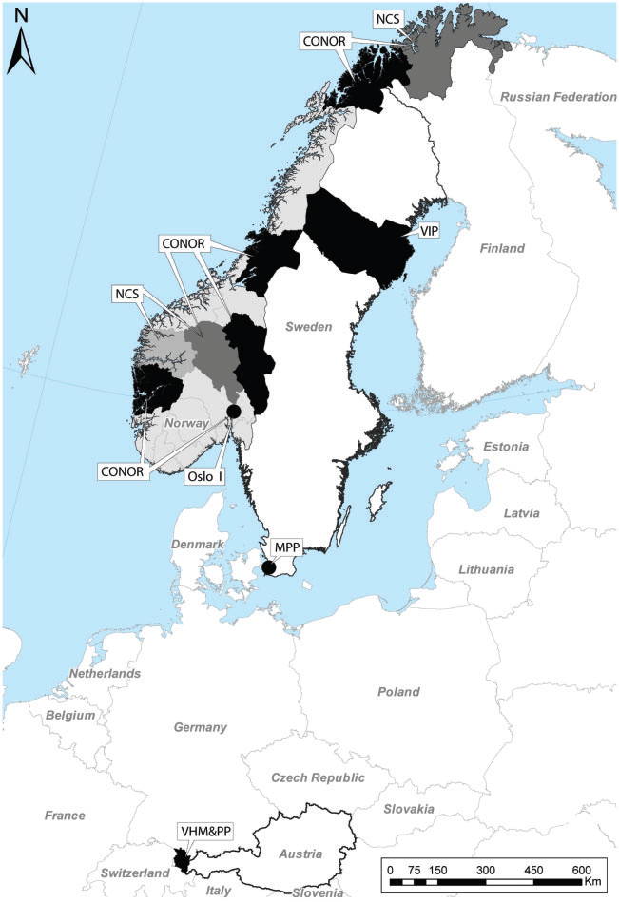
Me-Can project
In 2006, the Metabolic syndrome and Cancer project (Me-Can) was initiated in order to create a large pooled cohort to investigate factors of the metabolic
syndrome on the association with cancer risk.
Existing cohorts in Norway, Austria and Sweden were included in the project. The cohorts were: in Norway, the Oslo study I (Oslo), the Norwegian Counties Study
(NCS), the Cohort of Norway (CONOR) and the Age 40 programme (40-years); in Austria, the Vorarlberg Health Monitoring and Prevention Programme (VHM&PP); and in Sweden, the Vasterbotten Intervention Project (VIP) and the Malmo¨ Preventive Project (MPP).

Slide 8
Me-Can project
Sex-specific risk estimates of incident cancer by site per unit MetS score (standardised sum of the five separate z-scores)
Males
Females

Slide 9
Emerging Risk Factors Collaboration (ERFC) – University of Cambrige
The Emerging Risk Factors Collaboration (ERFC) has established a central database on over 1.2 million participants from >100 prospective population-based studies, in which subsets have information on lipid and inflammatory markers, other established risk factors and characteristics, as well as major cardiovascular morbidity and cause-specific mortality.
Information on repeated measurements on relevant characteristics has been collected in over 300,000 participants to enable estimation of and adjustment for within-person variability. Re-analysis of individual data will yield up to approximately 70,000 incident fatal or first ever major cardiovascular outcomes recorded during about 12 million person years at risk.
Mainly focussing on cardiovascular disease, however there are now already two papers with cancer mortality as an outcome

Slide 10
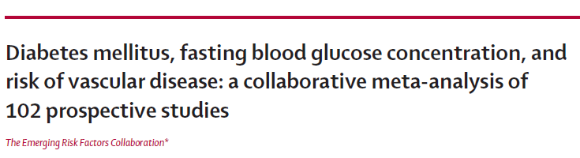

Slide 11
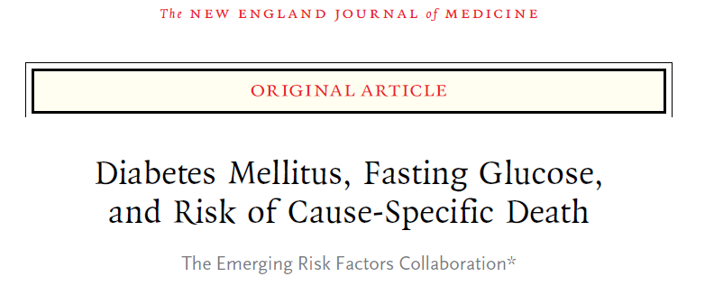
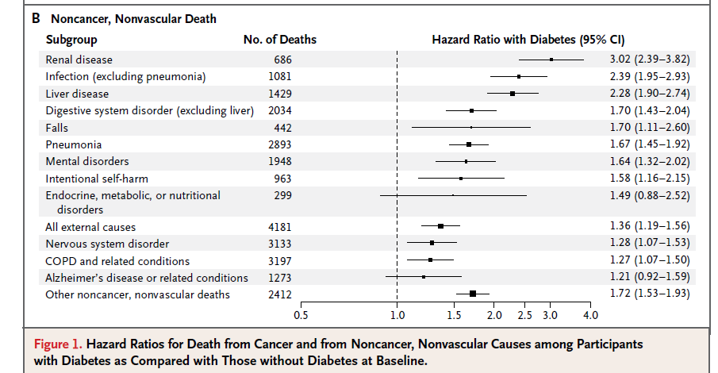

Slide 12

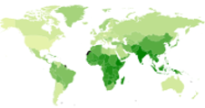
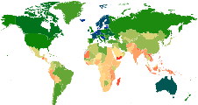
Obesity
(BMI ≥30 kg/m²)
Diabetes
Raised BP
(SBP ≥ 140 mmHg
or DBP ≥ 90 mmHg)

Slide 13
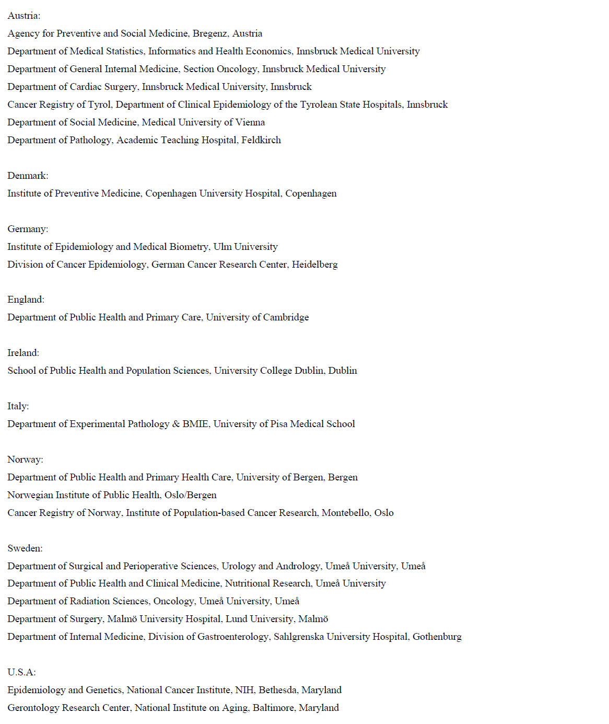

Slide 14
Publications

Slide 15
Studies in Cardiovascular Epidemiology
The Vorarlberg Health Monitoring & Promotion Programme (VHM&PP)

Slide 16
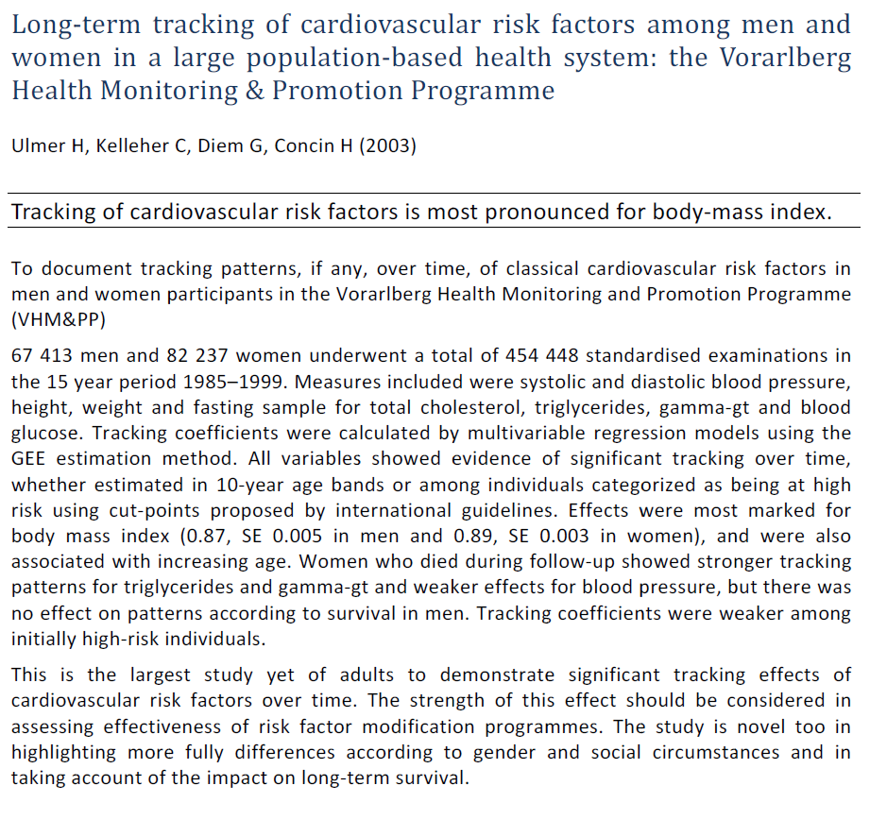

Slide 17
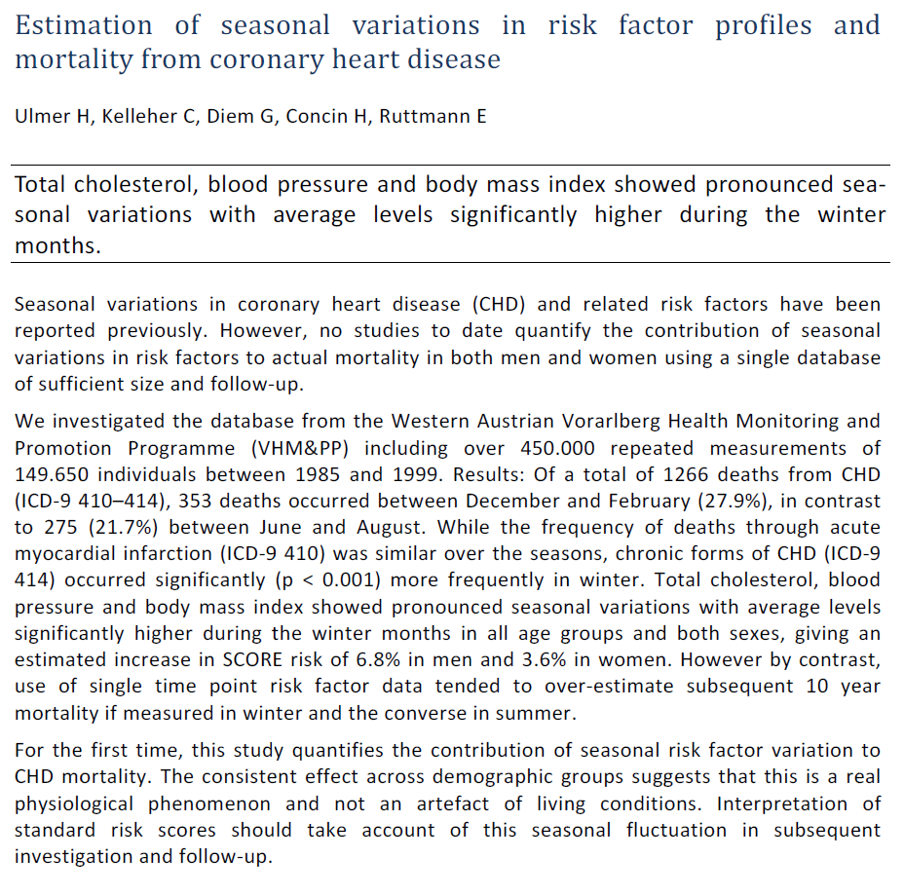

Slide 18
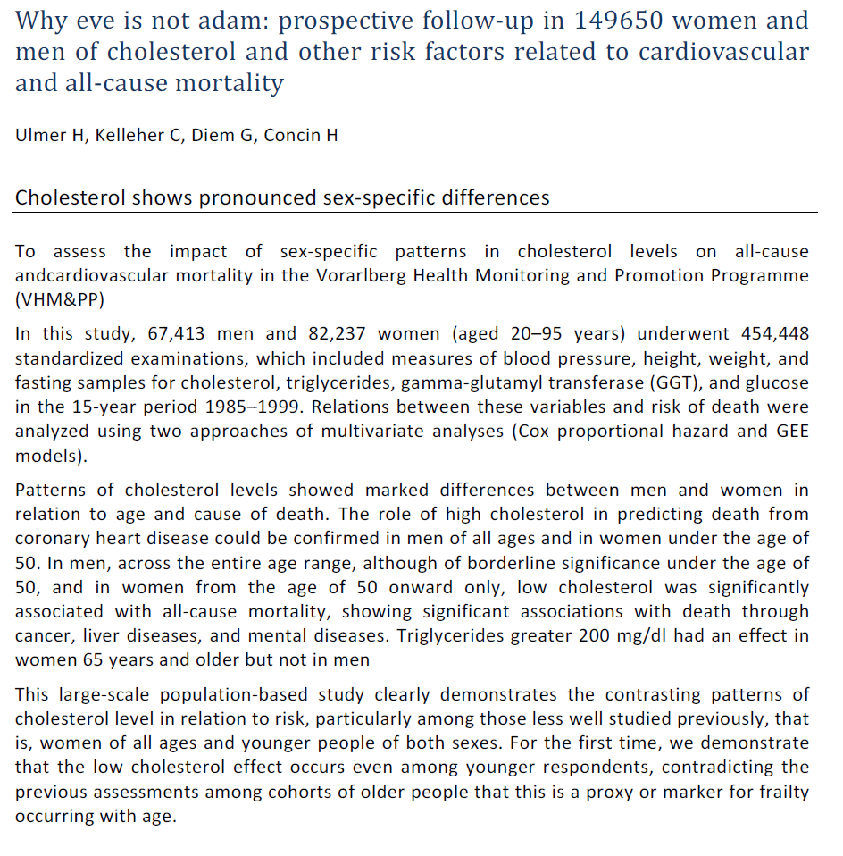

Slide 20
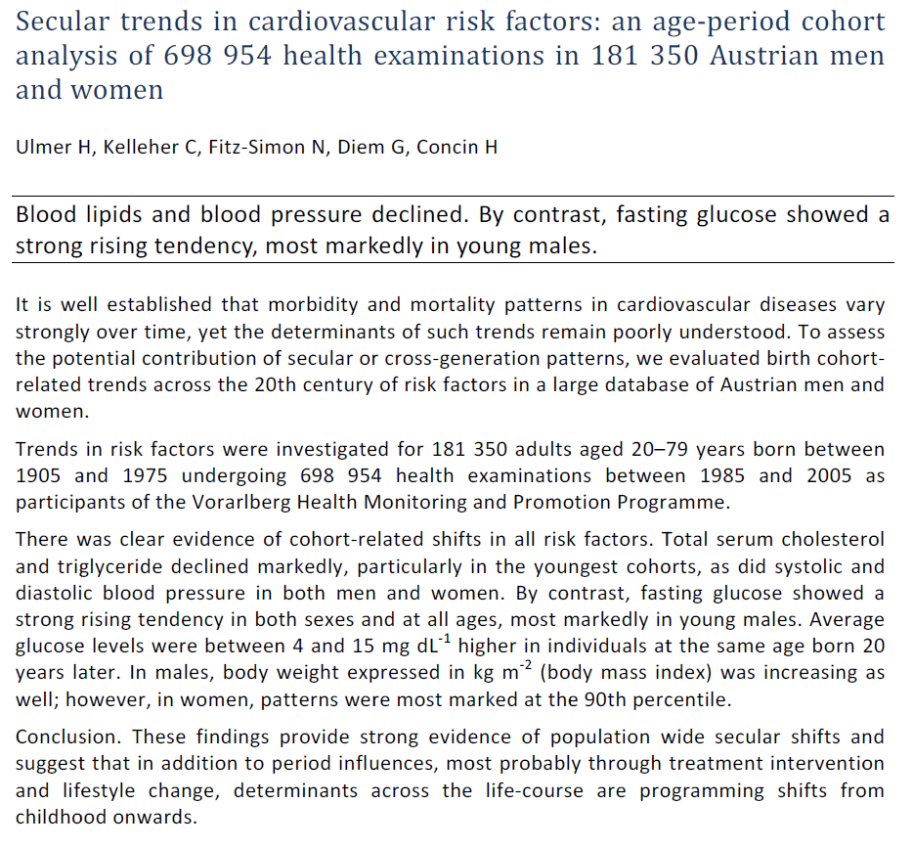

Slide 22
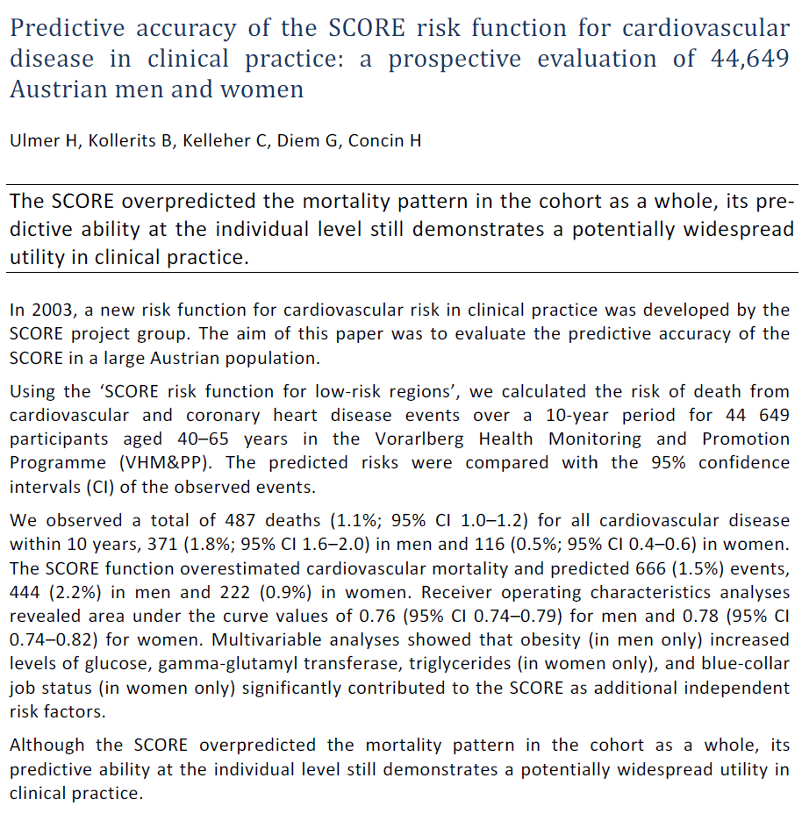

Slide 23
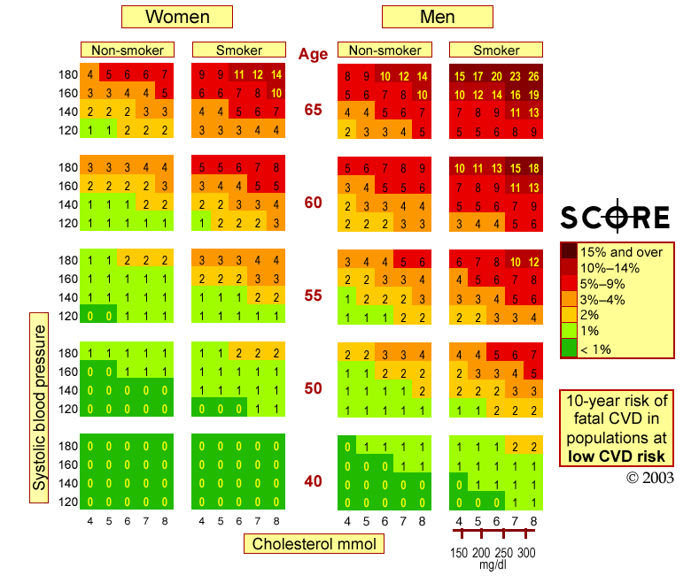

Slide 24
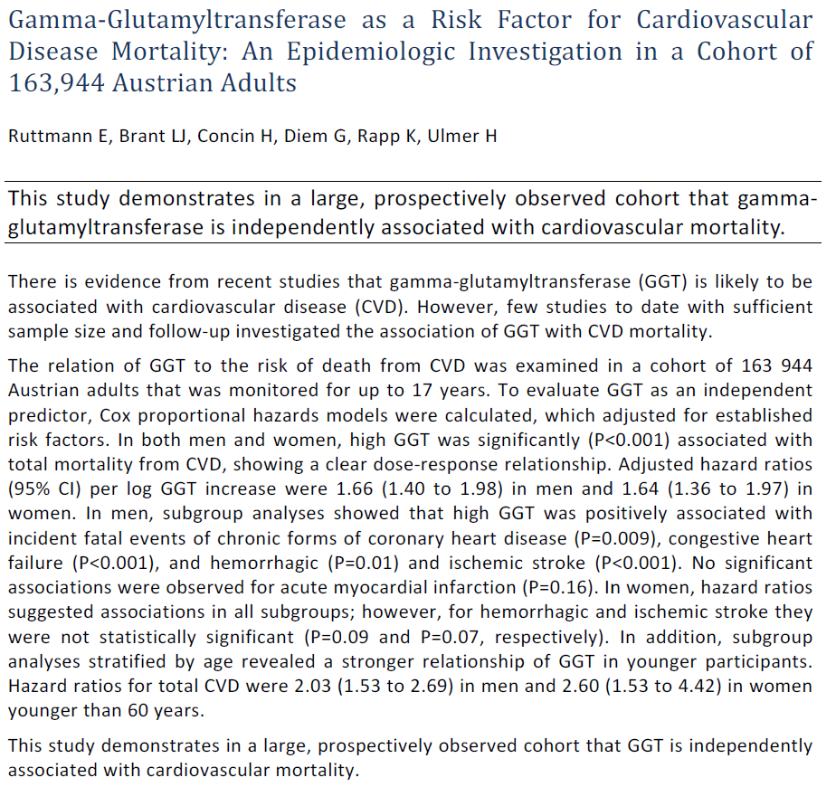

Slide 25
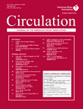
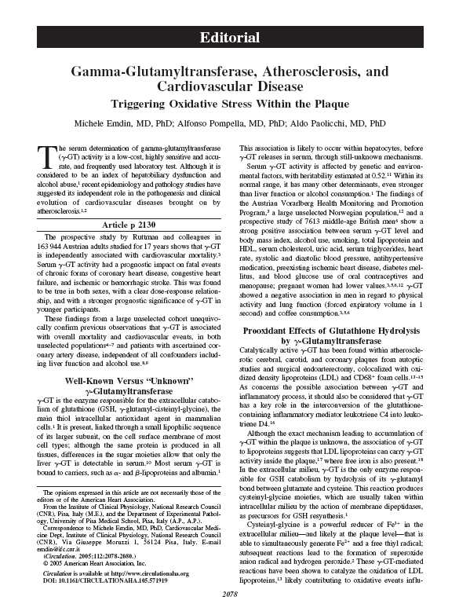
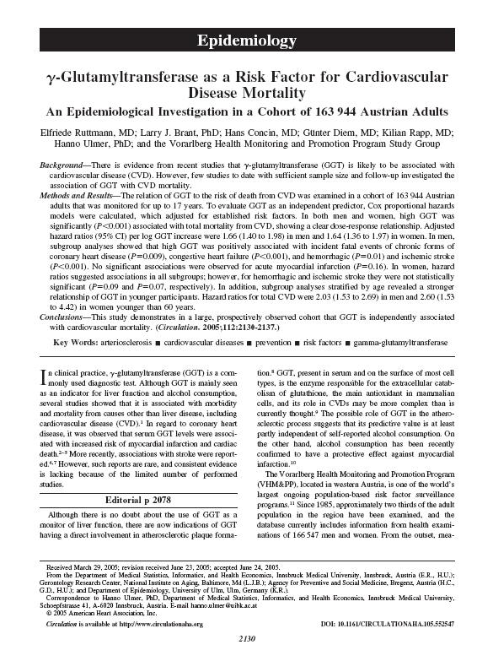

Slide 26
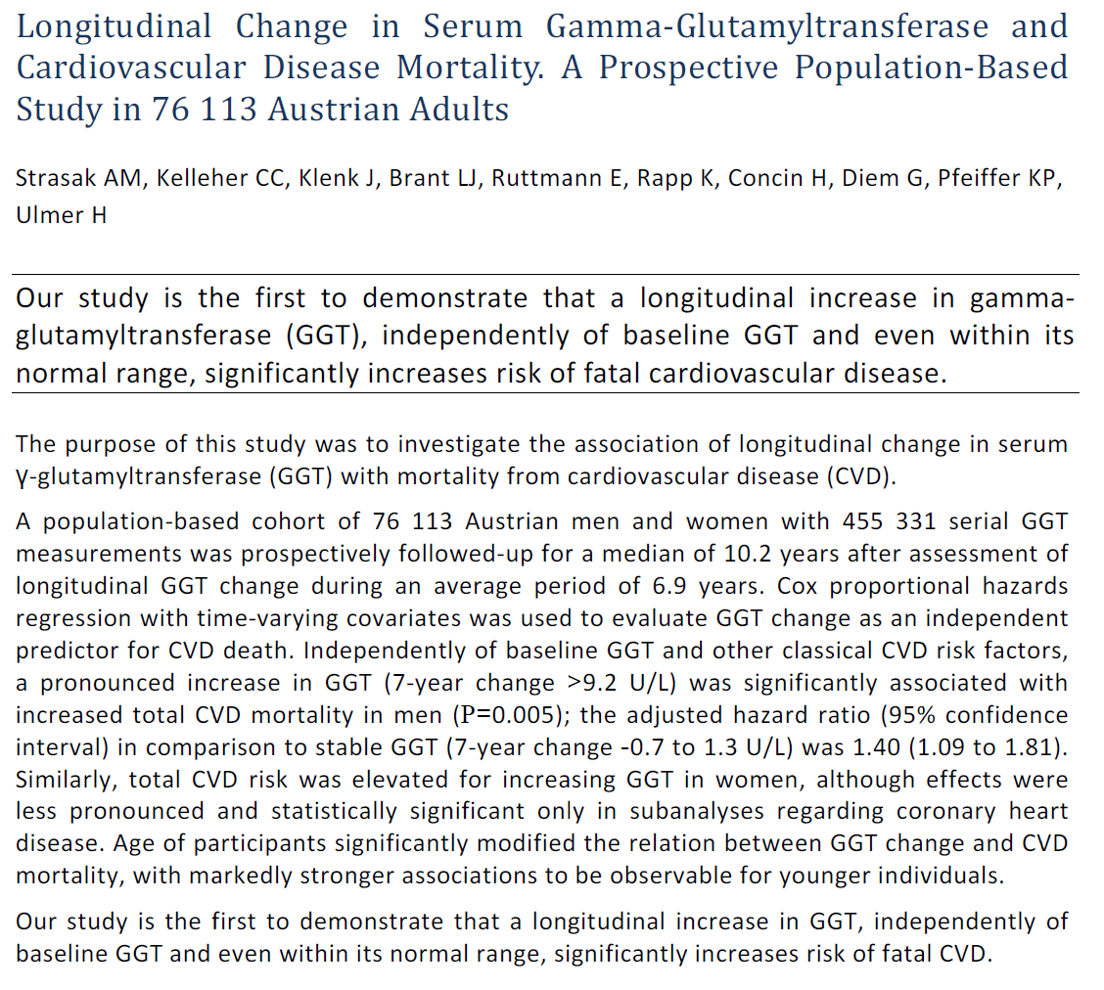

Slide 27
GGT improves risk prediction
_ _ _ SCORE predicted ____ real CVD mortality

Slide 28
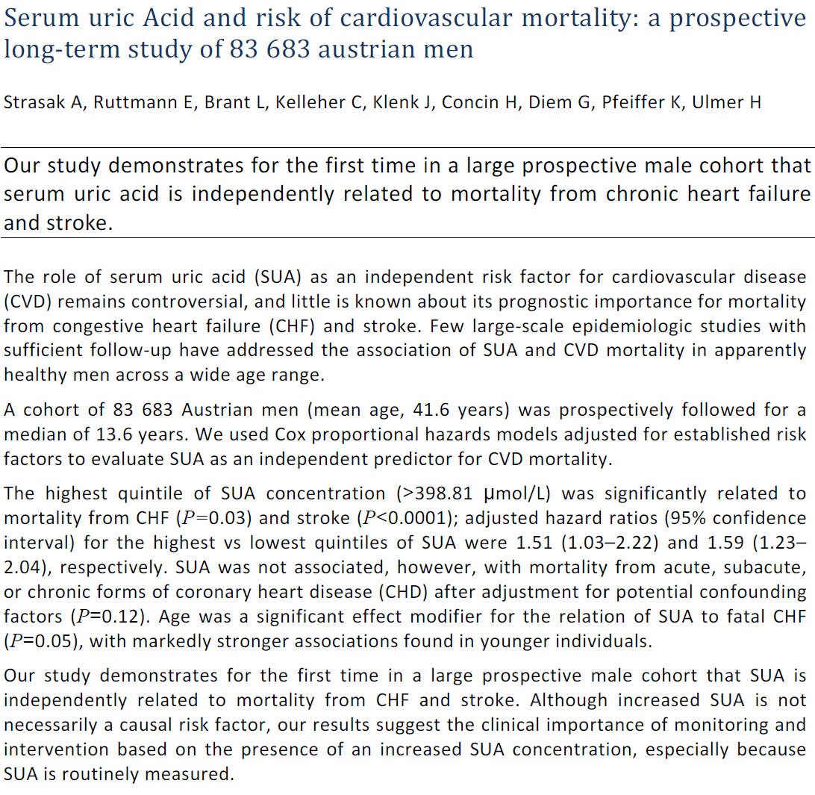

Slide 29
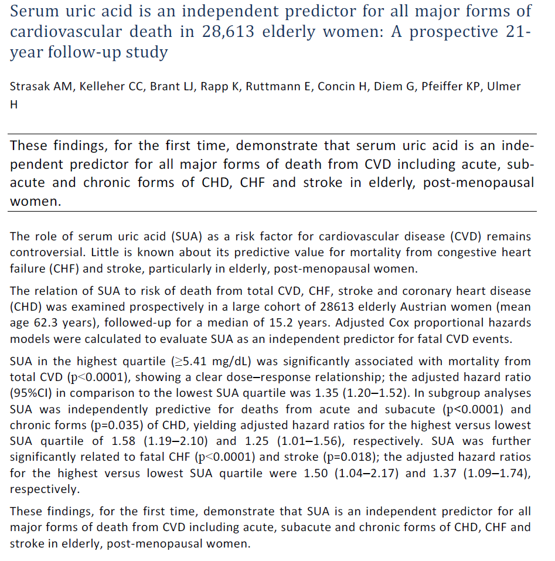

Slide 30
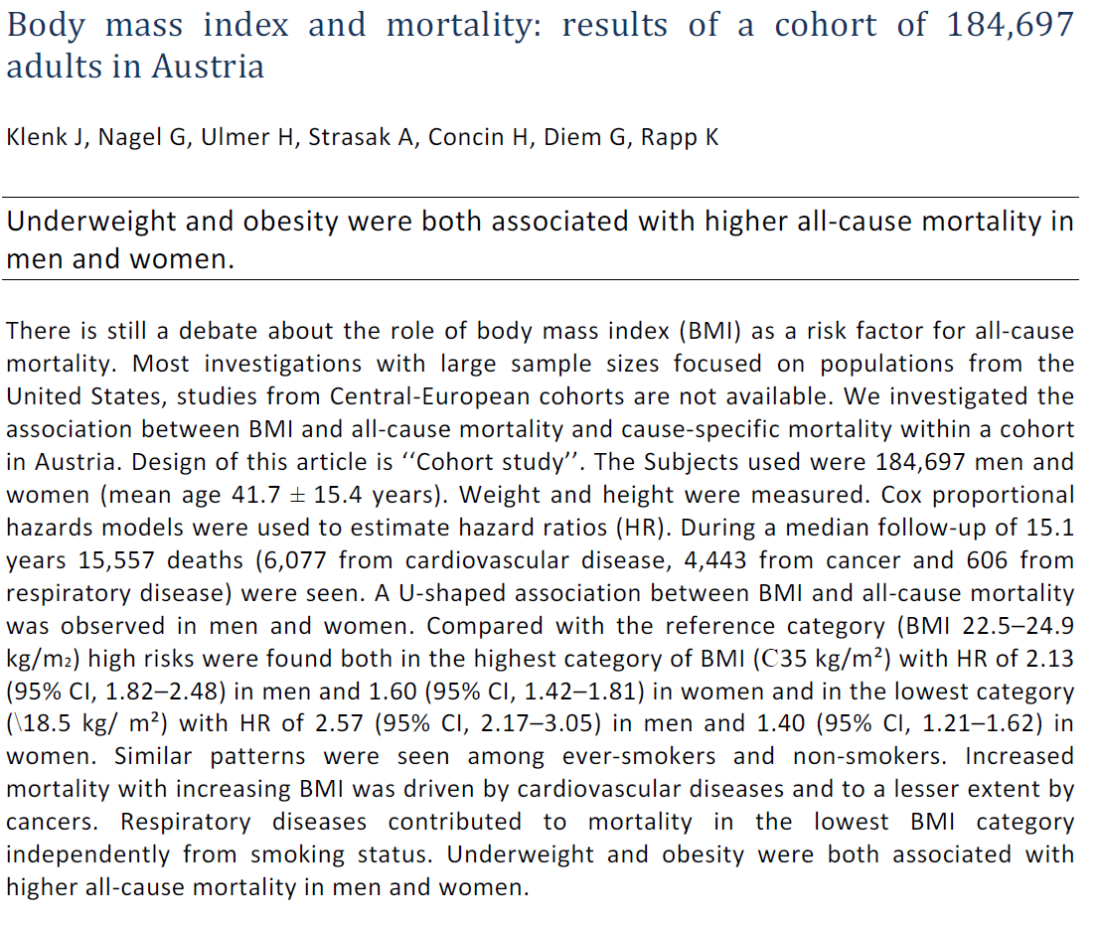

Slide 31
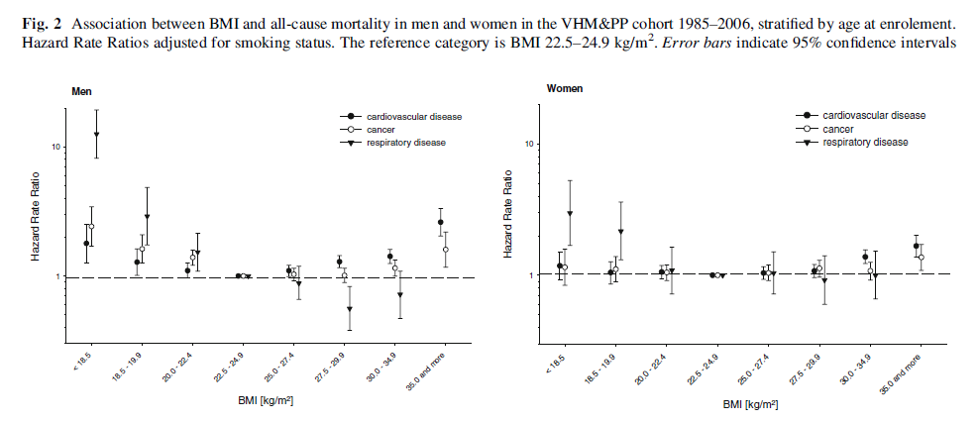

Slide 32
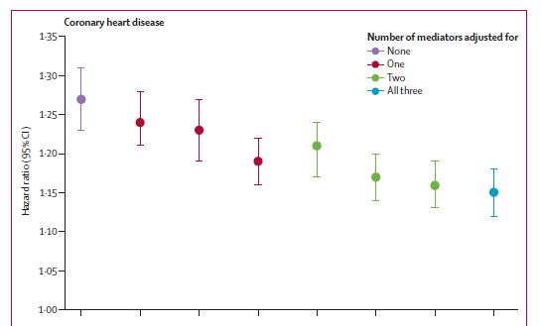
Lu Y, Hajifathalian K, Ezzati M, Woodward M, Rimm EB, Danaei G on behalf of the Global Burden of Metabolic Risk Factors for Chronic Diseases Collaboration (BMI Mediated Effect)
Metabolic mediators of the effect of body mass index, overweight and obesity on coronary heart disease and stroke: Pooled analysis of 97 prospective cohorts with 1.8 million participants. Lancet. 2014; 383(9921): 970-83.

Slide 33
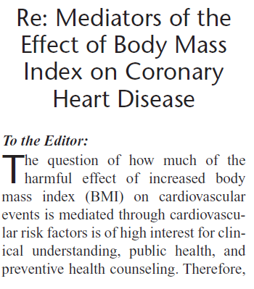
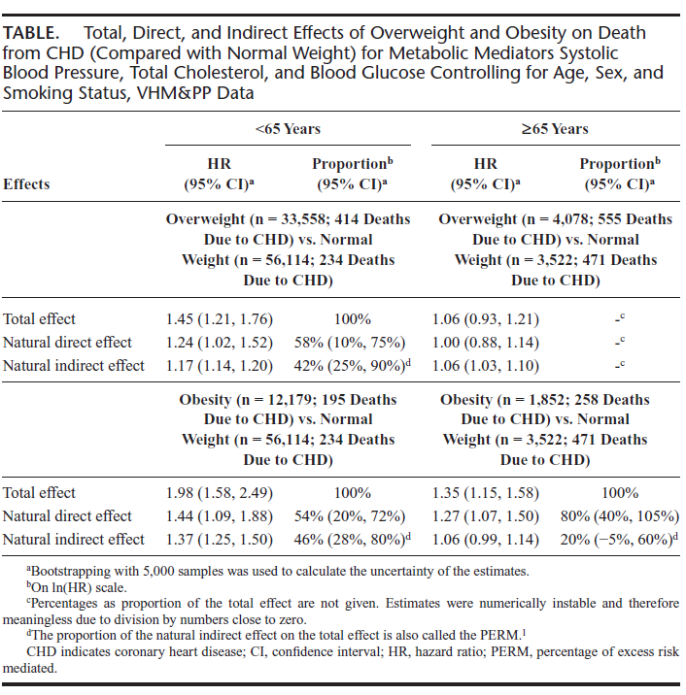

Slide 34
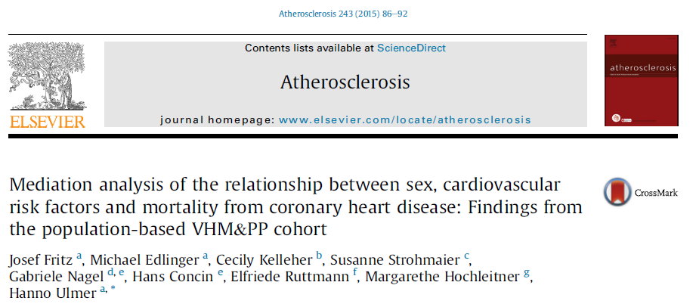

Slide 35
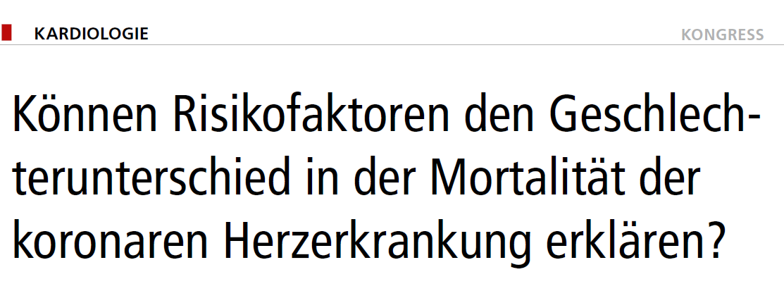
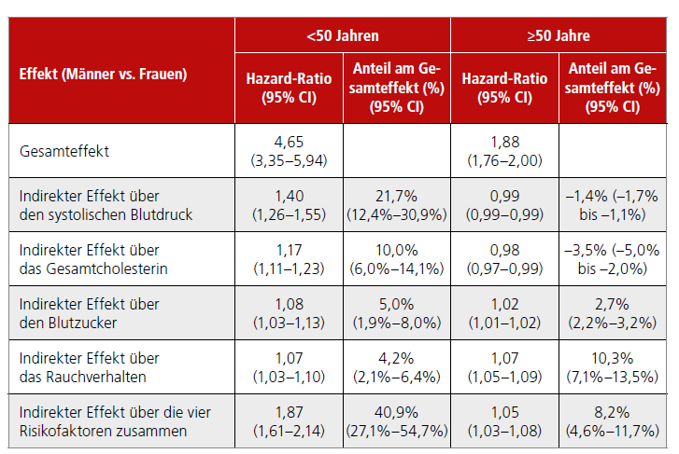

Slide 36
Studies in Cancer Epidemiology
The Vorarlberg Health Monitoring & Promotion Programme (VHM&PP)

Slide 37
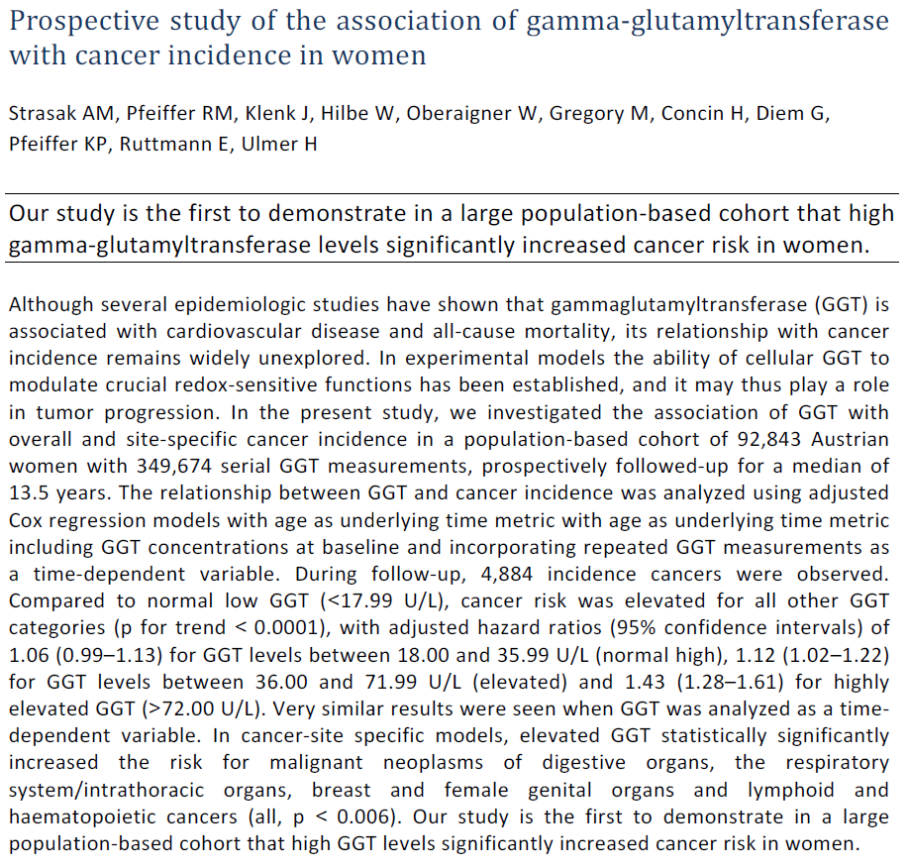

Slide 38
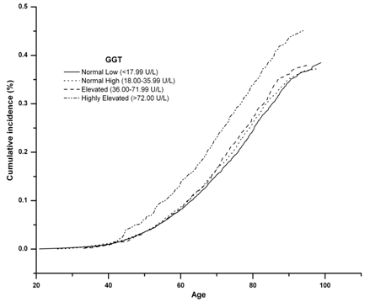

Slide 39
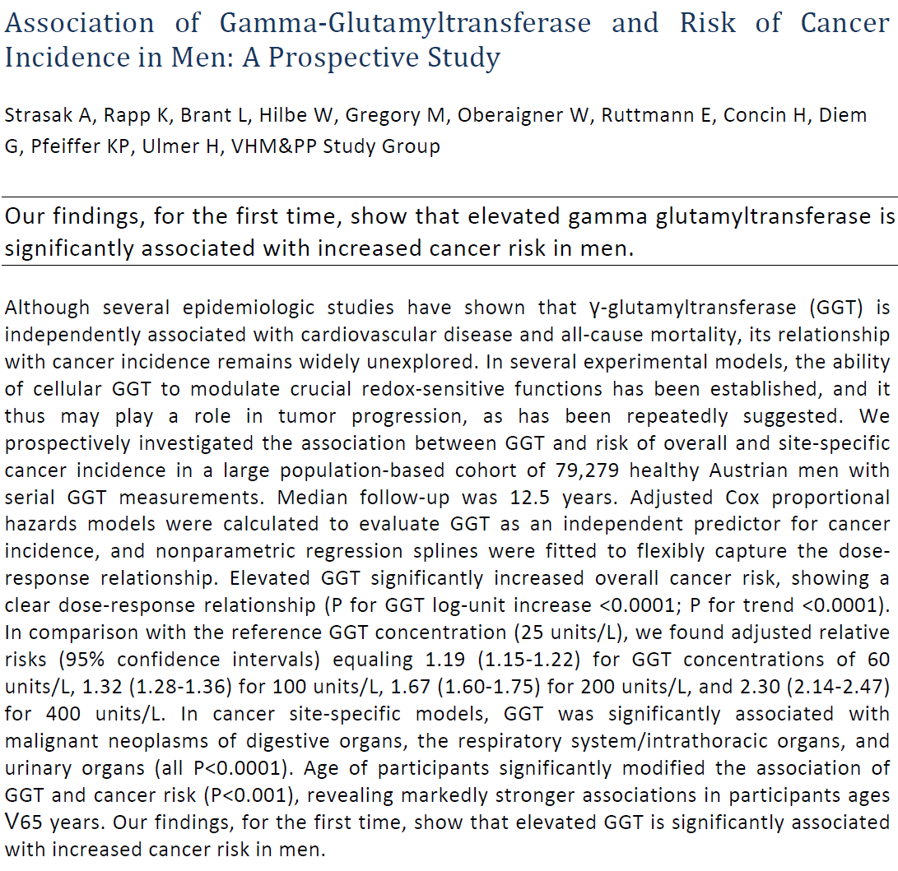

Slide 40
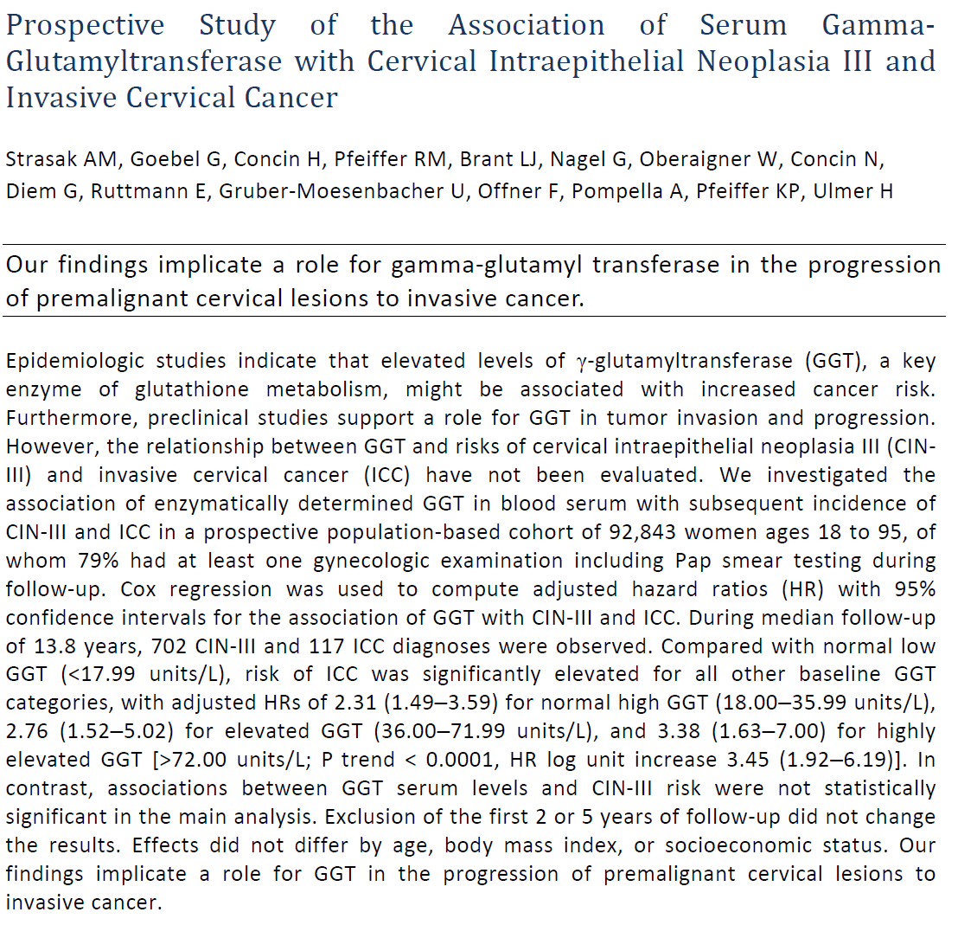

Slide 41
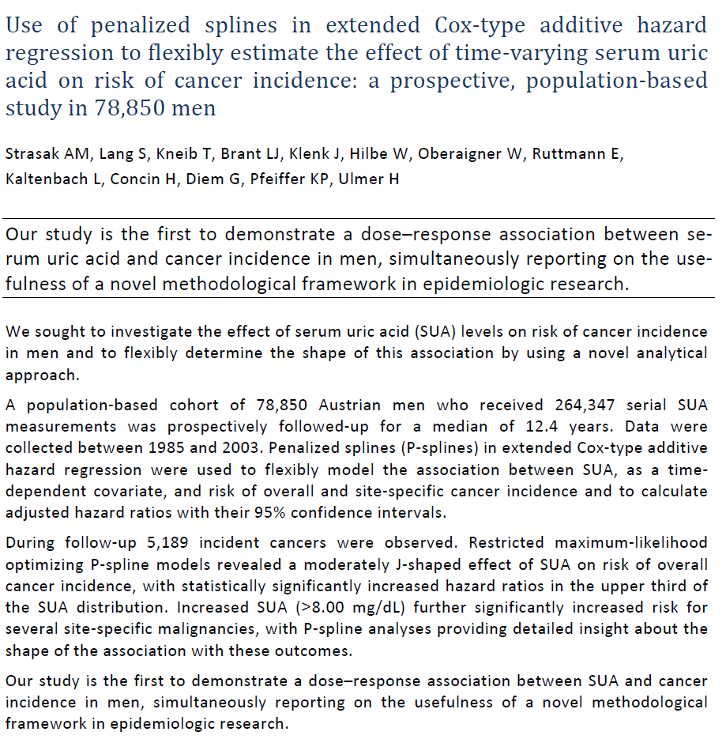

Slide 42
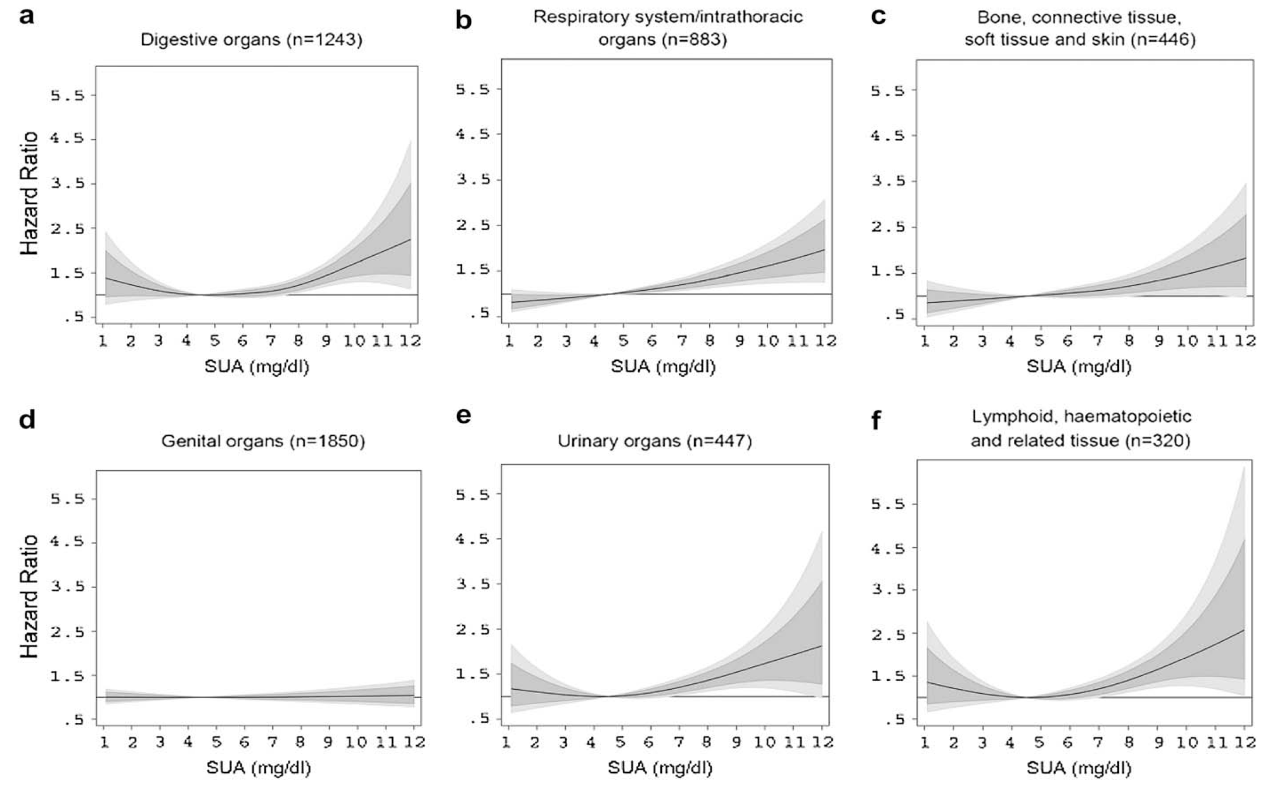

Slide 43
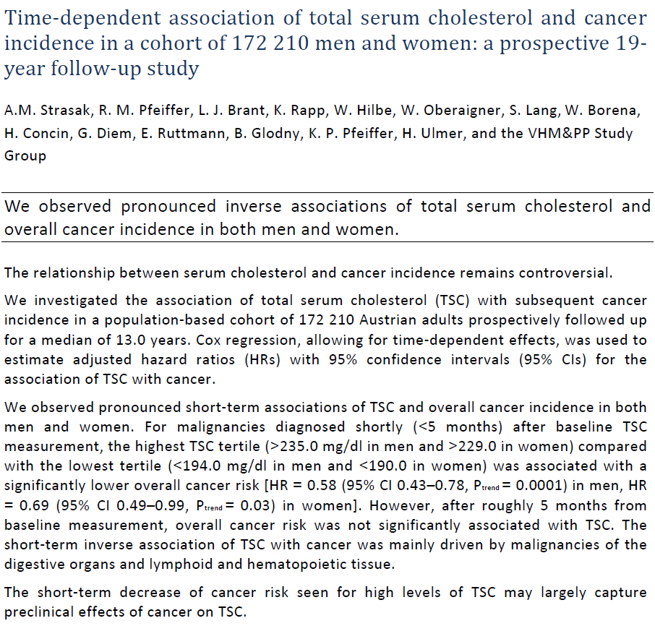

Slide 44
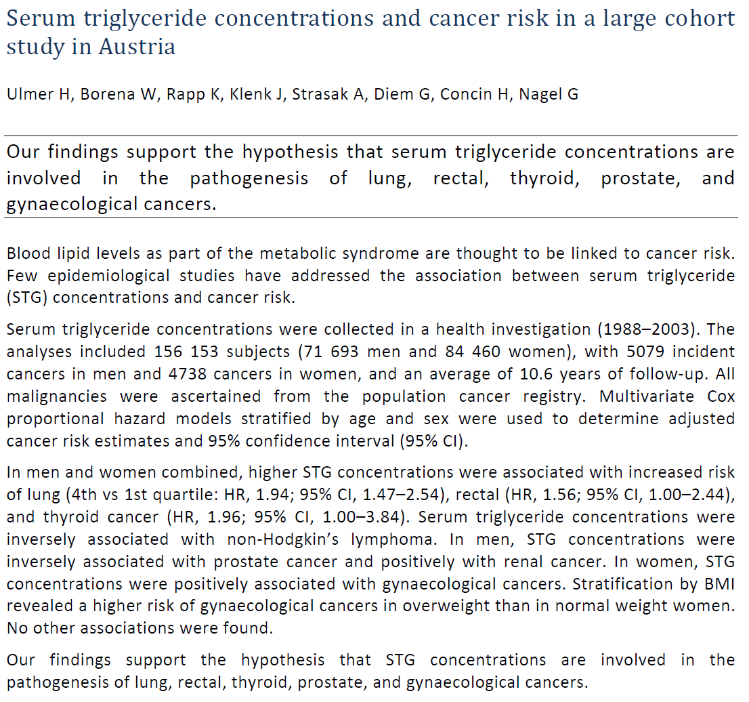

Slide 45



All our publications are online:
http://www.i-med.ac.at/msig/mitarbeiter/ulmer/vhmpp.html.de
Login: med
Password: medizin

