Slide 1
Motivating Regression Analysis: Confounding, Mediation, Moderation
Hanno Ulmer
Department for Medical Statistics, Informatics and Health Economics,
Innsbruck Medical University
Contact: hanno.ulmer@i-med.ac.at

Slide 2
Regression Analysis
Regression analysis is a statistical method to describe statistical associations between variables.
It generalizes bivariable correlation analyses to the modeling of multivariable associations, when the focus is on the relationship between a dependent variable and one or more independent variables.
Many techniques for carrying out regression analysis have been developed.
The earliest form of regression was the method of least squares, which was published by Legendre in 1805, and by Gauss in 1809.

Slide 3
Widely used Regression Analyses
Multivariable Analysis: Regress k independent on 1 dependent variable
Dependent variable is continuous: linear regression
e.g. Sex, Age, BMI -> systolic blood pressure
Estimate (standardized) Beta
Dependent variable is categorical: logistic regression
e.g. Sex, Age, BMI -> CHD within 10 years
Estimate Odds Ratio
Dependent variable is time-to-event: Cox proportional hazards regression
e.g. Sex, Age, BMI -> time to CHD (survival analysis)
Estimate Hazard Ratio

Slide 4
Why Regression Analysis?
Estimating the relationship between an exposure (e.g. risk factor, therapy) and an outcome variable (e.g. disease) is a common challenge in research.
Univariable/bivariable analyses (including significance testing, correlation coeffficients) are restricted to situations where fair comparisons are forced by study designs such as randomized, controlled trials.
In an optimal RCT, study groups only differ regarding the intervention
(e.g. Verum vs. Placebo)
This is rarely the case in observational studies. The relationship exposure – disease is usually a multivariable problem which requires techniques such as regression analysis.

Slide 5
Motivating Regression Analysis:
Confounding, Moderation, Mediation
Regression analysis is a multivariable statistical technique.
It allows to estimate the effect of an exposure variable (e.g. BMI, obesity) on an outcome variable (e.g. a disease such as coronary heart disease (CHD) in the presence of one or more ‘third factors’ (e.g. sex, age, smoking, systolic blood pressure, cholesterol, glucose, etc.) .
The impact of these third factors can be substantially different depending on the suspected causal relationships between these variables. These factors can act as confounders, moderators or mediators.
The three concepts will be discussed and illustrated using the BMI --- > CHD example

Slide 6
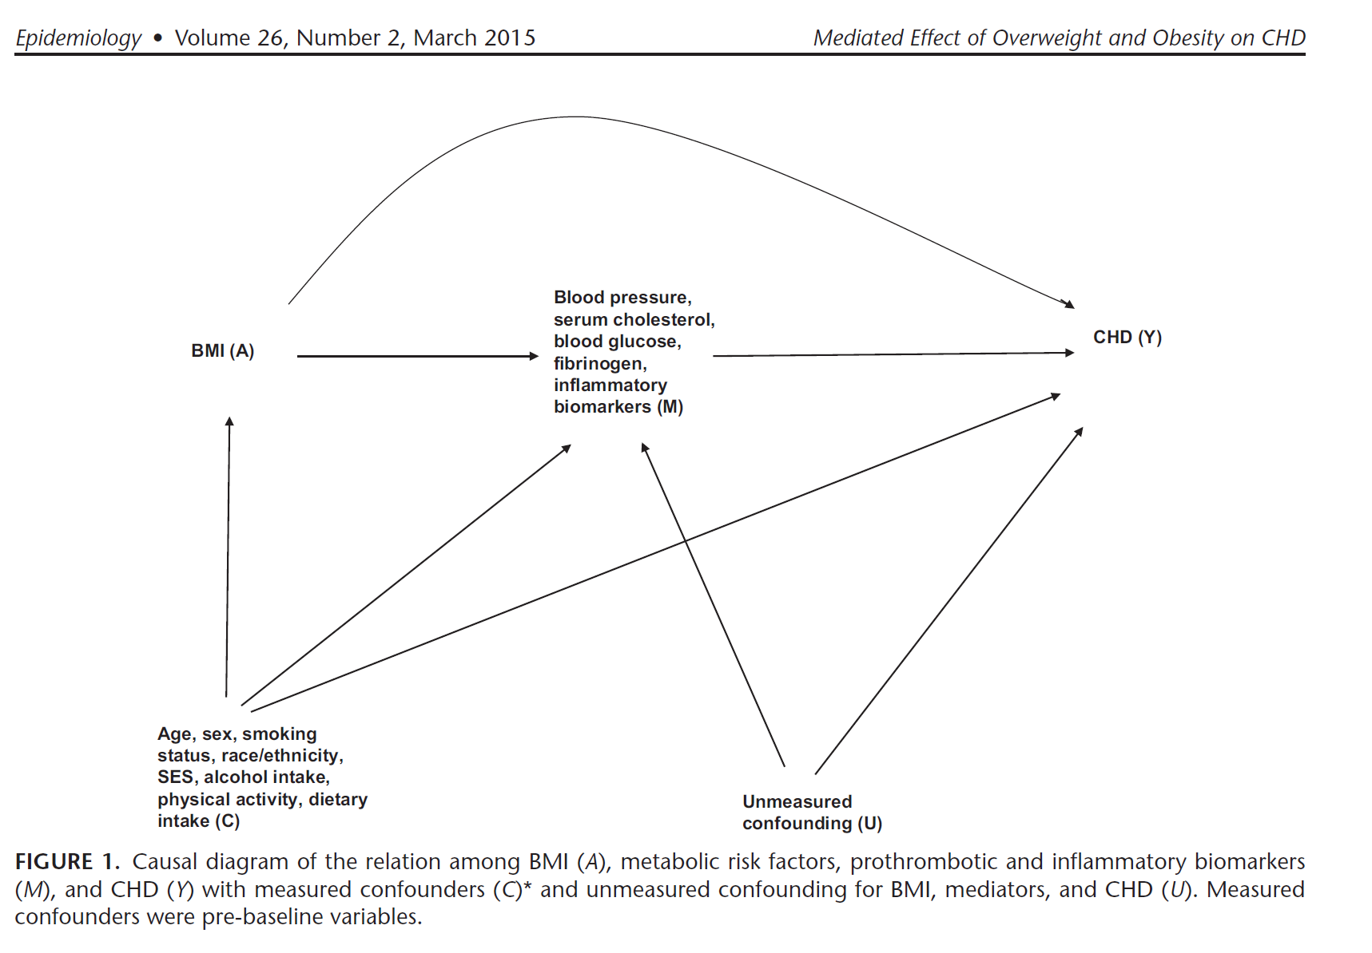

Slide 7
Example Data
Vorarlberg Health Examinations (VHM&PP)
Sex (male, female) categorical
Age in years continuous
Year of Examination continuous
Body Mass Index in kg/m2 continuous
Systolic Blood Pressure in mmHG continuous
Total Cholesterol in mg/dl continuous
Fasting Glucose in mg/dl continuous
Smoking (current or past, never) categorical
Coronary Heart Disease Mortality time to event
(ICD-10: I20-I25) continuous and categorical

Slide 8
Confounding
Confounding:
A “mixing of the effect” of the exposure-disease relationship with a third (or more) factors
BMI ----------------------------------------- > CHD
< ------ Sex, Age, Smoking ----- >

Slide 9
Example
Relationship between BMI and CHD incidence:
Crude Hazard Ratio
Obesity (30+ kg/m2) versus Normal Weight (20-25 kg/m2)
HR = 2.54 95%CI (2.32-2.78)
Sex, age and smoking adjusting Hazard Ratio:
HR = 1.60 95%CI (1.46-1.75)
Adjusted means controlled for confounding
Calculated with Cox proportional hazards regression analysis

Slide 10
Confounding
Three essential characteristics:
The confounder is associated with the exposure of interest (BMI)
The confounder is associated with the disease (CHD)
The confounder is not in the causal pathway leading from the exposure of interest (BMI) to the disease of interest (CHD)

Slide 11
Methods for Preventing Confounding in Study Designs
Stringent inclusion criteria to narrow the variability between study participants
Randomization (intervention/RCT only)
Matching:
Simple Matching e.g. for age and sex in case-controls studies
versus
Propensity Score Matching (involves logistic regression analysis)
Very popular in clinical research:
Blackstone EH. Comparing apples and oranges. J Thoracic and Cardiovascular Surgery 2002; 1: 8-15.
Ruttmann E, Fischler N, Sakic A, Chevtchik O, Alber H, Schistek R, Ulmer H, Grimm M. Second internal thoracic artery versus radial artery in coronary artery bypass grafting: a long-term, propensity score-matched follow-up study. Circulation. 2011 20;124(12):1321-9.

Slide 12
Effect Modification/Moderation
Effect modification occurs when the association between the exposure (BMI) and the disease (CHD) varies by levels of a third factor.
How to assess: include interaction terms into the regression model
Interaction age*obesity p<0.001
Young: BMI ----------------------------------------- > CHD
Old: BMI ----------------------------------------- > CHD

Slide 13
Example
Relationship between BMI and CHD incidence moderated by age:
Interaction age*obesity p<0.001
Obesity (30+ kg/m2) versus Normal Weight (20-25 kg/m2)
Sex, age and smoking adjusting Hazard Ratio:
<50 years of age:
HR = 3.13 95%CI (2.27-4.31)
50+ years of age:
HR = 1.51 95%CI (1.37- 1.66)

Slide 14
Mediation
Mediation occurs if factors, like confounders, are associated with the exposure of interest (BMI) and the disease (CHD), but are in the causal pathway leading from the exposure to the disease.
These factors are called mediators:
BMI ---- > Blood Pressure, Cholesterol, Diabetes ---- > CHD

Slide 15
Example
Mediators in the relationship between BMI and CHD incidence:
Sex, age and smoking adjusting Hazard Ratio:
Total effect of BMI (obesity versus normal weight) on CHD:
HR = 1.60 95%CI (1.46-1.75)
Direct effect of BMI on CHD
HR = 1.30 95%CI (1.19–1.43)
Indirect effect mediated by blood pressure, cholesterol and glucose
HR = 1.23 95%CI ( 1.15-1.32) 95% CIs estimated by Bootstrap

Slide 16
Example
Mediators in the relationship between BMI and CHD incidence:
Effect of BMI on CHD mediated by blood pressure, cholesterol and glucose
PERM (Percentage of excess risk mediated) =
(1.60-1.30)/(1.60-1)*100
= 50% (approximative formula)
Global Burden of Metabolic Risk Factors for Chronic Diseases Collaboration. Metabolic mediators of the effects of body-mass index, overweight, and obesity on coronary heart disease and stroke: a pooled analysis of 97 prospective cohorts with 1·8 million participants. Lancet. 2014 Mar 15;383(9921):970-83

Slide 17
Mediation Techniques
Traditional approach:
Baron RM, Kenny DA. The moderator-mediator variable distinction in social
psychological research: conceptual, strategic, and statistical considerations. J
Pers Soc Psychol. 1986 Dec;51(6):1173-82
New approaches:
Lange T, Rasmussen M, Thygesen LC. Assessing natural direct and indirect effects through multiple pathways. Am J Epidemiol. 2014 Feb 15;179(4):513-8.
VanderWeele T. Explanation in Causal Inference: Methods for Mediation and Interaction. Oxford University Press 2015.
New appraoches applied on BMI --- > CHD problem:
Lu Y, Hajifathalian K, Rimm EB, Ezzati M, Danaei G. Mediators of the effect of body mass index on coronary heart disease: decomposing direct and indirect effects. Epidemiology. 2015 Mar;26(2):153-62.

