Slide 1


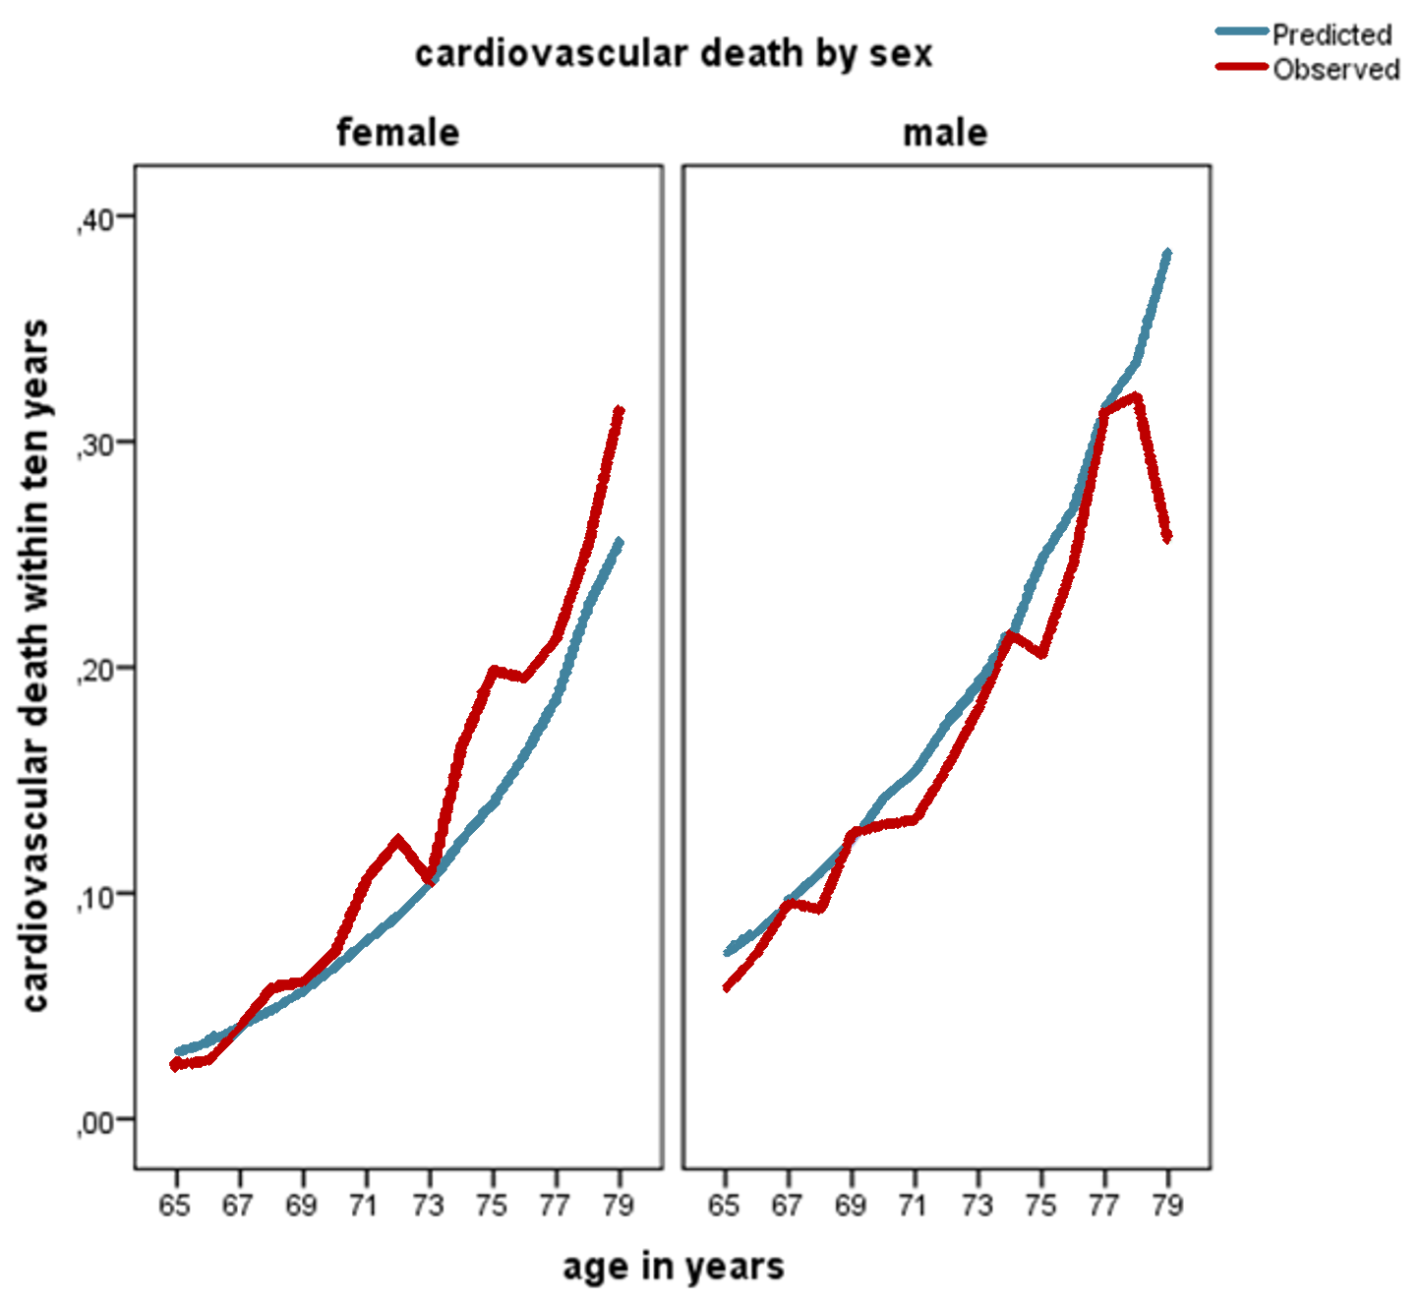
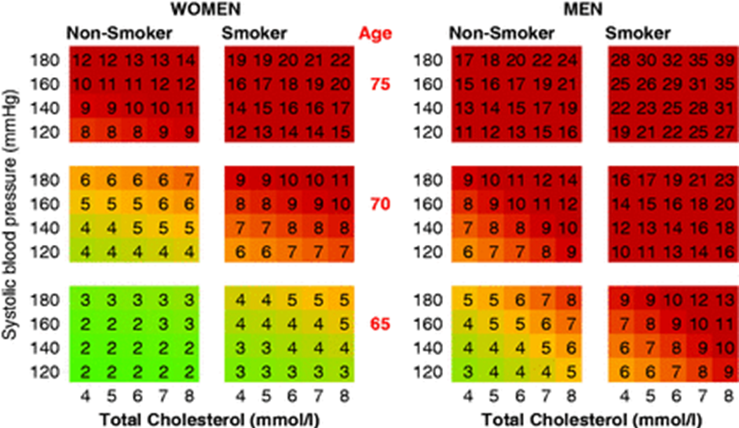


Validation of the SCORE O.P. for prediction of cardiovascular disease mortality in a large population of elderly individuals
Sophia Andexlinger ¹, Josef Fritz ¹, Michael Edlinger ¹, Hans Concin ², Gabriele Nagel ³, Wolfgang Brozek ², Elfriede Ruttmann ¹, Bernhard Föger ², Hanno Ulmer ¹
¹ Medical University of Innsbruck, Austria, ² Agency of Preventive- and Social Medicine, Bregenz, Austria, ³ University of Ulm, Germany
Background
Estimation of absolute cardiovascular risk in apparently healthy individuals, using SCORE (Systematic COronary Risk Evaluation) is recommended by the ESC guidelines on cardiovascular disease (CVD) prevention in clinical practice. Recently, the SCORE system has been extended by the SCORE O.P. (older people) aiming to improve estimates of cardiovascular risk specifically in older persons (65 years and older).
Purpose
The aim of this study was to validate the SCORE O.P. in an Austrian population of 34,909 healthy individuals aged between 65 and 80 years who were prospectively followed up for a minimum of 10 years.
Methods
Predicted fatal CVD and coronary heart disease (CHD) event rates within 10 years were calculated using the ‘SCORE O.P. risk function for low risk regions’ and compared to the actually observed rates, thereby assessing calibration. In addition, predicted probabilities were plotted against observed mortality by deciles of predicted risk. Regarding discrimination, receiver operating characteristics (ROC) analysis and corresponding c-statistics were used.
Results (males)
In 14,586 males, 1,509 deaths from CVD (10.4%) and 847 deaths from CHD (5.8%) occurred within 10 years of follow-up. SCORE O.P. predicted 1,699 fatal CVD (11.7%) and 872 CHD (6.0%) events. In male high risk individuals (10th decile), SCORE O.P. overestimated mortality from CVD and CHD. C-statistics were 0.68 (95% CI 0.67–0.70) for CVD and 0.67 (0.65-0.69) for CHD.
Results (females)
In 20,323 females, 1,340 deaths from CVD (6.6%) and 672 deaths from CHD (3.3%) were observed. SCORE O.P. predicted 1,232 fatal CVD (6.1%) and 539 CHD events (2.7%). In female high risk individuals (8th-10th deciles), SCORE O.P. underestimated mortality from CVD and CHD. C-statistics were 0.77 (0.75-0.78) for CVD and 0.77 (0.75-0.79) for CHD.
Conclusion
With regard to overall accuracy, the SCORE O.P. performed considerably well in this elderly Austrian population. However, in high-risk individuals, cardiovascular risk was overestimated for males and underestimated for females. Overall, SCORE O.P. was able to discriminate high-risk from low-risk individuals, better in women than in men. The authors declare no conflicts of interest.
VHM&PP: Vorarlberg
Health Monitoring and
Promotion Programme
References
Cooney M, Selmer R, Lindman A, Tverdal A, Menotti A, Thomsen T, et al. Cardiovascular risk estimation in older persons: SCORE OP. European Journal of Preventive Cardiology. 2016;23(10):1093 – 1103.
Piepoli M, Hoes A, Agewall S, Albus C, Brotons C, Catapano A, et al. 2016 European Guidelines on cardiovascular disease prevention in clinical practice. European Heart Journal. 2016; 37(29):2315–2381.
Steyerberg EW. Clinical prediction models: a practical approach to develop-ment, validation, and updating. New York: Springer, 2009.
Ulmer H, Kollerits B, Kelleher C, Diem G, Cocin H. Predictive accuracy of the SCORE risk function for cardiovascular disease in clinical practice: a prospective evaluation of 44 649 Austrian men and women. European Journal of Cardiovascular Prevention and Rehabiliation. 2005;12:433-441.
Figure 1.
Predicted versus observed cardiovascular death within 10 years by age (65-80 years) and sex (%). Predicted mortality was calculated with the SCORE O.P. risk function for low risk regions and validated in the study population of the VHM&PP.
Figure 2.
SCORE O.P. risk function for low risk regions.
(Cooney et al. 2016)
Department of MSIG
Innsbruck Medical University
Schöpfstraße 41 / 1
A-6020 Innsbruck, Austria
T: +43 512 9003 70900
E: Hanno.Ulmer@i-med.ac.at
I: http://www.i-med.ac.at/msig/

