Slide 1



Do metabolic risk factors mediate the genetic risk for coronary heart disease?
Josef Fritz¹, Dov Shiffman², Olle Melander^{3,4},
Hayato Tada⁵, Hanno Ulmer¹
¹Department of Medical Statistics, Informatics and Health Economics, Medical University of Innsbruck, Austria
²Quest Diagnostics, San Juan Capistrano, CA, USA
³Department of Clinical Sciences, Lund University, Malmö, Sweden
⁴Department of Internal Medicine, Skåne University Hospital, Malmö, Sweden
⁵Department of Cardiovascular and Internal Medicine, Kanazawa University Graduate School of Medicine, Kanazawa, Japan
josef.fritz@i-med.ac.at

Slide 2
Declaration of interest
Dov Shiffman is an employee of Quest Diagnostics.
Otherwise, we have nothing to declare.

Slide 3

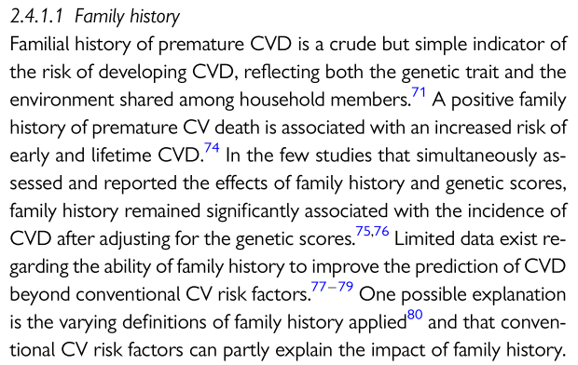
2016 ESC Guidelines on CVD prevention (1)
“A positive family history of premature CV death is associated with an increased risk of early and lifetime CVD.”
“… conventional CV risk factors can partly explain the impact of family history.”
Questions not answered:
  How much is explained?
  By which risk factors exactly?

Slide 4

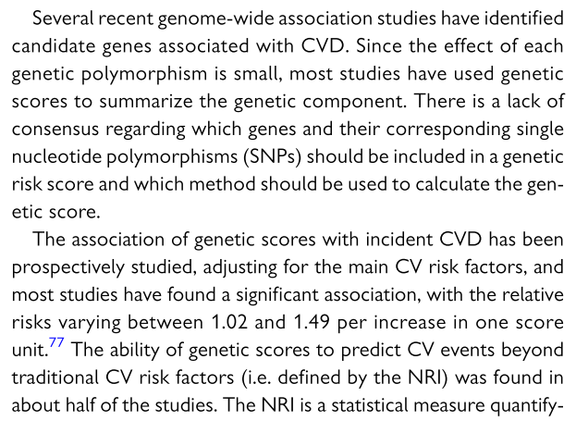
2016 ESC Guidelines on CVD prevention (2)
“… genetic scores to summarize the genetic component of CVD risk”
…
“Studies found a significant association of genetic scores with incident CVD, adjusting for the main CV risk factors.”

Slide 5
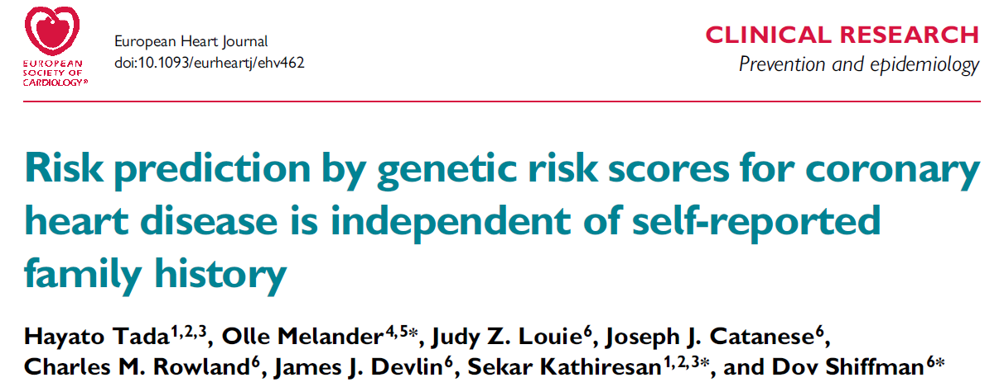
Measuring CHD genetics
Family history of CHD
    self-reported
Genetic risk scores (GRS)
    directly assessed
    based on multiple SNPs
    2010: GRS13
    2013: GRS46
    2016: GRS50 (EHJ 2016;37:561-7)

Slide 6
Data used – the Malmö Diet and Cancer (MDC) study
Community-based, prospective observational study
23,595 participants with complete data for our investigation
Middle-aged men and women (aged 45-73)
Enrolled between 1991 and 1996
2,213 first CHD events during a median follow-up of 14.4 years
    defined as coronary revascularization, fatal or nonfatal myocardial infarction, or death due to ischemic heart disease
Measured metabolic risk factors: blood pressure, antihypertensive medication, apolipoproteins (A-I and B), diabetes mellitus
Measured genetic risk factors: family history, GRS50

Slide 7
Metabolic risk factors are intermediate variables on the causal pathway between exposure (family history or GRS50) and outcome (CHD incidence)
Red: confounders; blue: mediators
: direct effect; : indirect effects
Total effect: direct and indirect effects together

Slide 8
Two examples
… for a strong direct effect:
    metabolically healthy person without risk factors and genetic risk
… for a strong indirect effect:
    metabolically unhealthy person with risk factors and genetic risk
    conventional CV risk factors explain the impact of genetic risk

Slide 9
Aim
To decompose the total effect of family history of CHD or GRS50 into a direct effect and indirect effects mediated by metabolic risk factors in a statistical mediation analysis
To quantitatively assess the fraction of family history and of GRS50 mediated through established cardio-metabolic risk pathways

Slide 10
Methods
Natural effect models proposed by Lange et al.
    Am. J. Epidemiol. 2012;176:190-5
    Am. J. Epidemiol. 2014;179:513-8
Novel method to perform statistical mediation analysis
Embedded in the framework of causal inference and counterfactuals
Cox proportional hazards and additive hazards models as final outcome models

Slide 11
Results: family history
Metabolic mediators of CHD incidence
Effects adjusted for age, sex, and smoking status

Slide 12
Results: family history
Metabolic mediators of CHD incidence
Effects adjusted for age, sex, and smoking status
Additional incident CHD cases per 100,000 person-years

Slide 13
Results: GRS50
Metabolic mediators of CHD incidence
Highest vs. lowest quintile of GRS50
Effects adjusted for age, sex, and smoking status

Slide 14
Results: GRS50
Metabolic mediators of CHD incidence
Highest vs. lowest quintiles of GRS50
Additional incident CHD cases per 100,000 person-years
Effects adjusted for age, sex, and smoking status

Slide 15
Conclusions
Our data indicates that a fraction of the CHD risk associated with family history or with GRS50 is mediated through dyslipidaemia and hypertension, but not through diabetes.
However, it seems that the major part (≥80%) of the genetic effect operates independently from the established metabolic risk factors.
Metabolically healthy individuals with genetic predisposition form an important group of individuals at risk for CHD providing a major challenge for primary prevention.
Therefore, intensified preventive measures in addition to risk factor surveillance and treatment may be of benefit in genetically predisposed individuals.

Slide 16
References
Piepoli, M. F. et al. 2016 European Guidelines on cardiovascular disease prevention in clinical practice: The Sixth Joint Task Force of the European Society of Cardiology and Other Societies on Cardiovascular Disease Prevention in Clinical Practice. Eur. Heart J. 37, 2315–81 (2016).
Tada, H. et al. Risk prediction by genetic risk scores for coronary heart disease is independent of self-reported family history. Eur. Heart J. 37, 561–7 (2016).
Schunkert, H. Family or SNPs: what counts for hereditary risk of coronary artery disease? Eur. Heart J. 37, 568–71 (2016).
Lange, T., Vansteelandt, S. & Bekaert, M. A simple unified approach for estimating natural direct and indirect effects. Am. J. Epidemiol. 176, 190–5 (2012).
Lange, T., Rasmussen, M. & Thygesen, L. C. Assessing natural direct and indirect effects through multiple pathways. Am. J. Epidemiol. 179, 513–8 (2014).

