Slide 1
REGISTRY DATA:
QUO VADIS?
Zeit: Mi, 04.03.2026, 17:00 Uhr
Ort: Fritz-Pregl-Straße 3, 8. OG

Slide 2
SYMPOSIUM OVERVIEW
Registry Data
Quo Vadis?
Where are clinical registries heading — and how do we get there?
EpiCenter · IET · Real World Evidence · Target Trial Emulation · Clinical & Scandinavian Perspectives

Slide 3
PROGRAMME
Opening Remarks Peter Willeit & Hanno Ulmer
The Registries of EpiCenter Hanno Ulmer & Lalit Kaltenbach
The Registries of IET Sabrina Neururer
Real World Data Going Public Georg Göbel
Hernan’s Target Trial Emulation Sarah Maier & Josef Fritz
The Clinical Perspective Markus Stühlinger
The Scandinavian Perspective Milada Hagen

Slide 4
KEY IDEAS FOR THE SYMPOSIUM
01
The Value of Longitudinal Data
02
Real World Data Goes Public
EpiCenter and IET registries demonstrate how sustained, high-quality data collection enables detection of long-term trends invisible to short-term studies.
Opening registry data to broader research communities unlocks unprecedented analytical power — but demands rigorous governance, privacy safeguards, and standardization.
03
Target Trial Emulation
04
The Clinical Reality Check
Hernán's framework provides a principled path to causal inference from observational data, closing the gap between registry evidence and randomized trial gold standards.
Frontline clinicians remind us that registries must serve patient care — data collection burden, completeness, and relevance to clinical decision-making are paramount.
05
Learning from Scandinavia
06
Where Do We Go From Here?
Nordic countries offer a proven model: population-wide registries, interoperability across health systems, and decades of infrastructure investment yield world-class evidence.
The path forward requires alignment between data scientists, clinicians, ethicists, and policymakers — turning registry data into actionable knowledge for patients.

Slide 5
The Registries of EpiCenter
Lalit Kaltenbach, Hanno Ulmer
IIK – Invasive Interventionelle Kardiologie
Austrian National CathLab Registry (ANCALAR)
PTCA – Percutane Transluminale Coronare Angioplastie
Registry of the Austrian Society of Cardiology
Ablationsregister
Registry of the Austrian Society of Cardiology
ÖPAR – Parkinsonregister
Registry of the Austrian Parkinson’s Society
HIR – Herzinsuffizienzregister
Registry of the Austrian Society Cardiology

Slide 6
Data of the Registries of EpiCenter
IIK – Invasive Interventionelle Kardiologie
Austrian National CathLab Registry (ANCALAR),
Started in 1995, Prof. Volker Mühlberger, complete annual survey of 39 centers, aggregated data, annual publication of Austrian-wide results
PTCA – Percutane Transluminale Coronare Angioplastie
Registry of the Austrian Society of Cardiology
Started in 2005, Prof. Franz Weidinger, Dr. Jakob Dörler, 24 centers,
individual patient data: 25,700 data records, ongoing
Ablationsregister
Registry of the Austrian Society of Cardiology
Started in 2015, Prof. Markus Stühlinger, 18 centers, individual patient data: 33,500 data records, ongoing

Slide 7
Data of the Registries of EpiCenter
HIR – Herzinsuffizienzregister
Registry of the Austrian Society of Cardiology
Started in 2006, Prof. Gerhard Pölzl, Dr. Hans Altenberger, 80 centers, individual patient data: 6,600 data records, 4,800 1-year follow-up measurements, ended in 2017, mortality follow-up ongoing
ÖPAR – Parkinsonregister
Registry of the Austrian Parkinson’s Society
Started in 2011, Prof. Werner Poewe, Prof. Klaus Seppi, 5 centers, individual patient data, 600 data records, 270 1-year follow-up measurements, ended in 2025, mortality follow-up ongoing

Slide 8
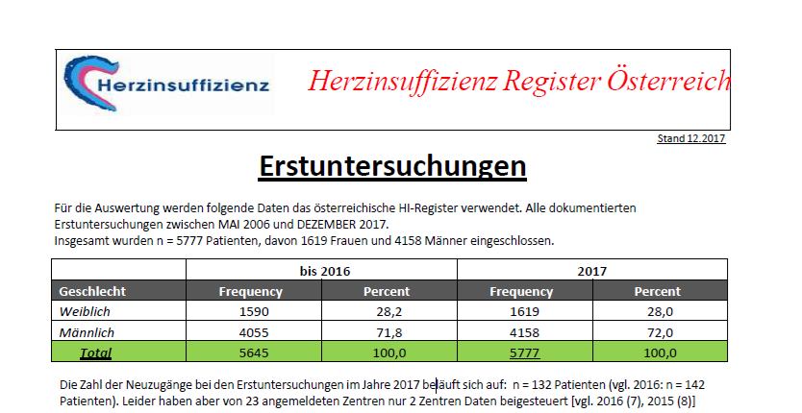
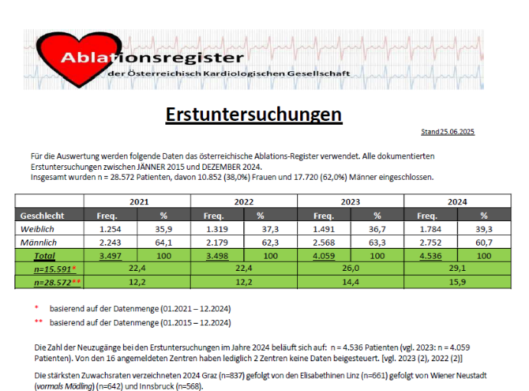
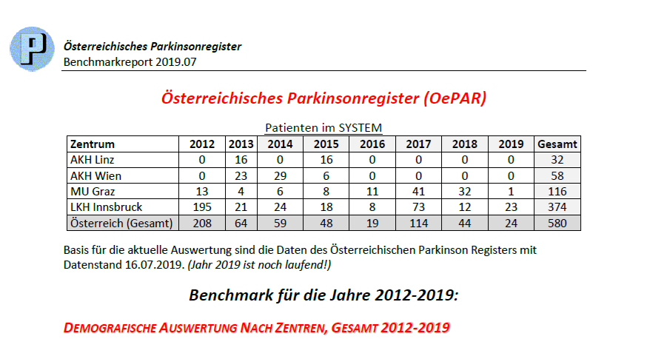
Benchmark Reports
Annual benchmark reports are produced for the registers.

Slide 9
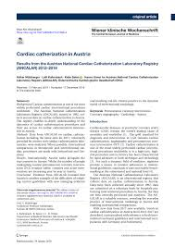
Publications
Peer-reviewed publications are produced using data from the registers.

